Slide 1




Kevin Whinnery
Engineer and Platform Evangelist
Appcelerator, Inc.
kwhinnery@appcelerator.com
Notes:
Most students cannot read slides while listening to a presenter. Make your presentation as visually graphic as possible.

Slide 2
Agenda
Using the HTTPClient API to fetch remote data
File uploads and downloads
Working with JSON and XML
Working with SOAP

Slide 3
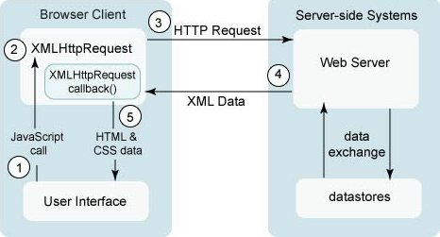
The XMLHTTPRequest Object
In the web browser, Ajax requests rely on the XMLHTTPRequest object provided by the browser

Slide 4
The HTTPClient Object
Ti.Network.HTTPClient implements the XHR specification
That’s why you see “xhr” in sample code
Low level HTTP client interface with support for all HTTP verbs
Should be familiar to Ajax programmers
Notes:
Xhr refers to the XMLHTTPRequest object, and is seen in demo apps like the Kitchen Sink

Slide 5
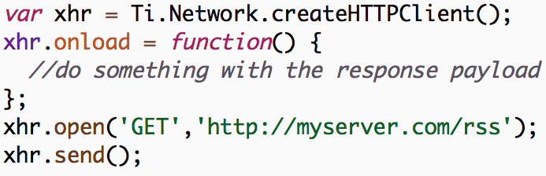
A Typical Network Request
Notes:
Xhr refers to the XMLHTTPRequest object, and is seen in demo apps like the Kitchen Sink

Slide 6
Lifecycle Callbacks
Generally, network requests are asynchronous
This is a good idea – synchronous network is a bad idea
onload: function called when HTTP request returns
onerror: function called for HTTP request error
onreadystatechange: low-level handler for HTTP state
onsendstream/ondatastream: file upload/download
Notes:
Xhr refers to the XMLHTTPRequest object, and is seen in demo apps like the Kitchen Sink

Slide 7

Demo: File Download

Slide 8
Working With JSON
JSON namespace is built in to global scope
Recommended data transport format for Titanium Mobile
Super easy to serialize response data
JSON.parse() – convert string to JavaScript object
JSON.stringify() – convert JavaScript object to string
Notes:
Xhr refers to the XMLHTTPRequest object, and is seen in demo apps like the Kitchen Sink

Slide 9
Working With XML
XML DOM Level 2 API built in
XML document created for your for every HTTPClient request
XML related functions in the Ti.XML namespace
Many XML/XHR examples in Kitchen Sink
More data over the wire, but still commonly used
Notes:
Xhr refers to the XMLHTTPRequest object, and is seen in demo apps like the Kitchen Sink

Slide 10
Demo: Twitter XML

Slide 11
A Few Words on SOAP
“Simple Object Access Protocol” – possibly the most ironic acronym in tech history
At the end of the day, it is just a layer of abstraction over the top of XML and HTTP
Plan A: Use a server-side proxy to return JSON
Plan B: Use the Suds helper library
Plan C: Manually construct SOAP envelopes
In practice, people usually go with Plan C
Notes:
Consuming/invoking SOAP web services means correctly setting the HTTP headers and XML payload (SOAP envelope) of the request

Slide 12
Lab Exercise

Slide 13
Lab Goals
Make TiBountyHunter communicate with a very simple web service over HTTP
Requirements:
Seed the database with results from the web service
Send a request to the server when a fugitive is captured
Demo and Lab URL

Slide 14
Solution Walkthrough

Slide 15
Q&A

