Slide 1
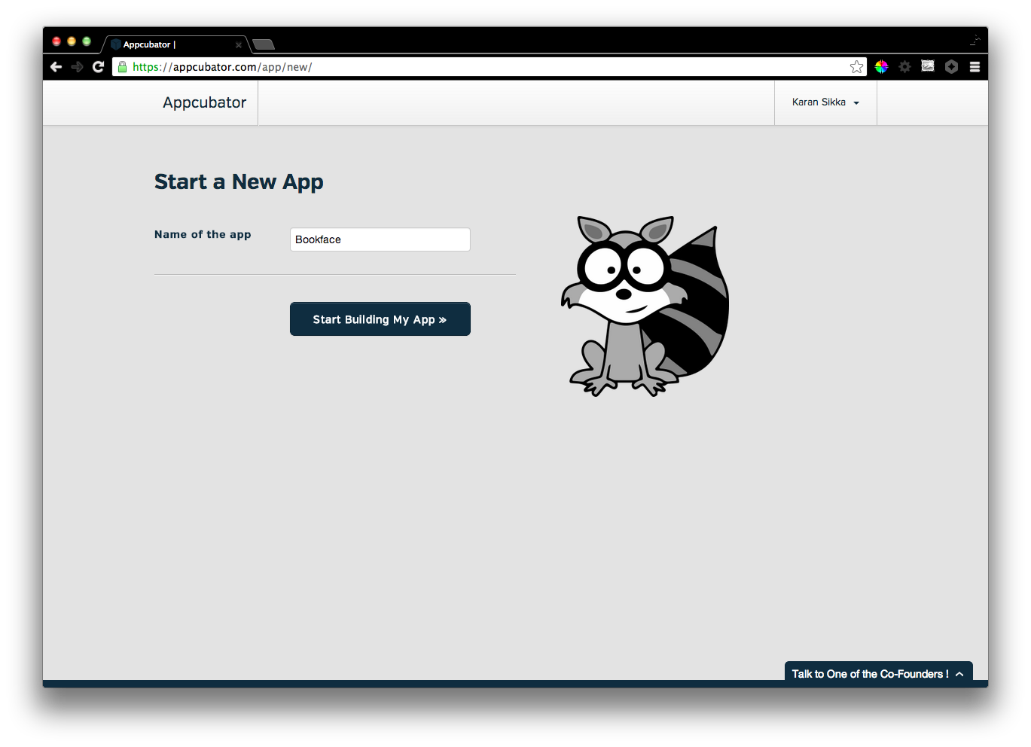
Notes:
New App

Slide 2
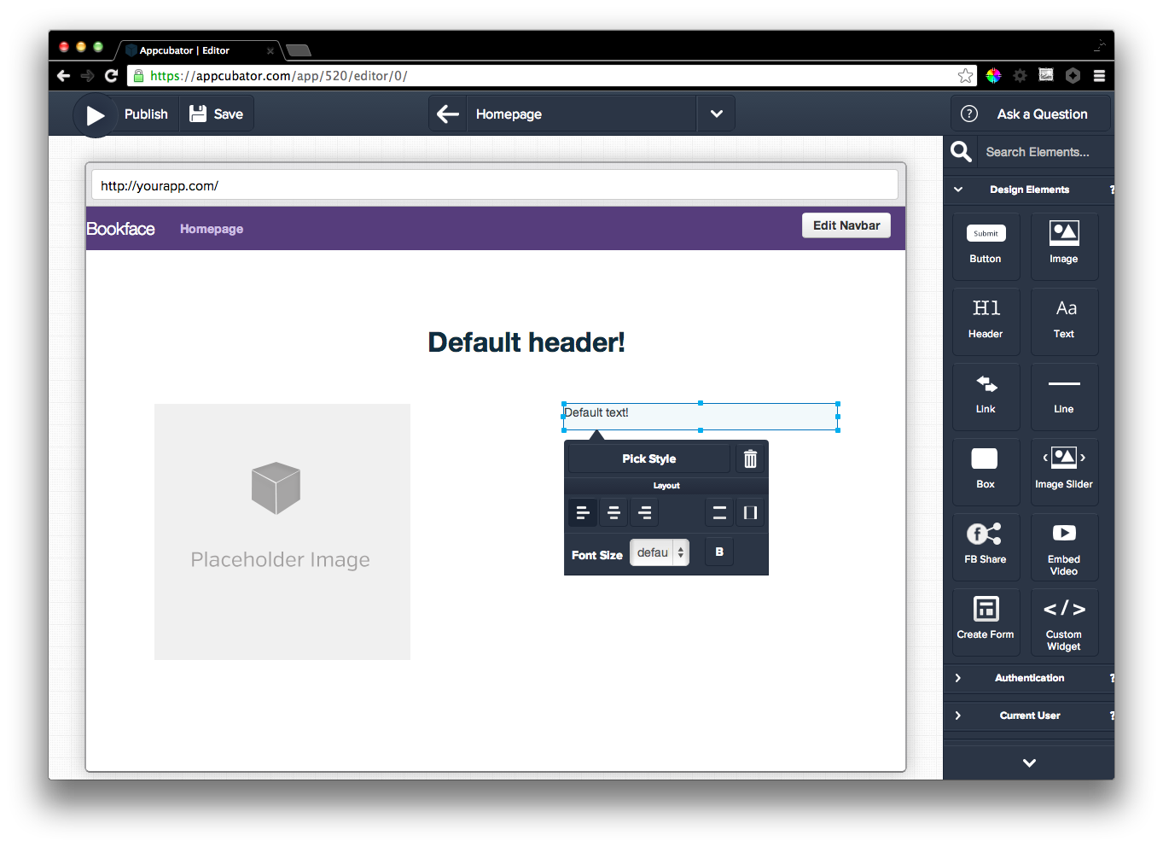
Notes:
Drag and drop design elements

Slide 3
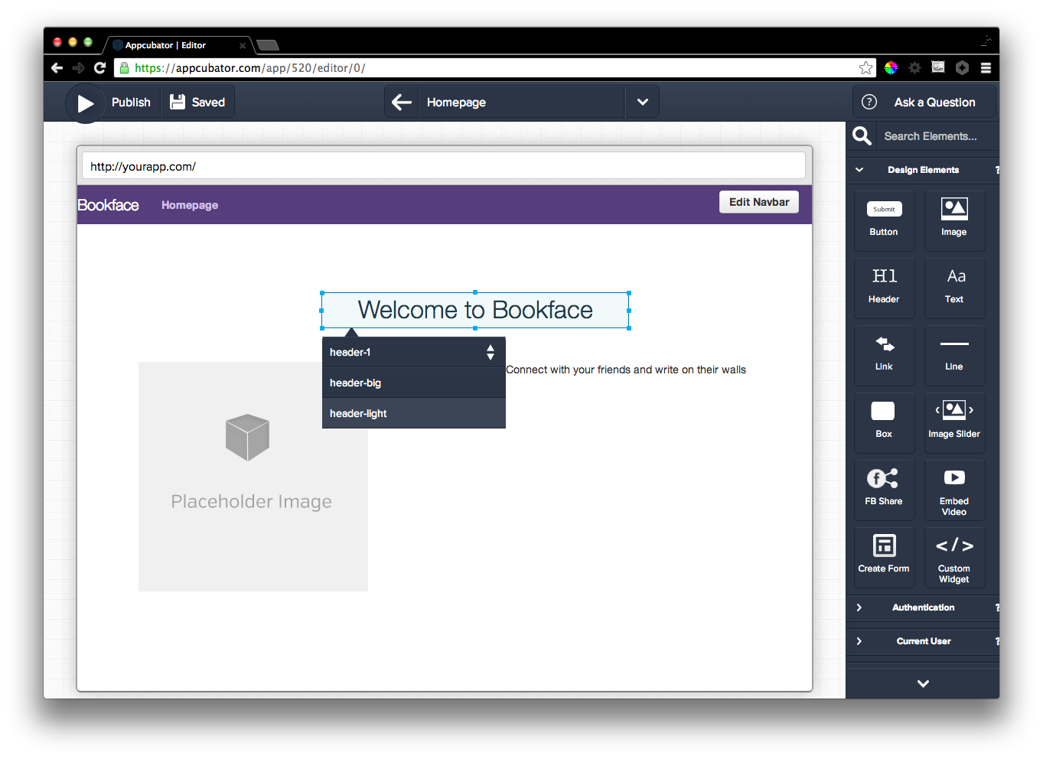
Notes:
Customize text, Pick style to change the way elements look

Slide 4
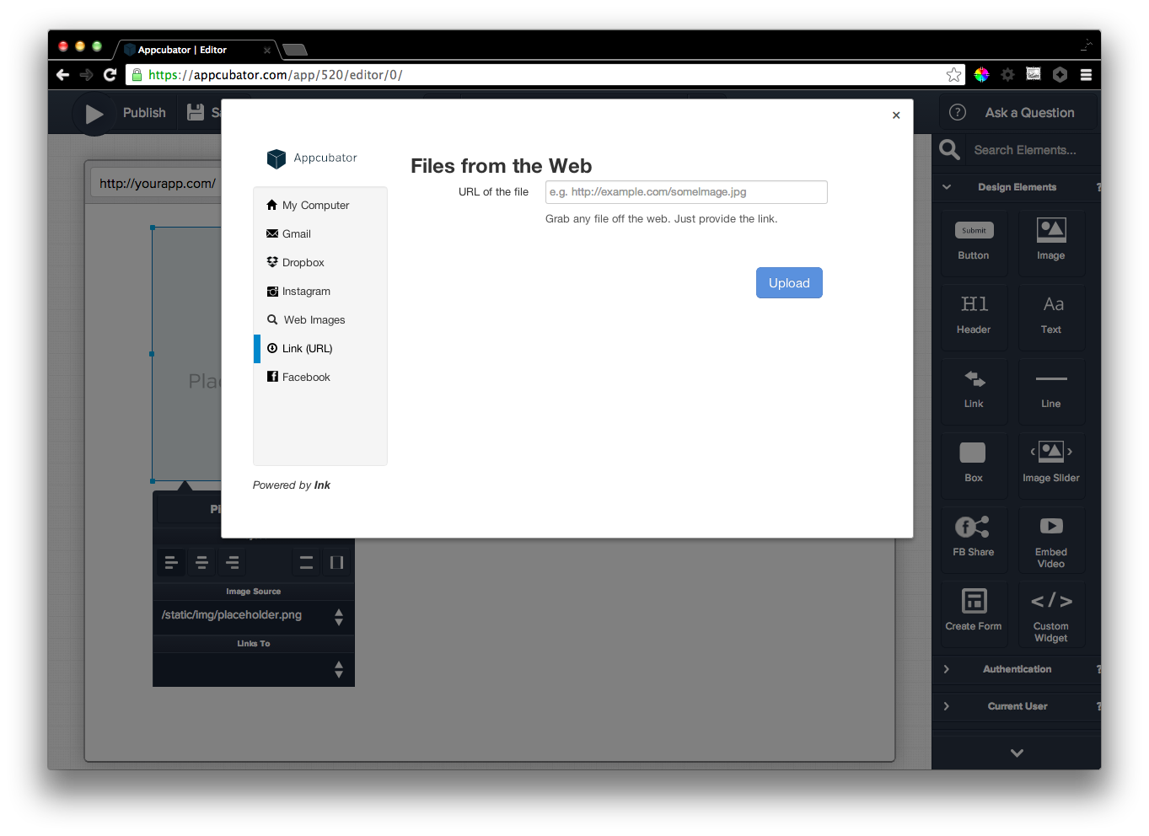
Notes:
Image picker

Slide 5
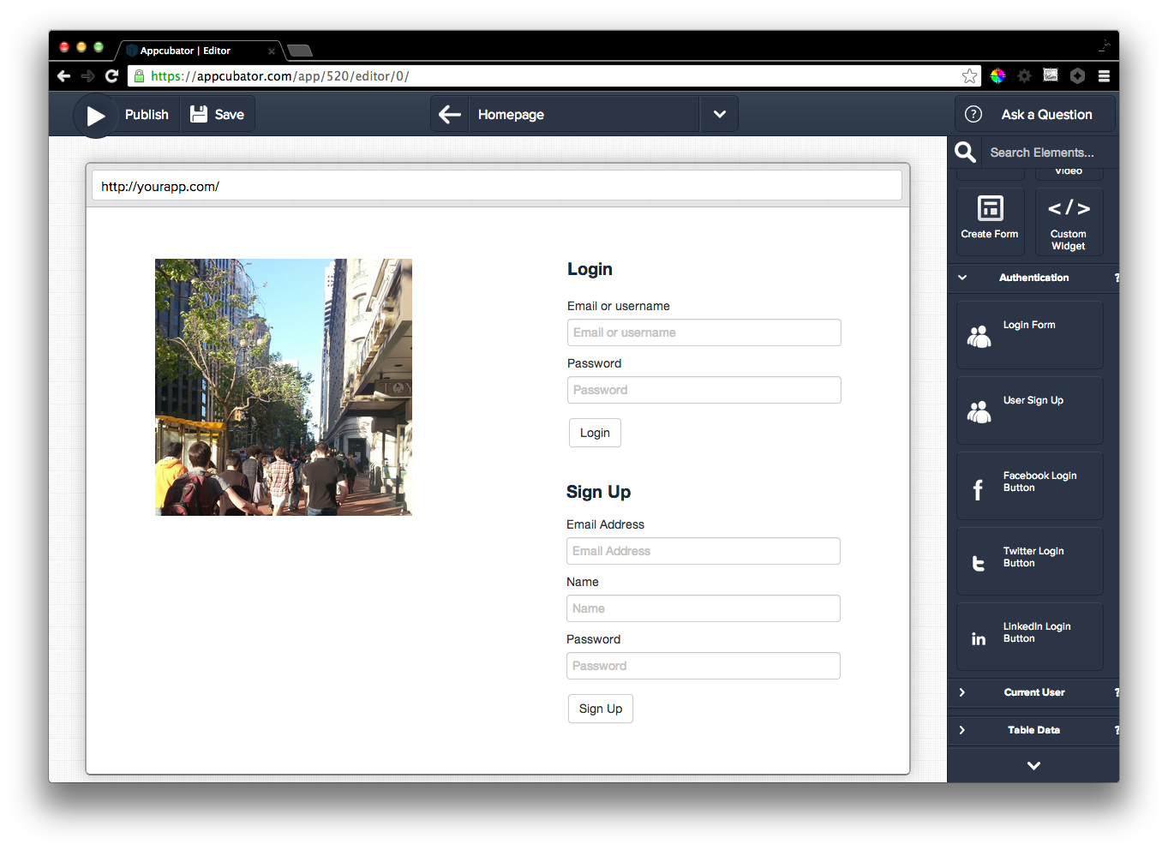
Notes:
Login/signup form

Slide 6
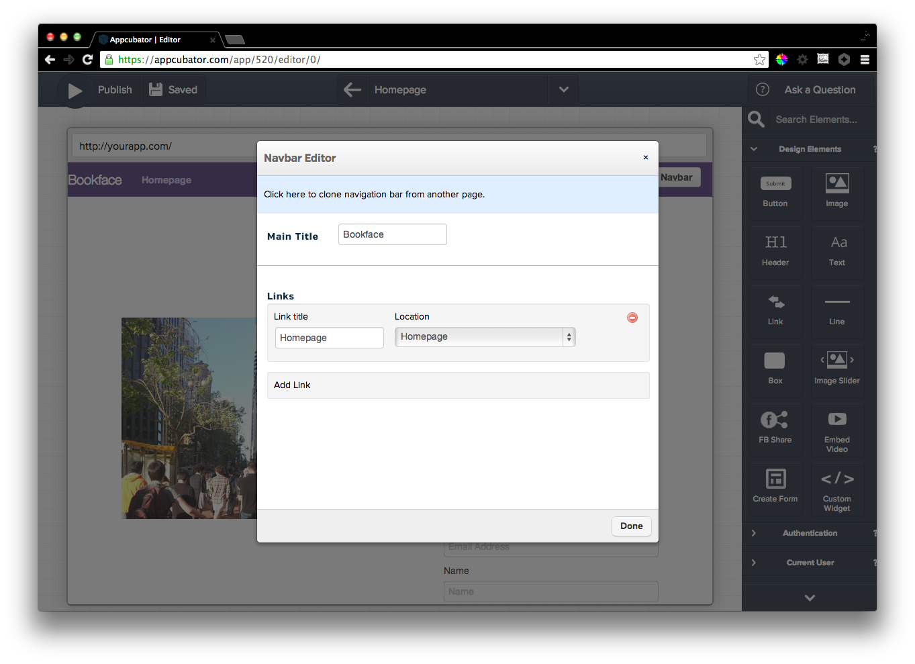
Notes:
Navbar Editor

Slide 7
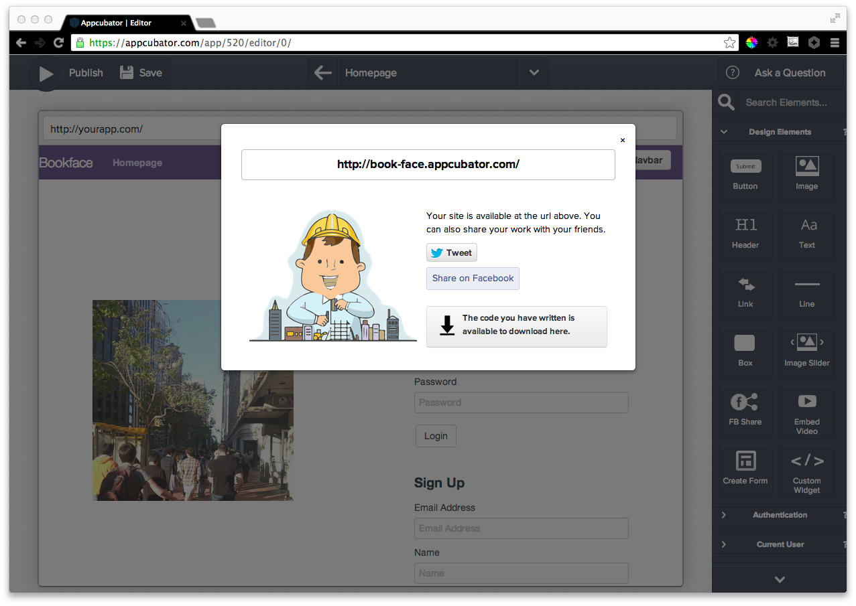
Notes:
Deployed

Slide 8
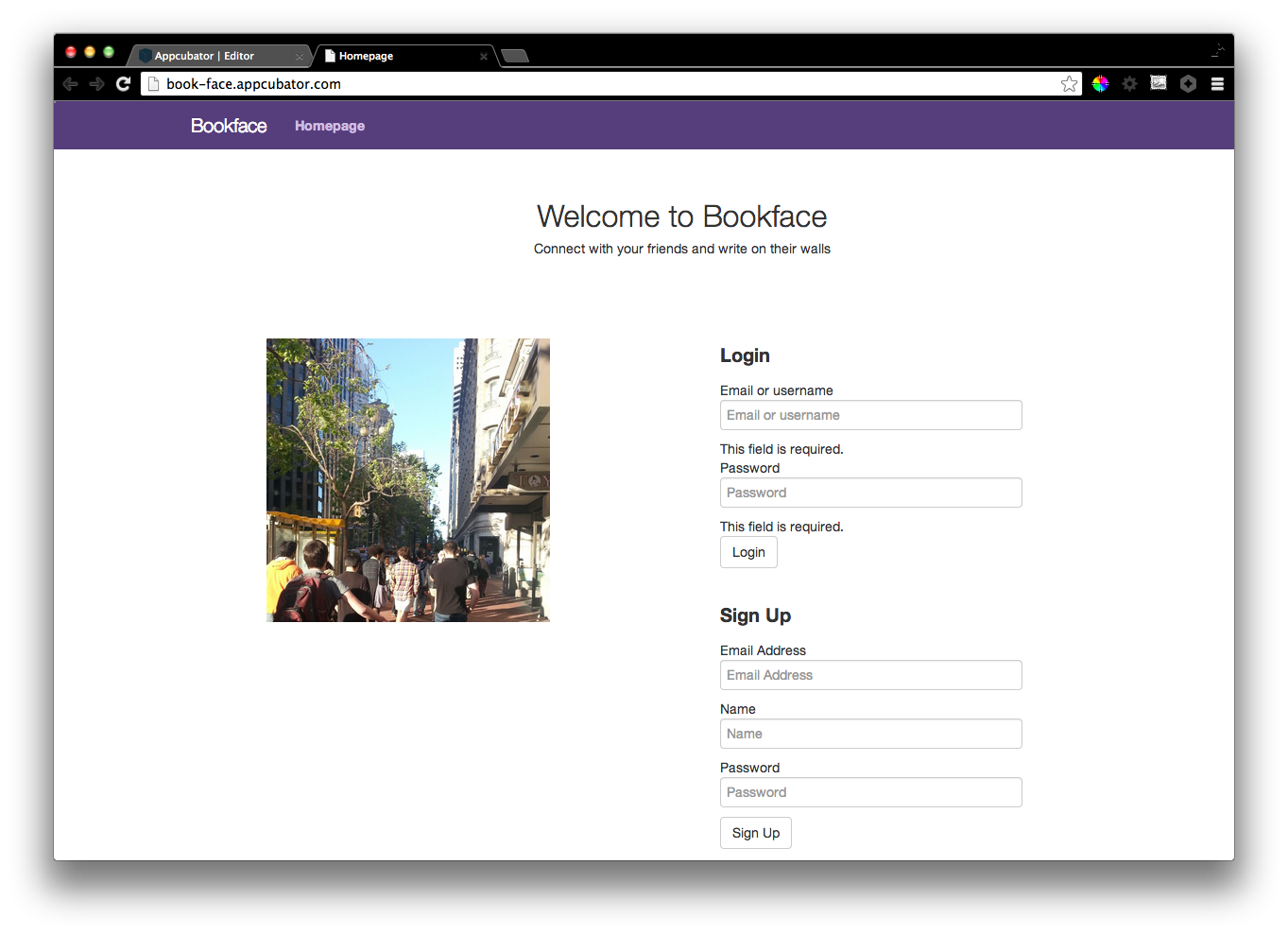
Notes:
End result

