Slide 1
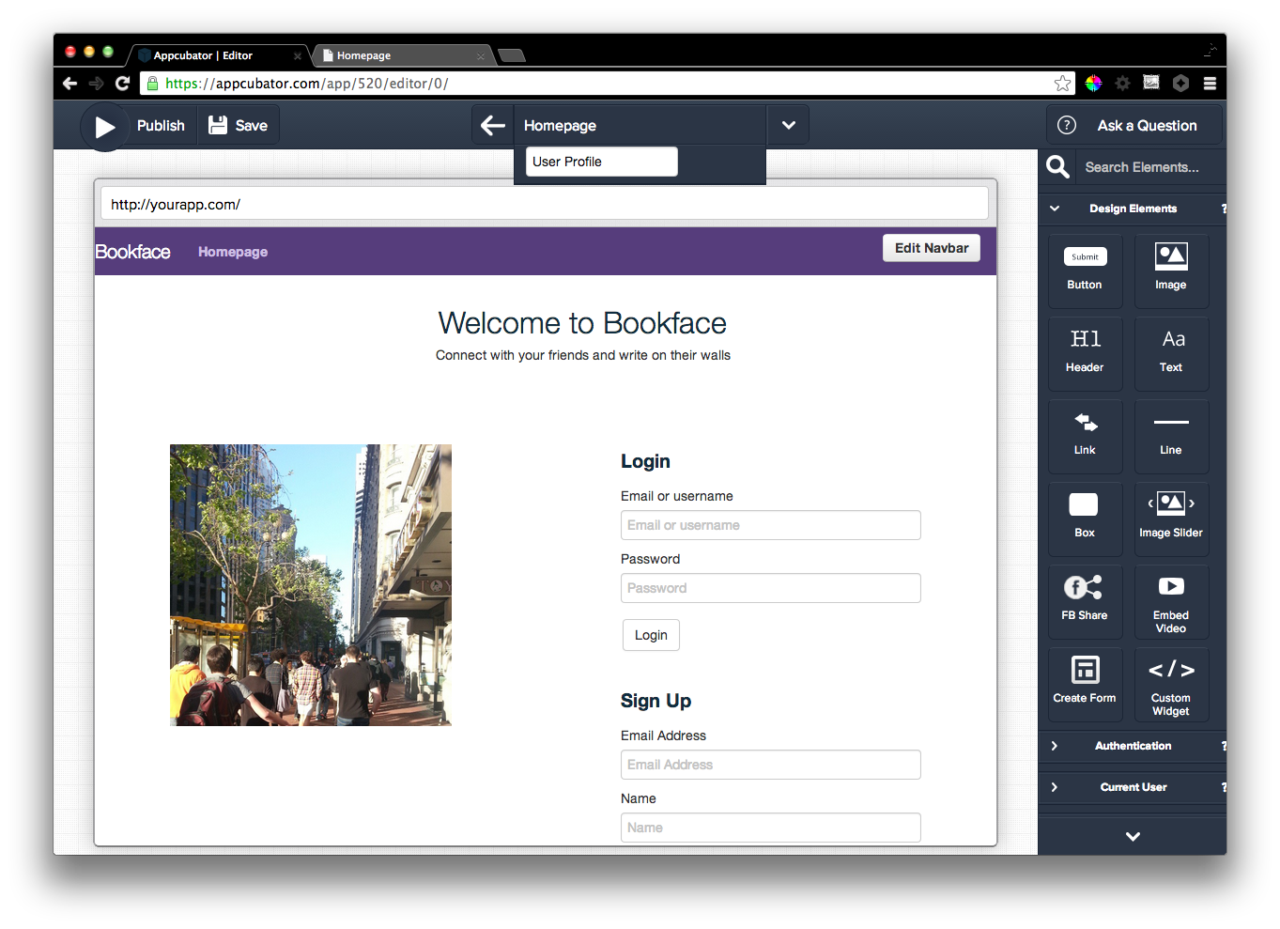
Notes:
Make a new page

Slide 2
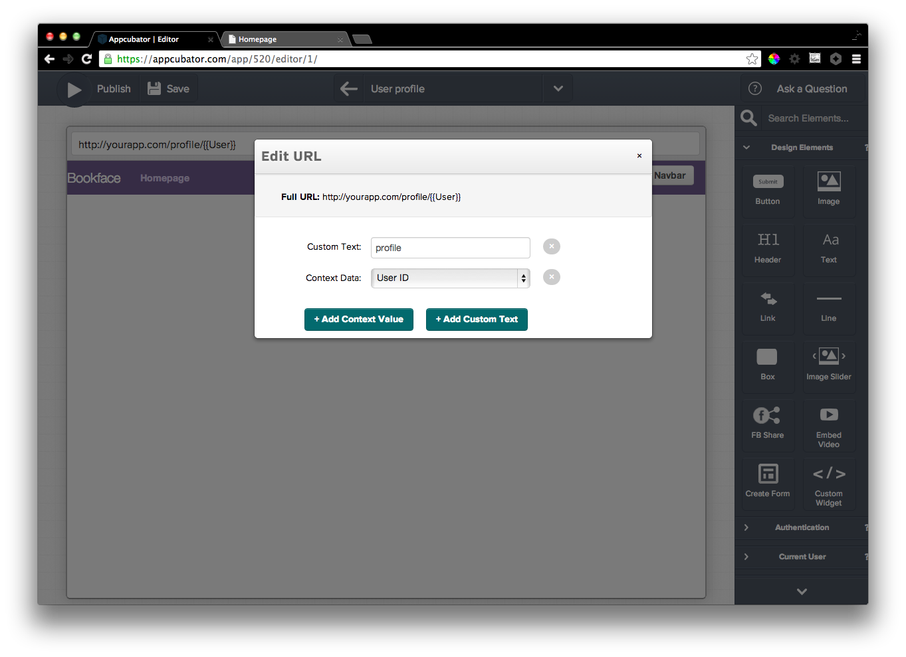
Notes:
URL Editor

Slide 3
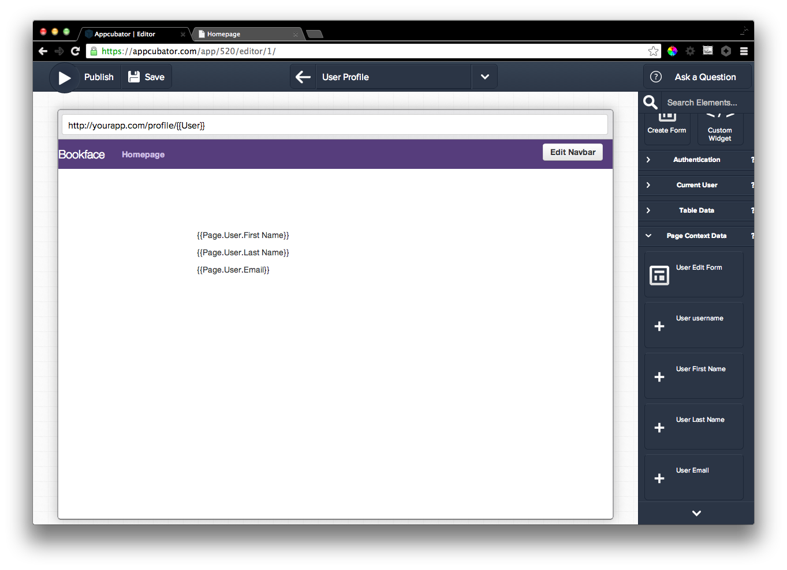
Notes:
Drag some dynamic stuff onto the page

Slide 4
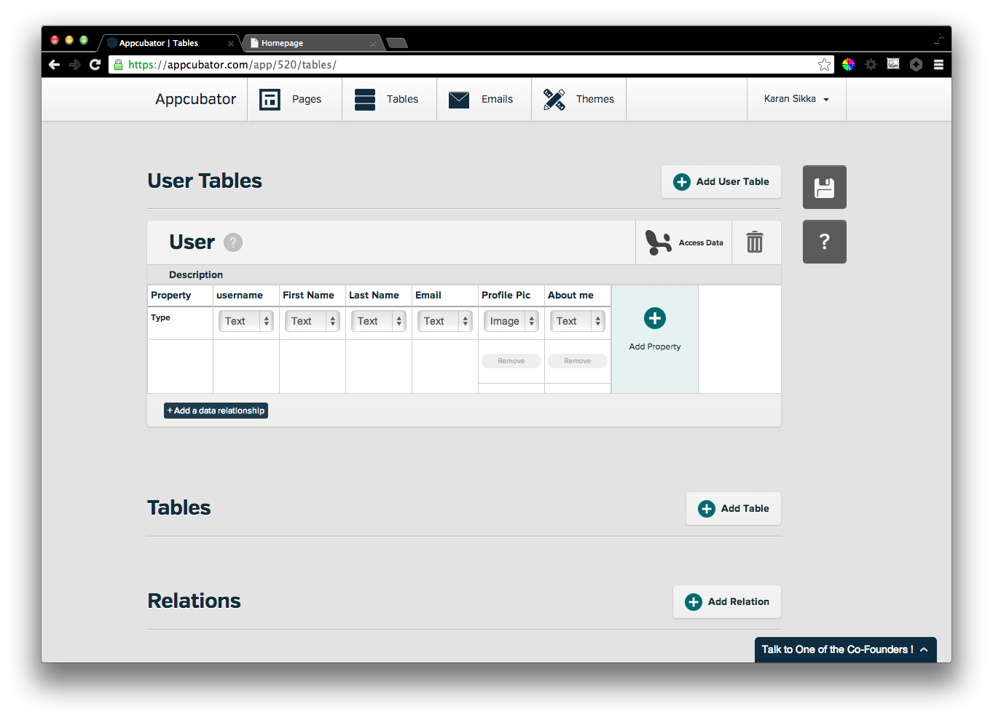
Notes:
Add prof pic and description to tables

Slide 5
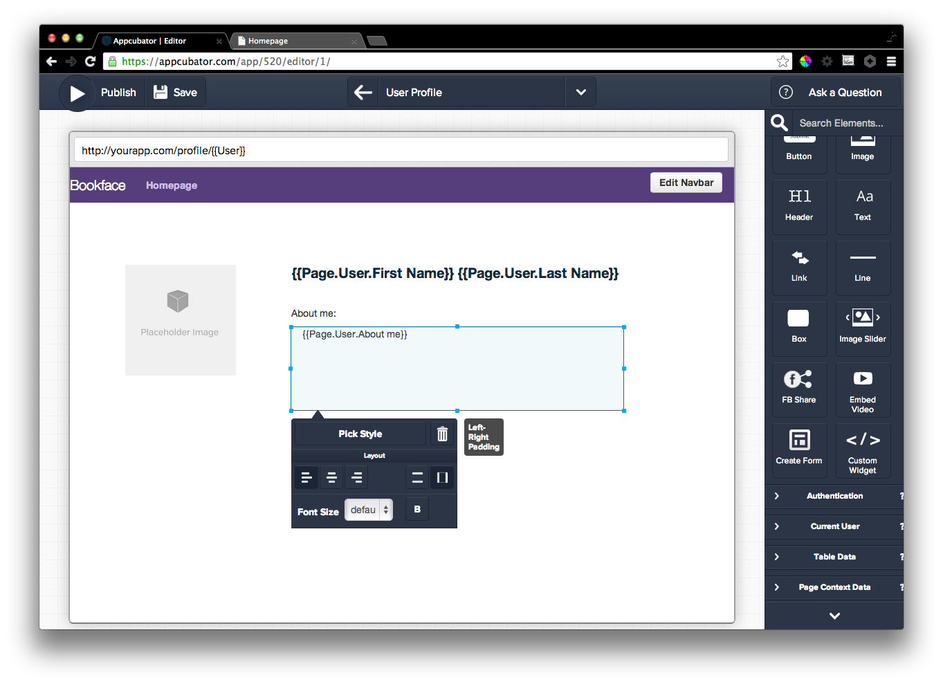
Notes:
Well designed, look you can use headers, oh and padding for offsets

Slide 6
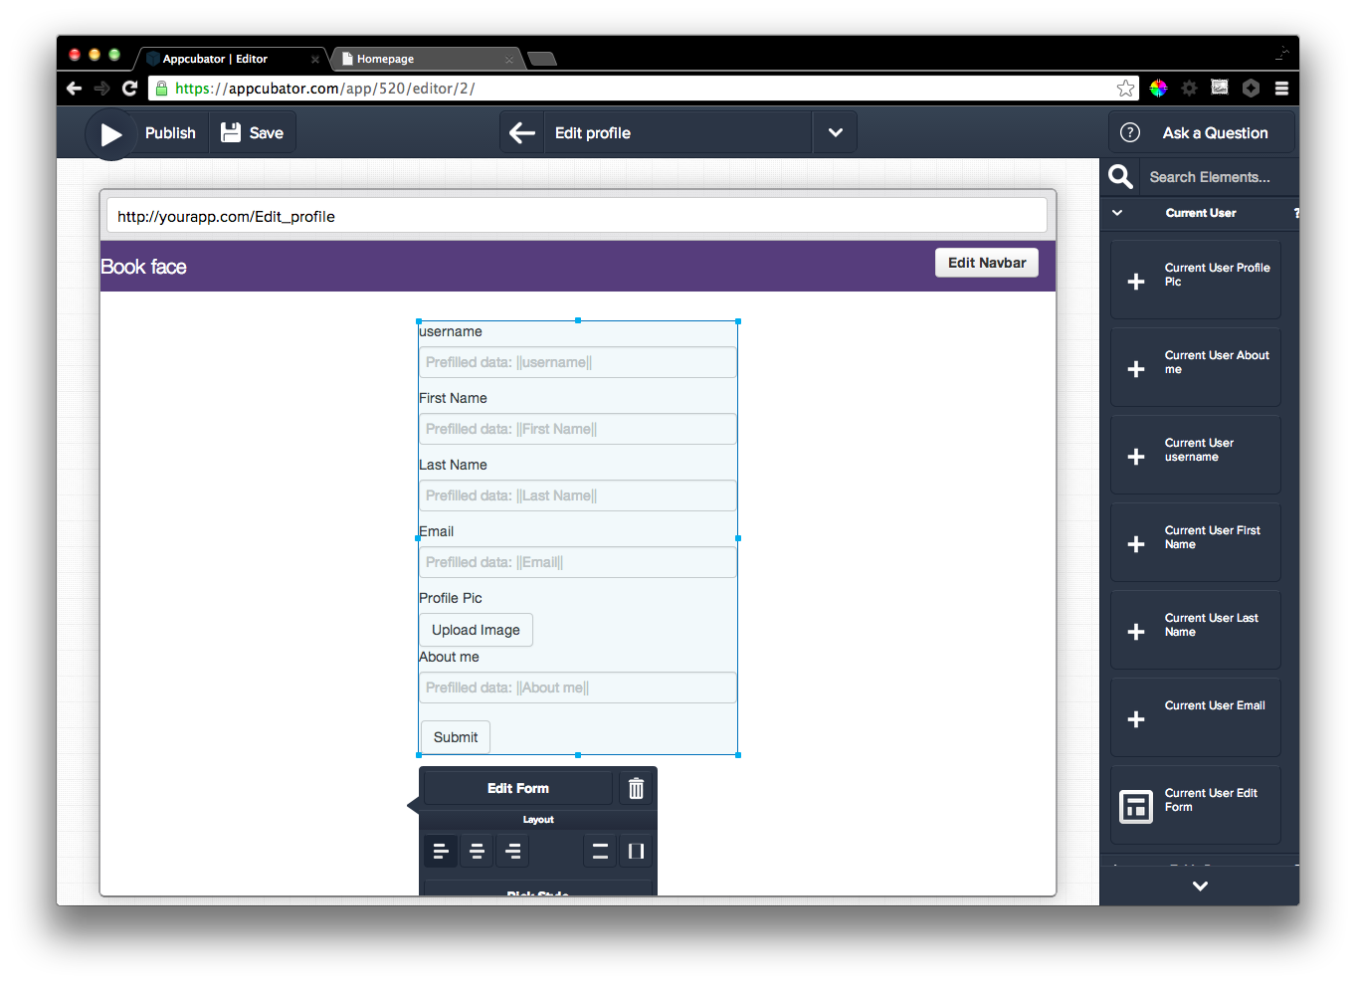
Notes:
Edit profile form

Slide 7
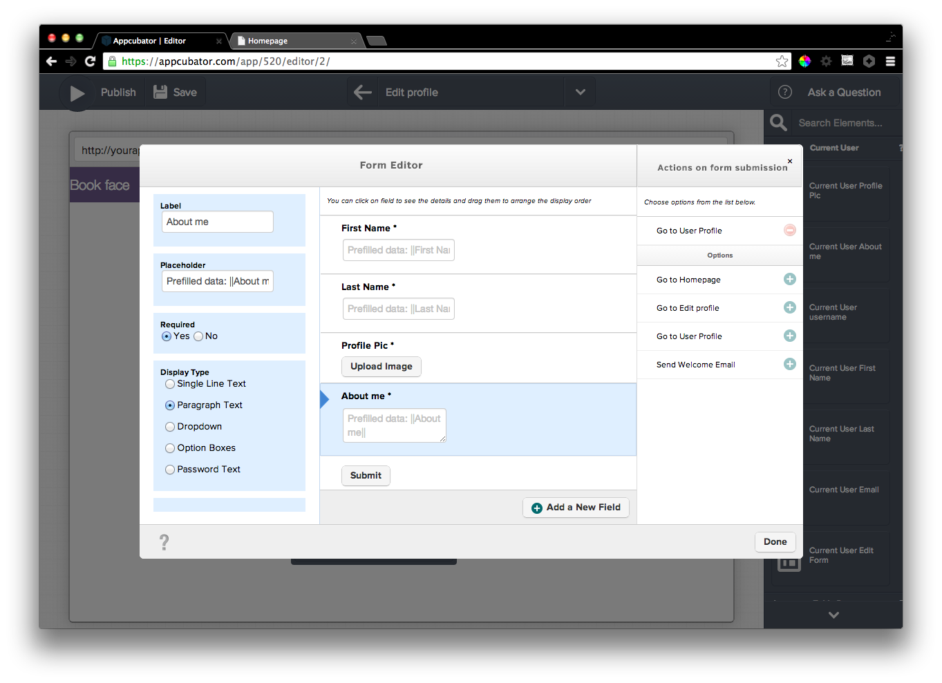
Notes:
Edit edit form. Delete some fields, change form redirect, change about me to paragraph text

Slide 8
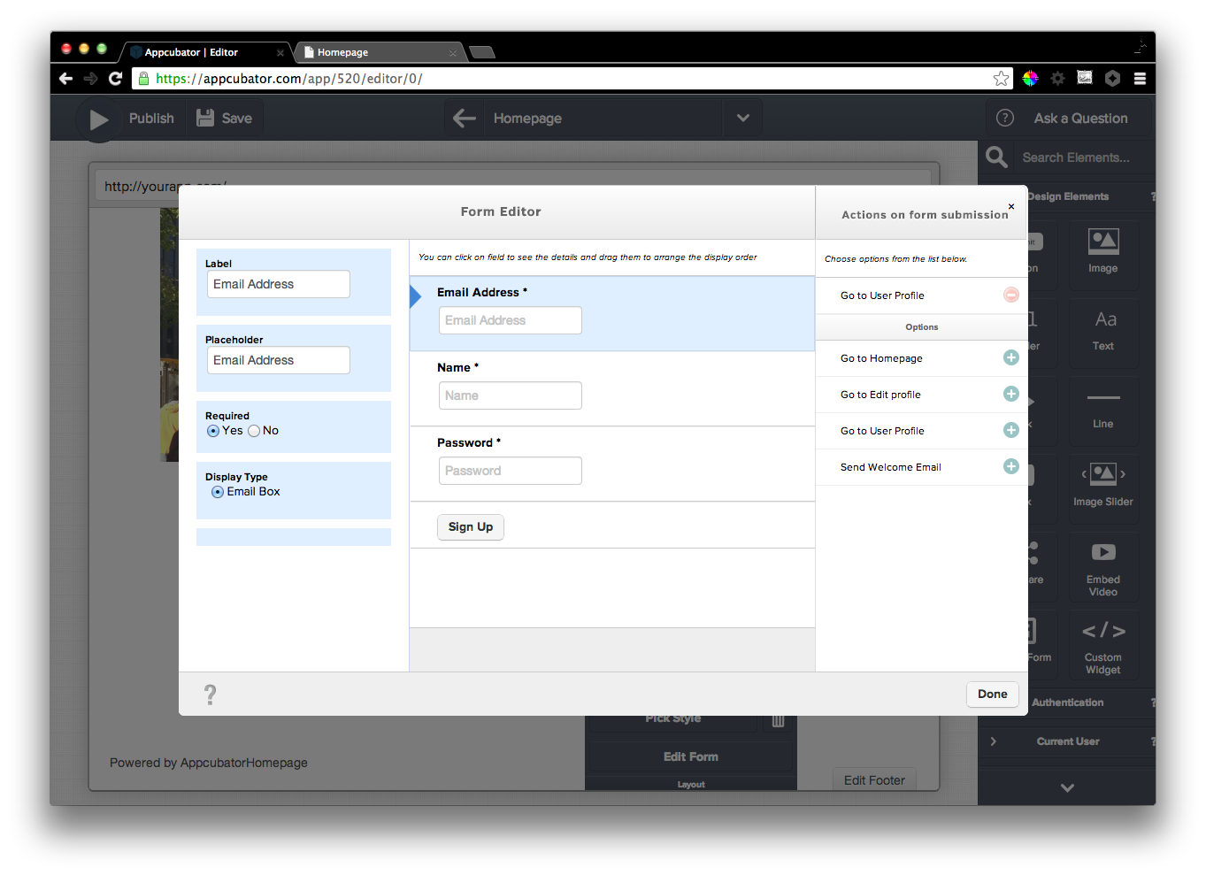
Notes:
Redirect signup form to edit form, also redirect login form to show user profile

Slide 9
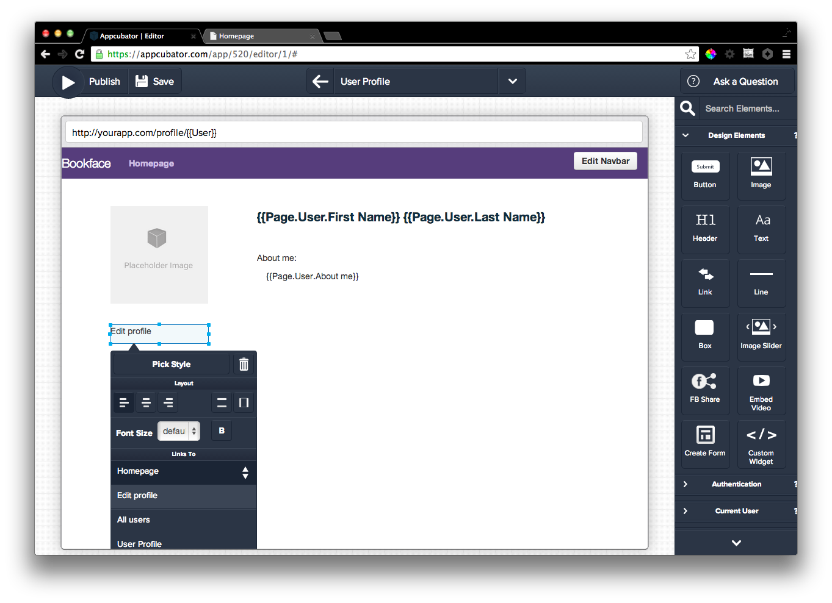

Slide 10
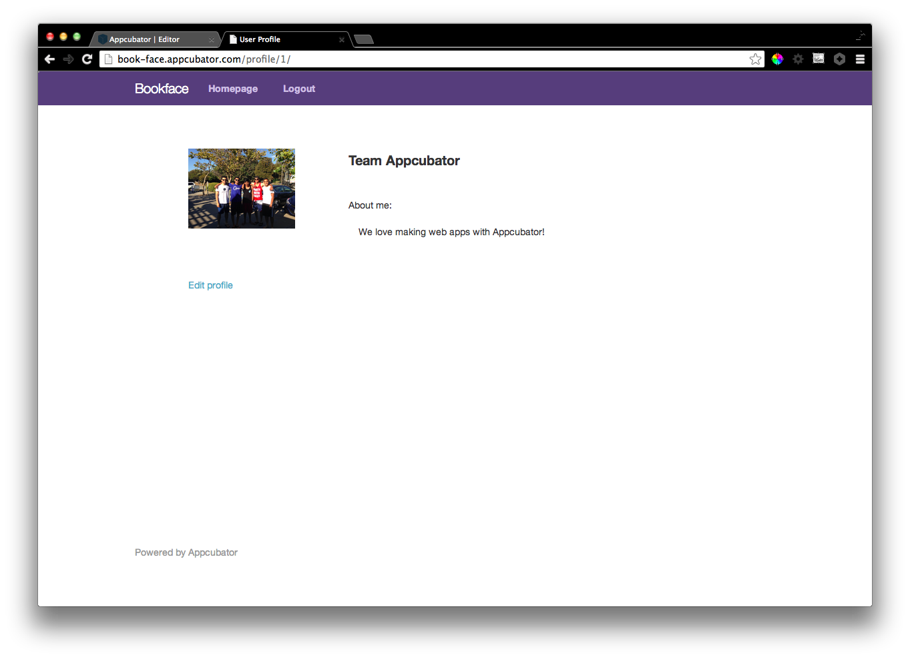
Notes:
End result

Slide 11
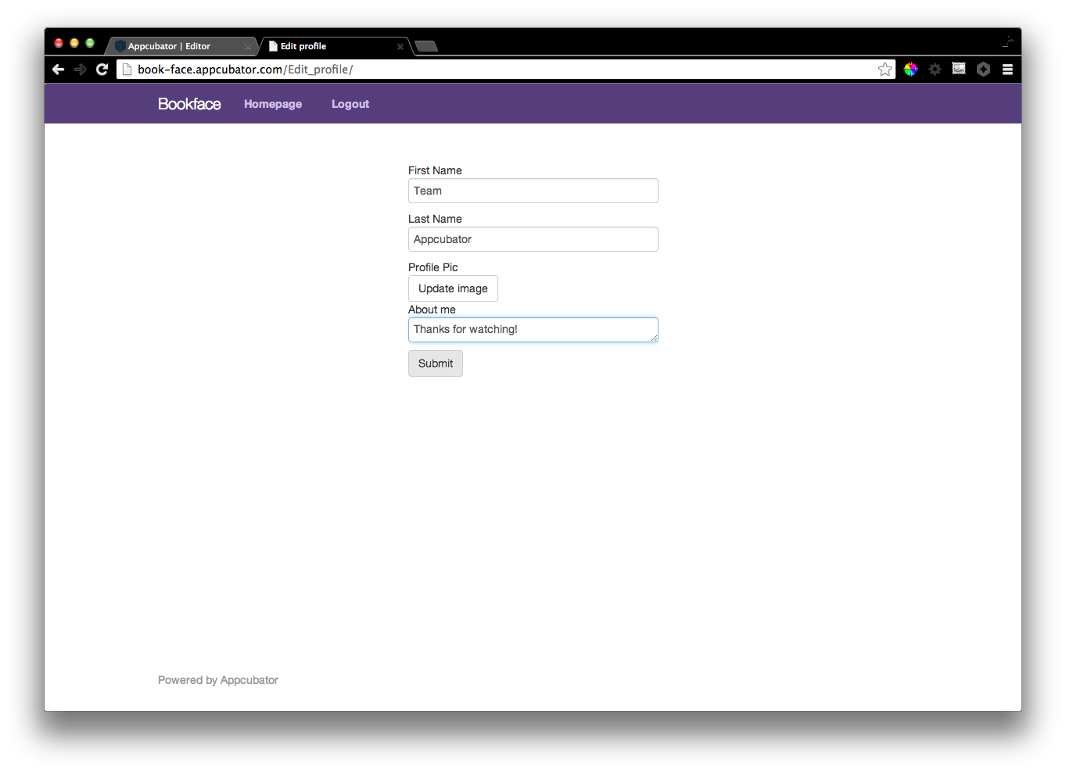
Notes:
Trying to edit

Slide 12

Notes:
Editing worked!

