Slide 1
MSE25HN - DDM501.7
Predictive Maintenance MLOP
Instructor: Nguyen doan dong
Student:
Nguyen Ngoc Tam
Nguyen BA Son
Bui Duc Lan
Nguyen anh Duc

Slide 2
agenda
What is Predictive Maintenance in electric vehicle.
Predictive Maintenance in ML Flow.
Dataset and AI algorithm
Machine Learning Flow: MLOP
Alert, Monitoring and Dashboard
Demo

Slide 3
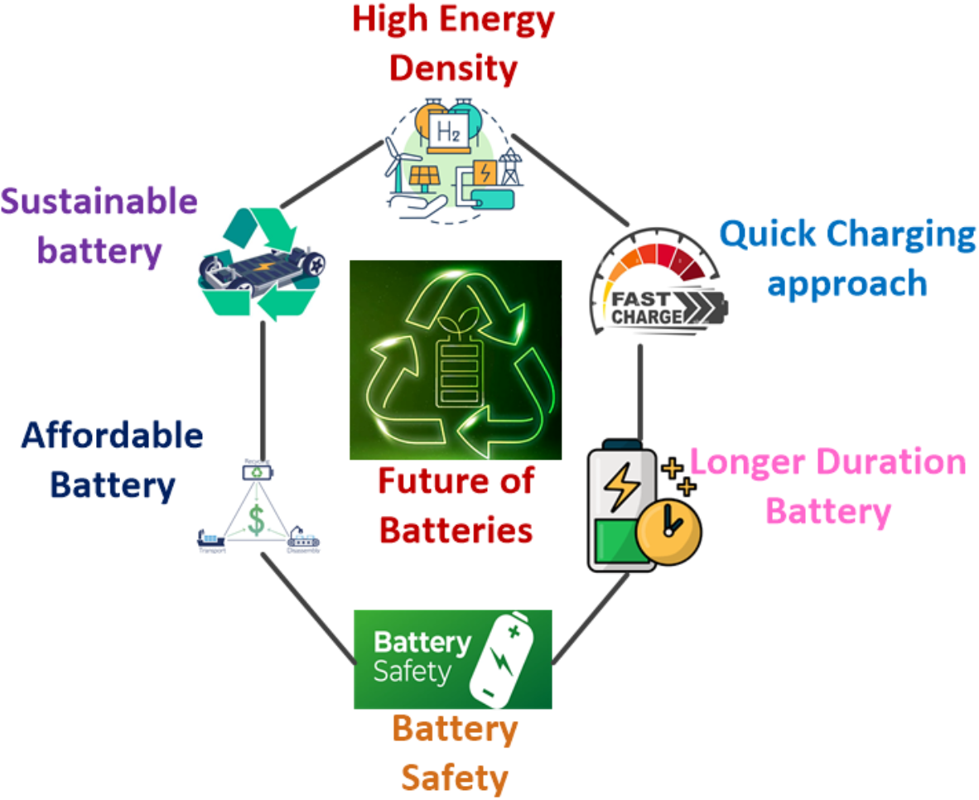
What is Predictive Maintenance in electric vehicle
Predictive maintenance (PdM) for electric vehicles (EVs) uses data-driven techniques, primarily machine learning (ML) and artificial intelligence (AI), to predict potential failures or degradation before they occur. This shifts from reactive (fix after breakdown) or scheduled maintenance to proactive interventions, reducing downtime, extending component life, and lowering costs.
In EVs, PdM focuses on critical components like the lithium-ion battery pack, electric motors, power electronics, inverters, and charging systems. The battery is the most expensive and vital part, so many models target battery health monitoring and degradation prediction.

Slide 4
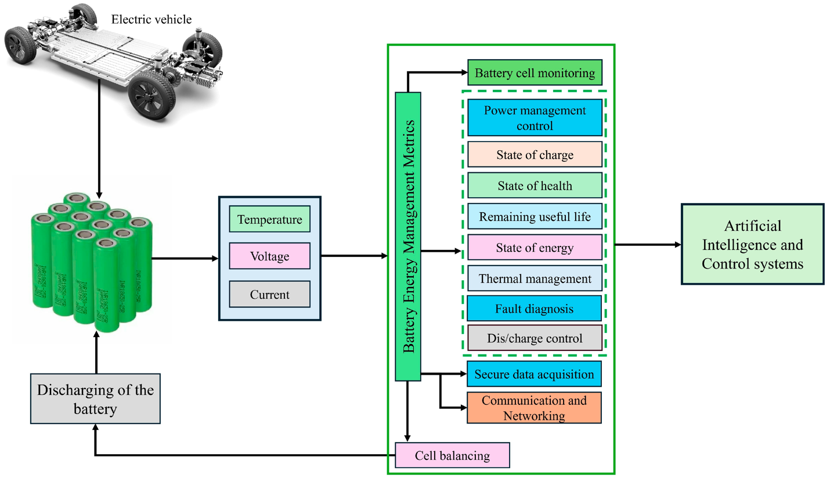
What is Predictive Maintenance in electric vehicle
Common predictive models in EV PdM include:
Remaining Useful Life (RUL) Prediction — Estimates how many cycles or miles remain before a component (e.g., battery) needs replacement. Models use regression techniques to forecast based on degradation patterns.
State of Health (SOH) Estimation — Measures battery capacity relative to its original state (e.g., 80% SOH means it holds 80% of new capacity). Lower SOH indicates degradation.
State of Charge (SOC) Prediction — Tracks current battery charge level for efficient energy management.
Anomaly/Fault Detection — Identifies unusual patterns (e.g., overheating) that signal impending failures using classification or anomaly detection.
Failure Probability Forecasting — Predicts likelihood of issues like thermal runaway or motor faults.

Slide 5
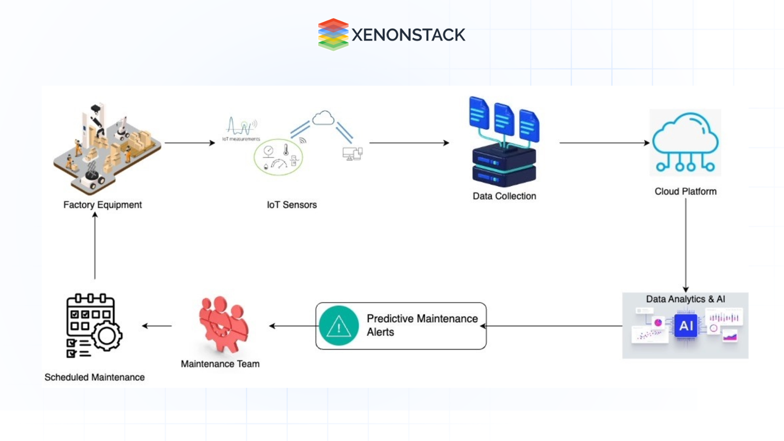
What is Predictive Maintenance in electric vehicle
Data flows from vehicle sensors/IoT → cloud processing → ML models → alerts/dashboards for maintenance.

Slide 6
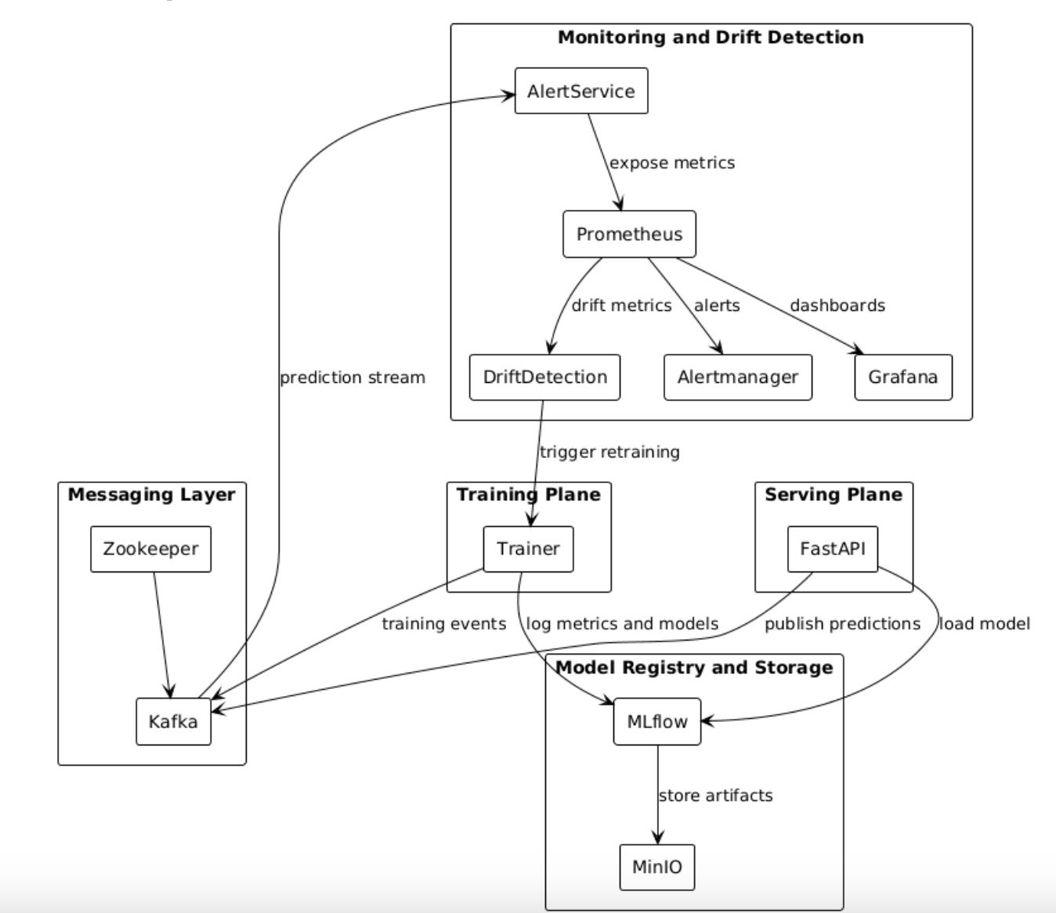
Predictive Maintenance in ML Flow.

Slide 7
Dataset and AI algorithm
Dataset: https://www.kaggle.com/datasets/datasetengineer/eviot-predictivemaint-dataset/data
Predictive maintanaince algrothim:
  Anonmoly detection (Isolation Forest, and Unsupervised learning).
  Classification (Maintenance Type Classifier)
    XGBoost (multi-class capable).
    Predicts fault / maintenance category.
  RUL Regression Model
    LightGBM Regressor.
    Non-linear degradation modeling.

Slide 8
FASTAPI – Interfere Server

Slide 9
Monitoring and ALERT

Slide 10
DEMO
Run docker.
Trigger model training in a docker.
View training status in MLFLOW docker.
Trigger query to FastAPI.
View alerts in monitoring dashboard.

Slide 11
Q&A
Thank you very.much!

