Slide 1
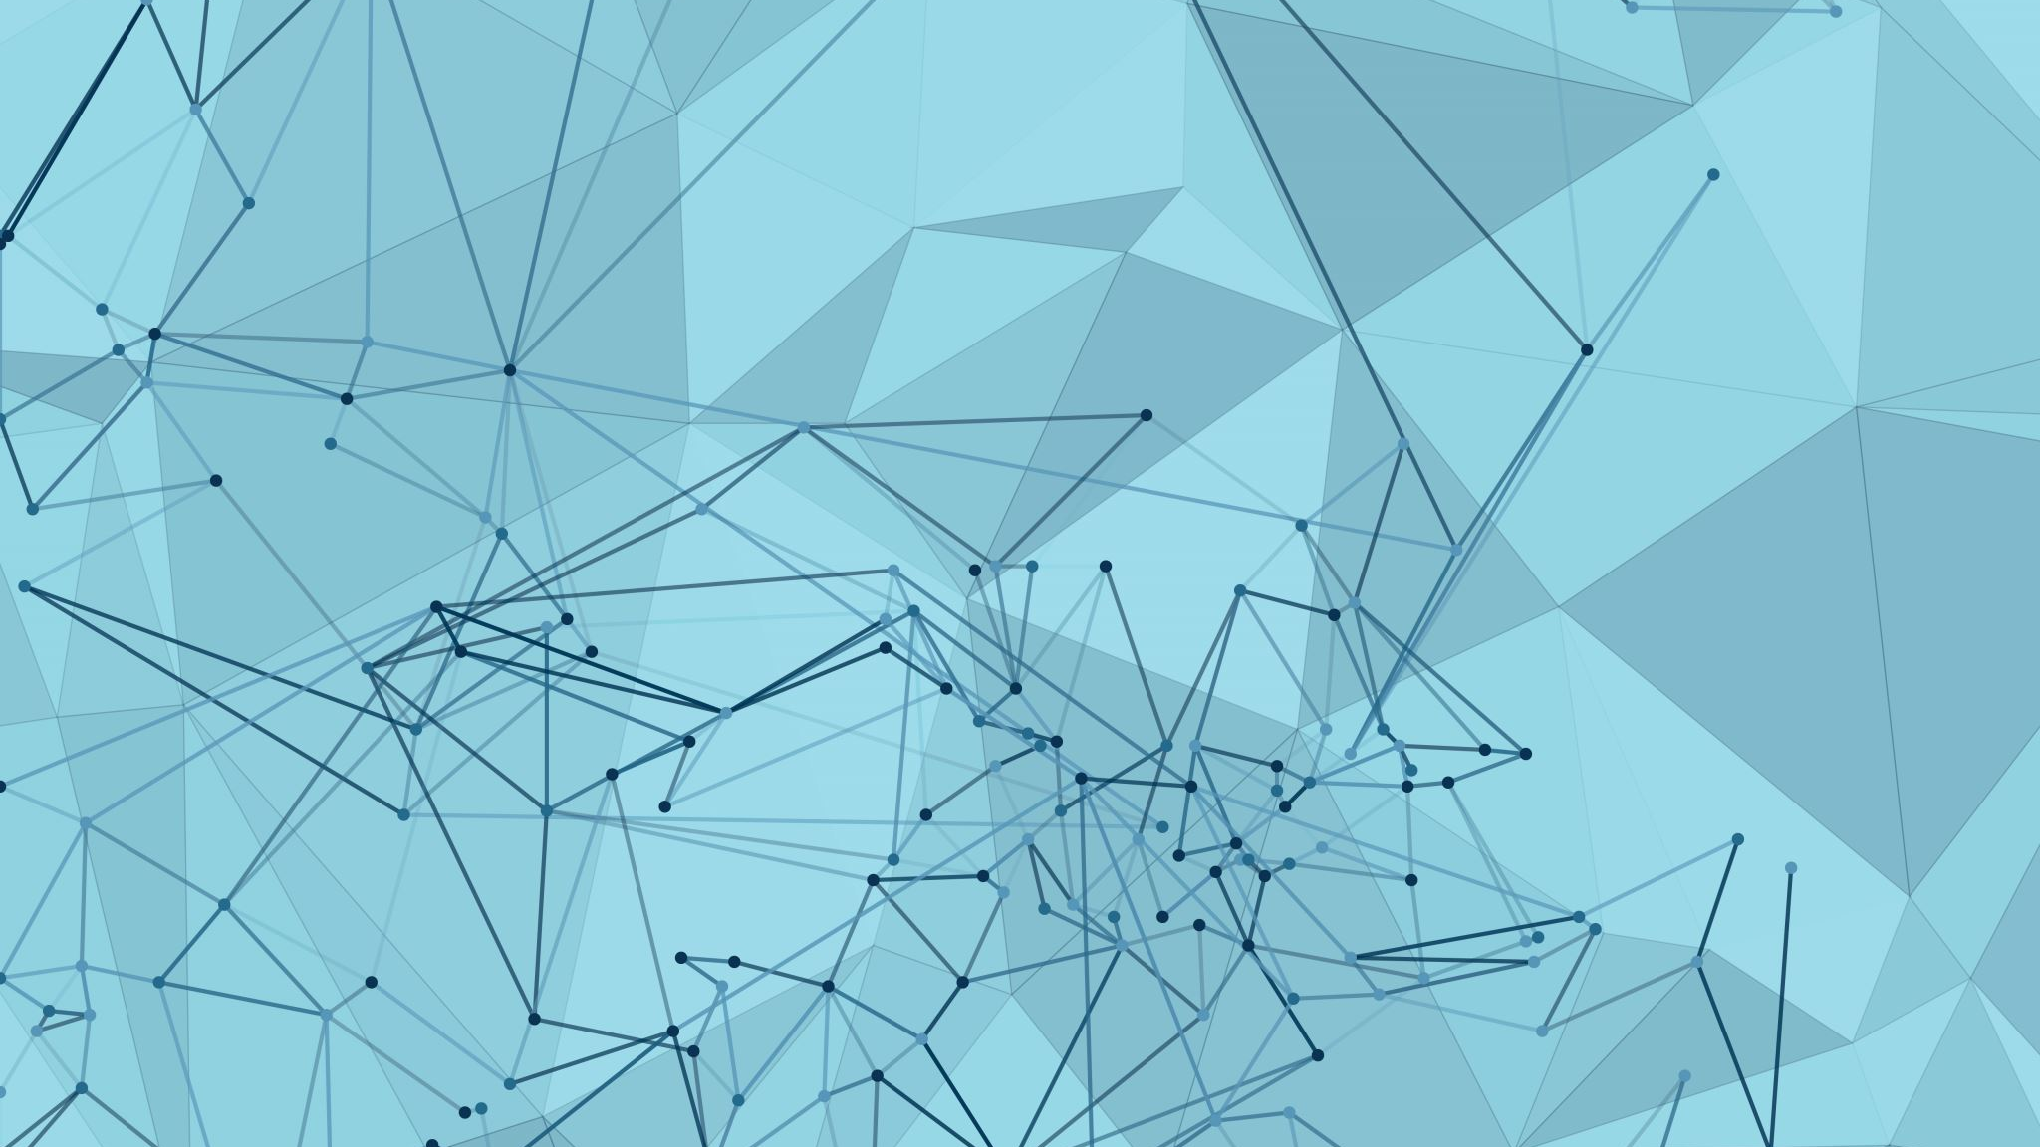

ABM
Absolute Beauty management
By: Daniel Appel, Tal Malchi and Yuval Ben Simhon

Slide 2
Description of the planned system and its need
Goals
The main goal of our application is to create comfortable, accessible and easy-to-use Customer Relationship Management application (CRM) .
Present situation, the need for solution and problem space
At present, there are no Android applications that give such easy-to-use way for managers to interact with, and manage their clients, as well as the revenue and every other day-to-day activities for a small business owner in general and more specifically beauty saloons, the later being the focus of our application.

Slide 3
Description of the planned system and its need
Similar Applications
Bumpix
Bitrix24
Pocket CRM – Customers and Leads
Our application’s advantages
Our application provides a drastically simplistic view on client management, with a client-side implementation for orders and appointment scheduling. This provides the business owner with a unique ability to be able to “learn” to handle a new technology to simplify his/her life in less than a day.

Slide 4
Main capabilities of the application
Login and Registration
Appointments:
Manager: Adding new, editing, deleting for every client
Client: Adding new, editing, deleting for the current client only
Products:
Manager: Adding new, editing, deleting products from catalogue
Client: Adding new, editing, deleting to and from the cart of the current client (cart unavailable to manager)
Clients:
Manager: Adding new, editing, deleting
History and Analytics:
Manager: Viewing history and analytics for all clients
Client: Viewing only history for only the current client
Appointment Types:
Manager: Adding new, editing, deleting appointment types

Slide 5
Main Abilities of the application
Ability to access and display data from Firebase database, which contains clients, appointments, products, orders and analytics.
Ability to store data on the Firebase
Ability to access and use device hardware such as phone’s gallery.

Slide 6
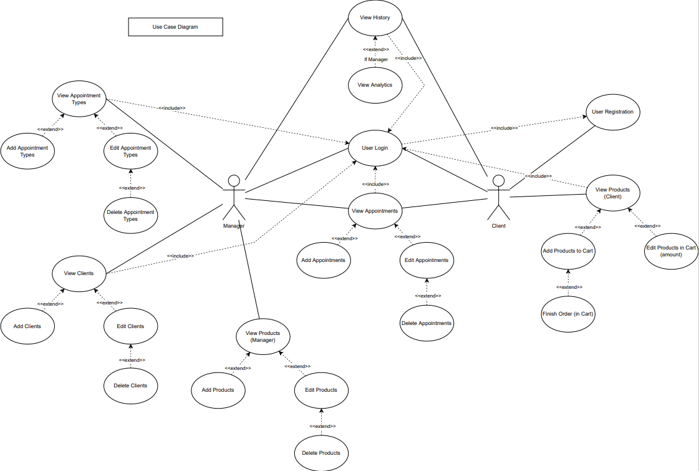
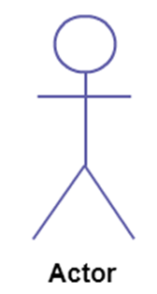
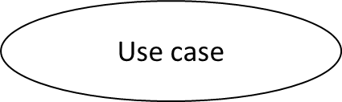

Selected uMl Diagrams
Use cases Diagram​
Actors:
Client
Manager
Use Case
View Analysis
Add clients
Edit Appointments
Etc.
Association

Slide 7
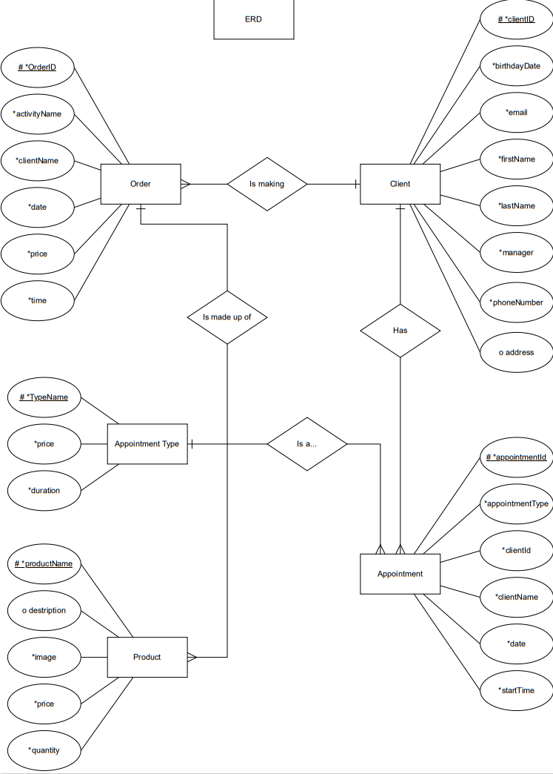
Selected uMl Diagrams
Entity Relations Diagram​
The relations between entities in the system:
One to many:
Client and Orders
Client and Appointments
Appointment type and Appointments
Order and Products

Slide 8
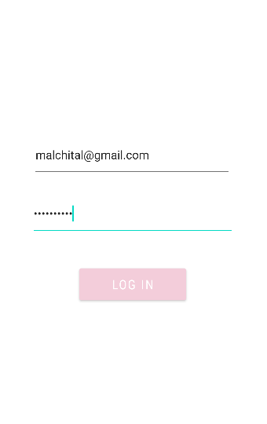
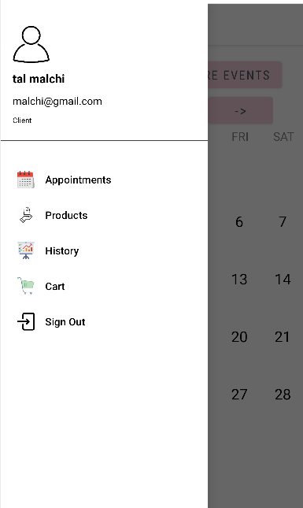
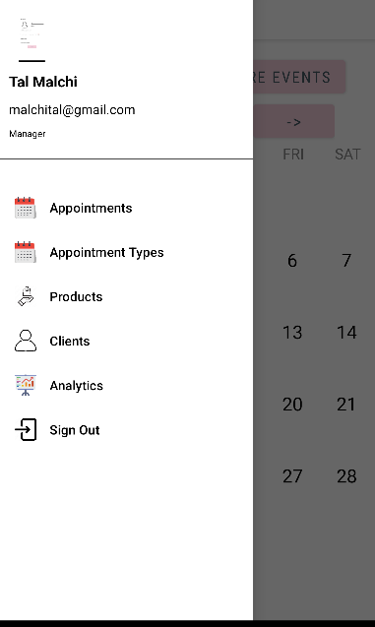
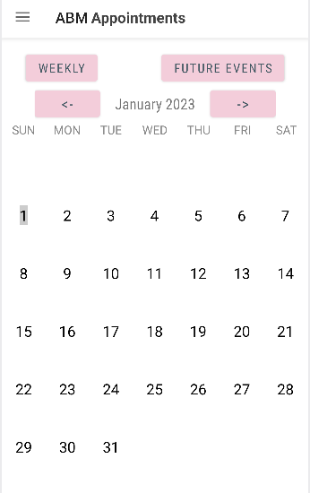
Description of the System
Client+Manger main page : adding new appointment
LOGIN
Client Menu
Manger Menu

Slide 9
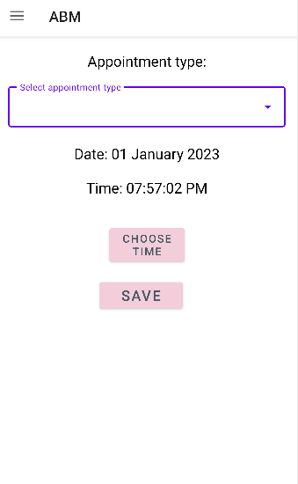
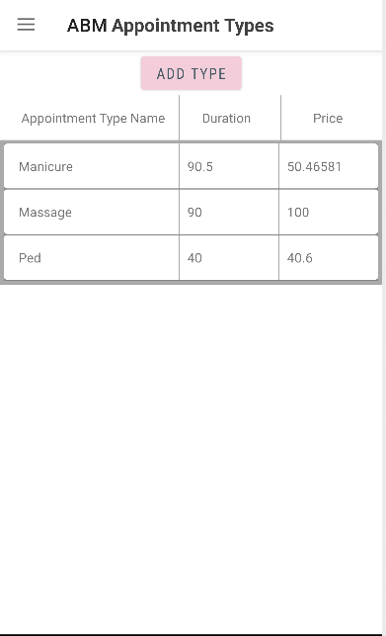
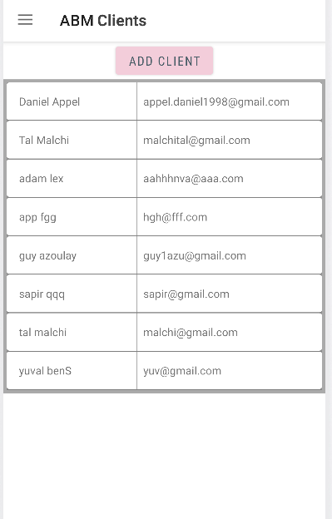
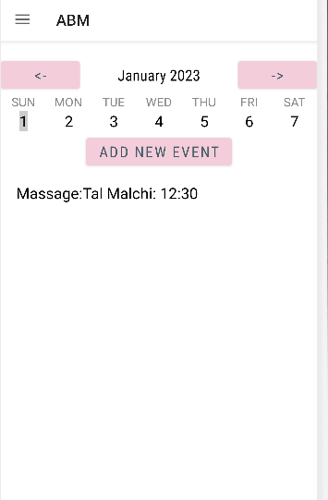
Description of the System
After adding new appointment Client will see his appointment only, Manger will see all the appointment of all the clients on the specific day
Manger can view all the clients and add and edit client as well
Add new appointment Both for Client and Manger
Manger can add and edit appointments type

Slide 10
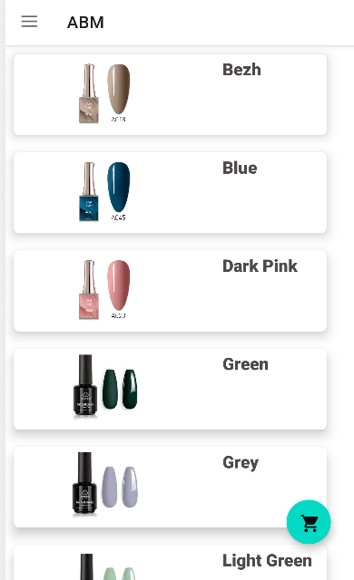
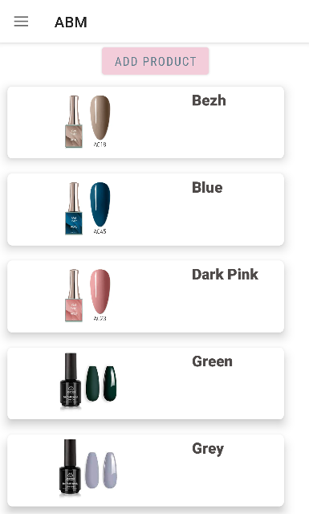
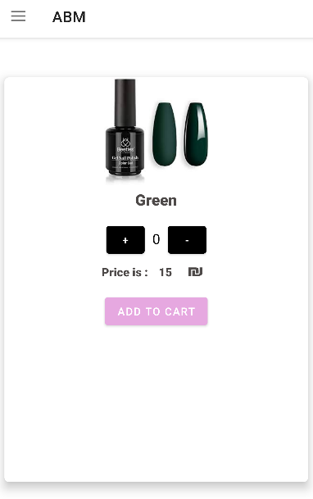
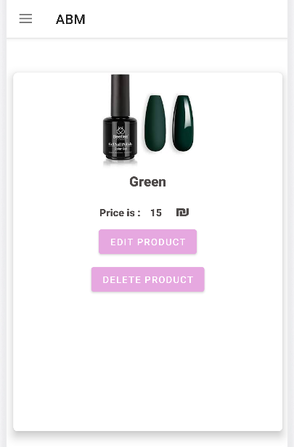
Description of the System
Client can order some product
Manger can view the product’s list
Client side One single product from the list
Manger side One single product from the list Can Edit and Delete as well

Slide 11
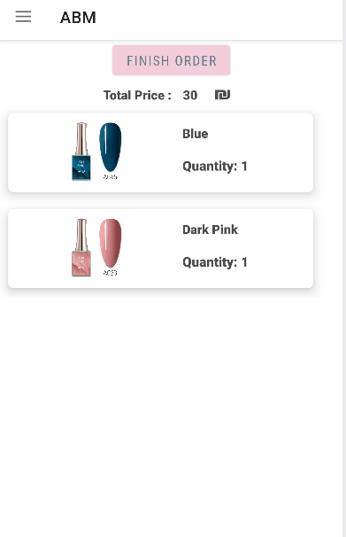
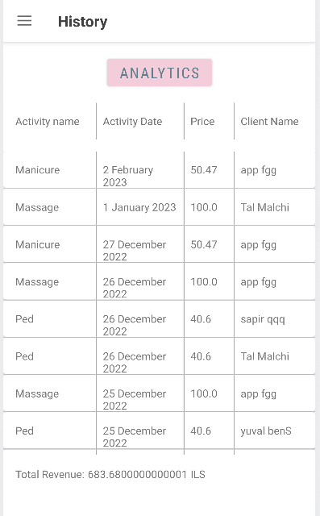
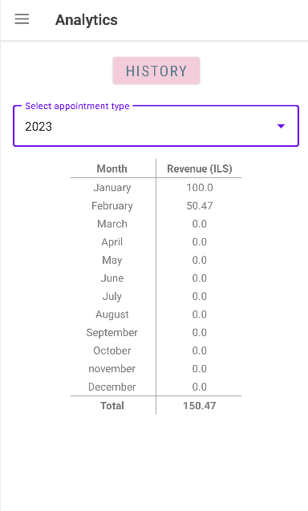
Description of the System
Client side: View Cart
Manger can view the history of all the clients
Manger can view the analytics of each year, split to months
Client side: will see his history only

Slide 12
Gaps between the original planning
During the work on our project, we realized a few things we would have like to have had the ability to change in our application, but due to time deficiency, such features were not implemented.
Implement a manager’s ability to dynamically change a product’s “profile” picture.
The design should be more user-friendly and esthetically pleasing.

Slide 13
Technological mapping and Tiers
We use the following technologies:
Server-Python using Flask - on local machine (accessible from local network only).
BackEnd- Android Studio implemented using JAVA, Server (previous bullet) - on Android.
FrondEnd – Android Studio implemented using XML, Material Design and JAVA – on Android.
Database – Firebase Firestore, Storage, Authentication - on cloud.

Slide 14
System Structure
Our application is organized into directories for each main activity, such as Clients, Appointments, Products, Cart, Login and Register, History and Analytics.
We followed the MVC architectural design pattern, which means that each directory contains classes for the model, view, and controller aspects of the activity.
In each directory, we also created a 'Utils' class to handle retrieval and manipulation of data from the server and database, for the corresponding directory.
Our server, implemented using Flask, communicates with Firebase to get data regarding certain processes and displays it to the user.

