Slide 1

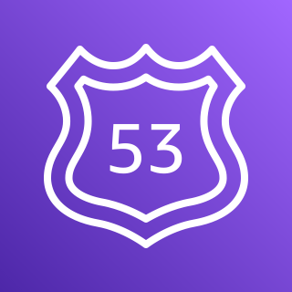

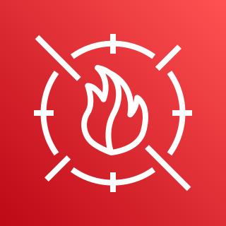








AWS Cloud
Amazon Route 53
Region
Availability Zone
AWS WAF
Availability Zone
VPC
Public subnet
Internet gateway
Elastic IP address
NAT gateway
Application Load Balancer
Availability Zone
Auto Scaling group
Private subnet
Public subnet

Slide 2
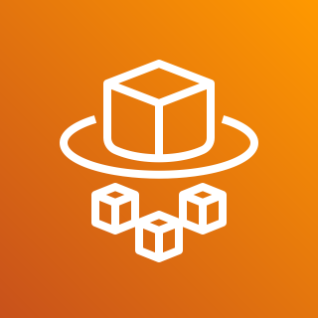
Amazon Route 53 (optional)
AWS WAF
Availability Zone
Availability Zone
VPC
Public subnet
Internet gateway
Public subnet
Elastic IP address
NAT gateway
Application Load Balancer
Elastic IP address
NAT gateway
Private subnet
Private subnet
Auto Scaling group
AWS Fargate
AWS Fargate

Slide 3

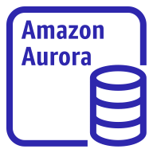



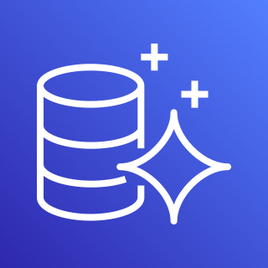
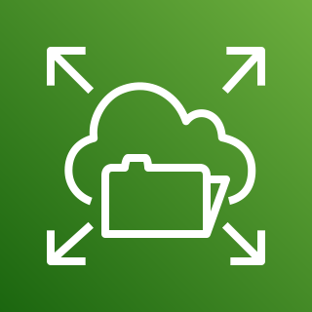

AWS Cloud
Users
Route 53 (optional)
Region
AWS WAF
Availability Zone 1
Availability Zone 2
VPC
Public subnet 1
Internet gateway
Public subnet 2
Elastic IP address
NAT gateway
Application Load Balancer
Elastic IP address
NAT gateway
Private subnet 1
Private subnet 2
Auto Scaling group
Amazon Aurora instance
AWS Fargate
AWS Fargate
File system
CloudWatch
Secrets Manager
Aurora
Amazon EFS
ACM

Slide 4

AWS Cloud
Users
Route 53 (optional)
Region
AWS WAF
Availability Zone 1
Availability Zone 2
VPC
Public subnet 1
Internet gateway
Public subnet 2
ACM
Elastic IP address
NAT gateway
Application Load Balancer
Elastic IP address
NAT gateway
Private subnet 1
Private subnet 2
Secrets Manager
Auto Scaling group
Amazon Aurora instance
AWS Fargate
Containers
Containers
AWS Fargate
File system
AWS Fargate

Slide 5

AWS Cloud
Users
Route 53 (optional)
Region
AWS WAF
Availability Zone 1
Availability Zone 2
VPC
Public subnet 1
Internet gateway
Public subnet 2
Elastic IP address
NAT gateway
Application Load Balancer
Elastic IP address
NAT gateway
Private subnet 1
Private subnet 2
Auto Scaling group
AWS Fargate
AWS Fargate
Amazon ECS
Amazon EFS
Aurora
Secrets Manager
ACM

Slide 6
AWS Cloud
Users
Route 53 (optional)
Region
AWS WAF
Availability Zone 1
Availability Zone 2
VPC
Public subnet 1
Internet gateway
Public subnet 2
ACM
Elastic IP address
NAT gateway
Application Load Balancer
Elastic IP address
NAT gateway
Private subnet 1
Private subnet 2
Secrets Manager
Auto Scaling group
Amazon Aurora instance
AWS Fargate
AWS Fargate
Container
File system
AWS Fargate
Container

