Slide 1

Ready to Learn
Teaching
Young
Students School
Success Skills
Linda Webb, Ph.D.
lwebb@fau.edu
Greg Brigman, Ph.D.
gbrigman@fau.edu

Slide 2
Today’s Workshop
Introduction of RTL Program
  Research
  Program Components
Overview of Key Skills & Strategies
RTL Stories
Logistics & Planning
Questions & Wrap-up

Slide 3
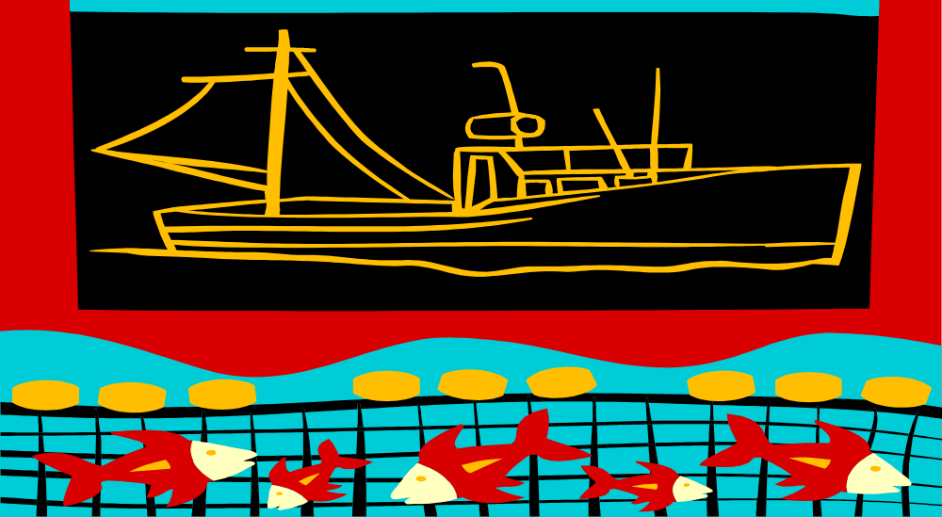
RTL: Embedding key skills and strategies into the daily curriculum to make the “learning net” tighter.

Slide 4
Sometimes you have to
go slow to go fast.

Slide 5
Materials in the RTL Kit
  Manual
  CD with Stories
  Big Books
  Posters
  Reproducibles

Slide 6
Research Supporting RTL Program Development
Cartledge & Milburn (1978) reviewed literature correlating social skills with school achievement
Zemmelman, Daniels & Hyde (1993) reviewed best practices for teaching and learning
Wang, et al. (1994) reviewed 50 years of research on “What helps students learn”
Masten & Coatsworth (1998) reviewed 25 years of research and identified the most critical factors associated with school competence
US Department of Education (2003) The National Reading Panel’s “Teaching Children to Read: An Evidence-Based Assessment of the Scientific Research Literature on Reading and Its implications for Reading Instruction.
Indicators of Early School Success (2004) indicators most frequently associated with later school success

Slide 7
Development of Ready to Learn
Skills associated with school achievement
  Attending – paying attention, being on task, and following directions
  Listening comprehension – understanding the main idea and knowing when and how to ask questions
  Social skills – learning to be encouraging to self, to increase persistence, work cooperatively with others

Slide 8

RTL Research
(all components field tested with over 1000 children)
First Grade (1994)
Head Start (1999)
Kindergarten (2003)
Students ages 4-7 in
urban, suburban, & rural settings
Significant & consistent positive findings in three targeted areas: listening, attending and social skills (23)

Slide 9

Methodology and Analysis
Random assignment of classes to treatment and comparison groups
Standardized measures of achievement
  and behavior
Manualized intervention to insure treatment
  fidelity
Multiple settings
Analysis of Covariance used to
determine statistical significance
Replicated with consistent results
in all three studies

Slide 10

RTL Headstart research recognized as the “research article of the year” by the
Journal of Educational Research

Slide 11

Instruments
Stanford Early School Achievement Test: Listening Comprehension Subtest (SESAT2)
Comprehensive Teacher’s Rating Scale (ACTeRS)
Trained observers

Slide 12
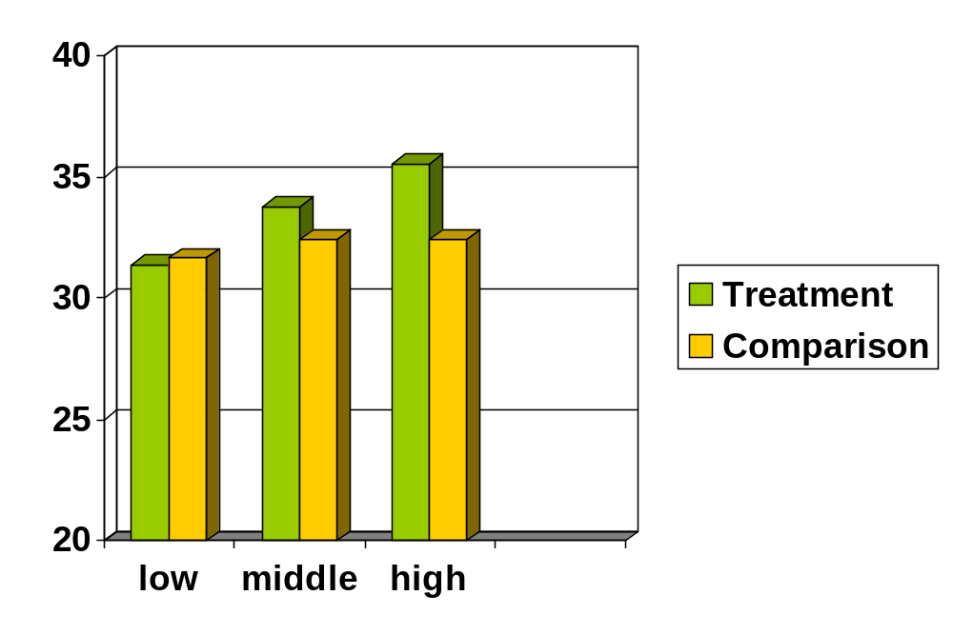
Listening Comprehension:
Adjusted Post test Means for Treatment vs Comparison by Sub-group (kdg. p = .021)

Slide 13
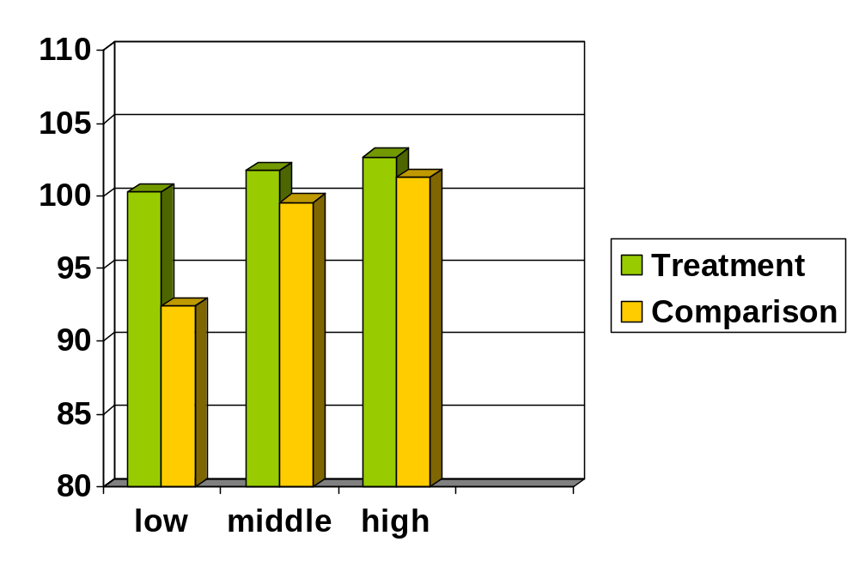
Behavior:
Adjusted Post-test Means for Treatment vs Comparison by Sub-group (kdg. p = .013)

Slide 14
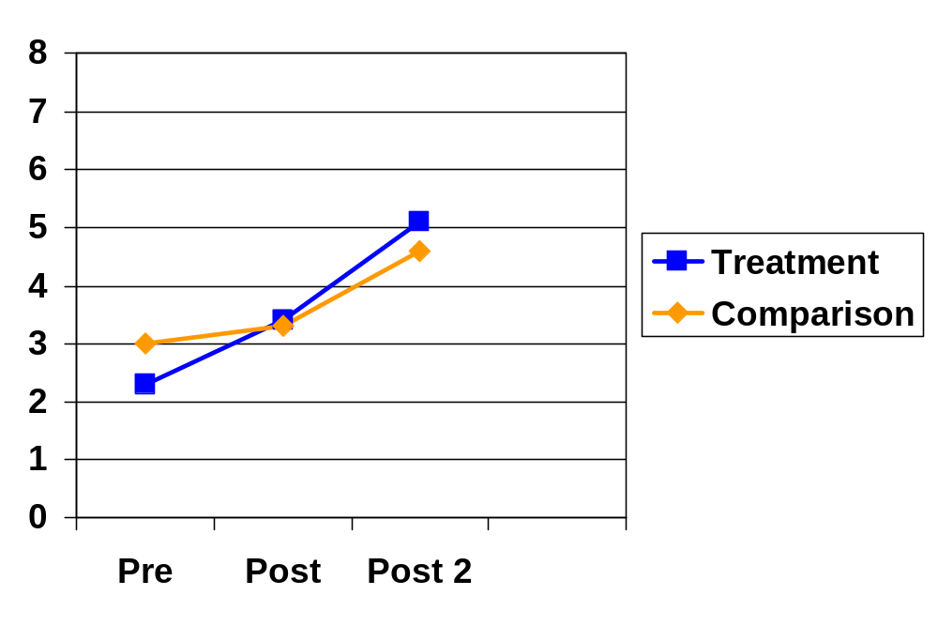
Listening Comprehension:
Means for Treatment vs Comparison
(p = .003)

Slide 15
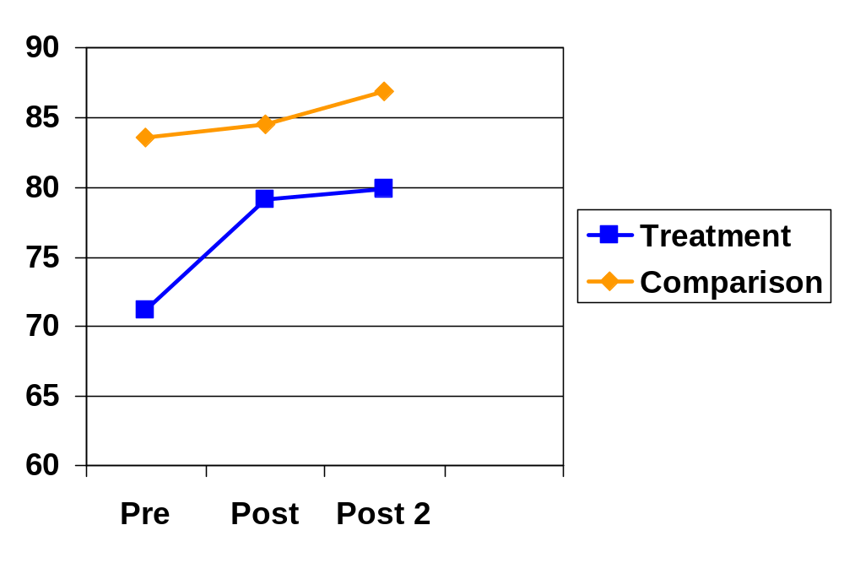
Behavior Rating:
Means for Treatment vs Comparison
(p = .005)

Slide 16
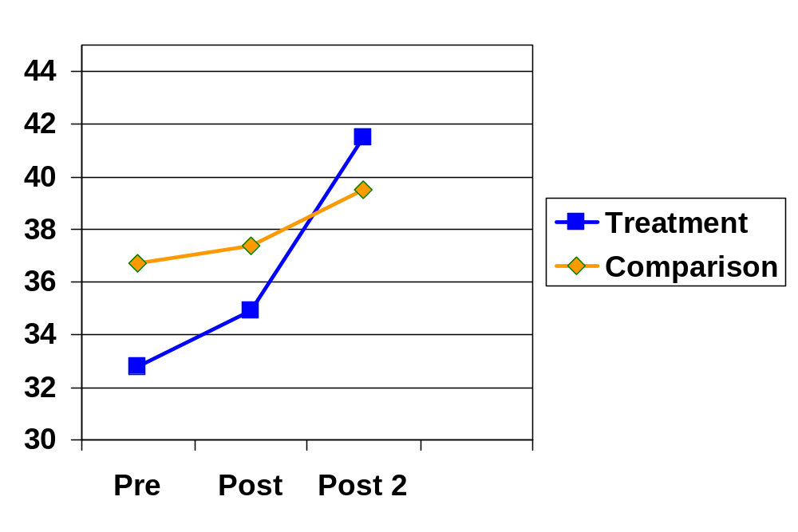
Attending Behavior Rating:
Means for Treatment vs Comparison
(p = .001)

Slide 17
Four Learning Skills
Paying Attention
Listening and Understanding
Asking Effective Questions
Encouragement

Slide 18
Five Teaching Strategies
Student story re-telling
Student story telling
Encouragement council
Peer reporting
Modeling-coaching-cueing

Slide 19
RTL Built Around Five Stories
Fuzzy and the Time of Great Change
  – overview of four key skills
2. Fuzzy and the Secret of Flowers – paying attention
3. Fuzzy and the Daring Rescue – importance of listening and understanding
4. Fuzzy and the Final Lesson – asking effective questions
5. Fuzzy and the Great Migration – encouragement of self and others

Slide 20
Fuzzy and the Time of Great Change

Slide 21
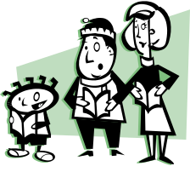










Who? Who was in the story? (35)
What? What happened in the story?
        First, next, then, last
When? When did the story happen? (day, night, morning, spring, summer…)
Where? Where did the story happen? Inside, outside, school…..
How? How were the characters feeling at the beginning, middle, end of story?

Slide 22
Strategy: Student Story Retelling
Fuzzy and the Time of Great Change
    Story Retelling (30)
    Sequencing (31)
    Prompt with poster of 4W and H questions (35)

Slide 23


Follow-up: If You’re a Fuzzy and you Know it
Hawkeye
Look at me

Slide 24
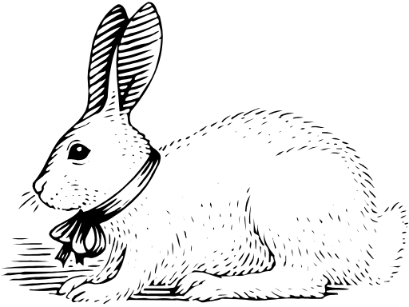

If You’re a Fuzzy and you Know it
Bonnie
SSS – Listen

Slide 25

If You’re a Fuzzy and you Know it
Hoot - ask a question
What do you mean?

Slide 26


If You’re a Fuzzy and you Know it
Skippy - say you can
I can do it!

Slide 27
If You’re a Fuzzy and you Know it
Fuzzy – do all 4
Look at me
SSS – listen
Ask a question?
I can do it!

Slide 28
Fuzzy and the Time of Great Change
Skills: Paying attention, listening, asking questions & encouragement
Lesson Plan (60)
Follow-up activities (61-62)
What else???

Slide 29
Using “Fuzzy” CD
Guided listening activities
  Students draw what happens at the beginning, middle, end of story
  Students draw how Fuzzy is feeling at the beginning, middle, end of story
  Students draw their favorite part of story

Slide 30

Fuzzy and the Secret of Flowers – Paying Attention

Slide 31
Follow-up: Fuzzies & Butterflies
Skills: Reinforce paying attention
Cut out flowers to match the “good and bad” flowers in the story
Divide into Fuzzies & Butterflies
Tell story from point of view of Master Butterfly
Choose one part to role play (paying attention or wiggling)
What happens when we don’t pay attention?
What other situations could it be dangerous to not pay attention?

Slide 32
Strategy: Student Story Telling
Review 4W & H questions
Choose story starter
  A time I learned to do something hard.
  A time I helped someone who was having a problem.
Think about and draw things that answer 4W & H questions
Pair share
Check listening
Pair share (reversed roles)

Slide 33
Who? Who was in the story? (35)
What? What happened in the story?
        First, next, then, last
When? When did the story happen? (day, night, morning, spring, summer…)
Where? Where did the story happen? Inside, outside, school…..
How? How were the characters feeling at the beginning, middle, end of story?

Slide 34
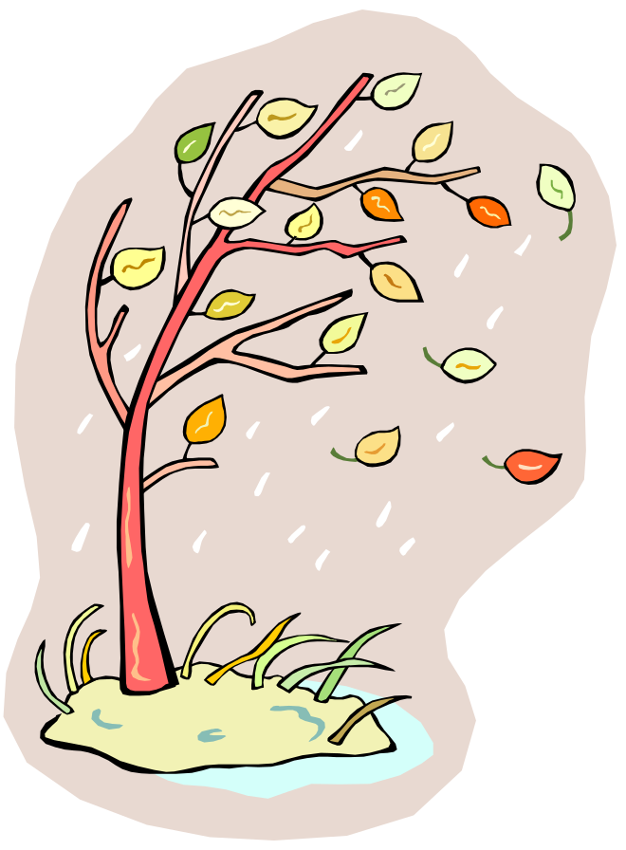
Fuzzy and the Daring Rescue –
Listening and Understanding

Slide 35

Follow-up: Gossip
Skill: Listening

Slide 36
Fuzzy and the Final Lesson –
Asking Effective Questions

Slide 37
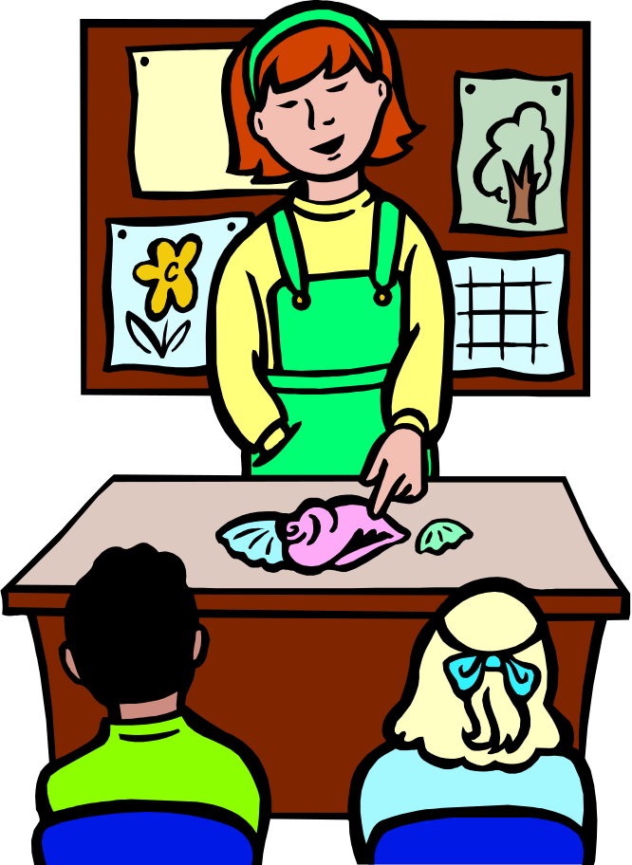
Follow-up: Show and Don’t Tell
Skill: Asking Effective Questions

Slide 38
Fuzzy and the Great Migration – Encouragement of Self and Others

Slide 39

Follow-up: Alexander and the Terrible Horrible No Good Very Bad Day
Skill: Encouragement and Self-encouragement
What would you say
to encourage Alex?
Have you ever felt like
Alex?
What words might
have helped?

Slide 40
RTL Typical Session (56)
Review previous session
  Who can tell me what the last story was about?
Reinforce
  What have you practiced?
Introduce new material
  Today our story is about….. We are going to learn about….. Listen for things that help Fuzzy…..
Present the story
Review the story
Summarize
  Main points for this and all previous stories
Transition to activity
Wrap up
Preview

Slide 41
Strategy: Encouragement Council (36)
Encouragement skills training
  Circle (10-15 minutes)
  Sample prompts
    Something I like about this class
    Something our class has improved on lately
    Something someone said to me this week that helped me feel good
  Group facilitation skills

Slide 42

Strategy: Positive Peer Reporting
Noticing other students (37)
  Pairs, groups – feedback at end of day
Encouragement Box (48)
Encouragement Council (36)
  Positive peer reporting starters
    One thing I noticed about you today that I liked was_______________.
    I could tell you were paying attention and listening because you________.
    Something you did today I thought was friendly was _____________________.

Slide 43
Strategy: Modeling/Coaching/Cueing (39)
Counselor/teacher model specific behaviors & report to class when they see targeted behaviors
  Attending, listening, questions & encouragement
  Use during story re-telling, story telling and the encouragement council
Supportive and corrective feedback
  Sandwich approach
Cueing (auditory & visual) to stimulate memory
  “I would like to see 25 good “fuzzies” right now.”

Slide 44
Using Group Discussion Skills (11-12)
Personalizing
Structuring
Modeling
Connecting
Responding to each comment
Involving everyone
Summarizing

Slide 45
Sample Weekly Plan (after all stories and strategies have been introduced - 54)
Student story re-telling with regular curriculum stories
Student story telling to reinforce story structure, attending, listening
Encouragement council to reinforce encouragement and practice listening and attending
Follow-up activities continue

Slide 46
Parent Follow-up (79)
Newsletters
  Key skills
  Important points
  Activity suggestions
Tips for building self-esteem, confidence, relationships
Encouraging things to say and do

Slide 47
Summary
Four Skills
Five Strategies
Introduced through Five Stories
Reinforced through Follow-up Activities and Story Repetition in the Classroom and at Home
Embedding in Daily Curriculum

Slide 48
Getting Teachers Involved – Teacher Counselor Collaboration
Planning
Modeling 5 strategies used to develop skills
Structured opportunities to problem solve and share successes
Evaluating outcomes

Slide 49
RTL Group Counseling Resource
The RTL curriculum has been adapted to a small group counseling format.
Social and academic skills through storytelling. Lori Bednarek.
In “Group Counseling for School Counselors”. Brigman, G. and Goodman, B. (2001, 2008). J.Weston Walch, Publishers.

Slide 50
How Might You Plan to Get Started?
Materials
Annual Plans
Teacher Training, Support & Follow-up
Format for Implementation
Parent Involvement

Slide 51
Setting Yourself Up for Success
Showing you make a difference
  Outcome measures
  Implement as intended
  Track attendance
  Keep brief notes
  Network and share successes
  Share outcomes with key stakeholders

Slide 52
Ready to Learn
Teaching
Young
Students School
Success Skills
Linda Webb, Ph.D.
lwebb@fau.edu
and Greg Brigman, Ph.D.
gbrigman@fau.edu

