Slide 1

Ben Edgar
Brian Kaplan
Fuad Balashov
Intro to Android
Open the Slides @ http://ap.pn/2faEOV1
Notes:
Ben Edgar (here to 10)
Course creation notes and tips:
Depending on the complexity, courses can easily take 10-12 hours to produce
Allocate the time each week on your calendar
Start with an outline of the topics & exercises to be covered and review this with someone before taking the time to go into details
Remember your audience, especially for Intro tutorials - you should expect them to know only what is taught in Academy & Bootcamp!
See this course as an example: https://docs.google.com/presentation/d/192fW-NHRjWe8H5vFCkbT1e2StNhMBESd-2yvypC1c3I/
Once you have a rough draft completed, bring it to the Education (Bootcamp) Guild for review.
Course Title Slide
Guidance:
Course Title:
Should begin with “Introduction to <Topic>” if this is course is the first on a topic.
Should be either “<Topic> <n>” if there is a series that builds on each other.
Should be “<Topic>: <Subtopic>” if this is not the Intro course on the topic, but the order of the follow-up courses are unimportant.
Estimated Completion Time should include exercises and should be in hours.

Slide 2
Agenda
Dissecting an Android App
Views
Activities
Layouts
Intents
Notes:
Course Overview Slide
Guidance:
Keep this to a single slide with either a bullet list or short description of what the course will cover

Slide 3
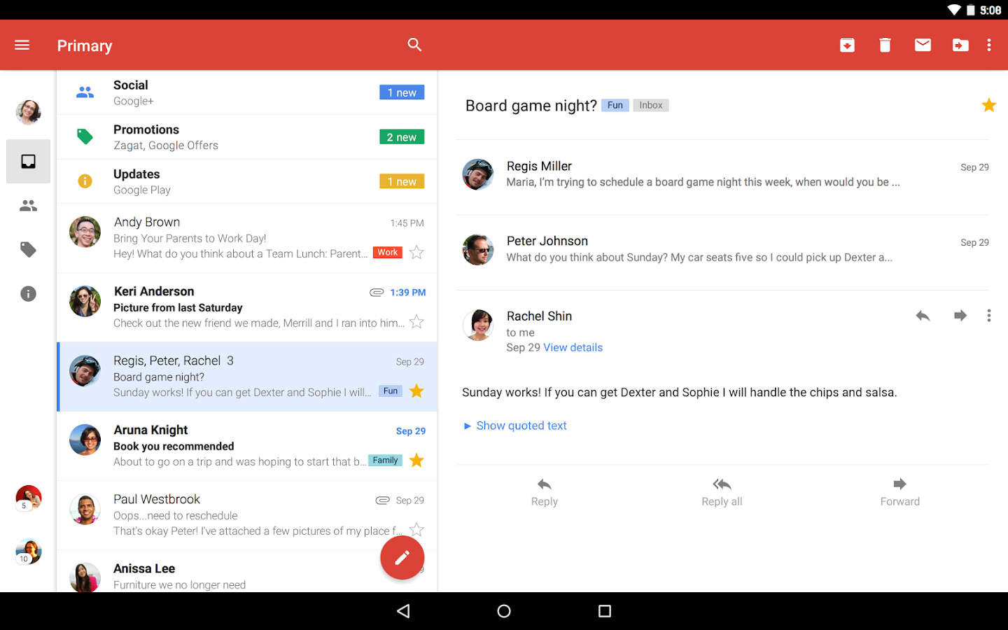
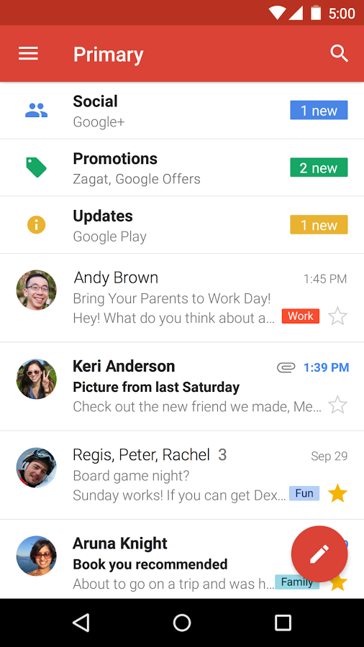
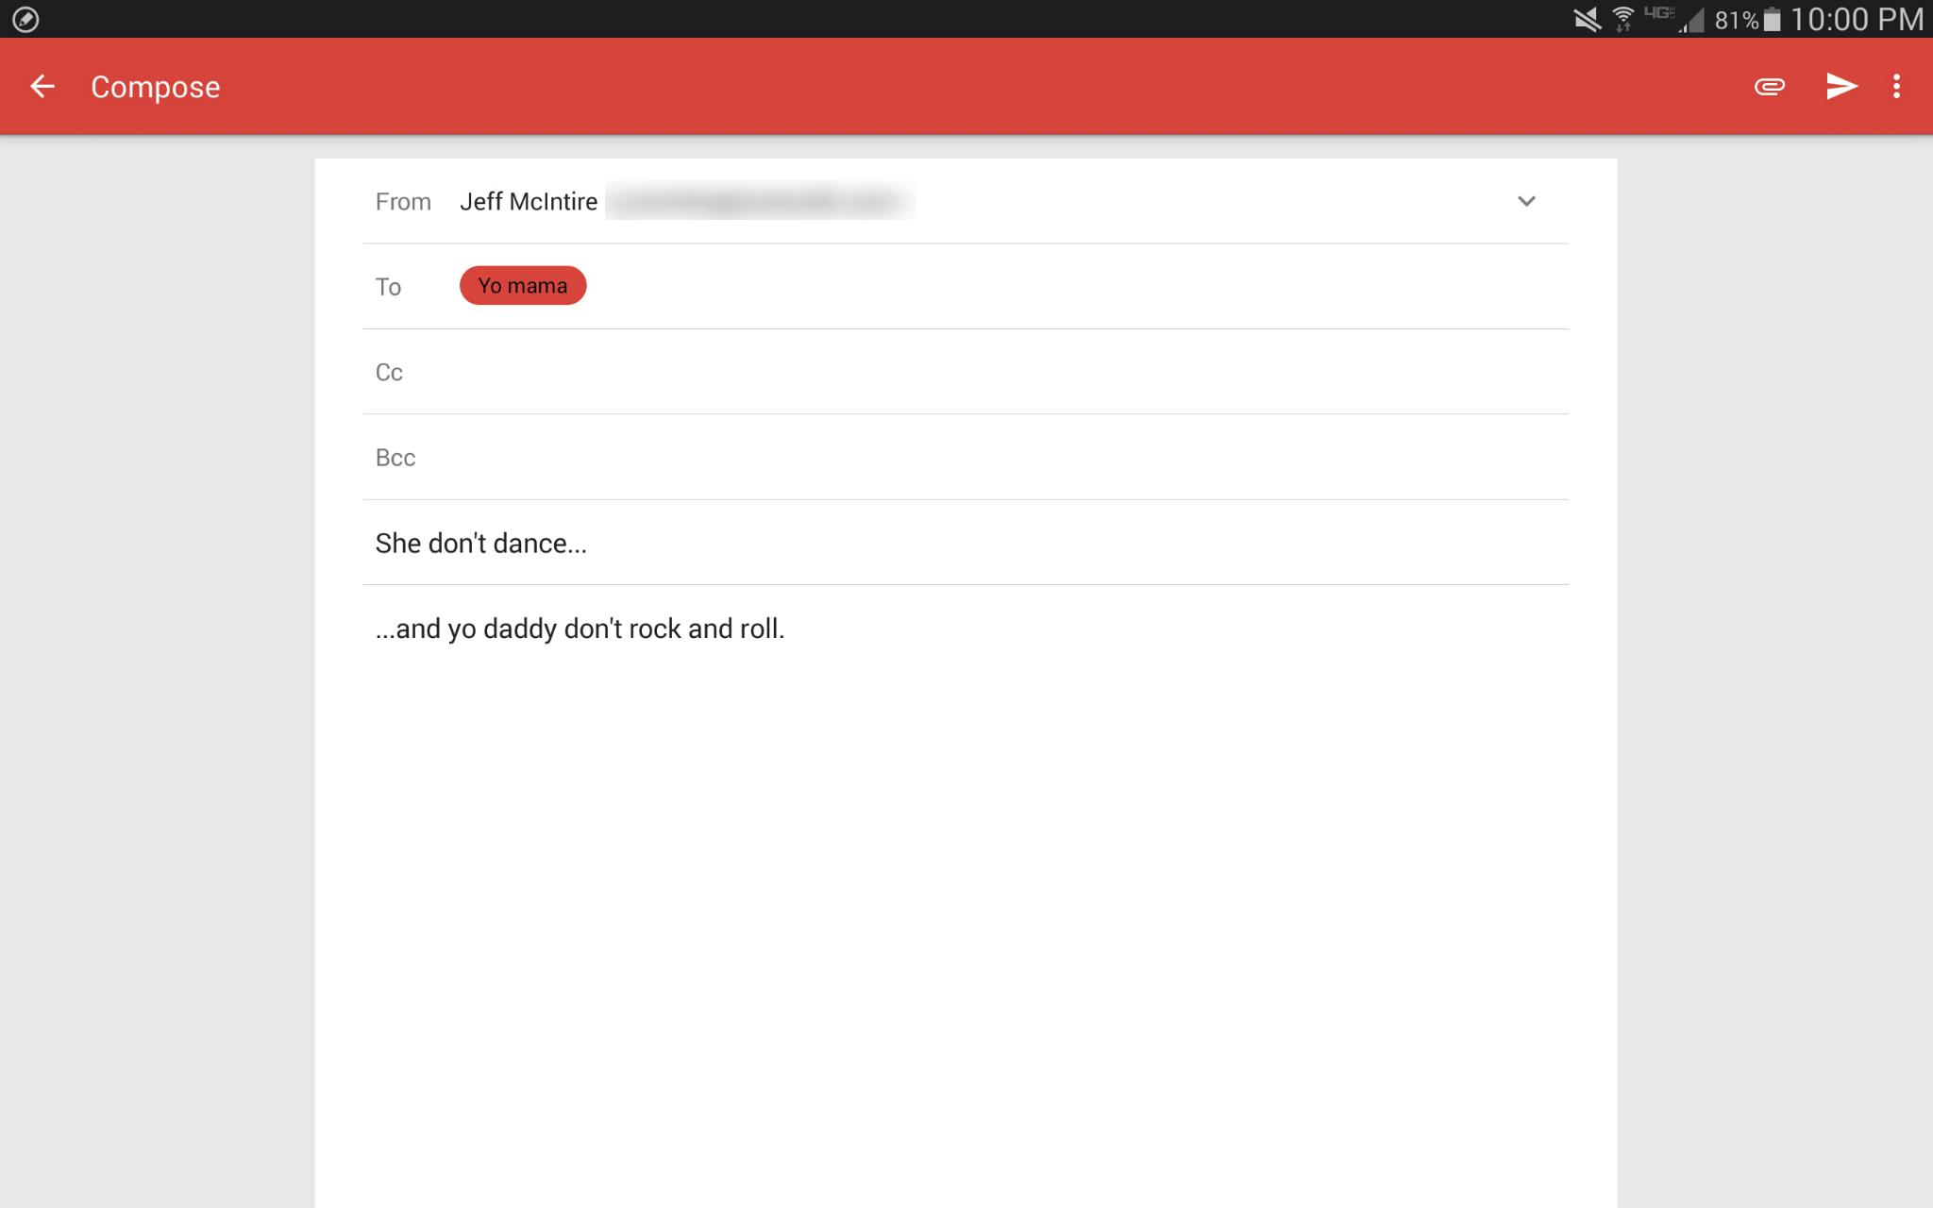
Dissecting an Android App
Activities
Intents
Fragments
Background Processing
Views
Notes:
What does an android app have?
For this exercise we will be exploring a fictional mail app, lets call it… GMayle!
For starters we have different screens
These screens are called activities in android
We also note that we need a way to navigate from one to another, and that the navigations (unlike on web) are well defined.
Navigations in android are handled with intents
If we focus on one of these activities we will see that there are panels of content
These panels are called fragments
If we drill down even further we can see that there are are different smaller “views” in the UI (for images, text, etc)
These are called views and view groups in android
Finally, we should note that while the Layout is defined by the application the data is not hardcoded in the app, it is pulled from local databases/filesystems and the server
This data is loaded with async tasks and loaders

Slide 4


Your Toolbox
XML
Defines UI
Java
App Logic
Android
+
=
Notes:
Now that we have an idea of what components make up an application lets talk about the toolbox we have to build them!
This consists of XML and Java (maybe ignore android framework here…
XML is used to build the UI’s of the application (Layouts, animations, etc)
Java is used for putting together our application logic

Slide 5
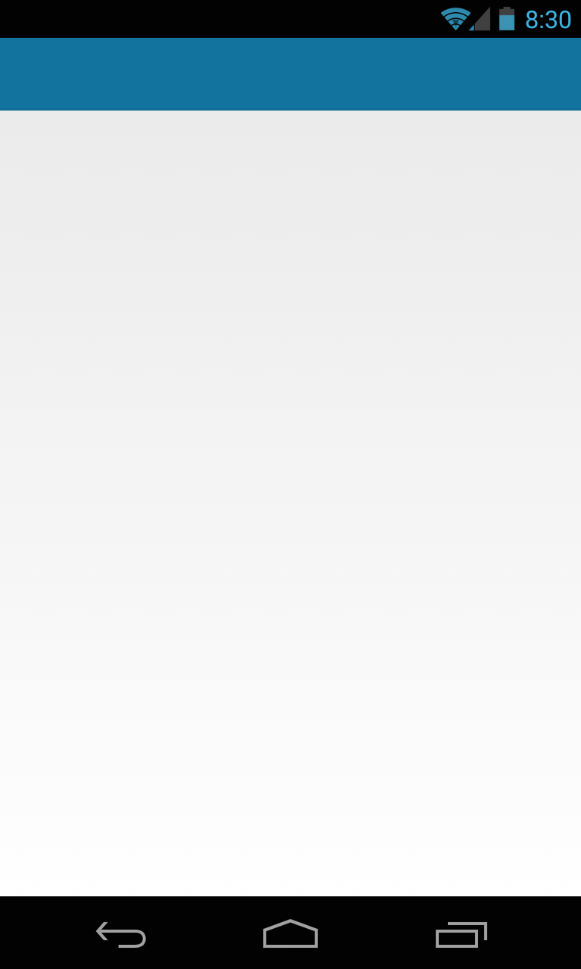

Let’s Build an App
10 min
Activity
Type a Number
Intent
Activity
View a Meme
Network
AsyncTask
Number Id
Notes:
Make sure to point out where resources and java files go.
In this project we will be touching on:
Views, Activities, Intents & AsyncTasks
Also: gradle, project filestructure
The Manifest

Slide 6

Views
<ImageView
/>
android:layout_width="wrap_content"
android:layout_height="wrap_content"
android:src="@drawable/peaceful_road"
Notes:
Ben Edgar
XML files consist of Tags and attributes. (image1 here: one xml element + image2 the element it describes)
Tags
are surrounded by angle brackets
have a name
Describe a UI component
Attributes
are listed within a tag
customize the component they describe
sometimes necessary (width, height), just listen to the errors in Android Studio!

Slide 7
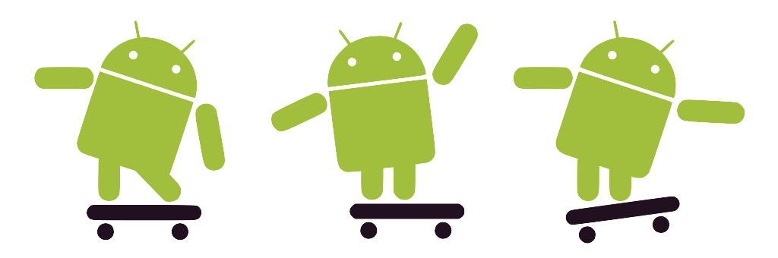
Let’s Build a Button
10 min
See the changes here!
Notes:
Add button xml to activity_main.xml file
Specify length and width to be wrap_content
Specify text to be “Click me!”
Think about error to make!

Slide 8
Activities
App Logic
UI
Everyone wants a piece of it
Notes:
Traditionally, each screen on android is an activity.
The activity encompasses both the app logic and the xml UI definition to build the UI on that screen.
Java is used to add logic and dynamically alter the UI
XML is used to build the static part of the UI, you can also use Java for this but you should avoid doing so.
The activity is passed into all views, broadcast receivers, tasks, etc so they all have a common “parent” to be associated with. It extends a class called context which you can read more about here

Slide 9
Activity: Managing Events
Responds to UI events
clicks, touches, scrolls
Notes:
Each activity is represented with a Java class that you write. This class is responsible for:
Picking the xml file that should represent its UI
Using ids to find elements in the UI
adding listeners to the UI elements and using these to Handling user interactions.
To do this job it uses listeners from the UI elements inside of it to react to user events. These are attached to views which we’ll discuss in a few slides

Slide 10
React to our Button
10 min
See the changes here!
Notes:
Add id to button in xml file
Get the button in the main activity
Add an on click listener
Use toast to make message appear

Slide 11
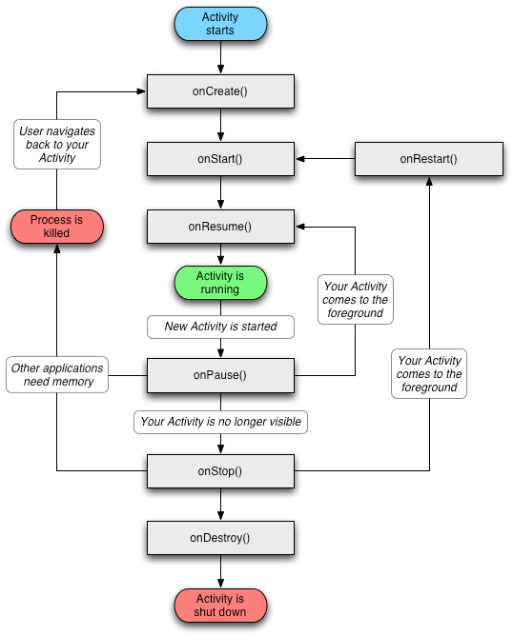
Activity: Lifecycle
onCreate
Activity Created
onDestroy
Activity Ending
etc...
Notes:
Fuad (here - end) The Activity gives you a lifecycle to hook into for different events, the lifecycle is kind of intense but we can just focus on a few key events:
onCreate: When the activity is first made: used to populate data
onResume: run before showing the screen: sets up the UI
onPause: run before the showing a new activity: saves UI state for when the activity is shown again
More on the lifecycle in this diagram: http://i.stack.imgur.com/Jk8de.png

Slide 12
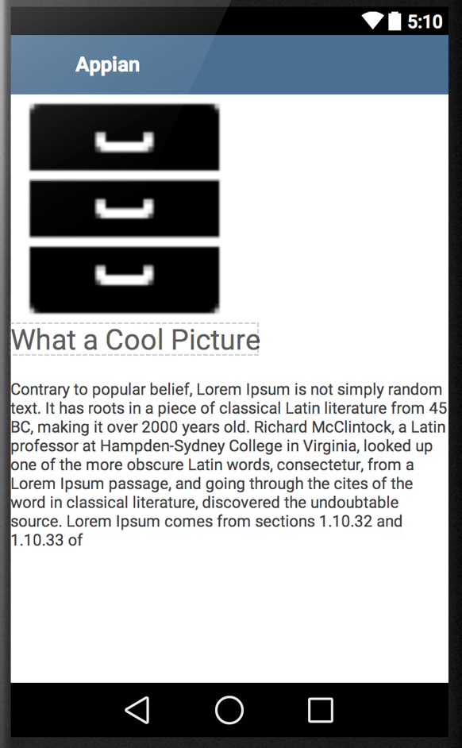
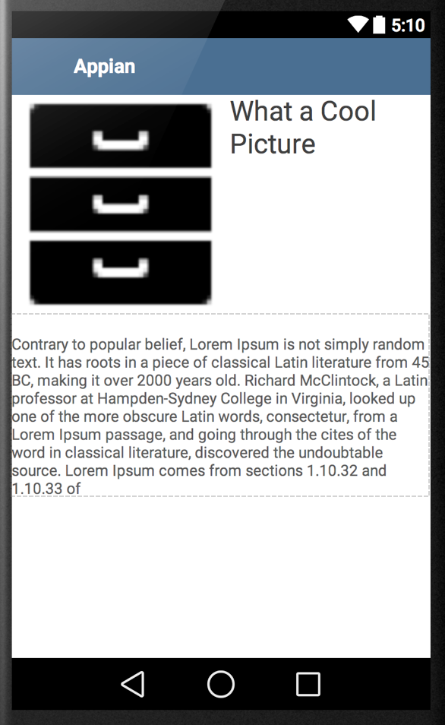
View Groups: Layouts
Linear Layout
Relative Layout
Notes:
To build a layout, you can put together multiple xml elements together in a view group
There are two basic types of View Groups.
Linear Layouts (that organize child views one after another)
Relative Layouts (that organize child views in relation to one another)
For more on Relative Layouts Vs Linear Layouts check out the developer docs
Linear Layouts are clearer to explain so we will discuss those in the presentation.
On this Linear Layout we have an image and two text views below it. These tags would look something like this in the xml we write.
However, this xml would not be complete without its attributes...

Slide 13
Relative Layout
<?xml version="1.0" encoding="utf-8"?>
<RelativeLayout >
<ImageView />
<TextView />
<TextView />
</RelativeLayout>
Notes:
The linear layout uses attributes to define its width and height and the orientation of its child views (vertical or horizontal).
The child views also have attributes to define their dimensions, text size, colors, image and on and on.
This xml we see could be a standalone file that is used to lay out an activity. We will see how to make use of it later in the presentation.
We can note a couple things while we are here!
Width and height can be defined with:
“dp” (exact sizing)
wrap_content (minimum to hold content)
fill_parent (stretches to fill parent)
2) Text size is defined with “sp” (exact sizing for text)
3) There must be ONE root element in the xml file, this is normally a View Group (linear layout or relative layout) though it could be a view
4) Attributes in an xml file use a namespace (in this case android), all namespaces that are used need to be declared at the top of the file. You don’t need to worry about this too much unless you delete the auto generated one in the first element of the xml file.
5) The first line in an xml file defines the version and encoding. You dont need to worry about it, just make sure it’s in your file.

Slide 14
Building on our Activity
10 min
See the changes here!
Notes:
Centering textview and button
Adding id to a textview
Positioning the button below the textview
Adding an EditView to type in the number above the textview

Slide 15
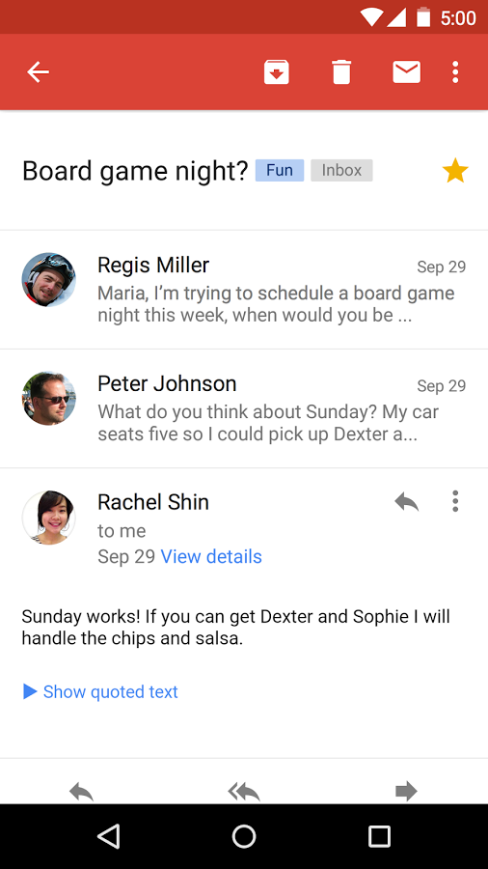
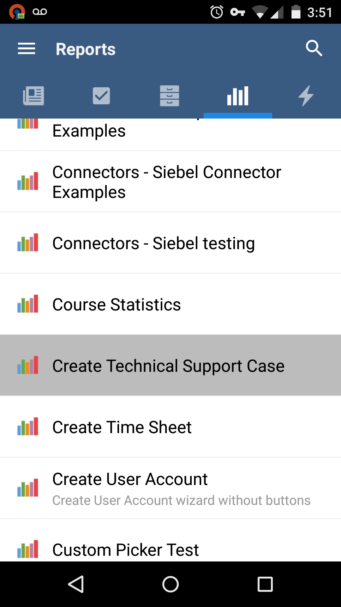
Intents
Intent
Data Bundle
Notes:
Fuad to end
Intents are used to start new activities, generally from another one.
In addition they hold a package of data for the next activity to read.
As you move through activities they are added onto an “Activity Stack”. When you hit the back button you are being transported to the last activity on the stack.

Slide 16
Navigating to a new Activity
10 min
See the changes here!
Notes:
Creating the new activity
Adding an intent to go from the first activity to the second one

Slide 17
Congratulations!
Join us to learn about networking and data

