Slide 1

Intro to Android
Open the Slides @ http://ap.pn/2faBVTX
Ben Edgar
Brian Kaplan
Fuad Balashov
Notes:
Brian Kaplan (here - 9)
Course creation notes and tips:
Depending on the complexity, courses can easily take 10-12 hours to produce
Allocate the time each week on your calendar
Start with an outline of the topics & exercises to be covered and review this with someone before taking the time to go into details
Remember your audience, especially for Intro tutorials - you should expect them to know only what is taught in Academy & Bootcamp!
See this course as an example: https://docs.google.com/presentation/d/192fW-NHRjWe8H5vFCkbT1e2StNhMBESd-2yvypC1c3I/
Once you have a rough draft completed, bring it to the Education (Bootcamp) Guild for review.
Course Title Slide
Guidance:
Course Title:
Should begin with “Introduction to <Topic>” if this is course is the first on a topic.
Should be either “<Topic> <n>” if there is a series that builds on each other.
Should be “<Topic>: <Subtopic>” if this is not the Intro course on the topic, but the order of the follow-up courses are unimportant.
Estimated Completion Time should include exercises and should be in hours.

Slide 2
Agenda
More on Intents
Networking
Local Storage
SQLite, Preferences
Other Cool Stuff
Notes:
Course Overview Slide
Guidance:
Keep this to a single slide with either a bullet list or short description of what the course will cover

Slide 3
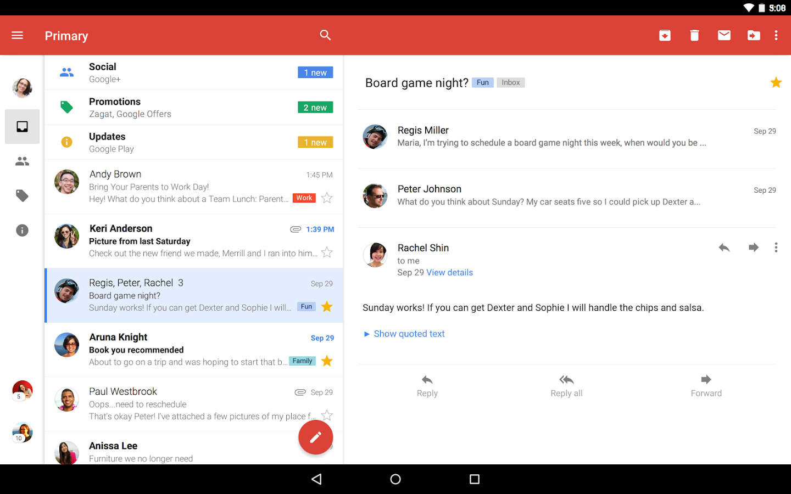
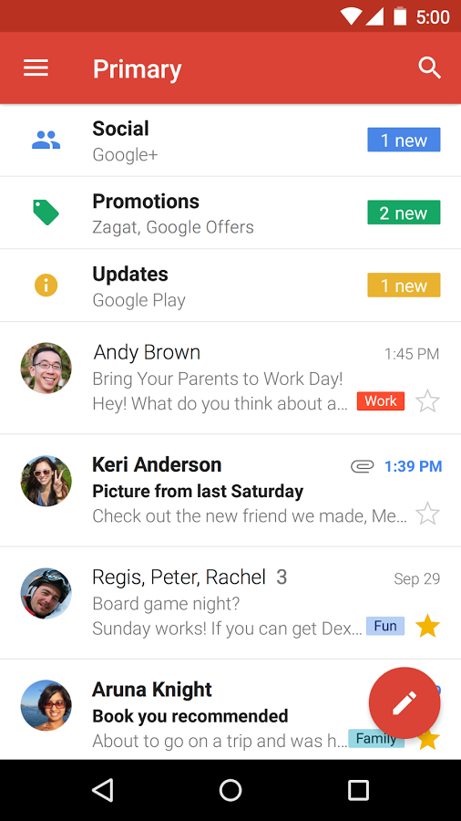
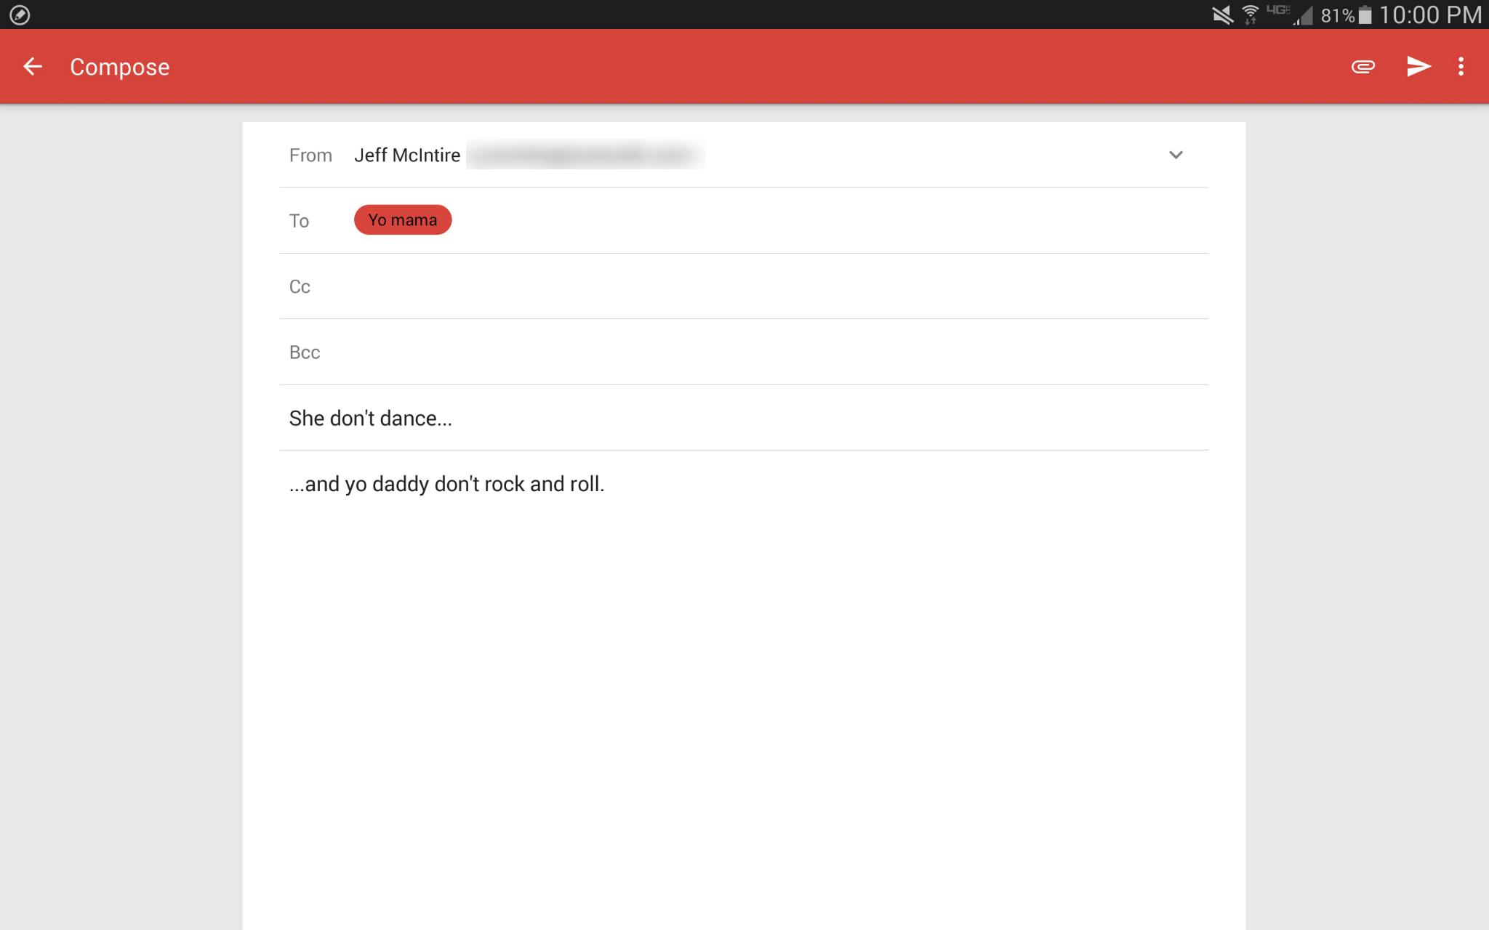
Dissecting an Android App
Activities
Intents
Fragments
Background Processing
Views
Notes:
What does an android app have?
For this exercise we will be exploring a fictional mail app, lets call it… GMayle!
For starters we have different screens
These screens are called activities in android
We also note that we need a way to navigate from one to another, and that the navigations (unlike on web) are well defined.
Navigations in android are handled with intents
If we focus on one of these activities we will see that there are panels of content
These panels are called fragments
If we drill down even further we can see that there are are different smaller “views” in the UI (for images, text, etc)
These are called views and view groups in android
Finally, we should note that while the Layout is defined by the application the data is not hardcoded in the app, it is pulled from local databases/filesystems and the server
This data is loaded with async tasks and loaders

Slide 4
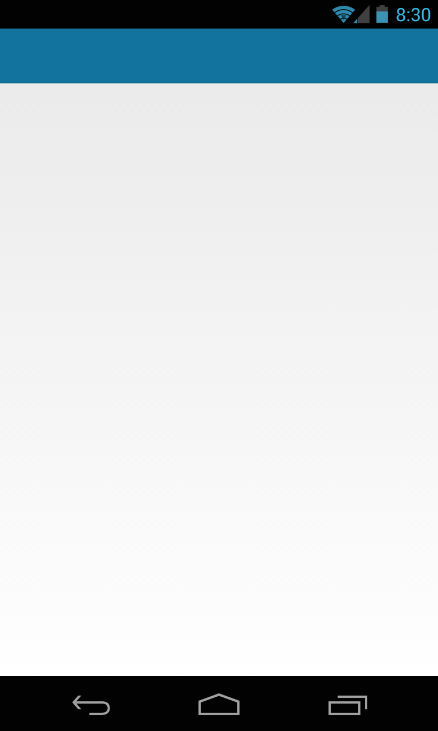

Let’s Build an App
Activity
Pick a Number
Intent
Number Id
Activity
View a Meme!
Network
AsyncTask
Notes:
Make sure to point out where resources and java files go.
In this project we will be touching on:
Views, Activities, Intents & AsyncTasks
Also: gradle, project filestructure
The Manifest

Slide 5
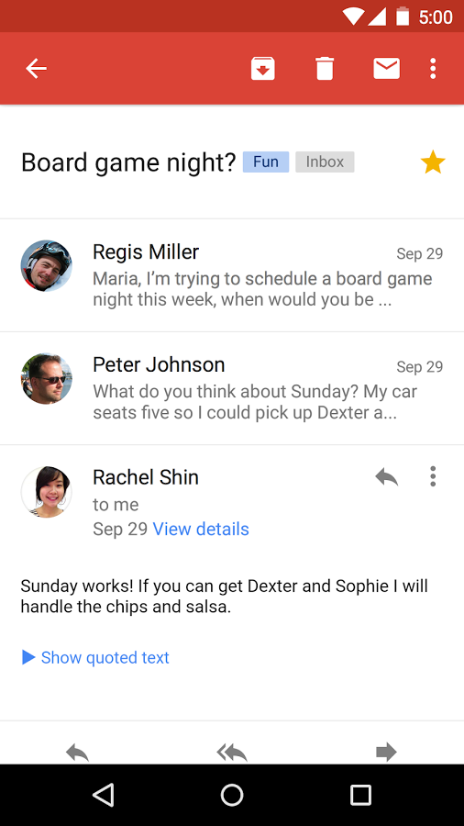
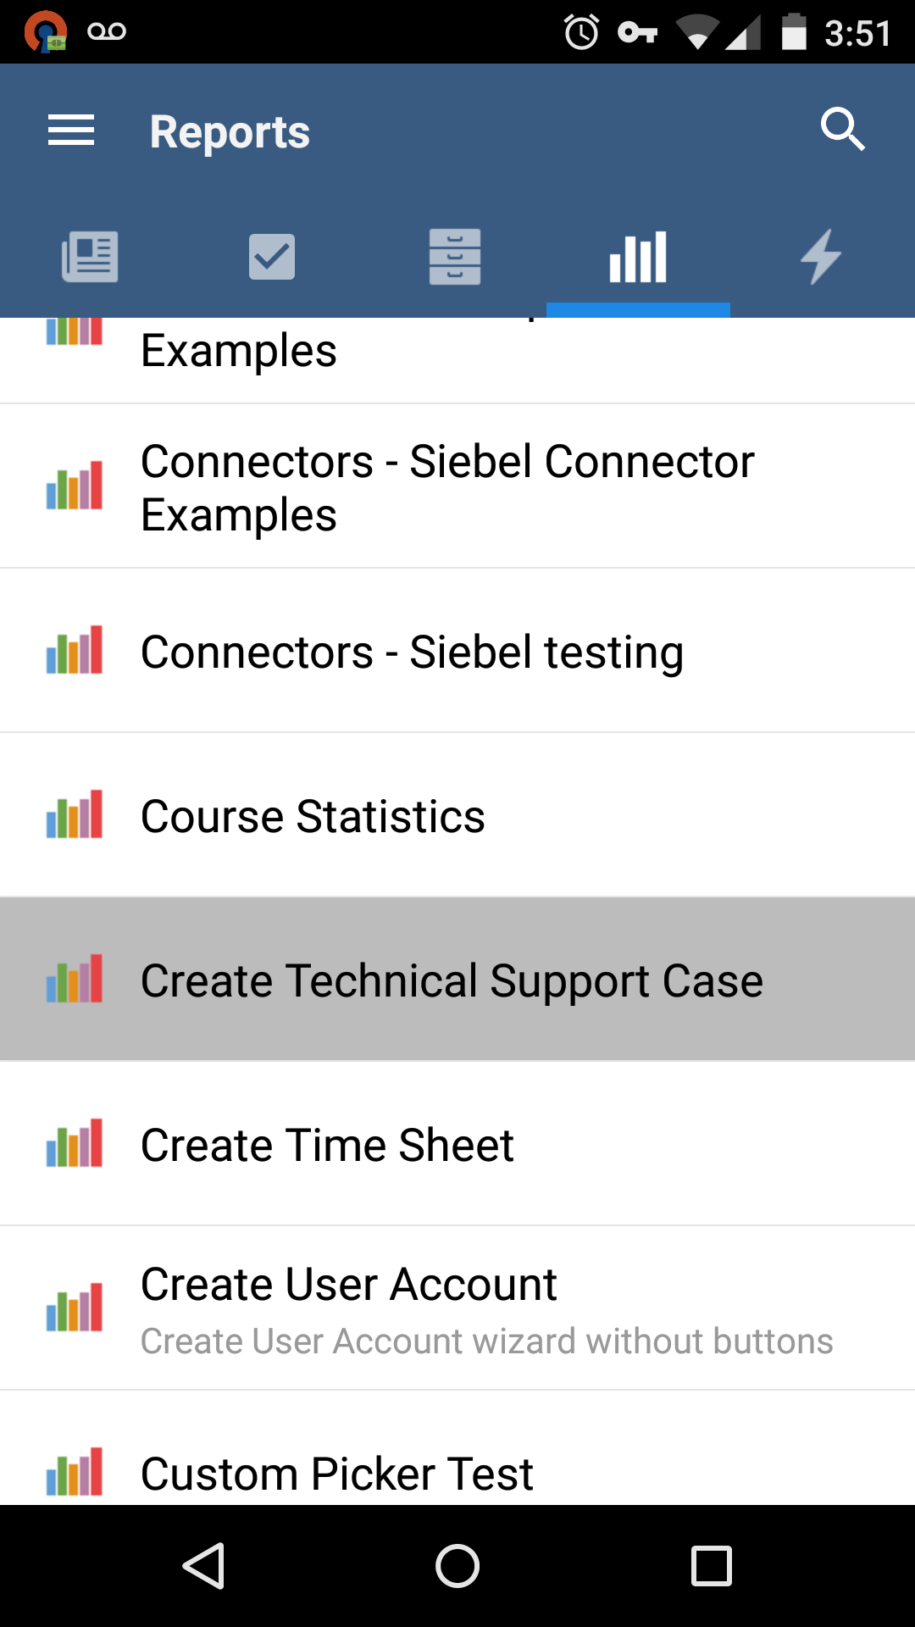
Intents
Intent with Data
- New Activity
- Meme ID
Notes:
Intents are used to start new activities, generally from another one.
In addition they hold a package of data for the next activity to read.
As you move through activities they are added onto an “Activity Stack”. When you hit the back button you are being transported to the last activity on the stack.

Slide 6
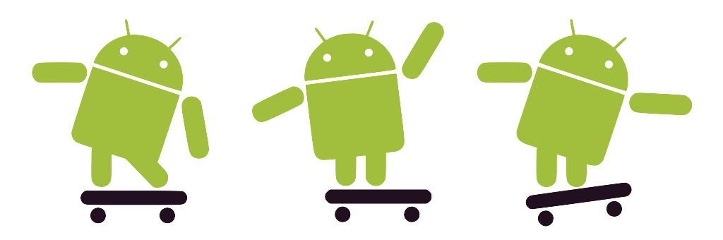
Passing more info in our Intent
10 min
See the changes here!
Notes:
Passing the number the user types into the second activity via the intent

Slide 7
Background Processing
Runs separate from UI Thread
Loaders, Loopers or AsyncTasks
Perfect for sending/fetching Data
Network
Bluetooth
Local Database
Notes:
Separate threads for fetching data so you don’t block the UI thread
spawned by the UI thread
can’t directly touch the UI
How we fetch Data (locally and from network): we extend one of these abstract classes!
Async Tasks (we used to use these everywhere)
Loaders (we are using these nowadays)
Then we just fill in the abstract methods

Slide 8
Networking with OkHttp
OkHttpClient
onFailure
(long running process)
onSuccess
(update UI component on the UI Thread)
Notes:
The most efficient way of making web requests in Java right not is by Squares OkHttp Client library.
It works by creating instance of their class, building requests using a Request class and the enquing those requests with the instance class.
There are built in callbacks that return the responses for you so you write minimal code in order to get your server responses

Slide 9
Networking
10 min
See the changes here!
Notes:
Write Meme code and display the meme

Slide 10
JSON, Picasso and the UI Thread
Background Thread (Meme Client)
Http Response OK 200 ->
Body = JSONObject from Body ->
Data = JSONArray from Body->
meme = JSONObject from Data[memeID]->
link = meme.getString(“link”) ->
handler.returnMeme(link) -> Back to Details Activity
Background Thread (Details Activity)
Switch to the UI Thread -> runOnUiThread
UI Thread (Details Activity)
picasso.with(DetailsActivity.this).load(link).into(mImageView);
Notes:
Now that we’re getting out data in our response callback let’s do something with it
We need to parse out the data that we want and we can do that by using JSONObject and JSONArray
We can’t update our UI on this background thread (inside the callback) so we need a way to get back on the UI Thread
runOnUiThread to the rescue
This function requires a reference to an activity and we don’t have that reference inside the callback
We could pass a reference to the activity when we make the meme client but it’s better to make an interface call instead
Now let’s add a new dependency called Picasso
Add the dependency to your build.gradle in the dependencies section and Android Studio will do all the downloading and linking for you
All you have to do is call the classes in your coded

Slide 11
Showing our Meme
10 min
See the changes here!
Notes:
Write Meme code and display the meme

Slide 12




Local Data Storage
Shared Prefs
Small volatile data
Great 4 Hacking!
Client Side DB
User Data
Email Data
Filesystem
Pictures
Files
Notes:
We use SQLite as a client side DB
file based SQL Database
ex: Offline data
Cached responses for news feed, or actions list
Cached forms you fill out
User data
File System
pictures
Cached response contents
Shared Preferences let you store a java object in the android OS. You identify it with a String which you can later use to retrieve it. Its really easy to use so make use of it for hacking buuuut, any app can grab that information if they figure out the string you used to store the data. So note that it is insecure for the long run, however, I use it all the time for hacking!

Slide 13
Other Cool Stuff
GPS
Bluetooth
Camera
Maps
Lists & Grids: RecyclerViews
Libraries for Everything
Speech Recognition, Barcode Scanning
Notes:
Course Overview Slide
Guidance:
Keep this to a single slide with either a bullet list or short description of what the course will cover

Slide 14
Congratulations!
Please fill out this short survey to help us improve this workshop!
ap.pn/2iNIl0m
Stop by if you have any questions
GLHF!

