Slide 1
Setup
Open these slides @ http://ap.pn/2exnBXp
Download and install Node.js (version 4.5): https://nodejs.org/en/download/
Note: Windows users may use the Node.js command prompt
Download and install the latest version of Sublime (or preferred editor): https://www.sublimetext.com/
Download and unzip the starter project: http://bit.ly/2fC4Bsw
Open Sublime or IDE of choice
Install “Package Control” and “Babel”
CTRL/CMD + SHIFT + P and search for the package
Change the syntax highlighting to Javascript (Babel)
View > Syntax > Babel > Javascript (Babel)
Go to File > Open... > select the starter project folder

Slide 2

Introduction to React
Go to: http://ap.pn/2exnBXp
Rose Wang
Justin Kenel
Aboli Kumthekar

Slide 3
Agenda
What is React?
Setup
Let’s go!

Slide 4
What is React - Intro
React makes it painless to create interactive UIs. Design simple views for each state in your application, and React will efficiently update and render just the right components when your data changes.
ReactJS
Notes:
Let’s say you have a complex view, with lots of different entry points (like facebook’s UI, or Appian’s).

Slide 5


What is React - Components and the DOM
Chat Box
😈
👺
🐼
🐼
🐵
💩
👻
Send
Notes:
Let’s say you have a complex view, with lots of different entry points (like facebook’s UI, or Appian’s).

Slide 6
What is React - Updating the UI
Chat Box
1
🐼
1
🐼
👺
🐵
💩
👻
Send
Notes:
Keeping the state of your UI consistent quickly becomes a challenge! Making a post should put the new post on the screen, sending notifications to others and updating the list of people you have messages with.

Slide 7
What is React - Centralized Logic for the View
Chat Box
1
State
🐼
1
🐼
👺
🐵
💩
👻
Send
Notes:
React simplifies this by centralizing where your ‘logic’ for the view lives.

Slide 8
What is React - Rebuilding the UI
Chat Box
1
State
🐼
1
🐼
👺
🐵
💩
set state
👻
New message
Send
Notes:
Rather than views modifying other views, they instead change the central logic which triggers a rebuild of the whole UI with the new data.

Slide 9
What is React - Re-Rendering
Chat Box
State
🐼
🐼
re-render
👺
🐵
💩
set state
👻
Send
Notes:
Rather than views modifying other views, they instead change the central logic which triggers a rebuild of the whole UI with the new data.

Slide 10
What is React - Re-Rendering
Database
Chat Box
State
🐼
🐼
👺
🐵
set state
💩
React.js
Virtual DOM
👻
Send
re- render
Notes:
Now, this sounds pretty expensive, to mitigate this React takes the View that you build and diffs it against what is currently on the screen and only updates the parts of the UI that changed.

Slide 11
Setup
Download and install Node.js (version 4.5): https://nodejs.org/en/download/
Note: Windows users may use the Node.js command prompt
Download and install the latest version of Sublime (or preferred editor): https://www.sublimetext.com/
Download and unzip the starter project: http://bit.ly/2fC4Bsw
Open Sublime or IDE of choice
Install “Package Control” and “Babel”
CTRL/CMD + SHIFT + P and search for the package
Change the syntax highlighting to Javascript (Babel)
View > Syntax > Babel > Javascript (Babel)
Go to File > Open... > select the starter project folder

Slide 12



Setup - Dependencies and Builds
npm (Node.js Package Manager) - takes care of getting your project dependencies
package.json - tells npm which dependencies your project needs (also defines build targets)
Babel - a library for compiling jsx into js that will work on any browser.
Webpack - A JS library that builds your project, and hosts it (locally)
webpack.config.js - Tells Webpack how to build your project
Notes:
Show these files as we go along
TODO: add links to files

Slide 13
Dependencies and Builds
Run npm install in the command line from the root of your project
This will download all the dependencies that are in your package.json file.

Slide 14
Setup - Key Files to Success
package.json: tells npm which dependencies your project needs (also defines build targets)
webpack.config.js: Tells Webpack how to build your project
main.js: This will be compiled into index.js by webpack (we defined it that way in webpack.config.js). It will load our React code.
index.html: The first page of your application
App.jsx: Component for our UI

Slide 15
// Import React and other stuff
import React ....
const App = React.createClass({
getInitialState() {
// Initialize empty list of messages
},
componentWillMount() {
// Turns on Firebase
},
componentWillUnmount() {
// Turns off Firebase
},
render() {
// shows your content on the screen
}
});
export default App;
App.jsx

Slide 16
Let’s run our app!
Once npm install has completed, we can run npm run start from the command line. This will deploy our project.
Go to localhost:8081 in your browser to see your app!

Slide 17
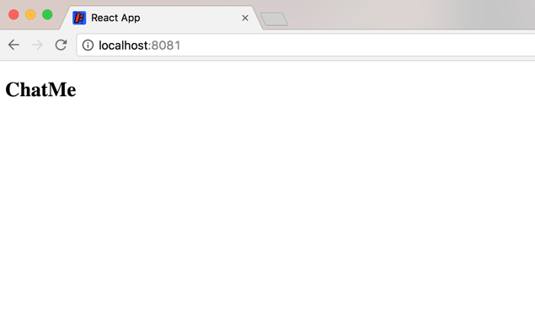
Let’s run our app!

Slide 18
React Component Lifecycle
Mounting (Creating)
Updating
Unmounting (Destroying)
getInitialState/getDefaultProps
componentWillReceiveProps
componentWillUnmount
shouldComponentUpdate
componentWillMount
true
false
componentWillUpdate
render
render
componentDidMount
componentDidUpdate
Docs for the lifecycle methods
Notes:
React’s component lifecycle allows us to have more control over the stages that a component goes through in a predictable manner. Don’t worry about all of these methods - we will get to the relevant ones through our exercise, and this diagram is useful for seeing all the methods that are available for use.

Slide 19
React Component Lifecycle: Mounting
Mounting (Creating)
Updating
Unmounting (Destroying)
getInitialState/getDefaultProps
componentWillReceiveProps
componentWillUnmount
shouldComponentUpdate
componentWillMount
true
false
componentWillUpdate
render
render
componentDidMount
componentDidUpdate
Docs for the lifecycle methods
Notes:
React’s component lifecycle allows us to have more control over the stages that a component goes through in a predictable manner. Don’t worry about all of these methods - we will get to the relevant ones through our exercise, and this diagram is useful for seeing all the methods that are available for use.

Slide 20
// Import React and other stuff
import React ....
const App = React.createClass({
getInitialState() {
return {
messages: [] // Initialize empty list of messages
};
},
componentWillMount() {
// Turns on Firebase
},
componentWillUnmount() {
// Turns off Firebase
},
render() {
// shows your content on the screen
}
});
export default App;
App.jsx
Mounting

Slide 21
React Component Lifecycle: Updating
Mounting (Creating)
Updating
Unmounting (Destroying)
getInitialState/getDefaultProps
componentWillReceiveProps
componentWillUnmount
shouldComponentUpdate
componentWillMount
true
false
componentWillUpdate
render
render
componentDidMount
componentDidUpdate
Docs for the lifecycle methods
Notes:
React’s component lifecycle allows us to have more control over the stages that a component goes through in a predictable manner. Don’t worry about all of these methods - we will get to the relevant ones through our exercise, and this diagram is useful for seeing all the methods that are available for use.

Slide 22
// Import React and other stuff
import React ....
const App = React.createClass({
getInitialState() {
return {
messages: [] // Initialize empty list of messages
};
},
componentWillMount() {
// Turns on Firebase
},
componentWillUnmount() {
// Turns off Firebase
},
render() {
// shows your content on the screen
}
});
export default App;
App.jsx
Updating

Slide 23
React Component Lifecycle: Unmounting
Mounting (Creating)
Updating
Unmounting (Destroying)
getInitialState/getDefaultProps
componentWillReceiveProps
componentWillUnmount
shouldComponentUpdate
componentWillMount
true
false
componentWillUpdate
render
render
componentDidMount
componentDidUpdate
Docs for the lifecycle methods
Notes:
React’s component lifecycle allows us to have more control over the stages that a component goes through in a predictable manner. Don’t worry about all of these methods - we will get to the relevant ones through our exercise, and this diagram is useful for seeing all the methods that are available for use.

Slide 24
// Import React and other stuff
import React ....
const App = React.createClass({
getInitialState() {
return {
messages: [] // Initialize empty list of messages
};
},
componentWillMount() {
// Turns on Firebase
},
componentWillUnmount() {
// Turns off Firebase
},
render() {
// shows your content on the screen
}
});
export default App;
App.jsx
Unmounting

Slide 25
Can We Do Something Now?
Sure, we are going to use Firebase to host the messages for our chat application.
First, let’s display the pre-recorded messages from our database
See the changes here! (or on the next slide)

Slide 26
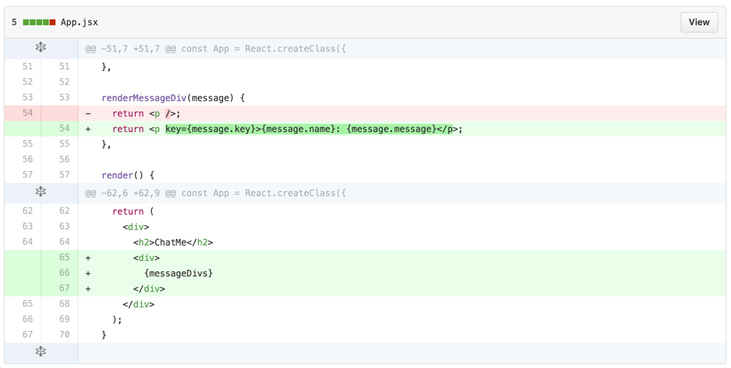
Can We Do Something Now?

Slide 27
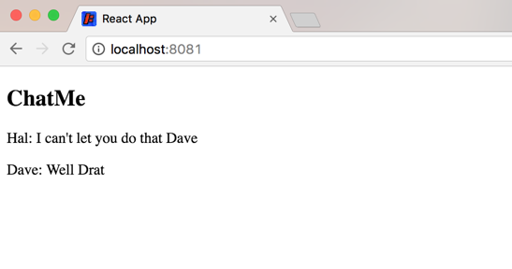
Can We Do Something Now?

Slide 28
Common React/JS mistakes
Syntax errors, like missing , . ; { or (
Mixing up , with . OR ( with {
Misspellig or mis-caSing variable names
Missing keywords like var, const, let or import
PRO-TIP: Run “npm run lint” in your directory to catch syntax errors!
Notes:
Link to handout: https://docs.google.com/document/d/1PFxSwu9vYmv1dOBGvVwo4xHQJ82-fv8E83LvsqO2VqQ/edit

Slide 29
Making A Component
You can make React components to modularize the UI
We are going to make each message a component
See the changes here!
Notes:
While having each message as a component may not have a lot of value right now, it will be helpful to see how we make React components and we’ll add some more complex logic later on.
Go over why components are useful

Slide 30
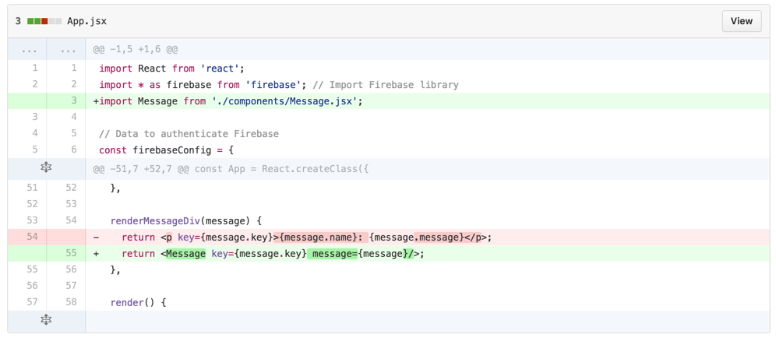
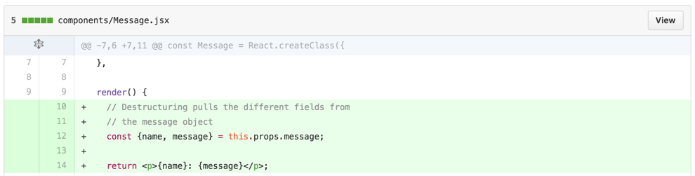
Making A Component
Notes:
While having each message as a component may not have a lot of value right now, it will be helpful to see how we make React components and we’ll add some more complex logic later on.

Slide 31
Destructuring Assignments
const {name, message} = this.props.message;
is the same as:
const name = this.props.message.name;
const message = this.props.message.message;
Notes:
While having each message as a component may not have a lot of value right now, it will be helpful to see how we make React components and we’ll add some more complex logic later on.

Slide 32
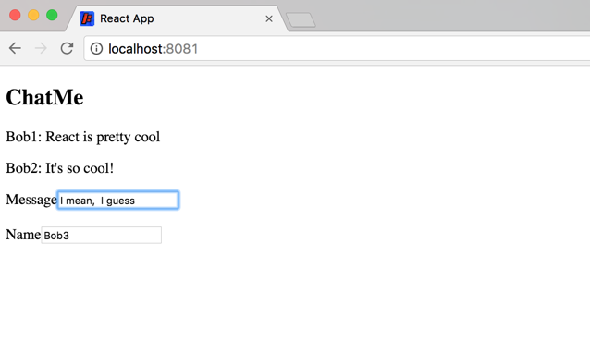
Adding new Messages

Slide 33
Adding new Messages
For both name and message we need an both an input and a label
Our message will be sent to the server when we hit Enter, then the message field will be cleared.
See the changes here!
Bonus: Play around with the events to make the message send with different keys

Slide 34
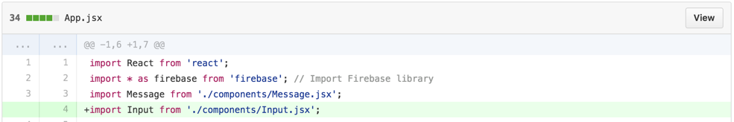
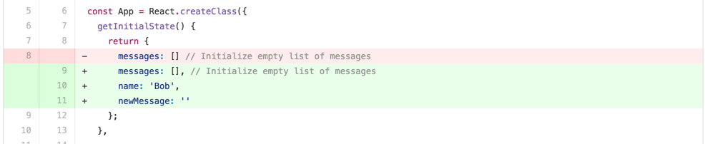
Adding new Messages

Slide 35
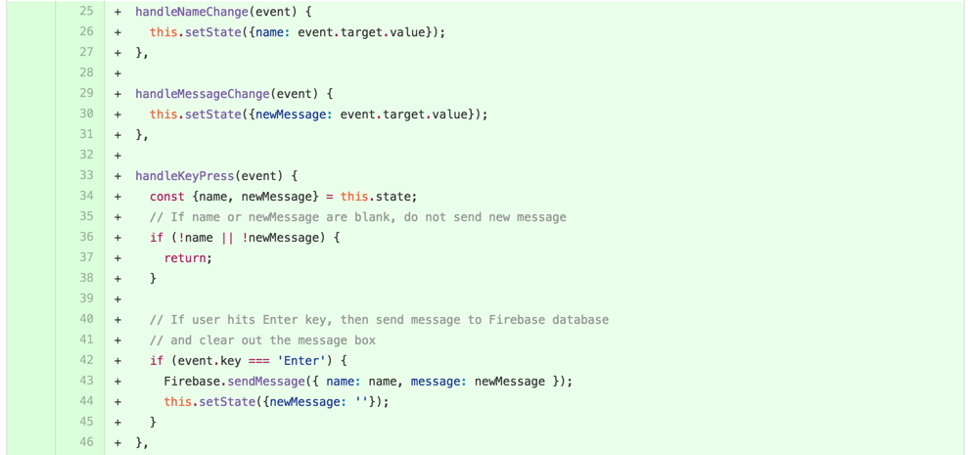
Adding new Messages

Slide 36
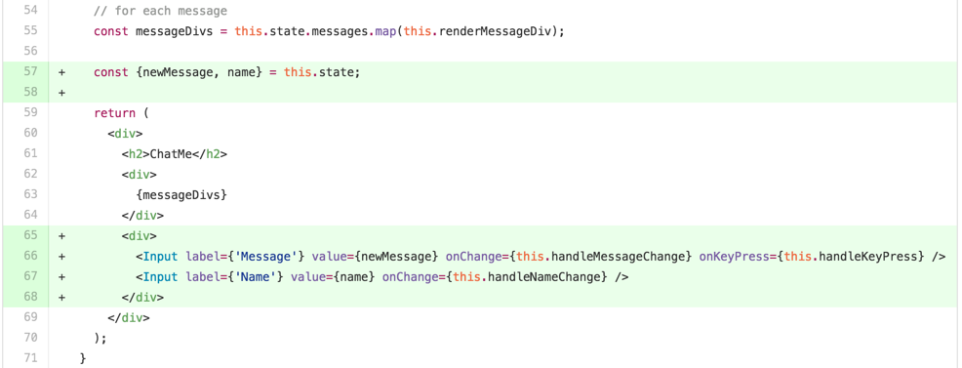
Adding new Messages

Slide 37
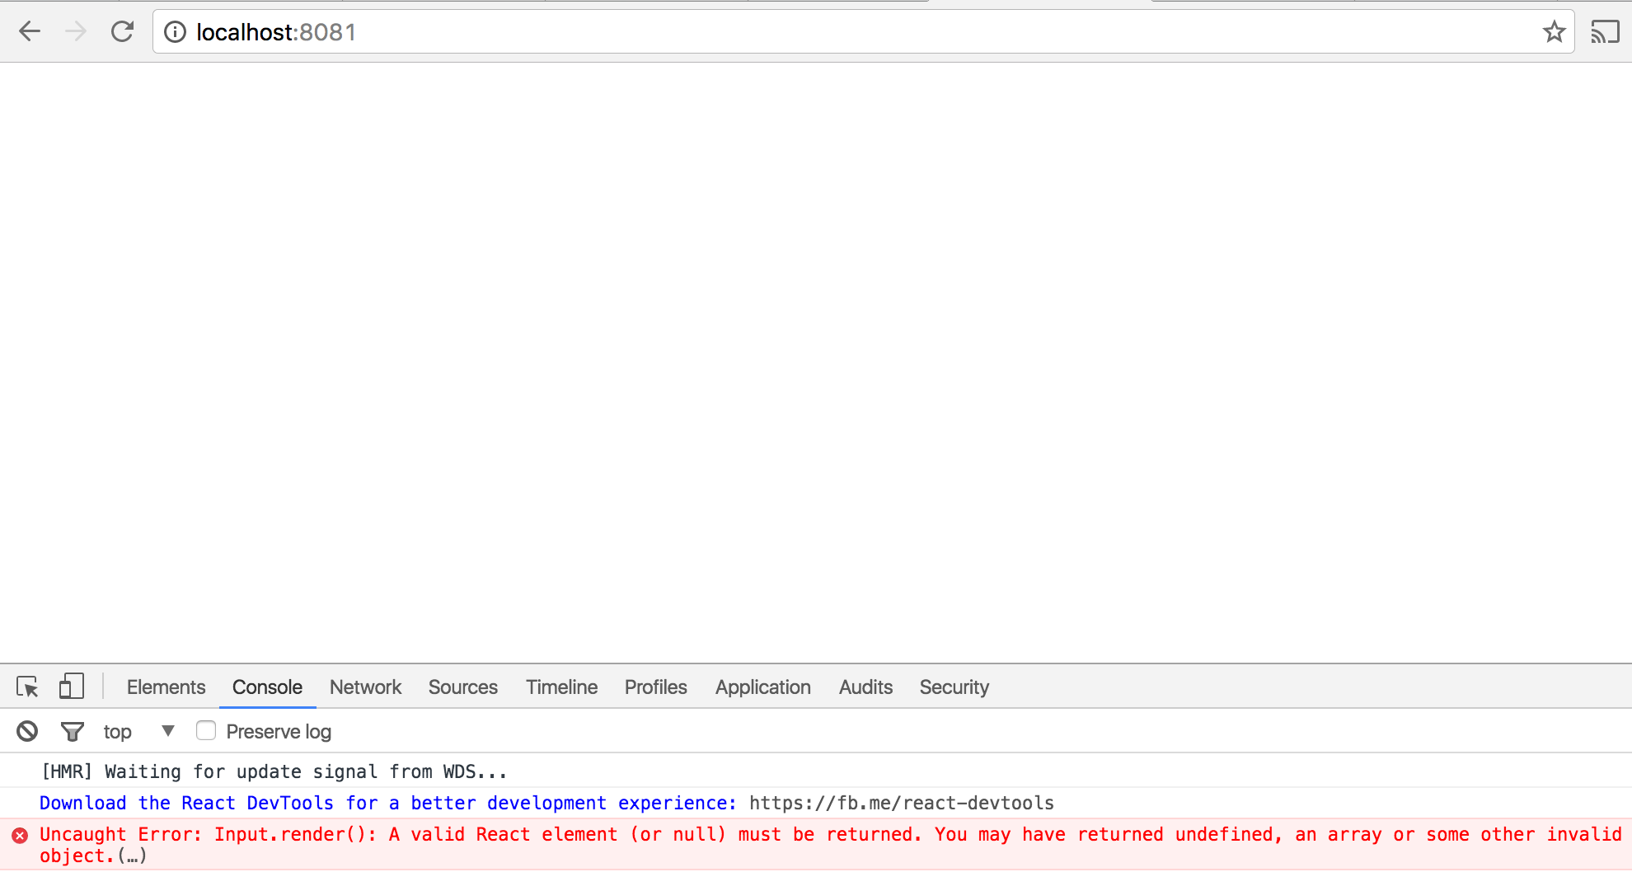
...because we’re not done!

Slide 38
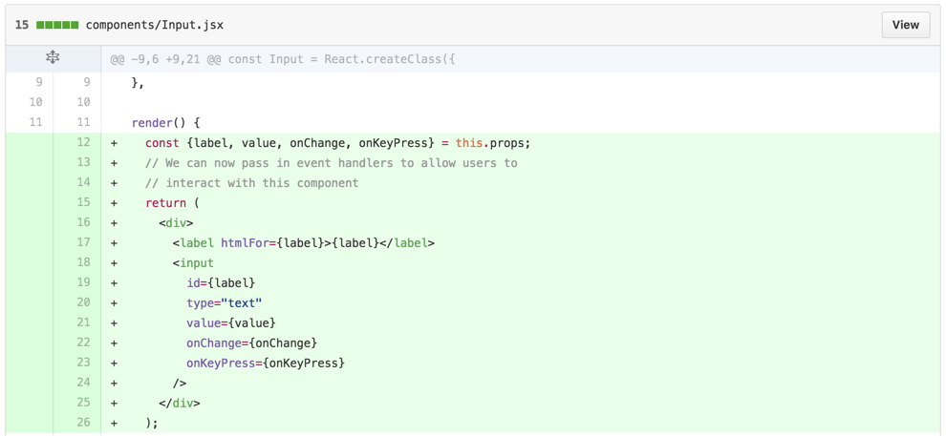
Adding new Messages

Slide 39
Styling our Interface
Our stylesheet is already included in the styles/ directory
Let’s import it and update our components to use the styles.
See the changes here!
Bonus: Change the class names on the different divs and see how the styles change

Slide 40
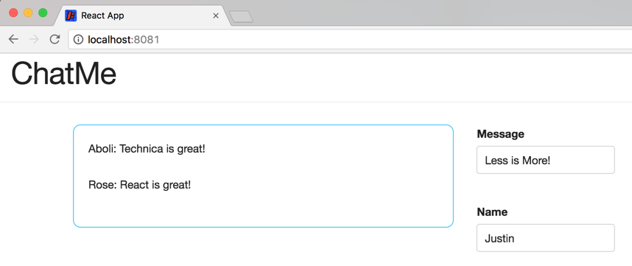
Styling our Interface

Slide 41
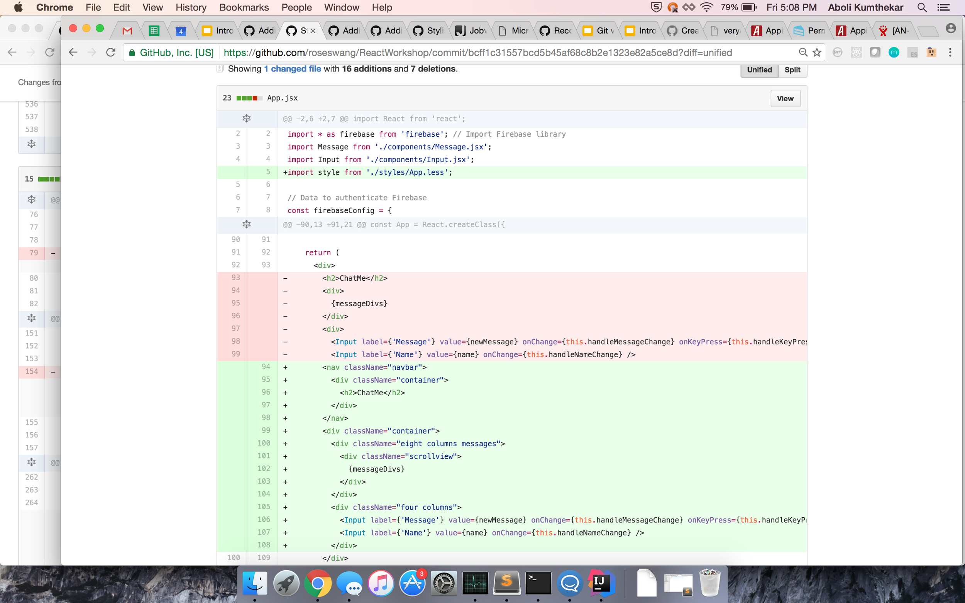
Styling our Interface

Slide 42
Styling our Interface

Slide 43
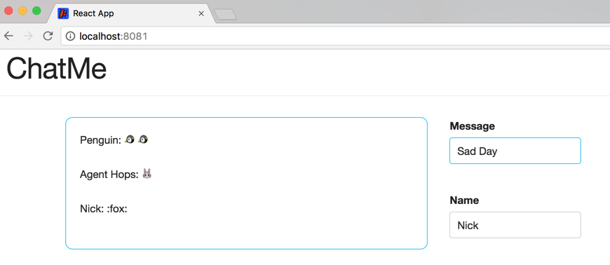
Adding Emoji Support

Slide 44
Adding Emoji Support
Go to you message component and add the library.
See the changes here!
Try: “:thumbsup:”, “:panda_face:”, “:money_with_wings:”, “:alien:”, or “:speedboat:”
link to more emojis

Slide 45
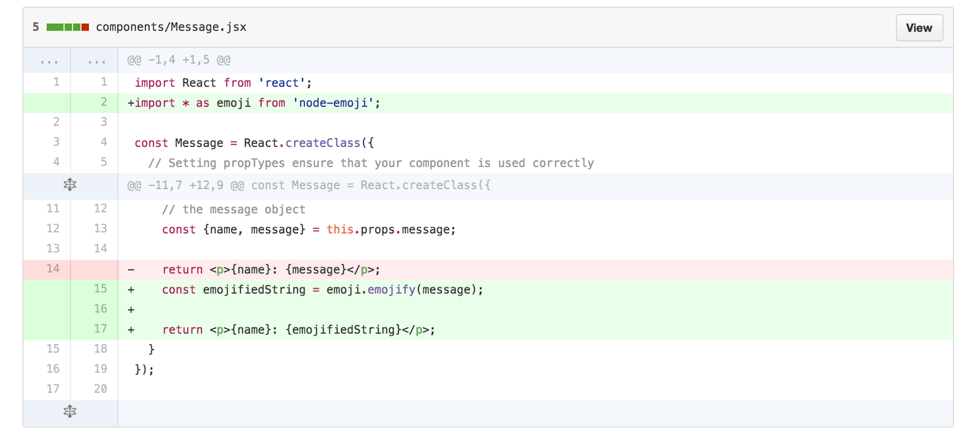
Adding Emoji Support

Slide 46
More Common React/JS mistakes
Missing imports
Forgetting to install libraries before using them
Not updating the state using setState on user interaction
Confusing =, ==, and ===
Accessing a variable, or even this, in the wrong scope
Check out this video
Notes:
Link to handout: https://docs.google.com/document/d/1PFxSwu9vYmv1dOBGvVwo4xHQJ82-fv8E83LvsqO2VqQ/edit

Slide 47
Questions?
Please fill out this short survey to help us improve this workshop!
ap.pn/2iNIl0m

