Slide 1

Ditch your IdentityServer
There’s a new kid on the block

Slide 2


Dominic Baier & Brock Allen

Slide 3
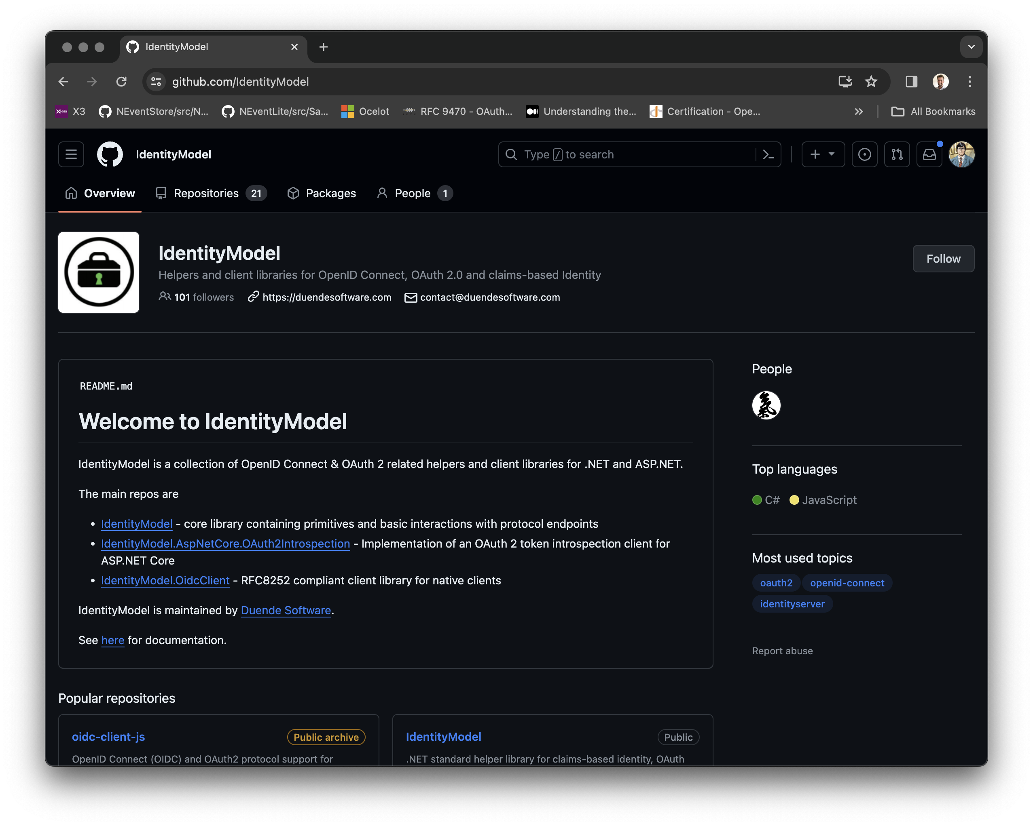

Slide 4


Slide 5
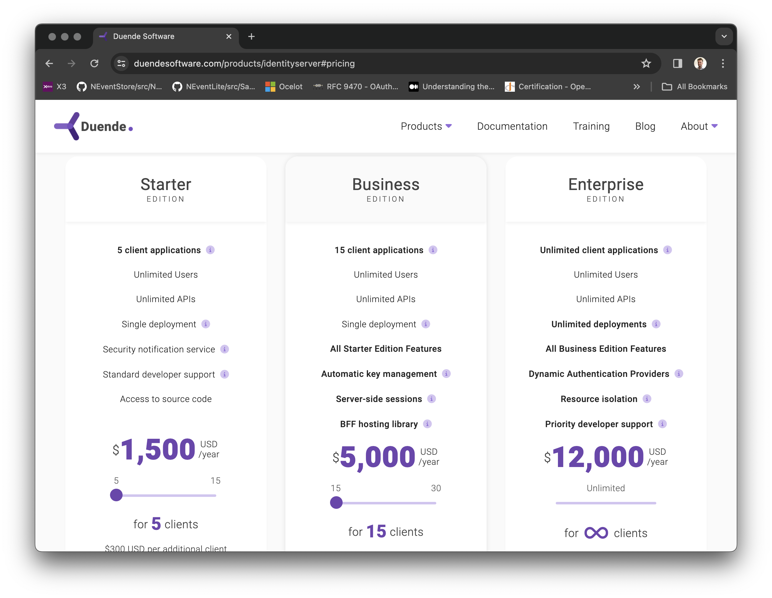

Slide 6

Kevin Chalet

Slide 7
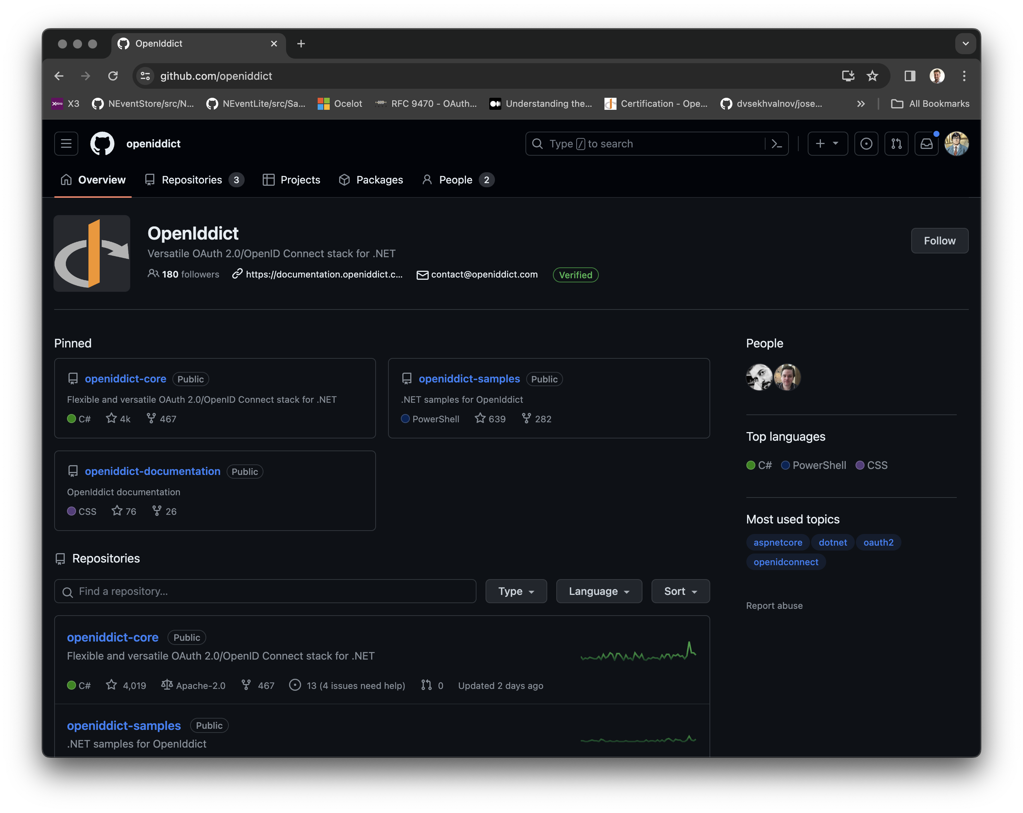

Slide 8
Demo time

