Slide 1
Abortion Protection and Mental Health: Evidence from Ohio
AP Pittman
PhD Candidate, Duke University

Slide 2
The Dobbs Decision
“The Constitution does not confer a right to abortion; Roe and Casey are overruled; and the authority to regulate abortion is returned to the people and their elected representatives.” (Dobbs v. Jackson Women’s Health Organization, syllabus)

Slide 3
Prior Research
Abortion restrictions lead to poorer mental health (Zandberg et al., 2023; Thornburg et al., 2024)
Restrictions put burdens on abortion seekers, and may lead them to more unsafe methods of abortion (Austin & Harper, 2018; Clarke & Muhlrad, 2021)
Autonomy and control are strong predictors of mental and physical health (Marmot, 2004 & 2015)
Being in places where women have less control/power on the institutional level is bad for health (Homan, 2019)
Notes:
End with the hook/opportunity to study inverse process

Slide 4
Present Study
What about the inverse process?
Opportunity for more research on how institutionalized abortion protections affect women’s health and mental health

Slide 5
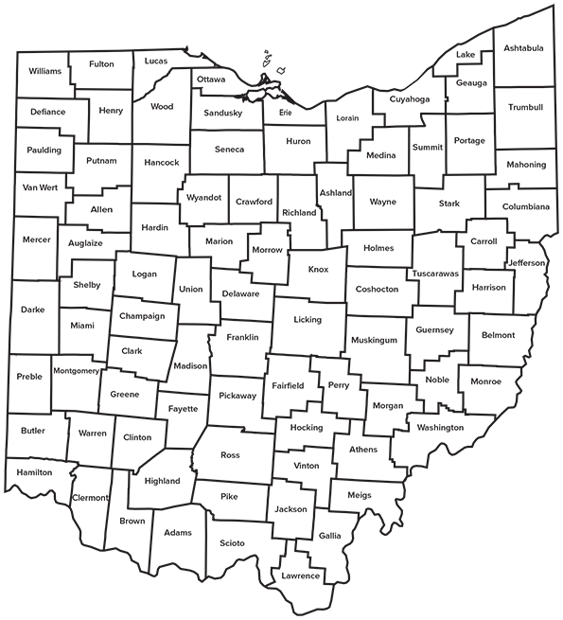
Why Ohio?

Slide 6
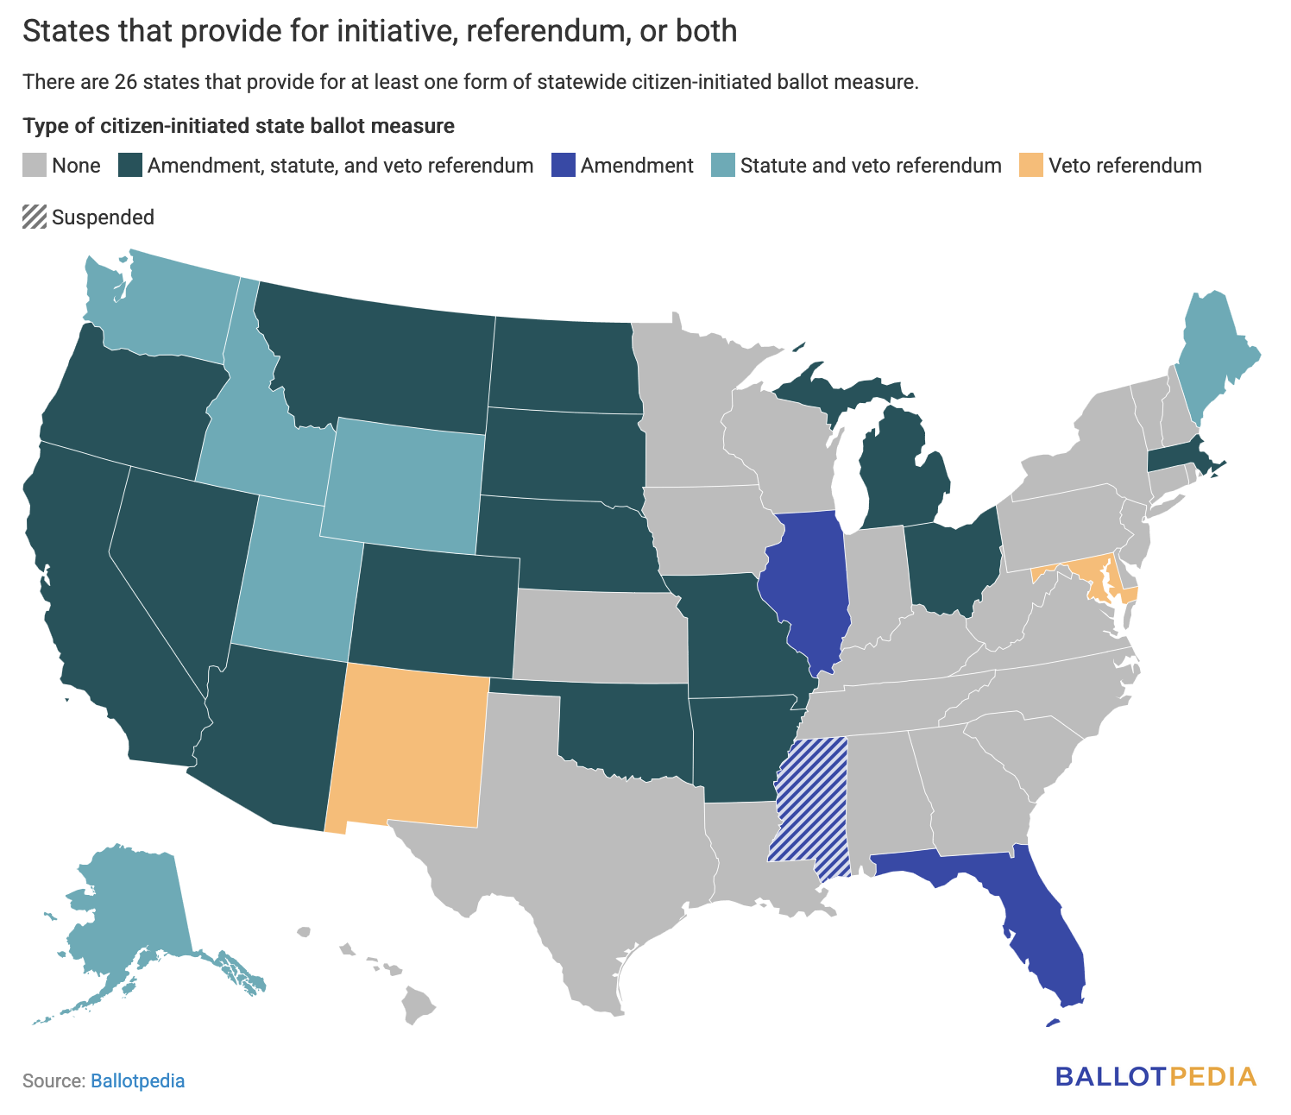
Why Ohio?

Slide 7
Why Ohio?
In November 2023, Ohio passed Issue 1, a citizen-initiated constitutional amendment protecting the right to abortion
Unique opportunity to examine the impact of abortion protections on mental health
Not in a presidential or midterm election year
Passed alongside only one other statewide ballot issue (Issue 2: legalized marijuana for Ohioans 21+; see supplemental slides)

Slide 8
Research Question
Did the passage of a constitutional amendment protecting the right to abortion improve the mental health of women in Ohio?

Slide 9
Data
U.S. Census Bureau’s Household Pulse Survey (HPS)
Collected approximately monthly
Cross-sectional across all 50 states
Sample is large (~60k per wave), but response rate is low (between 5% and 10%); survey weights are essential for analysis
Includes questions about COVID, person-level characteristics, household-level characteristics, and mental health
PHQ-4
21 waves, collected between December 2022 and September 2024 (12 pre, 9 post)
Notes:
Don’t hit survey weights as hard

Slide 10
Method
Difference-in-differences
Analysis 1: Ohio vs. all other states*
Analysis 2: Ohio vs. AZ, CO, MT, MS, NV
Analytic sample includes only those assigned female at birth
Survey weights are used in all analyses
Notes:
- don’t mention other methods by name

Slide 11
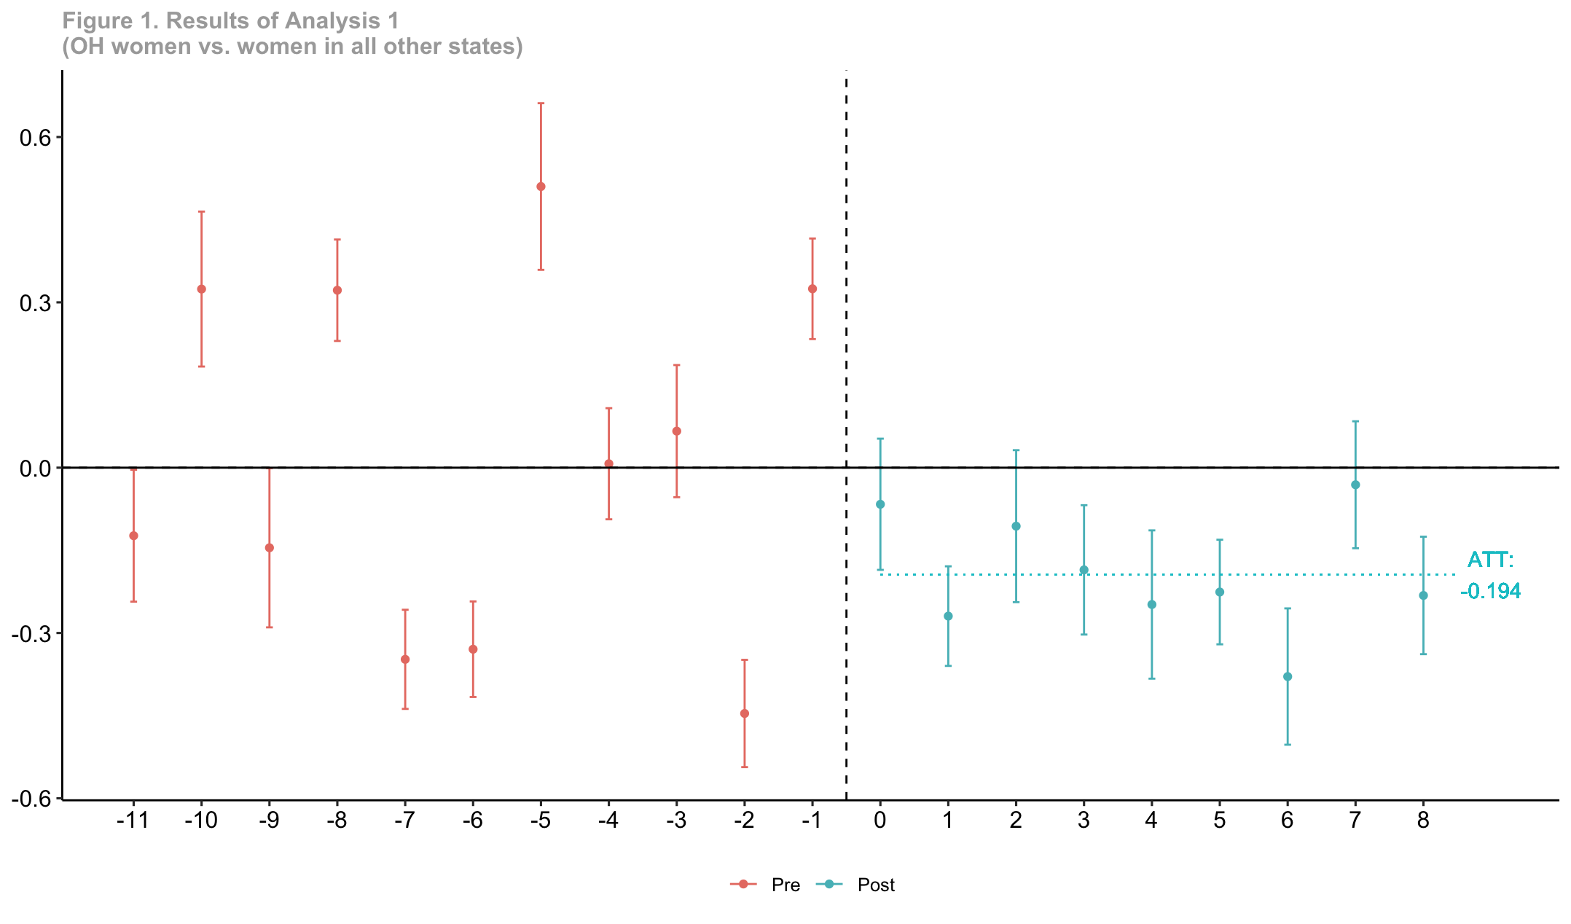
Results
Notes:
Change the dotted line

Slide 12
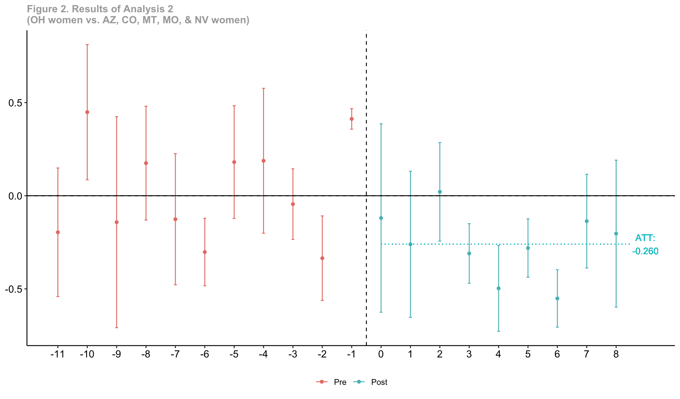
Results

Slide 13
Research Question
Did the passage of a constitutional amendment protecting the right to abortion improve the mental health of women in Ohio?
Yes – PHQ-4 scores were reduced by about 0.2 points
Thornburg, et al. (2024) report that the Dobbs decision increased women’s PHQ-4 scores by about 0.11 points

Slide 14
Implications
When abortion is “left up to the states,” diverging realities between states become more important
Action on this issue can have tangible positive results
Importance of direct participation in governance

Slide 15
Thank you!

Slide 16
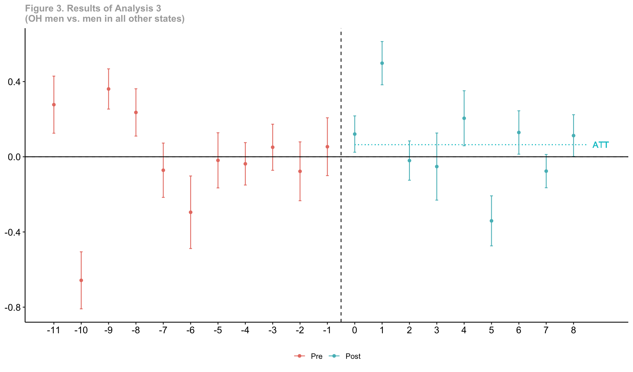
Supplemental Analyses: Men

Slide 17
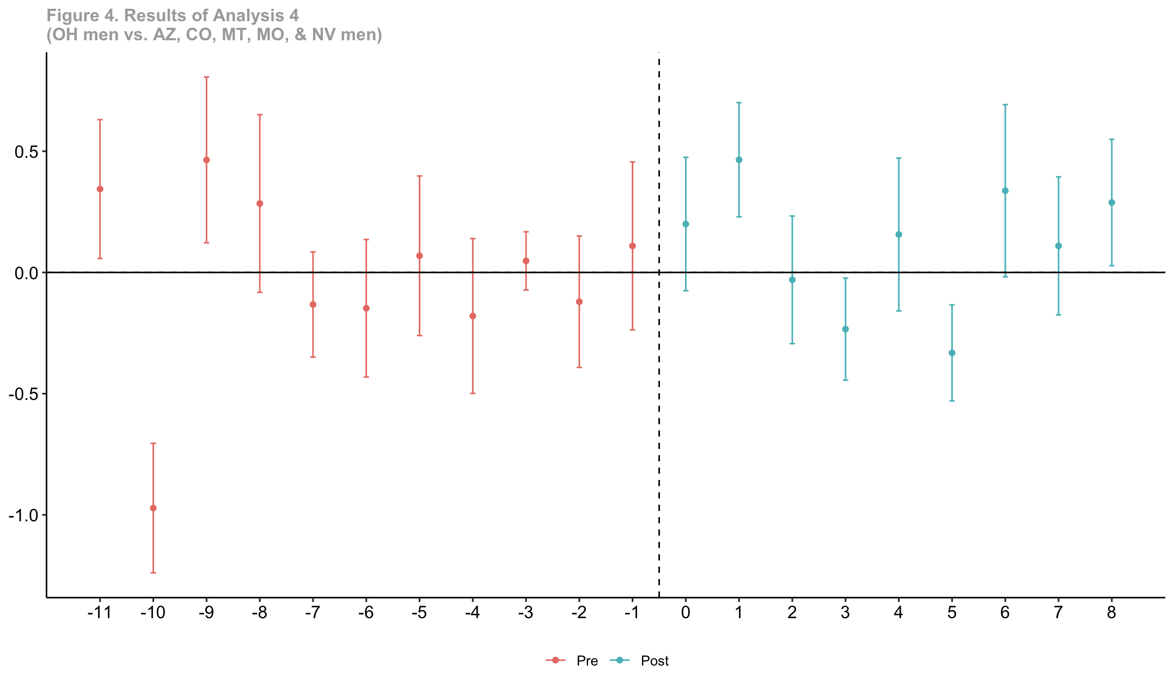
Supplemental Analyses: Men

Slide 18
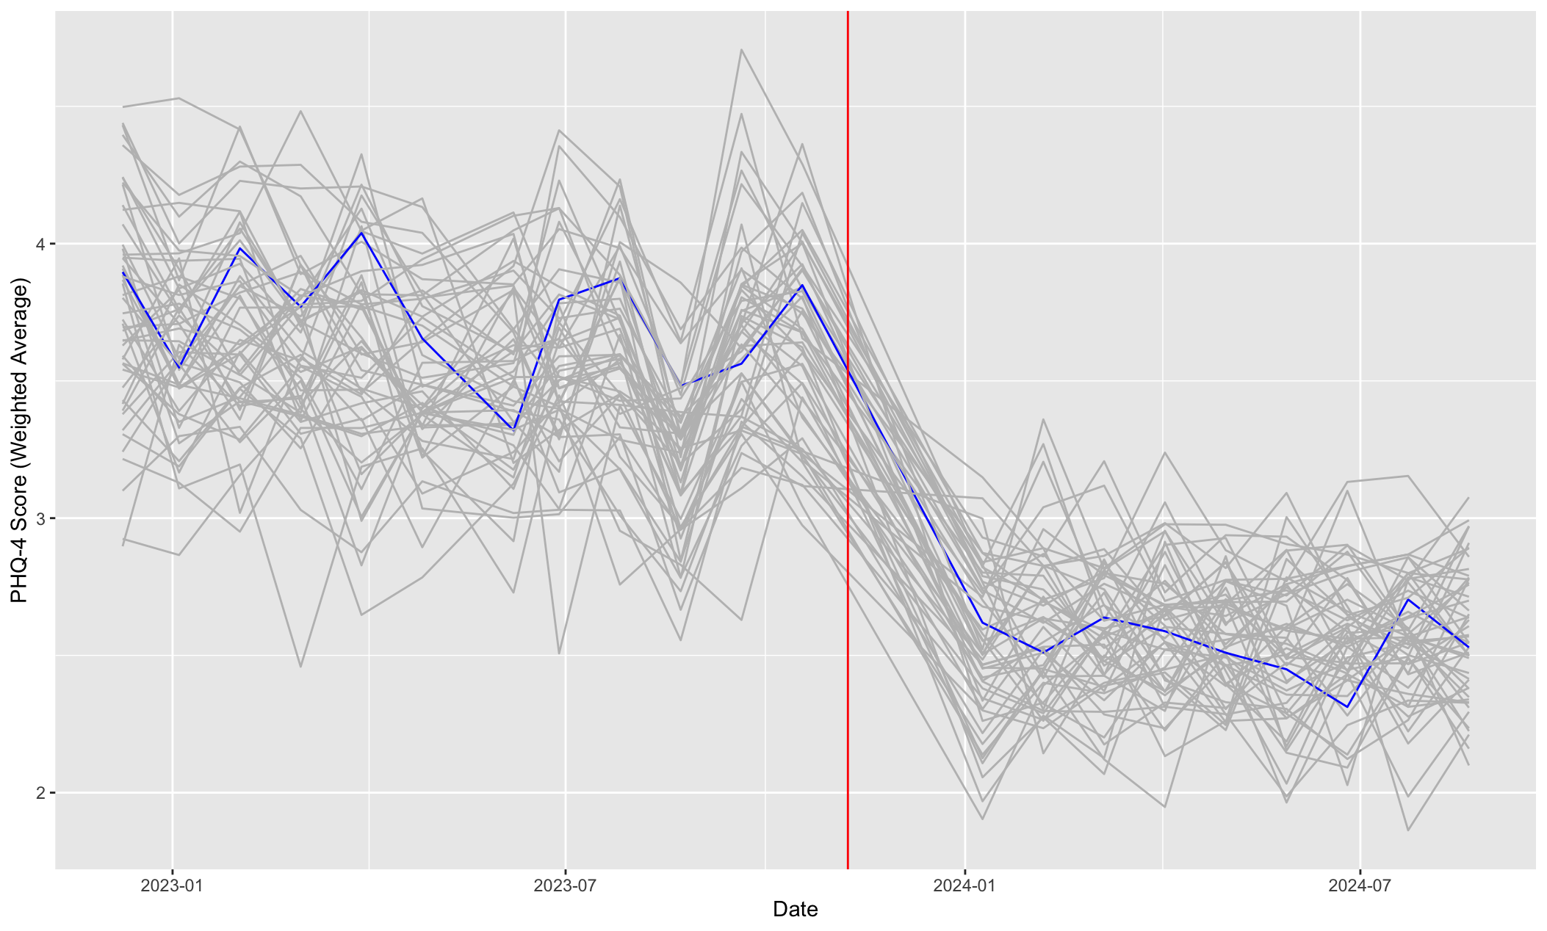
Descriptives

Slide 19
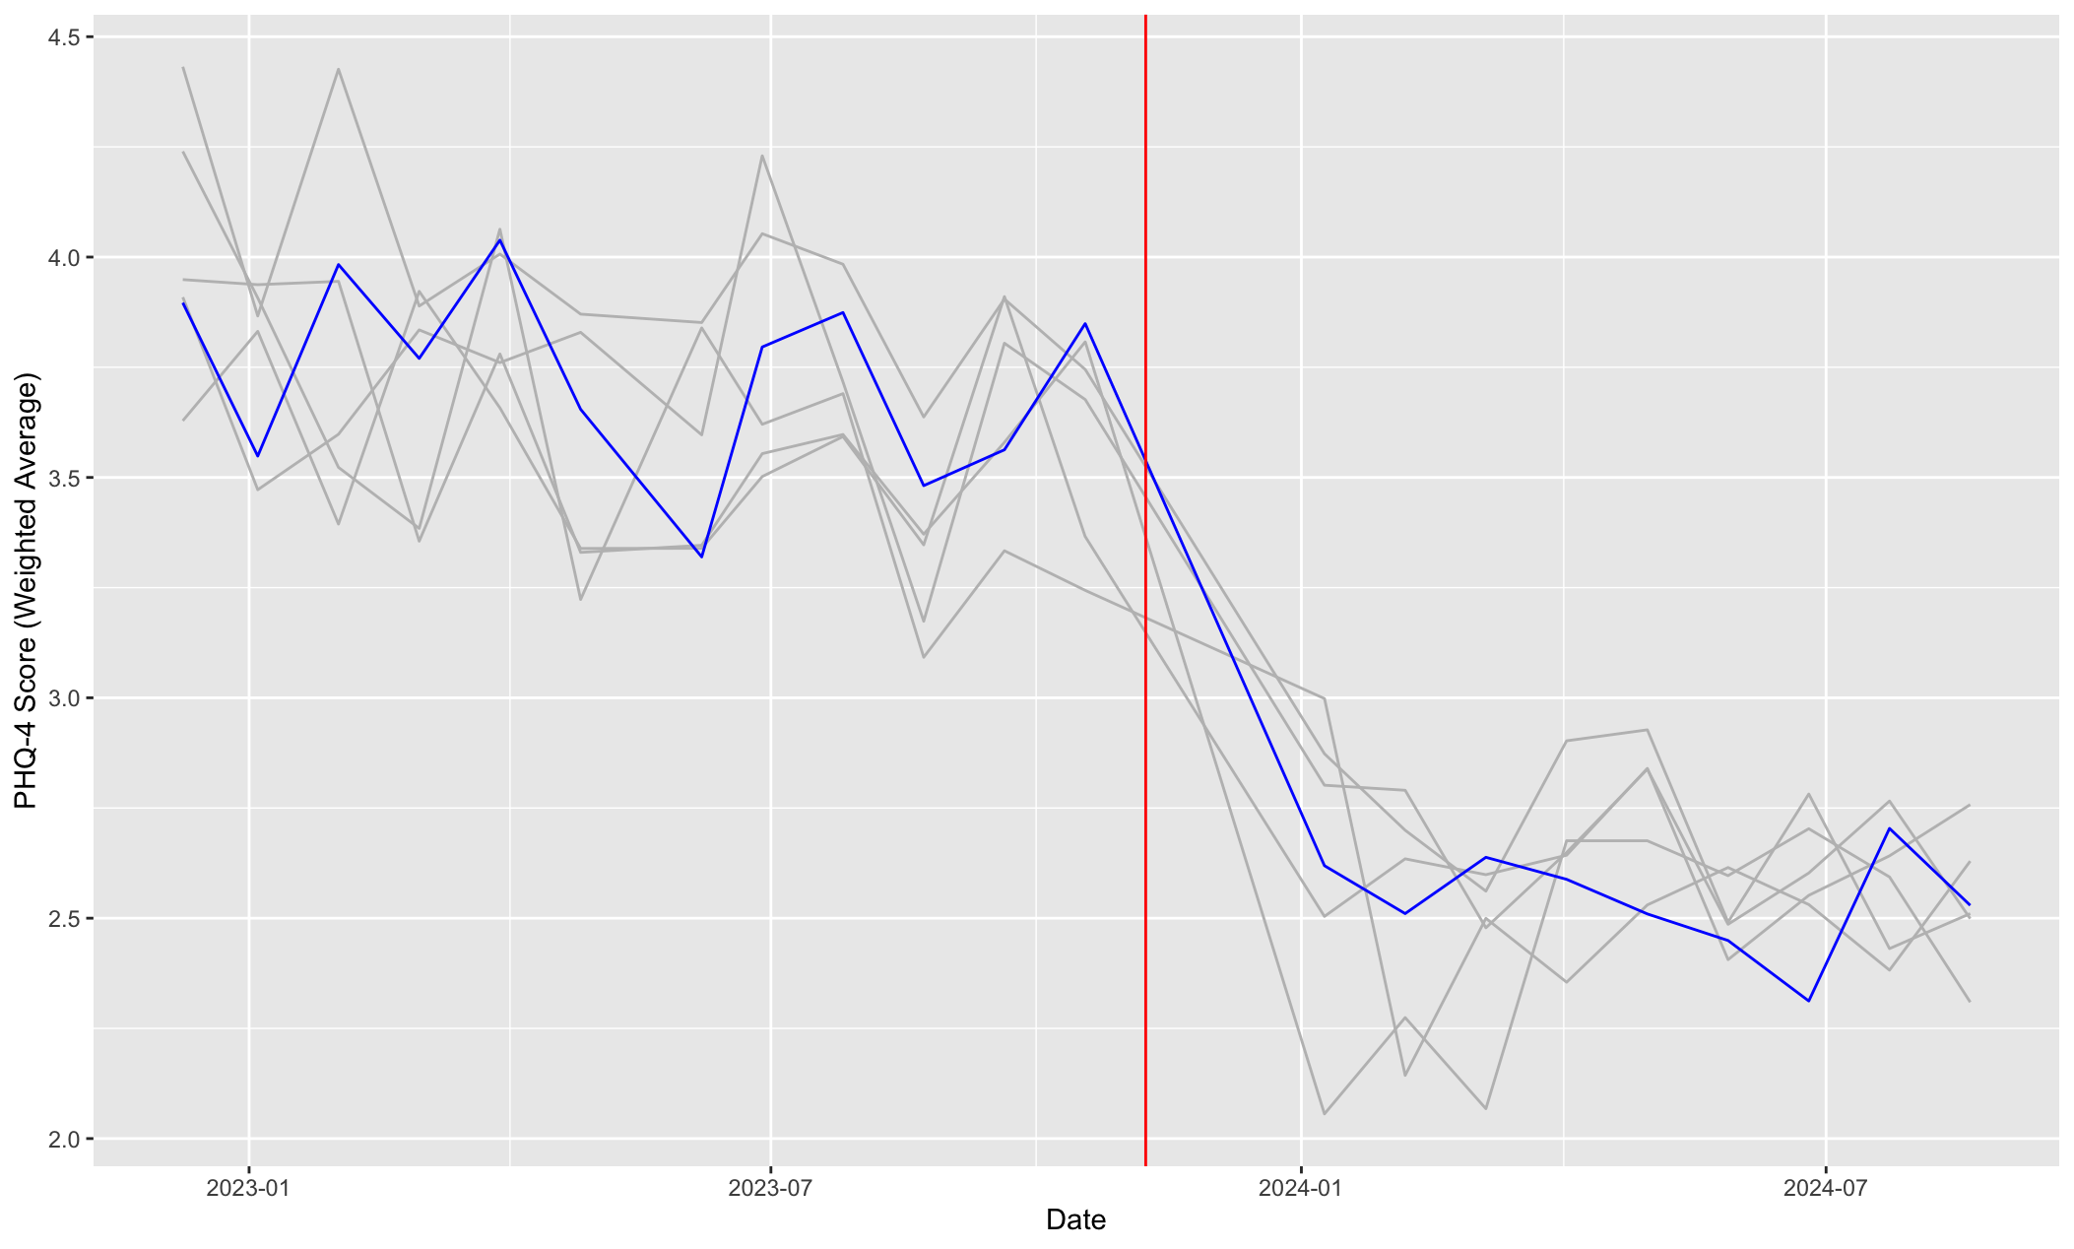
Descriptives

Slide 20
Why Ohio?
In November 2023, Ohio passed Issue 1, a citizen-initiated constitutional amendment protecting the right to abortion
Initial petition (1,000 signatures)
Signature collection (at least 44 of 88 counties; each of those counties need at least 5% of their voting population to sign; total must be at least 10% of the voting population)
General election (simple majority)

