Slide 1
Anti-Trans Laws and Mental Health
AP Pittman
Department of Sociology
DOHA Seminar 04/23/25

Slide 2
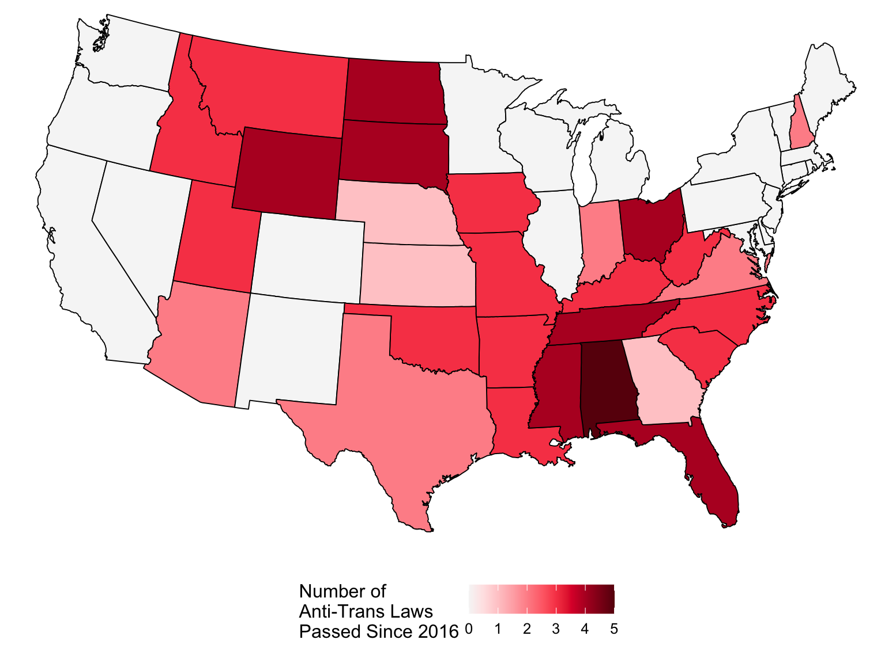
Motivation

Slide 3
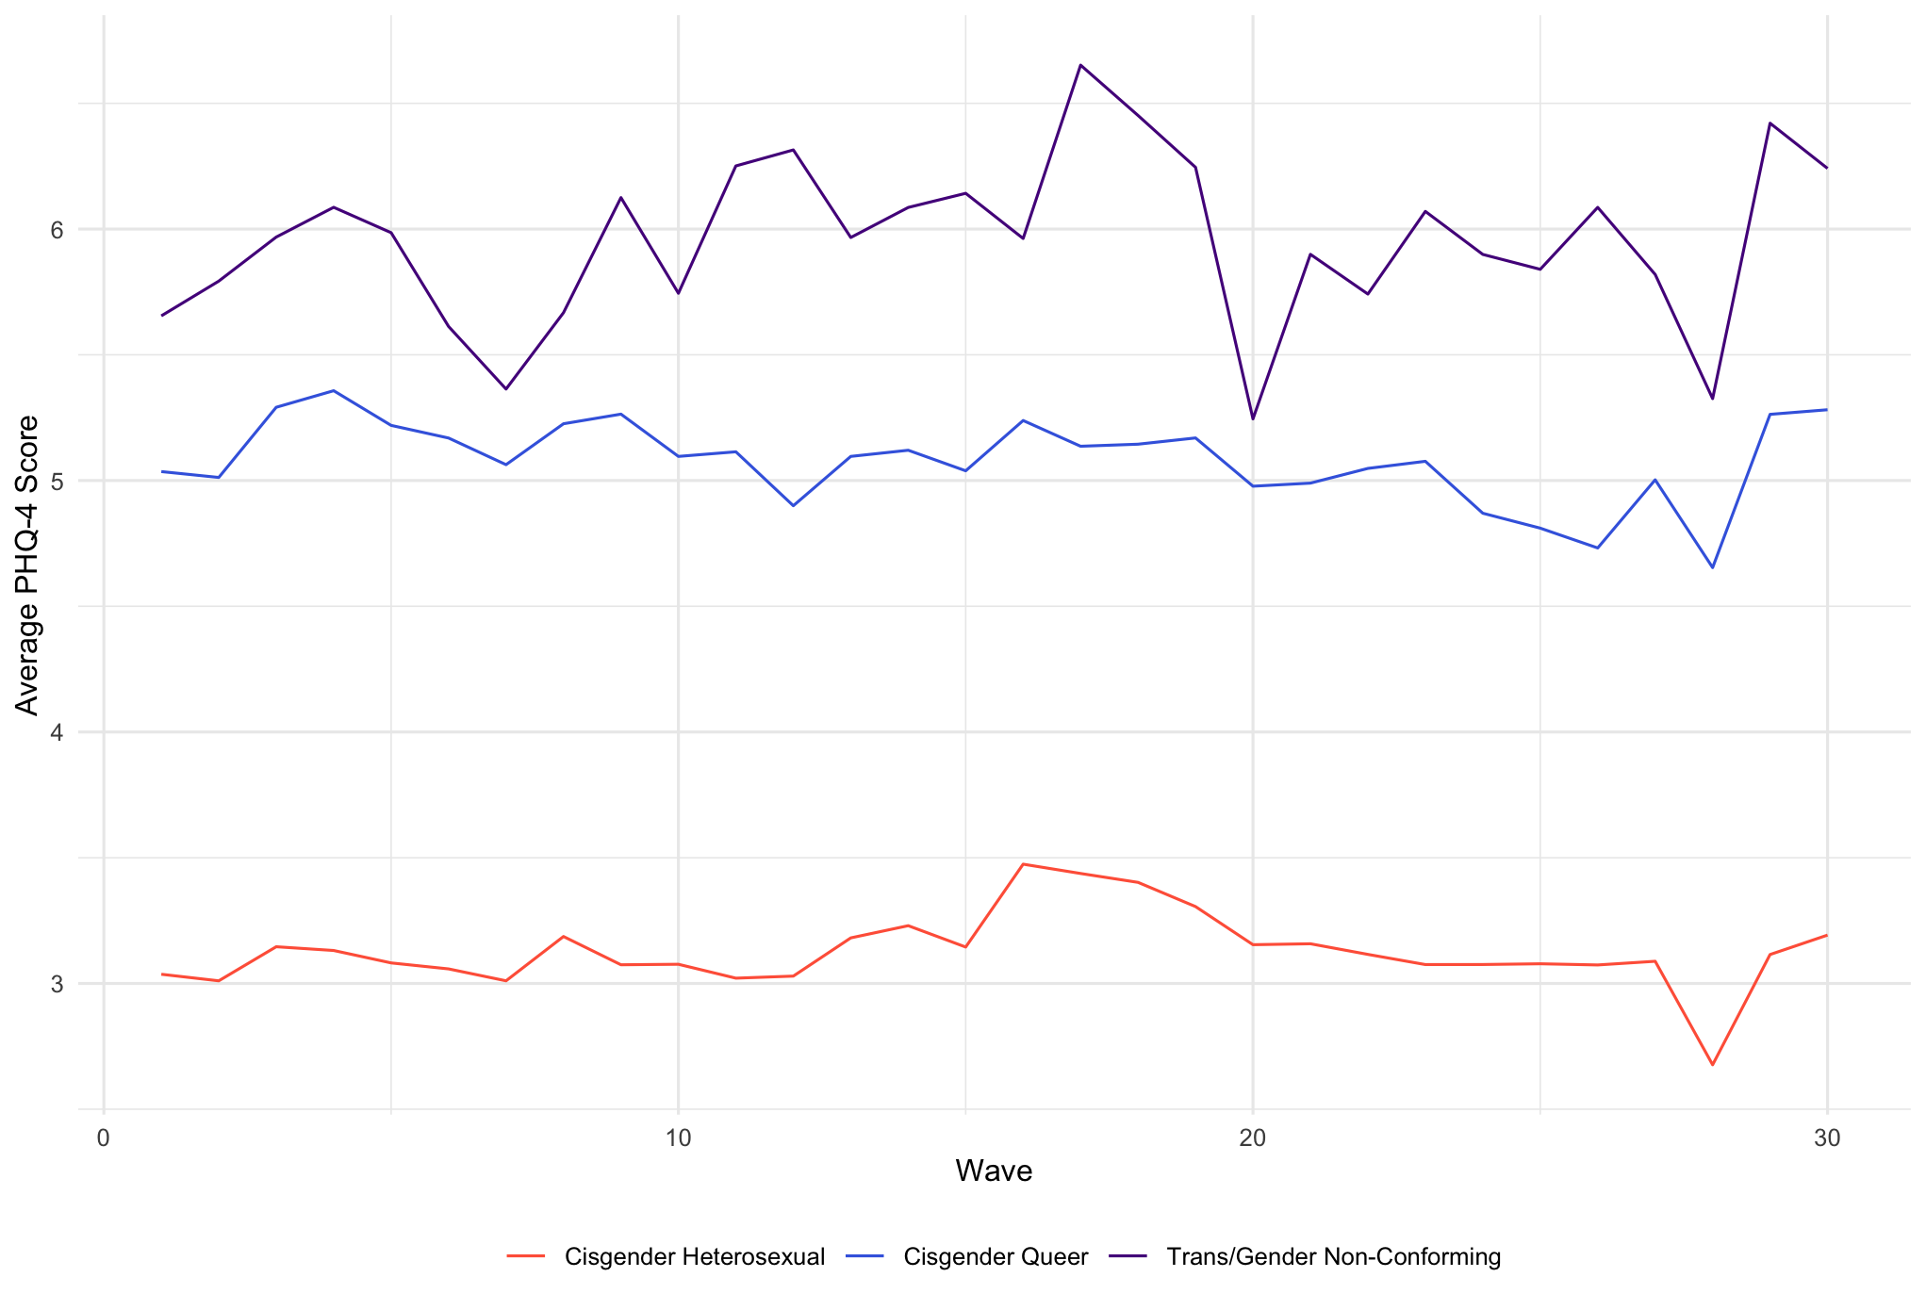
Motivation

Slide 4
Motivation: Theory
Open question in sociology: how do trans/gender non-conforming folks fit into our theories of structural oppression?
Structural sexism (Homan, 2019)
Structural stigma (Hatzenbuehler, 2016)
Structural cisheterosexism (Zubizarreta et al., 2024)

Slide 5
Research Questions
How do anti-trans policies impact the mental health of trans and gender non-conforming folks at the population level?
Are the effects of these structural changes different for trans/gender non-conforming folks than for cisgender queer folks? For women?

Slide 6
Data
Movement Advancement Project
Anti-trans laws passed in three domains: bathroom bills, sports bills, and medical care bills
Census Bureau’s Household Pulse Survey
Mental health (PHQ-4)

Slide 7
Data: Continued
Anti-Trans Laws
Looking at the effect of the first anti-trans law to pass in a state
16 states passed their first anti-trans law during the study period (Alaska, Arizona, Georgia, Iowa, Indiana, Kentucky, Louisiana, Missouri, North Dakota, Nebraska, Oklahoma, South Carolina, Texas, Utah, Virginia, Wyoming)
HPS
Waves 34-63
approximately monthly, from July 2021 through October 2023
Analysis 1: 51k people, of whom 8k were trans or gender non-conforming
Analysis 2: 679k people, of whom 72k were queer
Analysis 3: 746k people, of whom 429k were AFAB

Slide 8
Method
Difference-in-differences with multiple treatment groups (Calloway & Sant’Anna)
Event-study treatment effect aggregation
 | Analysis 1 | Analysis 2 | Analysis 3
Treatment Group | Trans/GNC | Queer | Women
Comparison Group | Cisgender LGBQ | Non-queer | Men

Slide 9
Results
The first anti-trans law passed in a state increases the PHQ-4 score of transgender / gender non-conforming people in that state by 1.42 points relative to their cisgender queer counterparts. There is no detectable effect on queer people relative to cisgender heterosexual people, nor on women relative to men.

Slide 10
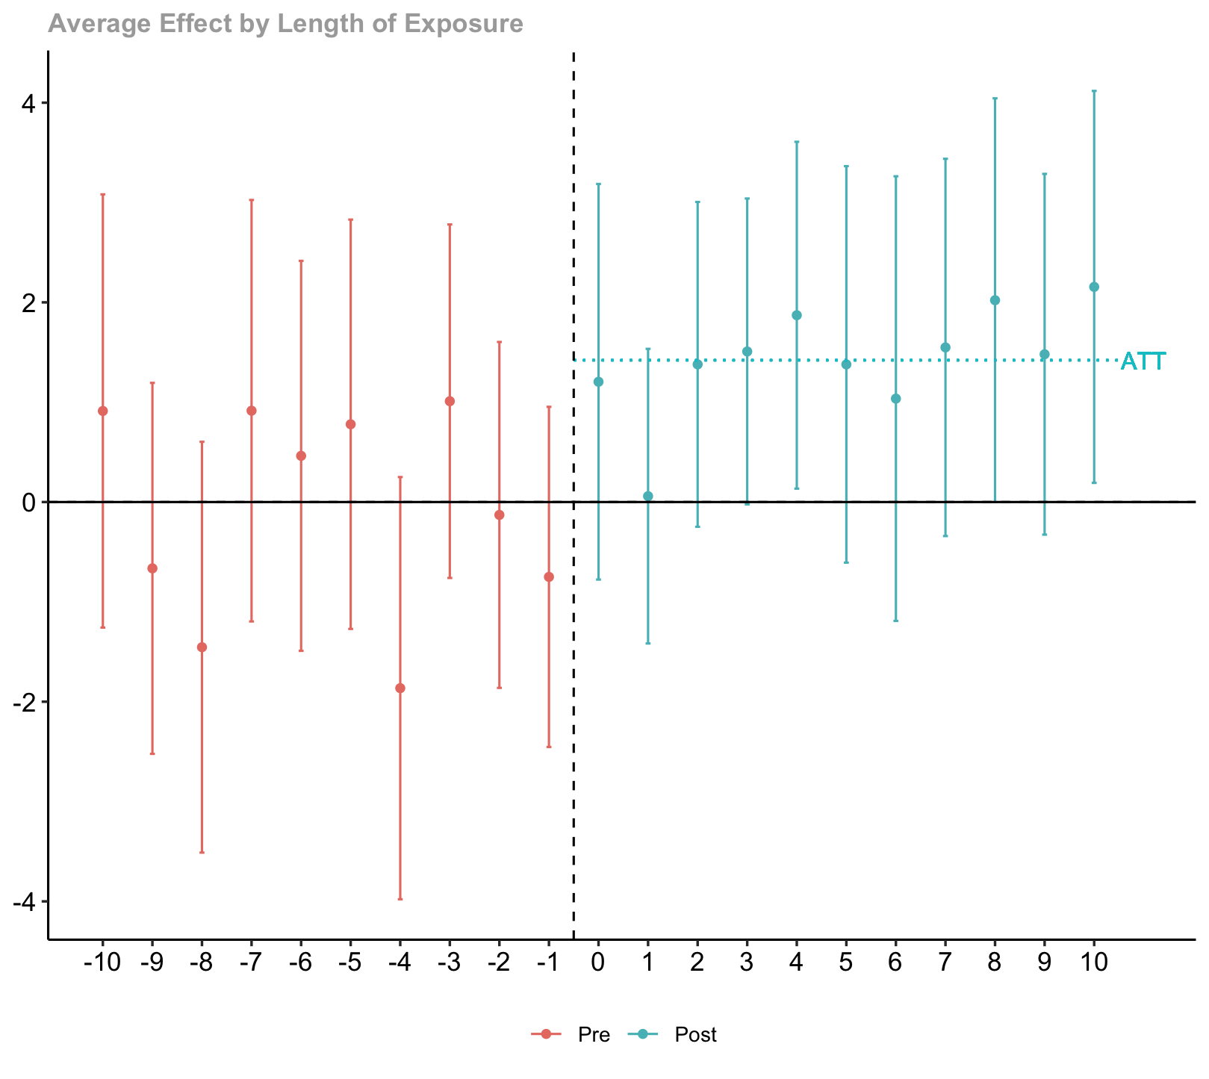

Slide 11
Discussion
Tangible negative health effect of anti-trans laws
The difference is not only statistically significant, but practically meaningful
Shield laws?

Slide 12
Thank you!

Slide 13
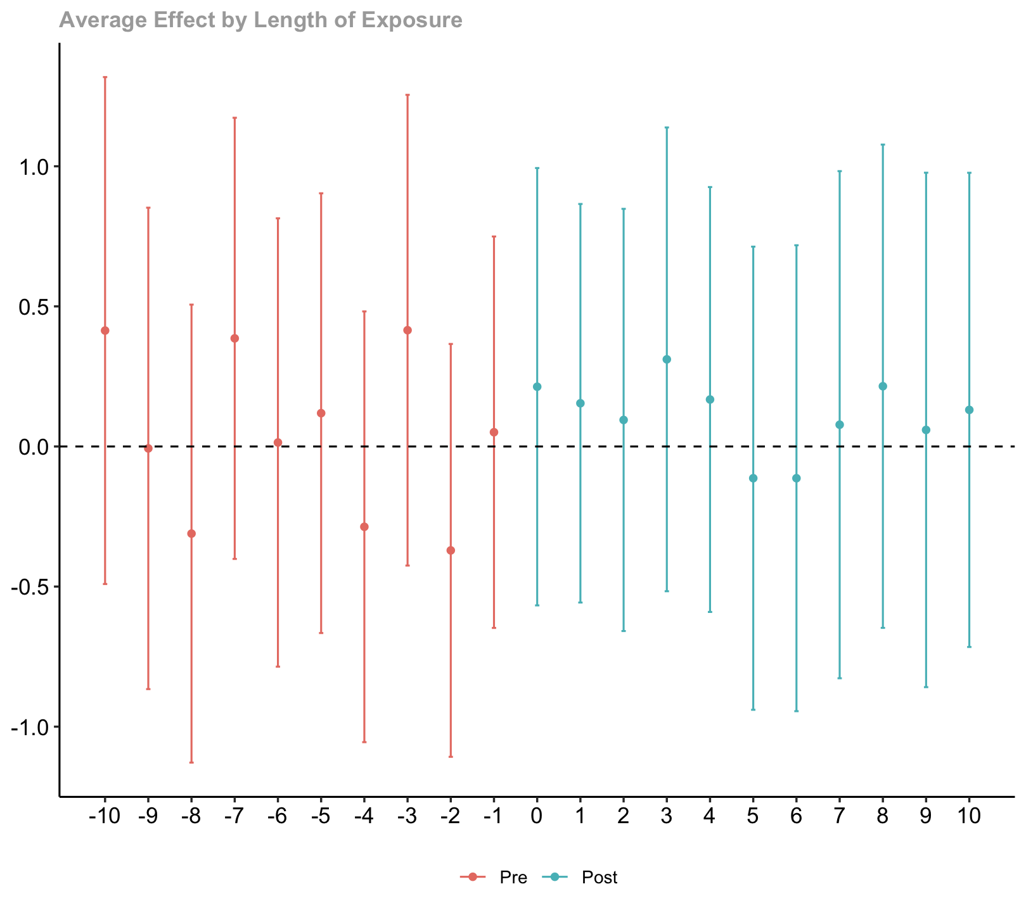
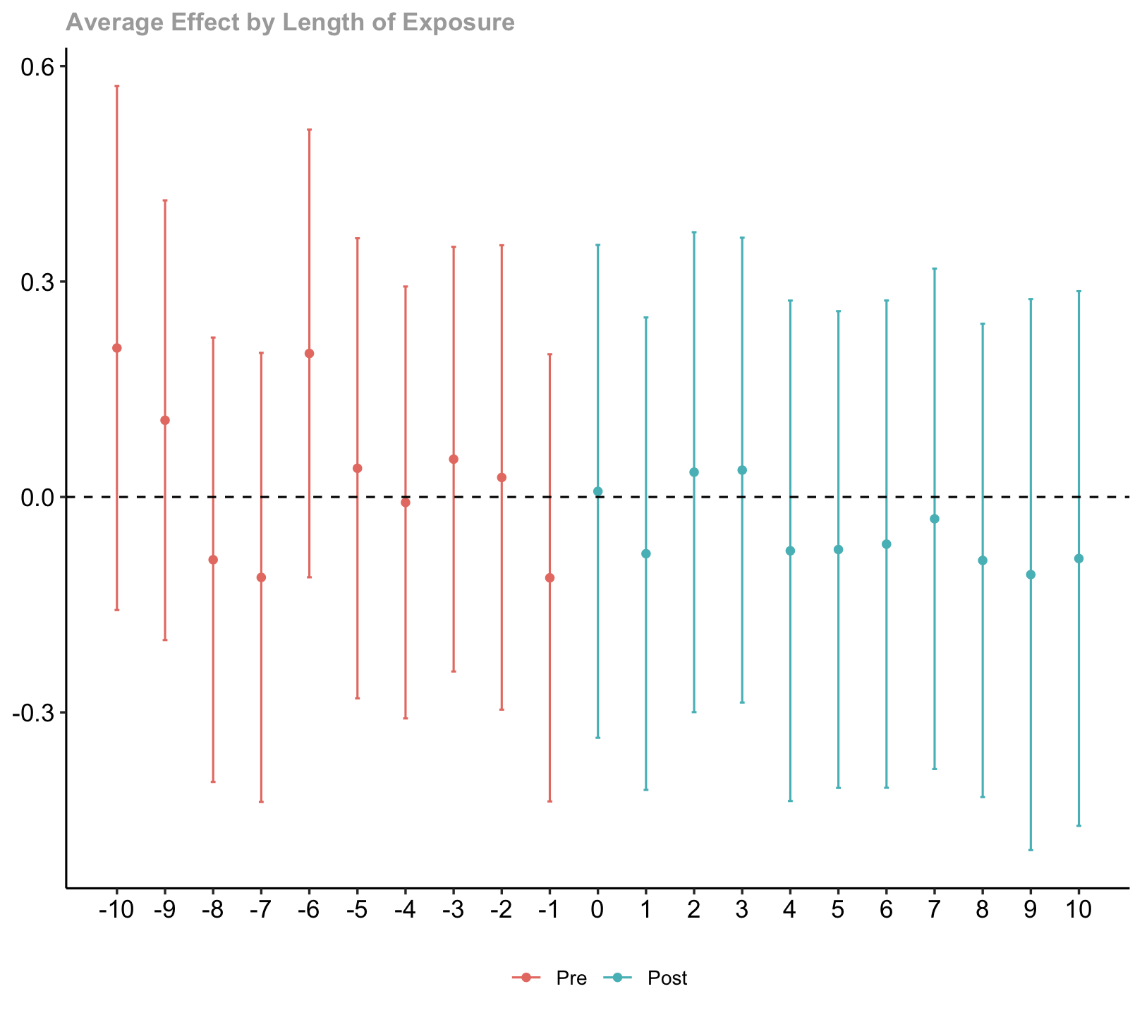
Boring Results
Queer Folks
Women

