Slide 1


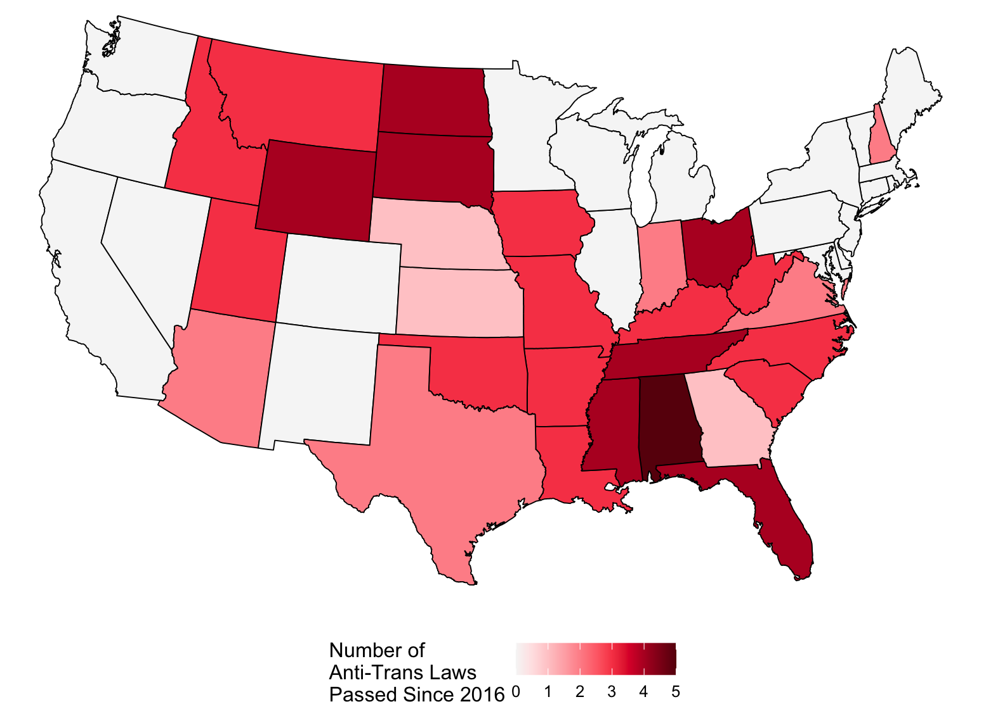
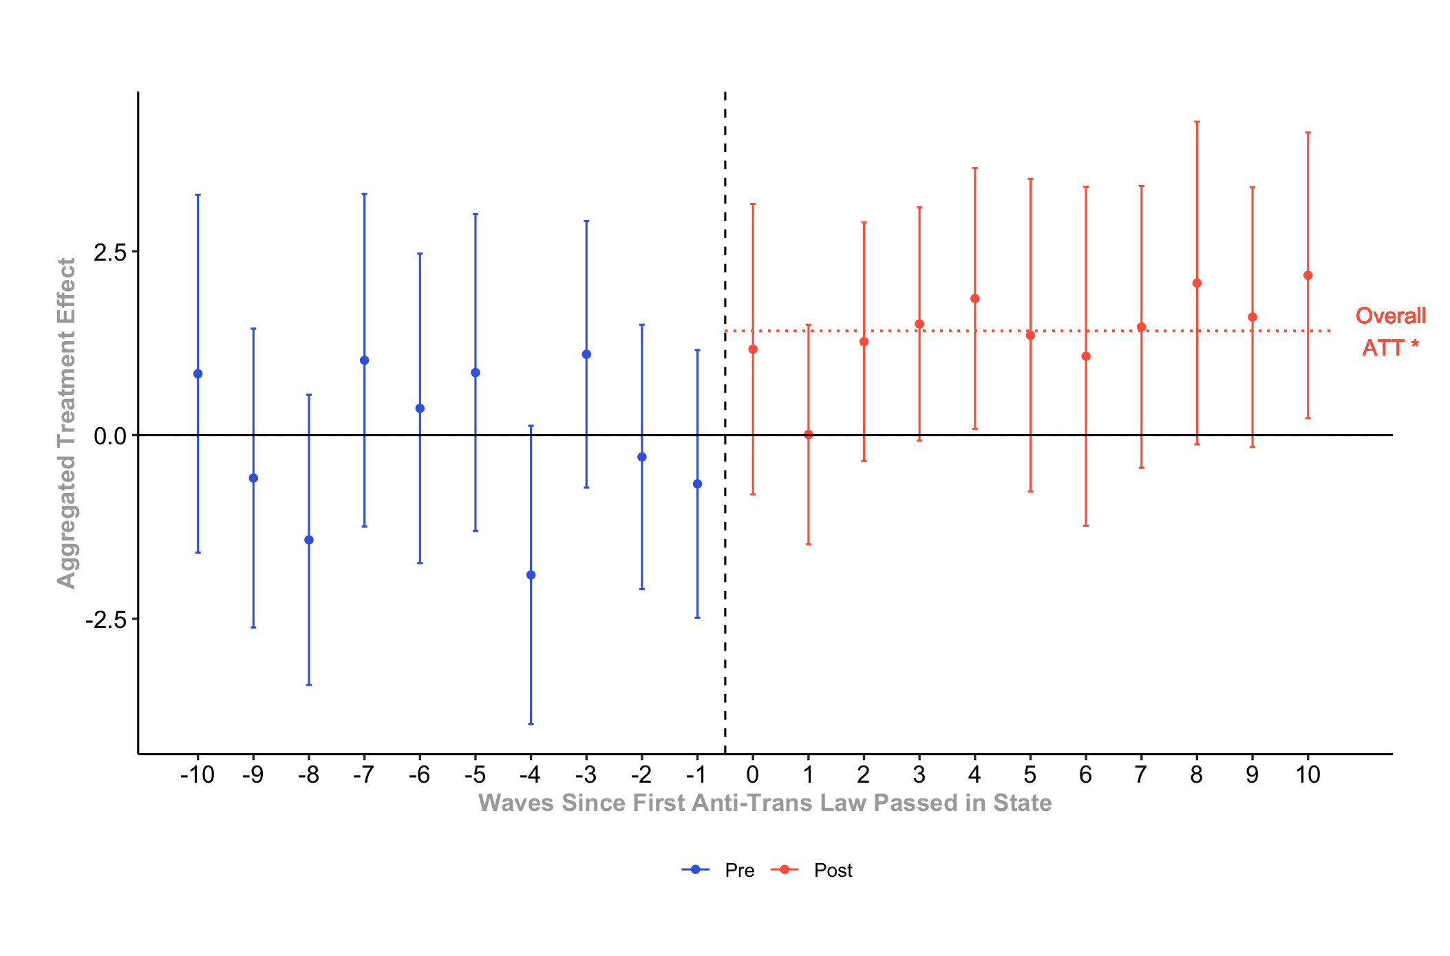
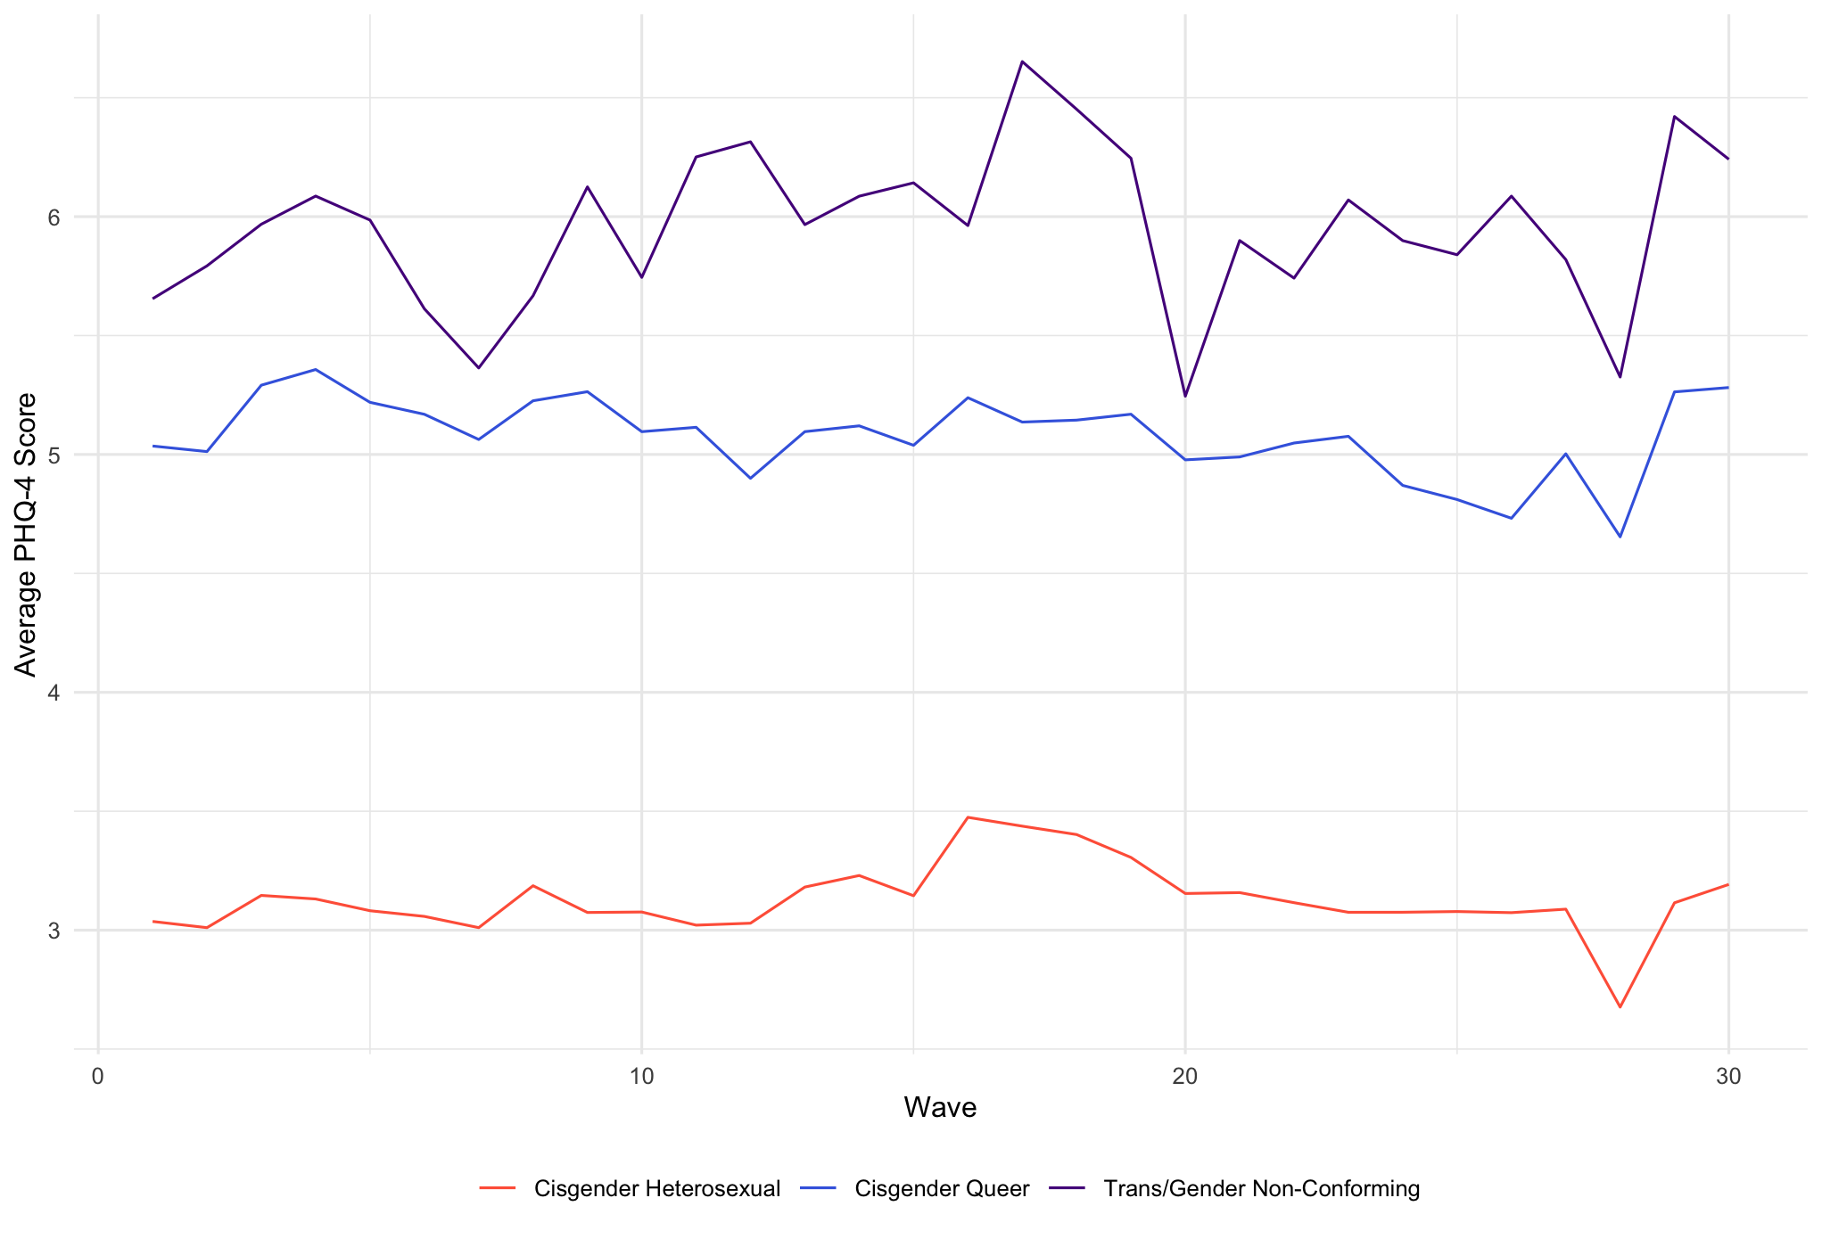



Github repository:
Anti-Trans Laws and Mental Health
AP Pittman, PhD Candidate
Department of Sociology, Duke University
Donate to Trans LifeLine:
ap.r.pittman@gmail.com
ap.pittman@duke.edu
Motivation
Method
Results
Staggered difference-in-differences, following best practices for multiple treatment groups
Weighted via Census-provided person-weights
Dynamic treatment effect aggregation
How do trans/GNC people fit into theories of structural oppression?
Are they included in structural patriarchy, structural sexism, or structural heterosexism? Do they experience similar enough realities to the rest of the queer community to be lumped together with them, or should they be considered separately?
How can we understand the recent flood of anti-trans laws, and quantify their impact?
The first anti-trans law passed in a state increases the PHQ-4 score of transgender / gender non-conforming people in that state by 1.42 points relative to their cisgender queer counterparts.
Data
Discussion
Predictor Data: Movement Advancement Project
Compiled a list of anti-trans laws passed and when they were passed
Three domains: bathroom/facility restrictions, medical restrictions, and sports bans
Trans folks, although part of the LGBTQ+ community, are affected above and beyond their community members by the recent trend in legislation targeting trans people
How does the passage of these laws affect cis LGBQ+ folks? Women? Is this part of a larger gender-essentialist movement?
Does the passage of shield laws produce the inverse effect?
Outcome Data: Census Bureau’s Household Pulse Survey
30 waves between July 2021 and October 2023 (approx. monthly)
About 158,000 observations of queer & trans/GNC residents (repeated cross-sectional)
PHQ-4 indicators (feeling anxious, feeling worried, losing interest in previously enjoyed activities, feeling down)
Gender & sexuality data, as well as state of residence

