Slide 1
Visual Perception & Cognitive Load
## Data Types, Encodings & Grammar of Graphics
## Python Visualization Fundamentals

Slide 2
Slide 1 – Class Overview
Today's Learning Objectives
Understand how humans perceive visual information
Learn about cognitive load and its impact on visualization design
Master data types and their valid visual encodings
Explore the Grammar of Graphics framework
Implement visualizations using Python (Matplotlib, Seaborn)
Apply perceptual principles to create effective visualizations
Course Context: Building on Week 2's Python introduction

Slide 3
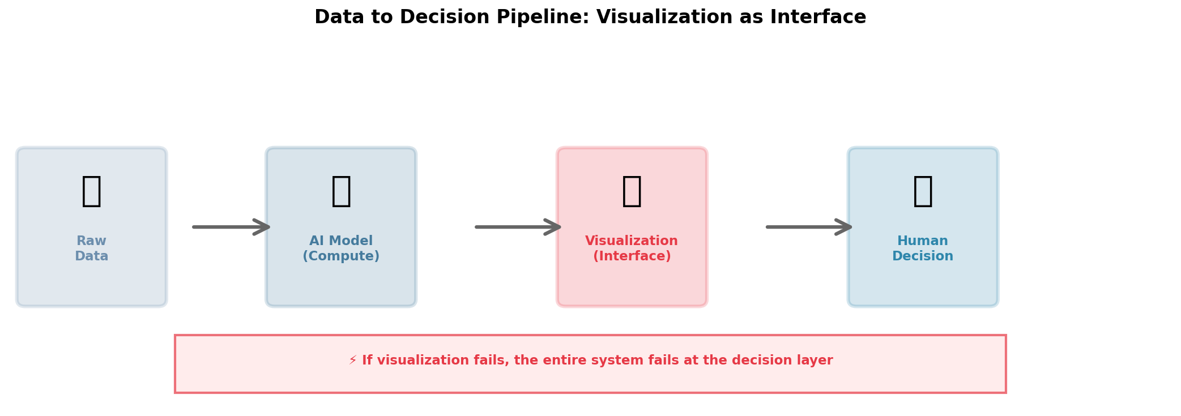
Slide 2 – Why Visualization Matters in Data Science

Slide 4
Slide 3 – Visualization as a Human–AI Interface
In modern analytics and AI systems:
```
┌─────────────┐ ┌──────────────┐ ┌─────────────┐
│ Raw Data │ → │ AI Model │ → │Visualization│ → Human Decision
│ │ │ (Compute) │ │ (Interface)│
└─────────────┘ └──────────────┘ └─────────────┘
```
Models compute predictions
Humans make decisions
Visualization is the critical translation layer
Human perceptual limits become system constraints
Key Insight: If the visualization fails, the entire system fails at the decision layer.

Slide 5
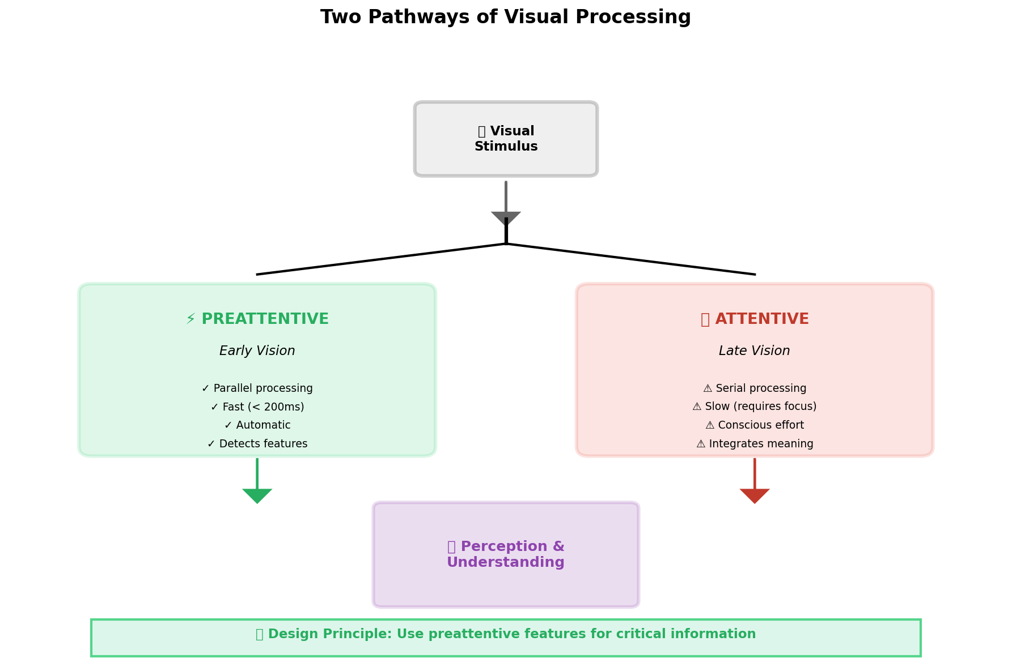
Slide 4 – The Two Pathways of Visual Processing

Slide 6
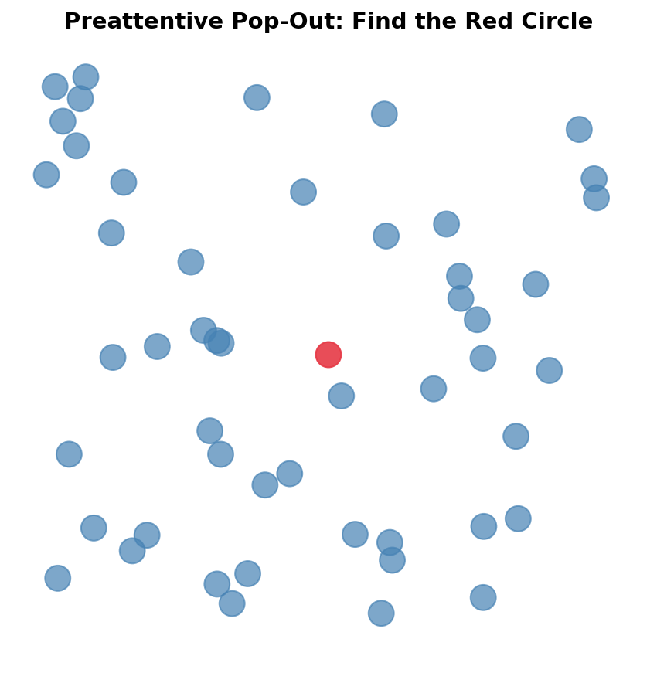
Slide 5 – Preattentive Processing: The 200ms Window

Slide 7
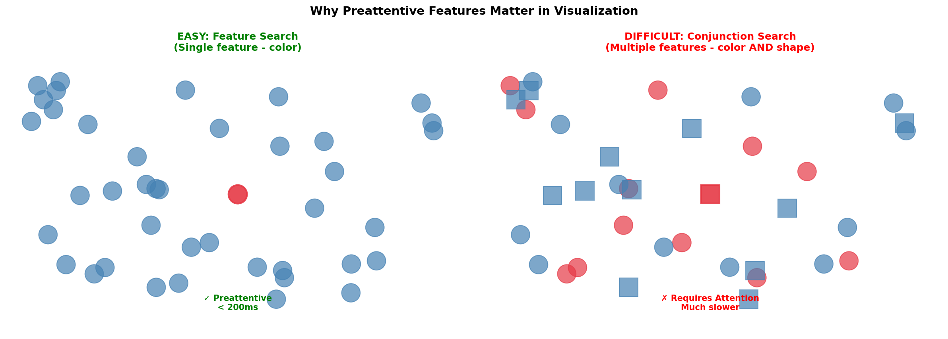
Slide 6 – Demonstrating Preattentive Processing

Slide 8
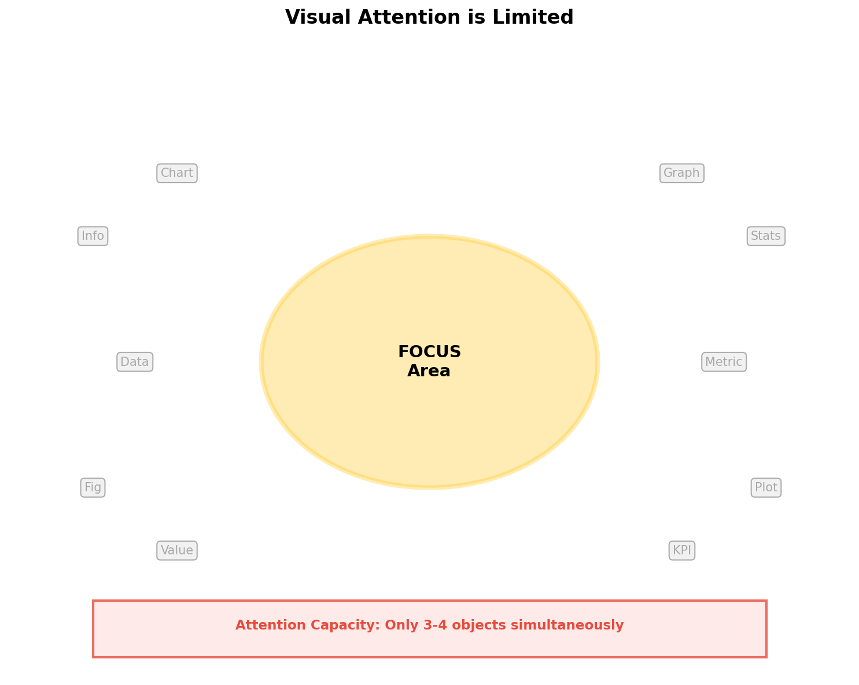
Slide 7 – Visual Attention is Limited

Slide 9
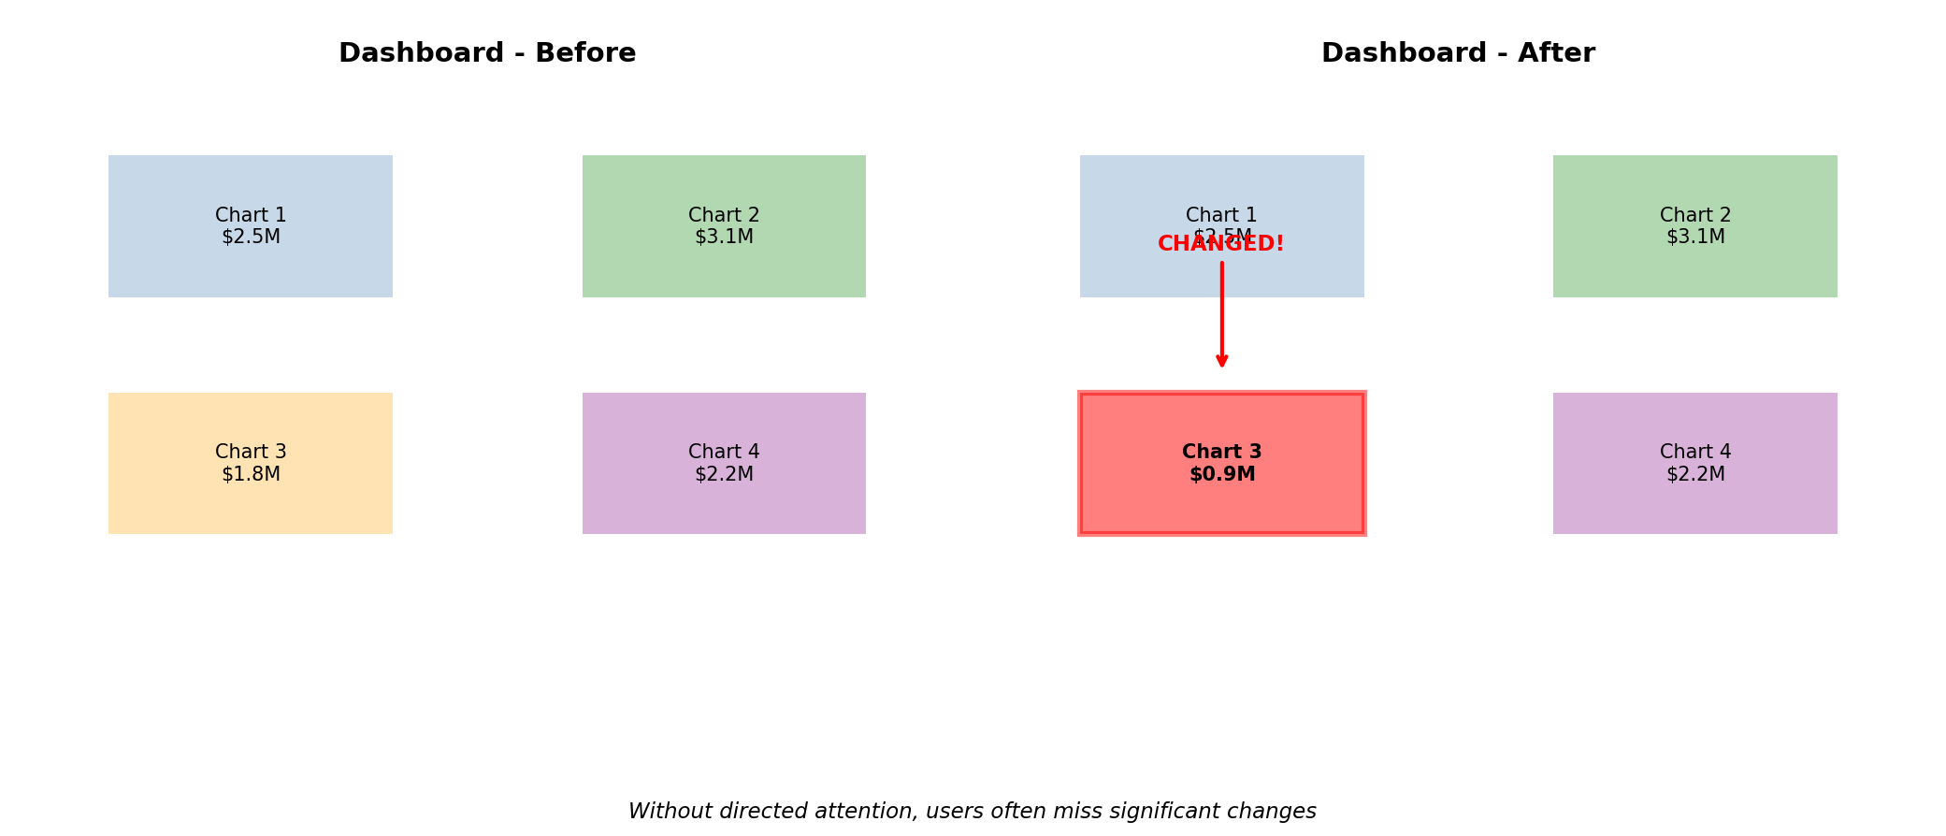
Slide 8 – Change Blindness

Slide 10
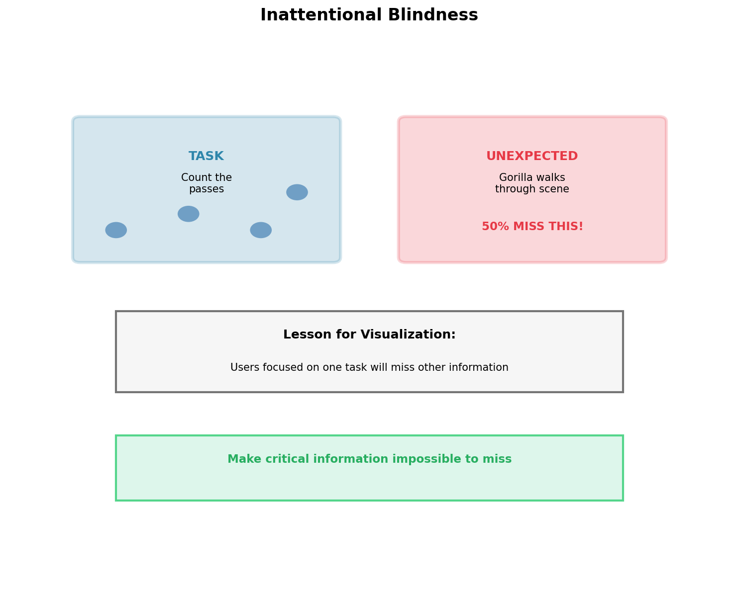
Slide 9 – Inattentional Blindness: The Invisible Gorilla

Slide 11
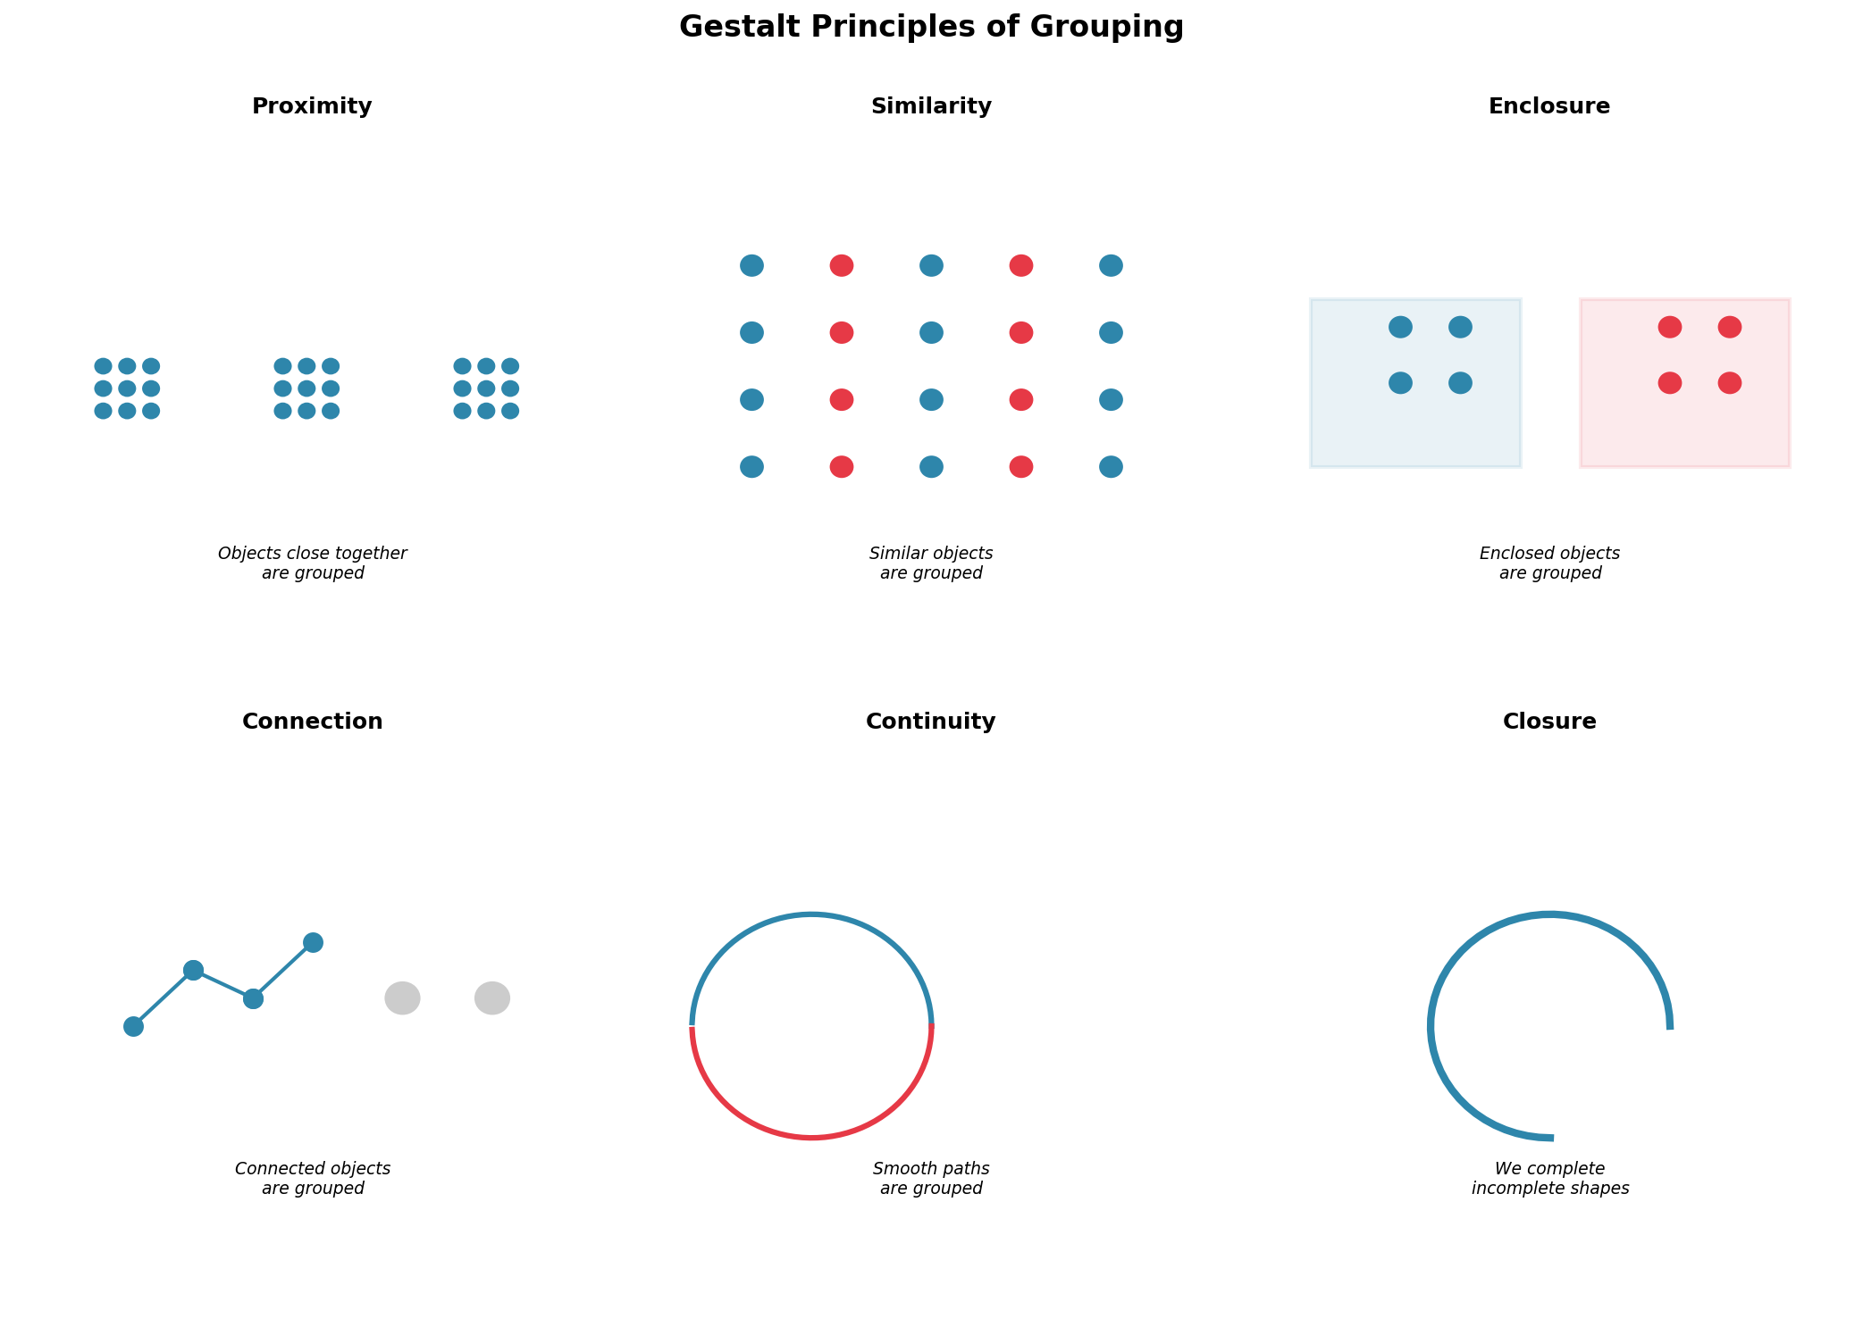
Slide 10 – Gestalt Principles: How We Group Information

Slide 12
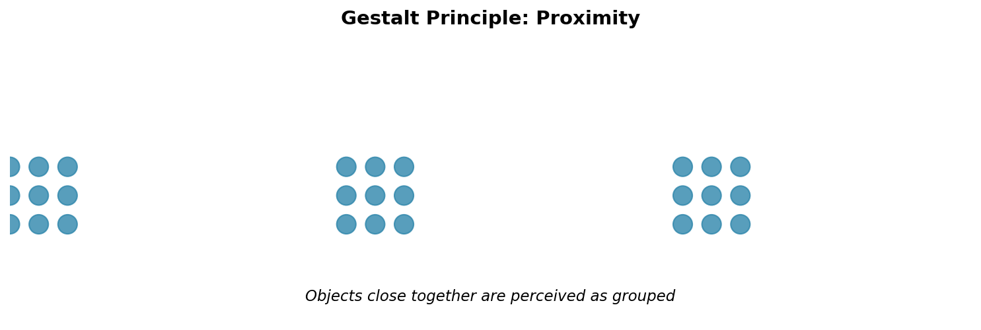
Slide 11 – Gestalt Principle: Proximity

Slide 13
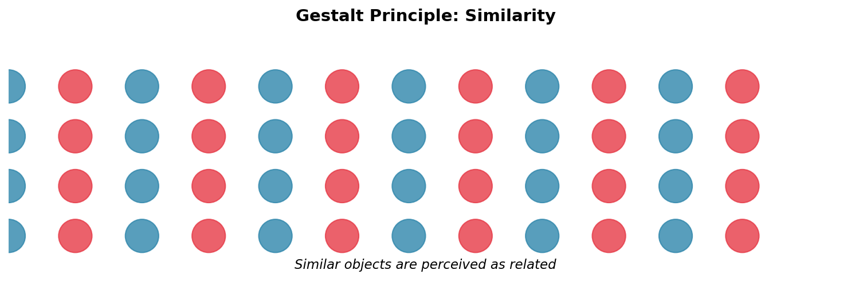
Slide 12 – Gestalt Principle: Similarity

Slide 14
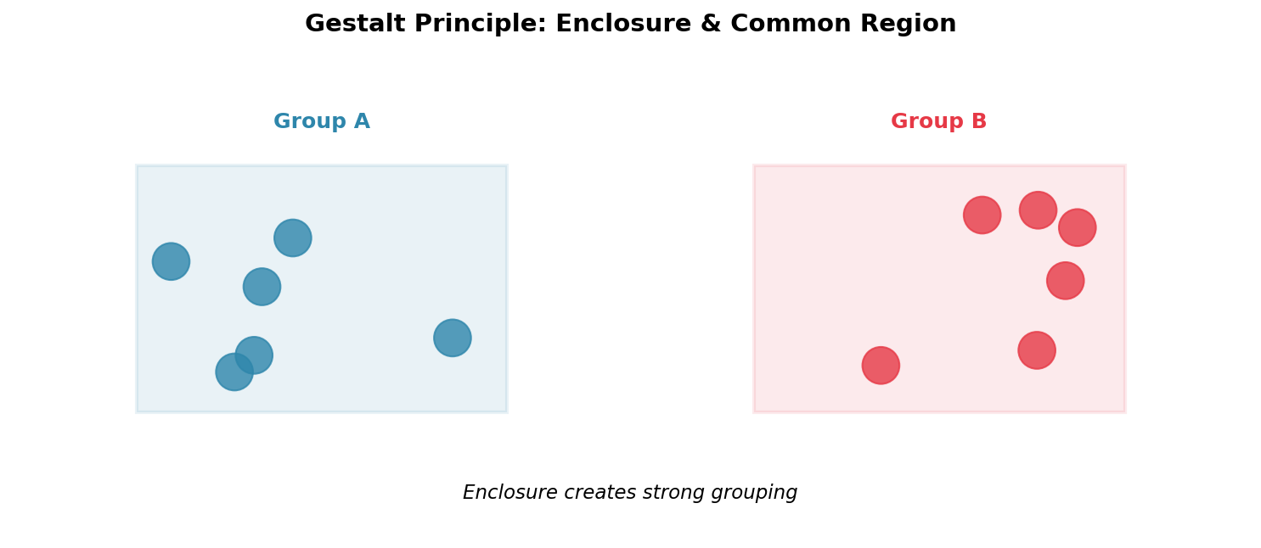
Slide 13 – Gestalt Principle: Enclosure & Common Region

Slide 15
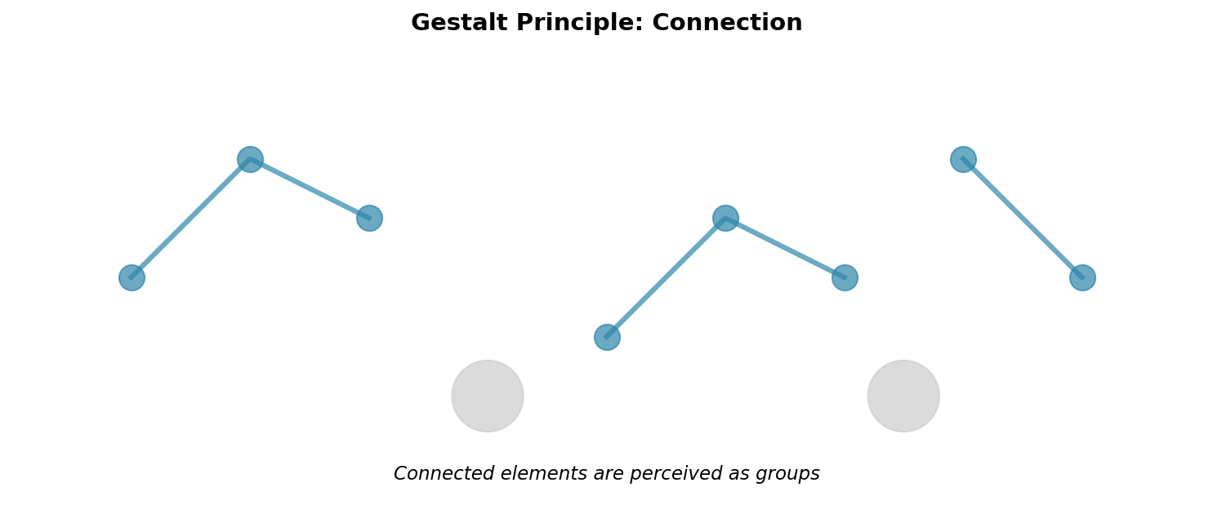
Slide 14 – Gestalt Principle: Connection

Slide 16
Slide 15 – Gestalt and Dashboard Design Mistakes
Common failures when Gestalt principles are ignored:
[X] Random layout: Elements scattered without visual hierarchy
[X] Inconsistent spacing: Creates accidental groups
[X] Color chaos: Similar colors used for unrelated data
[X] Over-boxing: Everything has a border, nothing stands out
[X] No whitespace: Cognitive overload
[OK] Good dashboard design:
Clear visual hierarchy through proximity and enclosure
Consistent use of similarity within groups
Strategic whitespace guides attention
Visual grouping matches logical relationships

Slide 17
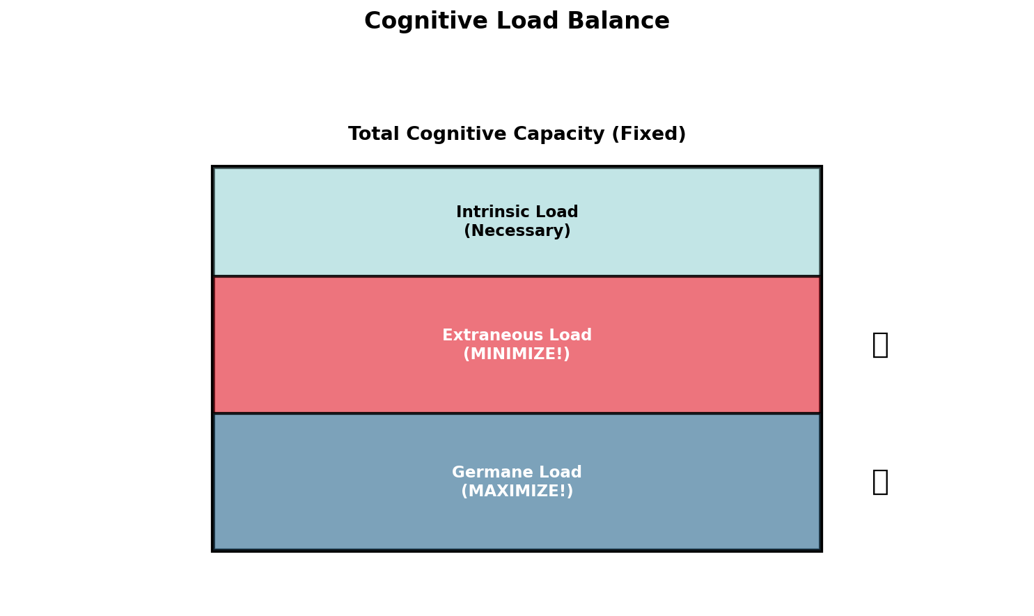
Slide 16 – Introduction to Cognitive Load Theory

Slide 18
Slide 17 – Intrinsic Load: Inherent Complexity
Intrinsic load comes from:
Data complexity (volume, dimensionality)
Task complexity (comparison, correlation, prediction)
Domain complexity (specialized knowledge required)
You cannot eliminate intrinsic load, but you can manage it:
[OK] Staging: Break complex tasks into steps
[OK] Scaffolding: Provide context and guides
[OK] Progressive disclosure: Show detail on demand
[OK] Hierarchy: Present overview first, details later
Example:
[X] Showing 50 variables at once → overwhelming
[OK] Showing top 10, with option to explore more → manageable

Slide 19
Slide 18 – Extraneous Load: Unnecessary Complexity
Extraneous load comes from poor design choices:
[X] Chart junk (decorative elements)
[X] 3D effects with no purpose
[X] Cluttered layouts
[X] Inconsistent encodings
[X] Poor color choices
[X] Missing labels or legends
[X] Excessive animation
These add NO value but consume cognitive resources
The solution: Ruthlessly eliminate extraneous load
> "Perfection is achieved not when there is nothing more to add, but when there is nothing left to take away." — Antoine de Saint-Exupéry

Slide 20
Slide 19 – Germane Load: Productive Mental Effort
Germane load supports:
Understanding patterns
Making comparisons
Drawing insights
Building mental models
Learning relationships
How to maximize germane load:
[OK] Clear visual hierarchy guides thinking
[OK] Comparisons are easy (aligned scales)
[OK] Patterns pop out (preattentive features)
[OK] Context is provided (annotations, benchmarks)
[OK] User can explore (interactive elements)
The goal: All cognitive effort goes toward insight, not decoding the chart.

Slide 21
Slide 20 – The Cognitive Load Balance
Visualization design as optimization:
```
Total Cognitive Capacity (Fixed)
┌────────────────────────────────────┐
│ Intrinsic Load (Necessary) │
├────────────────────────────────────┤
│ Extraneous Load (MINIMIZE THIS!) │ ← Bad design
├────────────────────────────────────┤
│ Germane Load (MAXIMIZE THIS!) │ ← Insight generation
└────────────────────────────────────┘
```
Design principle:
Every design choice should either reduce extraneous load or increase germane load
If it does neither, remove it
Real-world impact: Reducing cognitive load = faster decisions = better outcomes

Slide 22
Slide 21 – Cognitive Load in Dashboard Design
Scenario: Executive dashboard with 20 KPIs
[X] High Extraneous Load Approach:
All metrics same size and color
No hierarchy
3D pie charts and gratuitous gradients
Cluttered legends
Inconsistent time periods
[OK] Low Extraneous Load Approach:
Top 3-5 metrics prominently displayed
Clear visual hierarchy
Simple, clean charts
Direct labeling (no legend hunting)
Consistent time periods and scales
Result: Same data, drastically different cognitive load and decision quality.

Slide 23
Slide 22 – Exercise: Cognitive Load Analysis
Look at two versions of the same dashboard (provided)
For each, identify:
1. Sources of extraneous load (what can be removed?)
2. Ways to reduce intrinsic load (how to simplify?)
3. Opportunities for germane load (what supports insight?)
Discussion: How would redesigning reduce decision time and errors?

Slide 24
Slide 23 – Data Types: The Foundation of Encoding
Understanding data types is critical because:
Data type determines valid encodings
Violating data type rules creates confusion
Different data types support different tasks
Four fundamental data types:
1. Nominal (Categorical)
2. Ordinal (Ordered categories)
3. Quantitative (Numerical)
4. Temporal (Time-based)
Rule: Data type restricts which visual encodings are appropriate.

Slide 25
Slide 24 – Nominal (Categorical) Data
Characteristics:
Discrete categories
No inherent order
Identity and difference matter
Examples:
Product categories (Electronics, Clothing, Food)
Geographic regions (North, South, East, West)
Customer segments (A, B, C)
Business units
Valid encodings:
[OK] Hue (color)
[OK] Shape
[OK] Position (grouped)
[X] NOT size, intensity, or ordering
Common mistake: Using a gradient color scale for categories (e.g., red→yellow→green for product types)

Slide 26
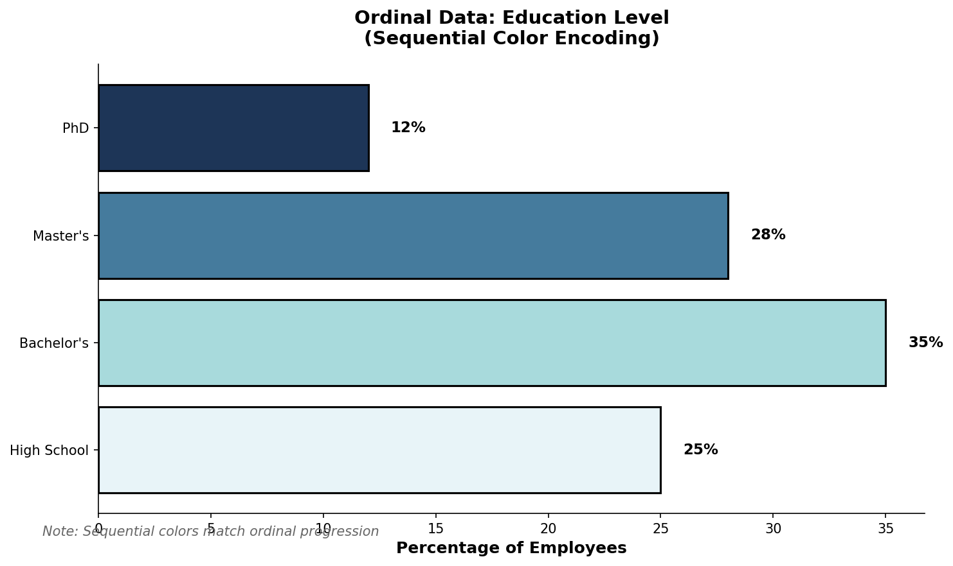
Slide 25 – Ordinal Data

Slide 27
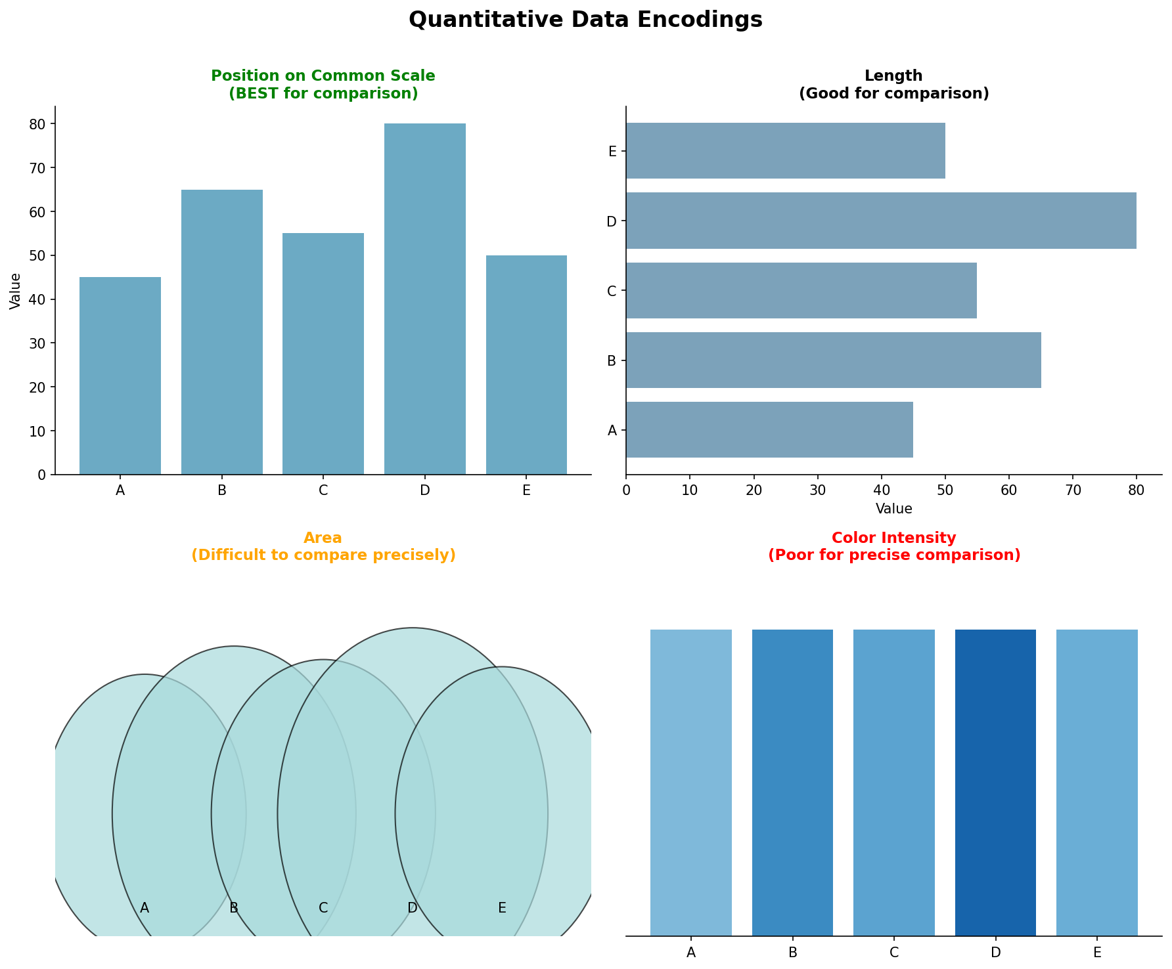
Slide 26 – Quantitative Data

Slide 28
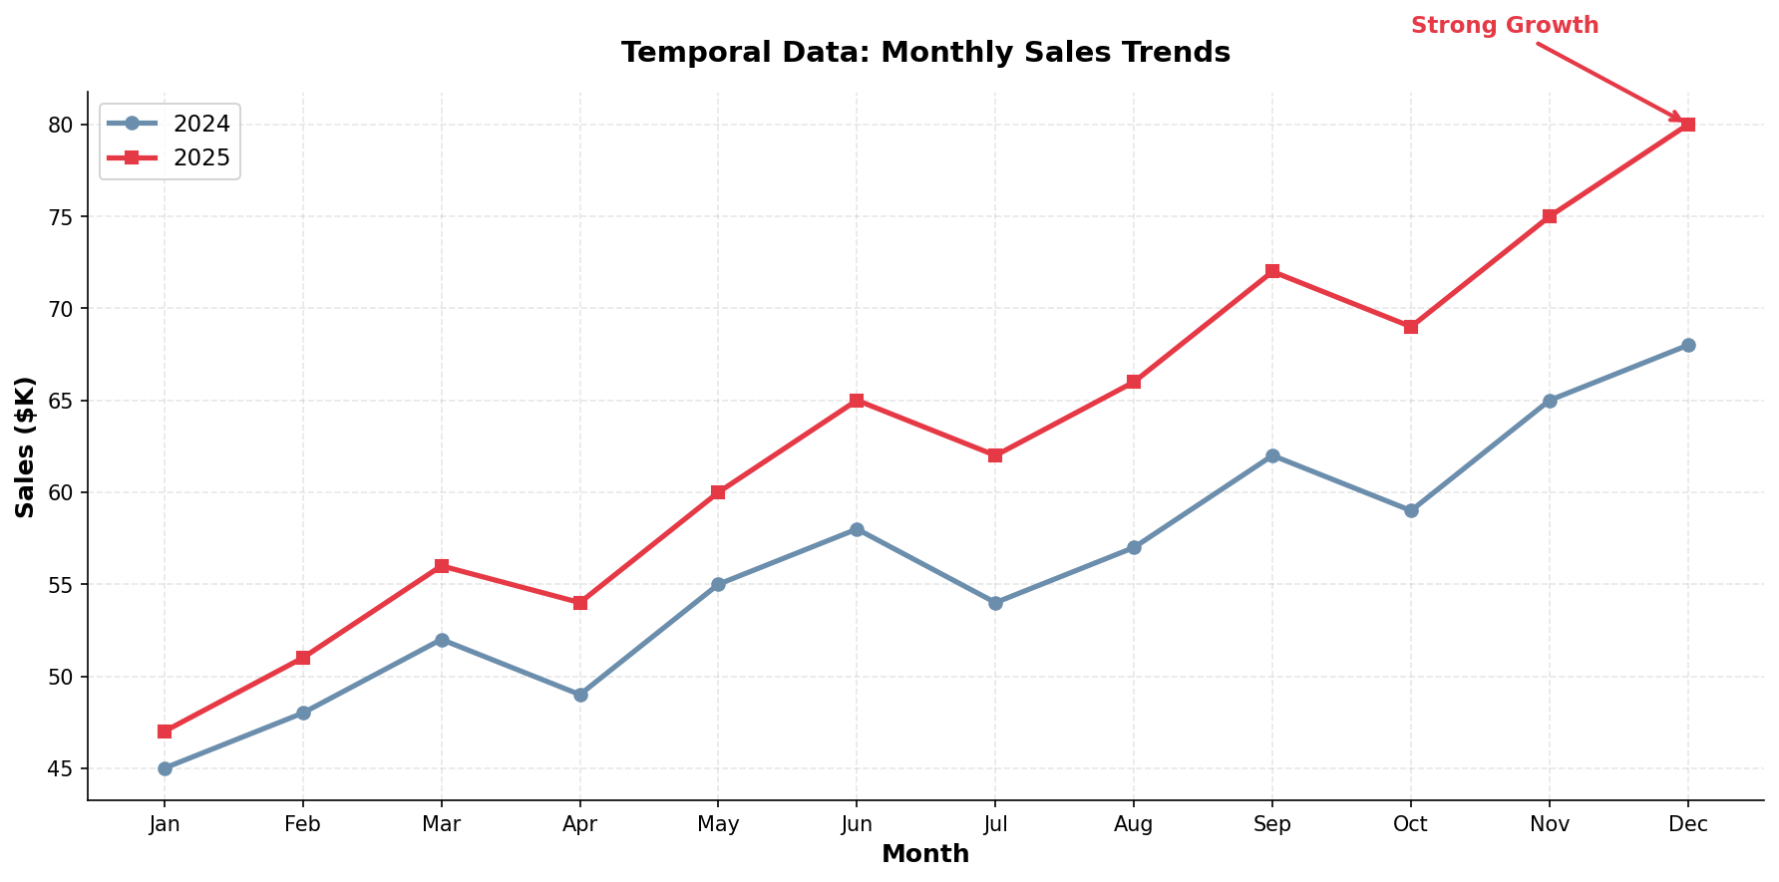
Slide 27 – Temporal (Time-Series) Data

Slide 29
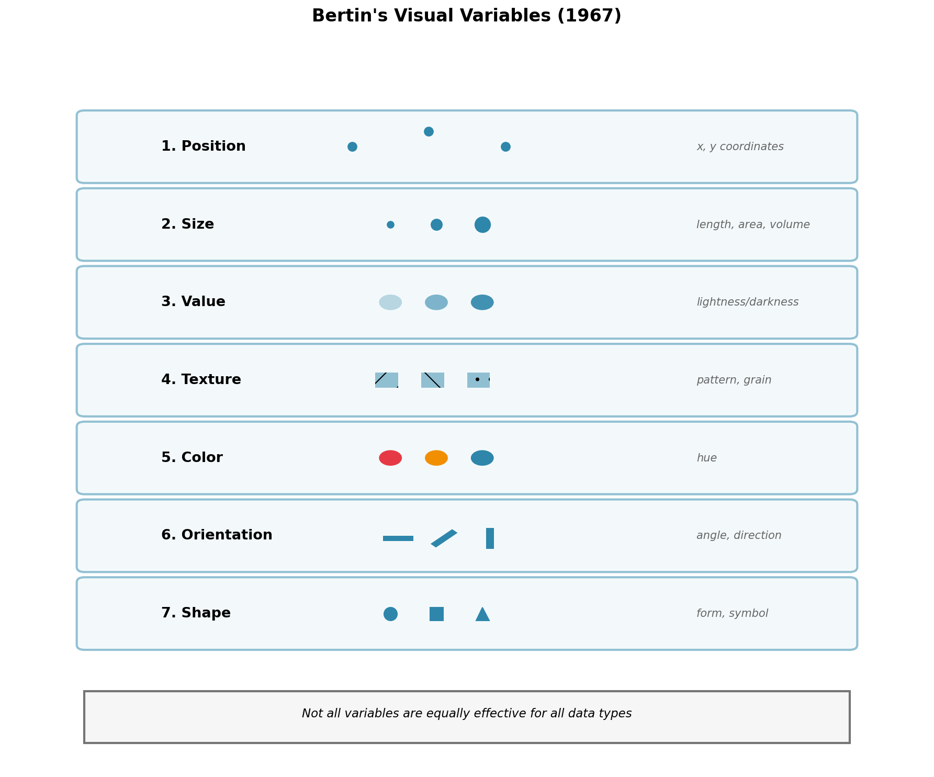
Slide 28 – Visual Variables (Bertin, 1967)

Slide 30
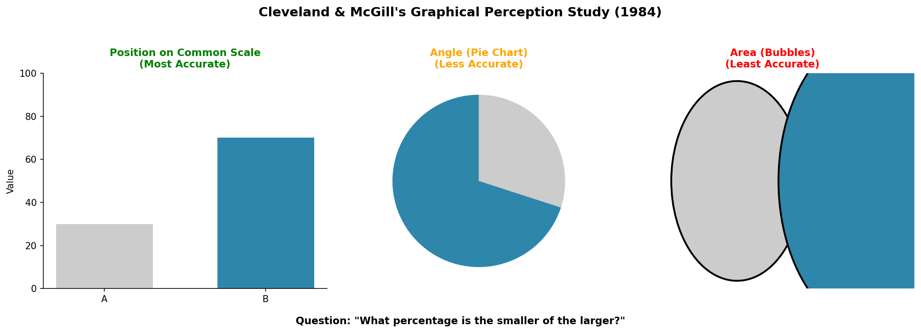
Slide 29 – Graphical Perception Research (Cleveland & McGill)

Slide 31
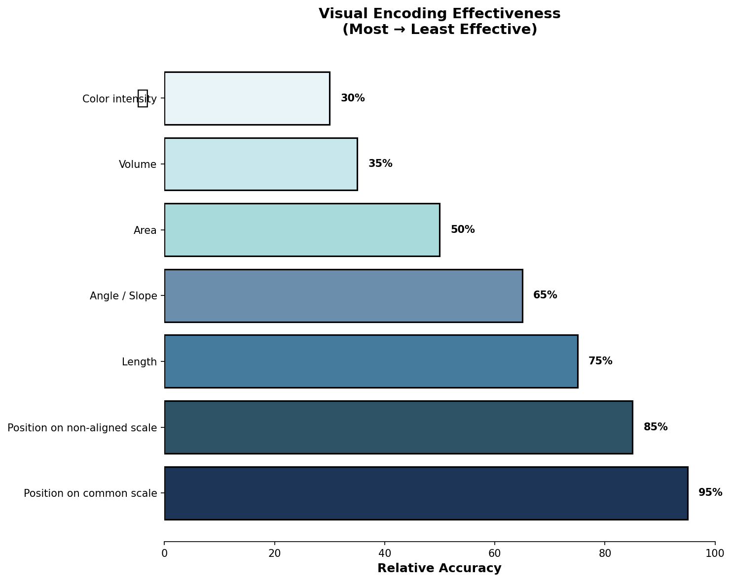
Slide 30 – Ranking of Visual Encodings (Most→Least Effective)

Slide 32
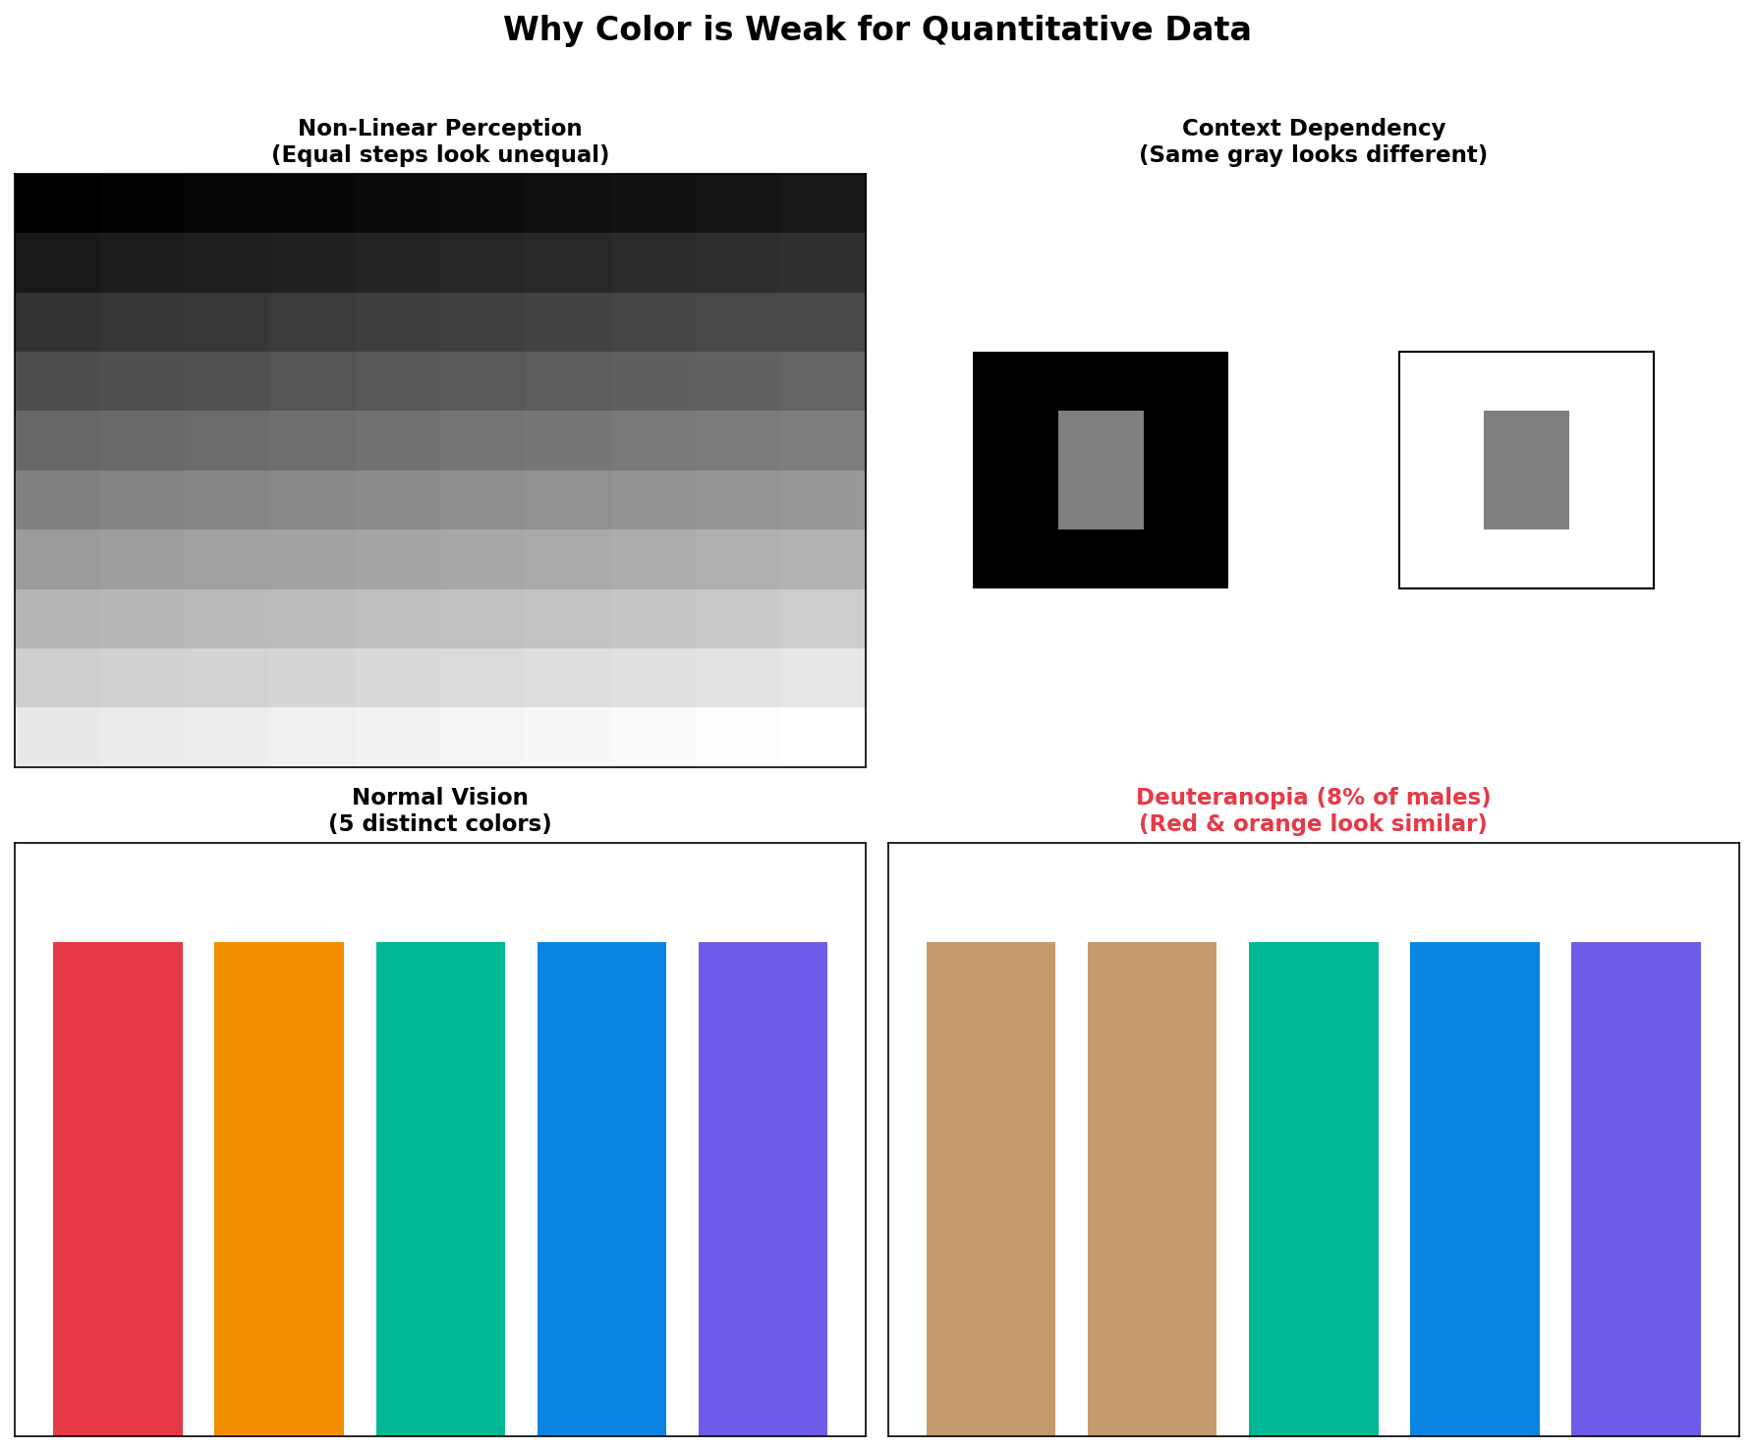
Slide 31 – Why Color Is Weak for Quantitative Data

Slide 33
Slide 32 – Data × Task × Encoding Framework
Effective visualization requires matching all three:
```
┌──────────┐ ┌──────────┐ ┌──────────┐
│ Data │ + │ Task │ = │ Encoding │
│ Type │ │ │ │ Choice │
└──────────┘ └──────────┘ └──────────┘
```
Always ask:
1. What is the data type? (Nominal, Ordinal, Quantitative, Temporal)
2. What is the task? (Compare, Identify trend, Find outliers, etc.)
3. Which encoding best supports this?
Example:
Data: Quarterly revenue (Quantitative + Temporal)
Task: Show trend over time
Encoding: Line chart with position on aligned scales [OK]

Slide 34
Slide 33 – Common Encoding Violations
Mistakes that violate perception principles:
[X] Pie charts with too many slices (angle is hard to compare)
[X] 3D charts (perspective distorts perception)
[X] Dual-axis charts (misleading scale comparison)
[X] Rainbow color scales (non-perceptual, creates false boundaries)
[X] Truncated y-axes (exaggerates differences)
[X] Bubble charts for precise comparison (area is hard to judge)
Each of these increases cognitive load and decreases accuracy.

Slide 35
Slide 34 – From Chart Types to Compositional Systems
Traditional approach:
Think in fixed chart types (bar, line, pie, scatter)
Pick a template
Limited flexibility
Modern approach:
Think in composable elements
Build visualizations from components
Infinite combinations possible
This is the shift from "choosing a chart" to "composing a visualization"
Enter: Grammar of Graphics

Slide 36
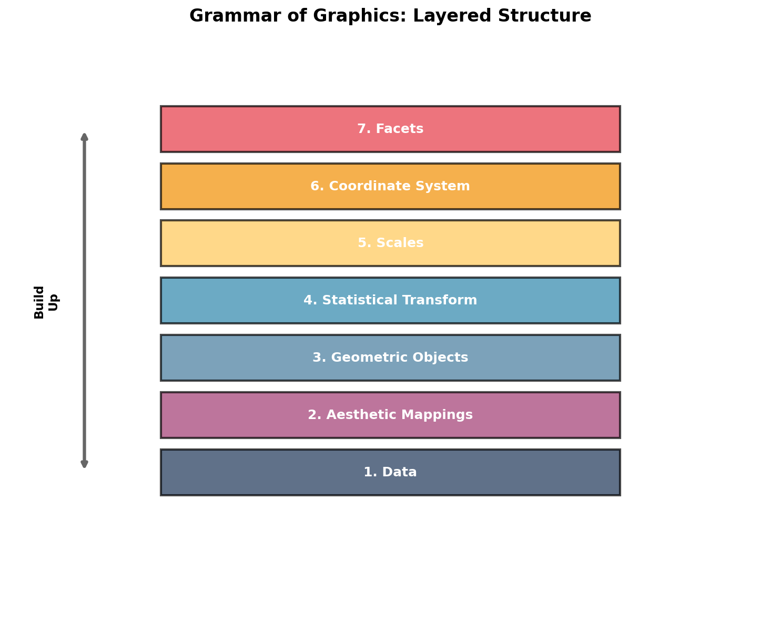
Slide 35 – Introduction to Grammar of Graphics

Slide 37
Slide 36 – The Layered Grammar: Core Components

Slide 38
Slide 37 – Component 1: Data
The foundation of any visualization
Requirements:
Structured format (typically tabular/dataframe)
Each row = observation
Each column = variable
Can be raw or transformed
Example data structure:
```
| Month | Product | Sales | Region |
|-------|----------|-------|--------|
| Jan | Widget A | 1500 | North |
| Jan | Widget B | 2300 | North |
| Feb | Widget A | 1800 | North |
...
```
Key insight: Same data + different mappings = different visualizations

Slide 39
Slide 38 – Component 2: Aesthetic Mappings
Map data variables to visual properties
Common aesthetics:
x, y - Position
color / fill - Color of points/areas
size - Size of points/text
shape - Shape of points
alpha - Transparency
linetype - Type of line (solid, dashed)
Example:
```
aes(x = Month, y = Sales, color = Product, size = Region)
```
Critical: Aesthetics define what data is shown and how it maps to visual properties

Slide 40
Slide 39 – Component 3: Geometric Objects (Marks)
The visual representation of data
Common geoms:
point - Scatter plot points
line - Connected lines
bar / col - Bars/columns
boxplot - Box-and-whisker plots
histogram - Frequency distributions
area - Filled areas
tile / raster - Heatmap cells
text - Labels
Same data + mapping, different geom = different chart:
geom_point() → scatter plot
geom_line() → line chart
geom_bar() → bar chart

Slide 41
Slide 40 – Component 4: Statistical Transformations
Compute derived values from data
Common transformations:
identity - Use data as-is (default for scatter plots)
count - Count observations (histograms)
bin - Bin continuous data
smooth - Fit smoothing line
boxplot - Compute quartiles
density - Compute density estimation
Example:
Raw data: 1000 individual sales transactions
After stat_count: Grouped counts per month
After stat_smooth: Trend line with confidence interval
Often implicit: Bar chart automatically counts, histogram automatically bins

Slide 42
Slide 41 – Component 5: Scales
Control how data values map to visual values
Examples:
Position scales: Linear, logarithmic, date/time
Color scales: Sequential, diverging, categorical palettes
Size scales: Linear, square root (for area)
Key functions:
Define domain (data range)
Define range (visual range)
Handle transformations
Create legends/axes
Example:
```
Sales: $0 - $1M → Y-axis: 0px - 400px
Product: A, B, C → Colors: blue, red, green
```

Slide 43
Slide 42 – Component 6: Coordinate Systems
The space in which data is plotted
Common coordinate systems:
Cartesian (x, y) - Most common, rectangular
Polar - Circular (pie charts, radar charts)
Geographic - Map projections
Transformed - Log scale, square root
Impact:
Same data, different coordinate system = dramatically different interpretation
Cartesian bar chart vs. Polar (coxcomb) chart
Design tip: Don't use polar coordinates unless circular relationships are meaningful!

Slide 44
Slide 43 – Component 7: Faceting (Small Multiples)
Create subplots for data subsets
Power of small multiples:
[OK] Easy comparison across groups
[OK] Reduces overplotting
[OK] Maintains consistent scales
[OK] Reduces cognitive load vs. overlaying
Types:
Grid: Rows × Columns (e.g., by Region × Product)
Wrap: Single variable, wraps to fit space
Example: Sales trends for each product category in separate panels

Slide 45
Slide 44 – Grammar and Cognitive Load
How Grammar of Graphics reduces cognitive load:
[OK] Separation of concerns - Each component has one job
[OK] Consistent structure - Same logic across all visualizations
[OK] Explicit mappings - No hidden assumptions
[OK] Composability - Build complex from simple
[OK] Systematic thinking - Framework guides design decisions
Result: Less accidental complexity, more intentional design
The grammar makes design decisions explicit, reducing extraneous load.

Slide 46
Slide 45 – Transition to Python: Implementing the Grammar
Now we'll see how to implement these concepts in Python
Python visualization ecosystem:
Matplotlib - Low-level, full control, foundation for others
Seaborn - Statistical graphics, built on Matplotlib
Plotly - Interactive visualizations
Altair - Declarative, pure Grammar of Graphics implementation
Today's focus: Matplotlib + Seaborn
Why?
Industry standard
Flexible and powerful
Foundation for understanding other libraries

Slide 47
Slide 46 – Python Visualization Ecosystem Overview
Matplotlib Architecture:
```
┌─────────────────────────────────────┐
│ Pyplot (plt) │ ← High-level interface
├─────────────────────────────────────┤
│ Artist API │ ← Mid-level (figures, axes)
├─────────────────────────────────────┤
│ Backend (rendering) │ ← Low-level rendering
└─────────────────────────────────────┘
```
Seaborn sits on top:
Provides high-level statistical plots
Better default aesthetics
Grammar-inspired interface
Built on Matplotlib
Learning path: Start with pyplot, understand axes/figures, then use Seaborn for statistical plots.

Slide 48
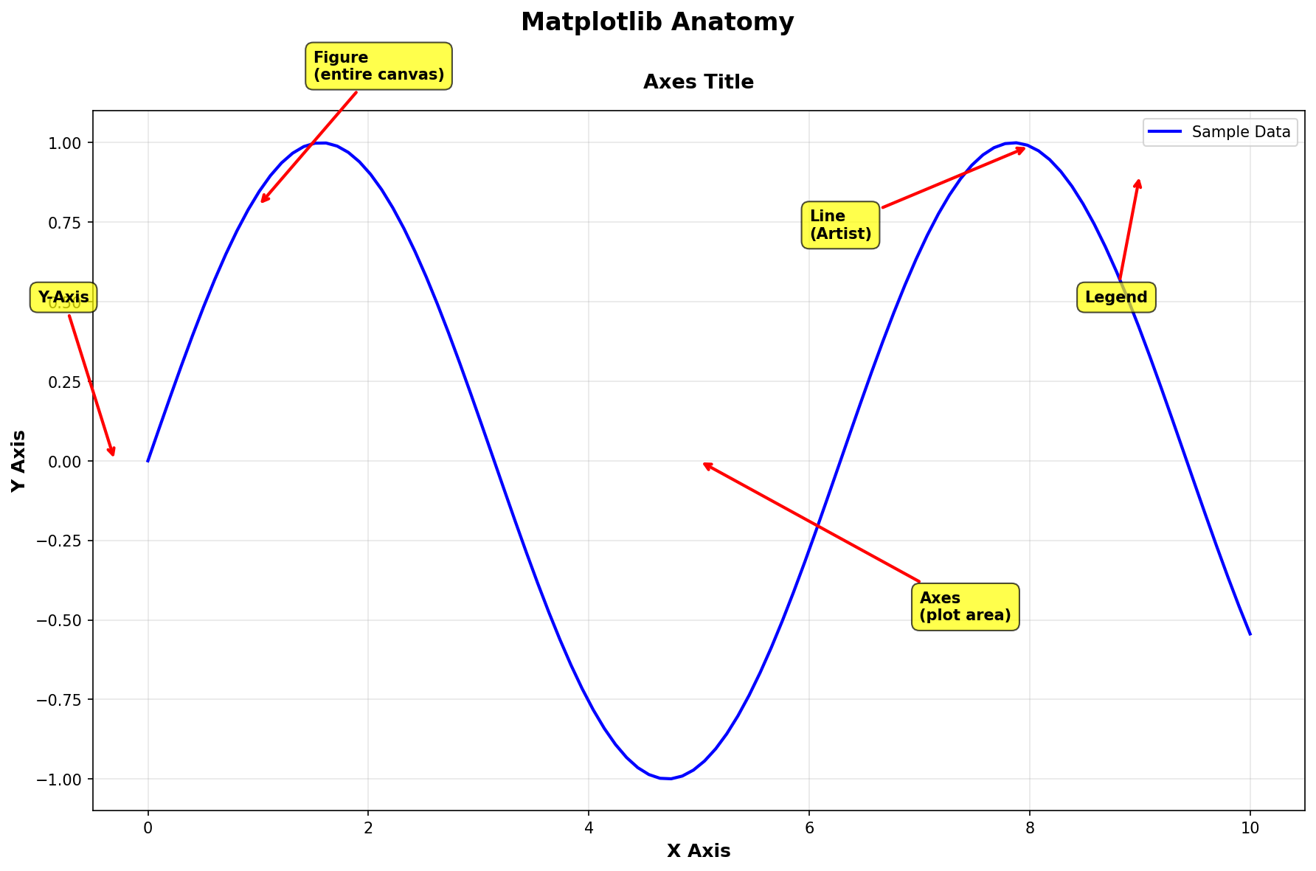
Slide 47 – Matplotlib: Anatomy of a Figure

Slide 49
Slide 48 – Creating Your First Plot
Basic bar chart in Matplotlib:
```python
import matplotlib.pyplot as plt
import numpy as np
# Data
categories = ['Product A', 'Product B', 'Product C', 'Product D']
sales = [2500, 3200, 2800, 3500]
# Create plot
fig, ax = plt.subplots(figsize=(8, 5))
ax.bar(categories, sales, color='steelblue')
# Customize
ax.set_xlabel('Product Category', fontsize=12)
ax.set_ylabel('Sales ($)', fontsize=12)
ax.set_title('Q1 2026 Sales by Product', fontsize=14, fontweight='bold')
# Add value labels on bars
for i, v in enumerate(sales):
ax.text(i, v + 50, str(v), ha='center', fontweight='bold')
plt.tight_layout()
plt.show()
```
Output: Clean bar chart with direct labeling (reducing cognitive load!)

Slide 50
Slide 49 – Customizing Plots: Colors, Labels, Styles
Applying perception principles:
```python
import matplotlib.pyplot as plt
# Create data
months = ['Jan', 'Feb', 'Mar', 'Apr', 'May', 'Jun']
sales_2025 = [45000, 48000, 52000, 49000, 55000, 58000]
sales_2026 = [47000, 51000, 56000, 54000, 60000, 65000]
# Create plot with good practices
fig, ax = plt.subplots(figsize=(10, 6))
# Use position (best encoding for quantitative comparison)
ax.plot(months, sales_2025, marker='o', linewidth=2,
label='2025', color='#2E86AB') # Distinct colors
ax.plot(months, sales_2026, marker='s', linewidth=2,
label='2026', color='#A23B72')
# Clear labels (reduce extraneous load)
ax.set_xlabel('Month', fontsize=11)
ax.set_ylabel('Sales ($)', fontsize=11)
ax.set_title('Sales Comparison: 2025 vs 2026',
fontsize=13, fontweight='bold', pad=15)
# Legend with clear positioning
ax.legend(frameon=True, loc='upper left', fontsize=10)
# Remove top and right spines (reduce clutter)
ax.spines['top'].set_visible(False)
ax.spines['right'].set_visible(False)
# Add grid for easier reading (but subtle)
ax.grid(True, alpha=0.3, linestyle='--')
plt.tight_layout()
plt.show()
```

Slide 51
Slide 50 – Matplotlib: Common Plot Types
Quick reference for basic plots:
```python
import matplotlib.pyplot as plt
import numpy as np
# Sample data
x = np.arange(10)
y1 = np.random.rand(10) * 100
y2 = np.random.rand(10) * 100
fig, axes = plt.subplots(2, 3, figsize=(12, 8))
# Scatter plot
axes[0,0].scatter(y1, y2, alpha=0.6, s=100)
axes[0,0].set_title('Scatter Plot')
# Line plot
axes[0,1].plot(x, y1, marker='o')
axes[0,1].set_title('Line Plot')
# Bar chart
axes[0,2].bar(x, y1, color='coral')
axes[0,2].set_title('Bar Chart')
# Histogram
axes[1,0].hist(y1, bins=10, edgecolor='black', alpha=0.7)
axes[1,0].set_title('Histogram')
# Box plot
axes[1,1].boxplot([y1, y2], labels=['Group A', 'Group B'])
axes[1,1].set_title('Box Plot')
# Heatmap (using imshow)
data = np.random.rand(10, 10)
im = axes[1,2].imshow(data, cmap='YlOrRd')
axes[1,2].set_title('Heatmap')
plt.colorbar(im, ax=axes[1,2])
plt.tight_layout()
plt.show()
```
Key insight: Same pyplot interface, different geom!

Slide 52
Slide 51 – Introduction to Seaborn
Seaborn = Statistical Data Visualization
Built on Matplotlib, but provides:
Better default aesthetics
Grammar-inspired interface
Statistical transformations built-in
Works directly with pandas DataFrames
Themes and color palettes
Installation:
```python
pip install seaborn
```
Import convention:
```python
import seaborn as sns
import matplotlib.pyplot as plt
```
Philosophy: Make complex statistical plots simple, apply perception principles by default.

Slide 53
Slide 52 – Seaborn: Working with DataFrames
Seaborn loves pandas DataFrames:
```python
import seaborn as sns
import pandas as pd
# Create sample data
data = pd.DataFrame({
'month': ['Jan', 'Feb', 'Mar', 'Apr', 'May', 'Jun'] * 2,
'sales': [2500, 2700, 3000, 2900, 3200, 3400,
2600, 2800, 3100, 3000, 3300, 3500],
'region': ['North']6 + ['South']6
})
# Create plot using column names (Grammar-like!)
sns.lineplot(data=data, x='month', y='sales', hue='region',
marker='o', linewidth=2)
plt.title('Sales by Region Over Time')
plt.show()
```
Notice: Direct mapping from data columns to aesthetics!

Slide 54
Slide 53 – Seaborn Plot Types
Common Seaborn plots mapped to tasks:
Distribution:
histplot() - Histograms with KDE
kdeplot() - Kernel density estimation
boxplot() - Box-and-whisker
violinplot() - Violin plot (box + density)
Relationships:
scatterplot() - Scatter with regression
lineplot() - Line with confidence intervals
regplot() - Scatter + regression line
Categories:
barplot() - Bars with confidence intervals
countplot() - Count plot
pointplot() - Point estimates with error bars

Slide 55
Slide 54 – Seaborn Example: Distribution Plot
Visualizing distributions with built-in statistics:
```python
import seaborn as sns
import numpy as np
import matplotlib.pyplot as plt
# Generate sample data
np.random.seed(42)
data1 = np.random.normal(100, 15, 500)
data2 = np.random.normal(120, 20, 500)
# Create figure
fig, axes = plt.subplots(1, 2, figsize=(12, 5))
# Histogram with KDE
sns.histplot(data1, kde=True, color='steelblue', ax=axes[0])
axes[0].set_title('Sales Distribution - Product A')
axes[0].set_xlabel('Daily Sales ($)')
# Violin plot comparing two groups
import pandas as pd
df = pd.DataFrame({
'Sales': np.concatenate([data1, data2]),
'Product': ['A']500 + ['B']500
})
sns.violinplot(data=df, x='Product', y='Sales', ax=axes[1])
axes[1].set_title('Sales Distribution Comparison')
plt.tight_layout()
plt.show()
```
Automatic statistical transformations!

Slide 56
Slide 55 – Seaborn: Faceting (Small Multiples)
Create small multiples with FacetGrid:
```python
import seaborn as sns
import pandas as pd
# Load sample data
tips = sns.load_dataset('tips')
# Create FacetGrid (Component 7: Faceting!)
g = sns.FacetGrid(tips, col='time', row='smoker', height=4)
g.map(sns.scatterplot, 'total_bill', 'tip', alpha=0.7)
g.add_legend()
g.set_titles(col_template="{col_name}", row_template="{row_name}")
g.set_axis_labels("Total Bill ($)", "Tip ($)")
plt.show()
```
Result: 4 panels (Lunch/Dinner × Smoker/Non-smoker)
Grammar in action:
Data: tips dataset
Aesthetics: x=total_bill, y=tip
Geom: scatter
Facets: time × smoker

Slide 57
Slide 56 – Color Palettes in Python: Perception-Aware Choices
Choosing the right color palette matters!
```python
import seaborn as sns
import matplotlib.pyplot as plt
import numpy as np
# Sample data
data = np.random.randn(100, 4)
fig, axes = plt.subplots(1, 3, figsize=(15, 4))
# [X] BAD: Rainbow (perceptually non-uniform, creates false boundaries)
axes[0].imshow(data, cmap='jet', aspect='auto')
axes[0].set_title('[X] Rainbow (Jet) - Avoid!')
# [OK] GOOD: Sequential (perceptually uniform)
axes[1].imshow(data, cmap='viridis', aspect='auto')
axes[1].set_title('[OK] Viridis - Sequential Data')
# [OK] GOOD: Diverging (for data with meaningful midpoint)
axes[2].imshow(data, cmap='RdBu_r', aspect='auto')
axes[2].set_title('[OK] Red-Blue - Diverging Data')
plt.tight_layout()
plt.show()
```
Seaborn color palettes:
Categorical: 'Set2', 'tab10', 'Paired'
Sequential: 'Blues', 'Greens', 'rocket'
Diverging: 'RdBu', 'coolwarm', 'vlag'

Slide 58
Slide 57 – Applying Preattentive Features in Code
Using color for visual pop-out:
```python
import matplotlib.pyplot as plt
import numpy as np
# Data
categories = ['Q1', 'Q2', 'Q3', 'Q4']
sales_2025 = [450, 480, 520, 490]
sales_2026 = [470, 510, 560, 540]
fig, axes = plt.subplots(1, 2, figsize=(12, 5))
# WITHOUT preattentive highlighting
axes[0].bar(categories, sales_2025, color='steelblue', alpha=0.7)
axes[0].set_title('Without Visual Emphasis')
axes[0].set_ylabel('Sales (K$)')
# WITH preattentive highlighting (Q3 is best quarter)
colors = ['#CCCCCC', '#CCCCCC', '#E63946', '#CCCCCC'] # Pop-out!
axes[1].bar(categories, sales_2026, color=colors, alpha=0.9)
axes[1].set_title('With Visual Emphasis - Q3 Highlighted')
axes[1].set_ylabel('Sales (K$)')
plt.tight_layout()
plt.show()
```
Result: Q3 immediately pops out (preattentive color feature)

Slide 59
Slide 58 – Reducing Clutter: Before and After
Applying "reduce extraneous load" principle:
```python
import matplotlib.pyplot as plt
import numpy as np
months = ['Jan', 'Feb', 'Mar', 'Apr', 'May', 'Jun']
sales = [2500, 2700, 3000, 2900, 3200, 3400]
fig, axes = plt.subplots(1, 2, figsize=(14, 5))
# [X] CLUTTERED (high extraneous load)
axes[0].plot(months, sales, marker='o', linewidth=3, color='red',
markersize=12)
axes[0].set_title('BEFORE: High Extraneous Load', fontsize=14,
fontweight='bold', color='darkred')
axes[0].set_facecolor('#FFEEEE') # Distracting background
axes[0].grid(True, linewidth=2, color='blue') # Heavy grid
axes[0].spines['top'].set_linewidth(3)
axes[0].spines['right'].set_linewidth(3)
axes[0].spines['bottom'].set_linewidth(3)
axes[0].spines['left'].set_linewidth(3)
# [OK] CLEAN (low extraneous load)
axes[1].plot(months, sales, marker='o', linewidth=2, color='#2E86AB',
markersize=7)
axes[1].set_title('AFTER: Low Extraneous Load', fontsize=13)
axes[1].set_xlabel('Month', fontsize=10)
axes[1].set_ylabel('Sales ($)', fontsize=10)
axes[1].spines['top'].set_visible(False) # Remove clutter
axes[1].spines['right'].set_visible(False)
axes[1].grid(True, alpha=0.2, linestyle='--') # Subtle grid
plt.tight_layout()
plt.show()
```

Slide 60
Slide 59 – Direct Labeling vs. Legend
Reduce cognitive load by eliminating legend lookup:
```python
import matplotlib.pyplot as plt
months = ['Jan', 'Feb', 'Mar', 'Apr']
product_a = [2500, 2700, 3000, 2900]
product_b = [2200, 2400, 2600, 2500]
product_c = [1800, 2000, 2200, 2100]
fig, axes = plt.subplots(1, 2, figsize=(14, 5))
# WITH LEGEND (requires lookup - adds cognitive load)
axes[0].plot(months, product_a, marker='o', label='Product A')
axes[0].plot(months, product_b, marker='s', label='Product B')
axes[0].plot(months, product_c, marker='^', label='Product C')
axes[0].legend()
axes[0].set_title('With Legend (More Cognitive Load)')
axes[0].set_ylabel('Sales ($)')
# WITH DIRECT LABELS (immediate understanding)
axes[1].plot(months, product_a, marker='o', color='#2E86AB')
axes[1].plot(months, product_b, marker='s', color='#A23B72')
axes[1].plot(months, product_c, marker='^', color='#F18F01')
# Add direct labels
axes[1].text(3.05, product_a[-1], 'Product A', va='center', fontsize=10,
color='#2E86AB', fontweight='bold')
axes[1].text(3.05, product_b[-1], 'Product B', va='center', fontsize=10,
color='#A23B72', fontweight='bold')
axes[1].text(3.05, product_c[-1], 'Product C', va='center', fontsize=10,
color='#F18F01', fontweight='bold')
axes[1].set_title('With Direct Labels (Less Cognitive Load)')
axes[1].set_ylabel('Sales ($)')
axes[1].set_xlim(-0.2, 3.8)
plt.tight_layout()
plt.show()
```
Principle: Direct labeling reduces the need to constantly refer back to legend.

Slide 61
Slide 60 – Exercise: Bar Chart vs. Pie Chart
Implementing Cleveland & McGill's findings:
```python
import matplotlib.pyplot as plt
# Data
categories = ['North', 'South', 'East', 'West', 'Central']
values = [25, 22, 18, 20, 15]
fig, axes = plt.subplots(1, 2, figsize=(14, 5))
# PIE CHART (uses angle - weak encoding)
axes[0].pie(values, labels=categories, autopct='%1.1f%%', startangle=90)
axes[0].set_title('Pie Chart: Angle Encoding\n(Harder to Compare)')
# BAR CHART (uses position - strong encoding)
axes[1].barh(categories, values, color='steelblue')
axes[1].set_xlabel('Sales (%)')
axes[1].set_title('Bar Chart: Position Encoding\n(Easier to Compare)')
axes[1].spines['top'].set_visible(False)
axes[1].spines['right'].set_visible(False)
# Add value labels
for i, v in enumerate(values):
axes[1].text(v + 0.5, i, str(v) + '%', va='center')
plt.tight_layout()
plt.show()
```
Question: Which makes it easier to see that North > South > West?
Answer: Bar chart (position is more accurate than angle)

Slide 62
Slide 61 – Putting It All Together: Complete Example
Building a perceptually-optimized visualization from scratch:
```python
import pandas as pd
import matplotlib.pyplot as plt
import seaborn as sns
# Sample data
data = pd.DataFrame({
'Quarter': ['Q1', 'Q2', 'Q3', 'Q4'] * 3,
'Revenue': [450, 480, 520, 490, 470, 510, 560, 540, 490, 530, 580, 560],
'Year': ['2024']4 + ['2025']4 + ['2026']*4
})
# Apply all principles
sns.set_style("whitegrid", {'grid.linestyle': '--', 'grid.alpha': 0.3})
fig, ax = plt.subplots(figsize=(10, 6))
# Use position encoding (best for quantitative)
sns.lineplot(data=data, x='Quarter', y='Revenue', hue='Year',
marker='o', linewidth=2.5, palette=['#CCCCCC', '#999999', '#E63946'],
ax=ax)
# Clear, direct labels
ax.set_xlabel('Quarter', fontsize=12)
ax.set_ylabel('Revenue ($K)', fontsize=12)
ax.set_title('Quarterly Revenue Growth 2024-2026\n2026 Shows Strong Performance',
fontsize=14, fontweight='bold', pad=20)
# Reduce extraneous load
ax.spines['top'].set_visible(False)
ax.spines['right'].set_visible(False)
ax.legend(title='Year', frameon=False, loc='upper left')
# Add annotation for insight
ax.annotate('Best Quarter', xy=('Q3', 580), xytext=('Q4', 595),
arrowprops=dict(arrowstyle='->', color='#E63946', lw=2),
fontsize=10, color='#E63946', fontweight='bold')
plt.tight_layout()
plt.show()
```
Principles applied: Position encoding, color for emphasis, reduced clutter, direct annotation

Slide 63
Slide 62 – Common Mistakes to Avoid
Real-world examples of what NOT to do:
1. [X] Too many colors - Rainbow schemes for categories
2. [X] 3D without purpose - Distorts perception
3. [X] Dual Y-axes - Misleading comparisons
4. [X] Truncated axes - Exaggerates differences
5. [X] Pie charts with 10+ slices - Impossible to compare
6. [X] Busy backgrounds - Distracts from data
7. [X] Tiny fonts - Can't read = won't use
8. [X] No labels - Forces guessing
Remember: Every element should serve the data and the user's task!

Slide 64
Slide 63 – Visualization Design Checklist
Before finalizing any visualization, ask:
1. Data & Task
□ What data type am I showing?
□ What task does the user need to perform?
□ Is this the right chart for the task?
2. Perception
□ Am I using the most effective encoding?
□ Are preattentive features highlighting what matters?
□ Can users see the pattern in < 5 seconds?
3. Cognitive Load
□ Have I removed all chart junk?
□ Is the visual hierarchy clear?
□ Are labels direct and clear?
4. Accessibility
□ Is it colorblind-friendly?
□ Are fonts large enough?
□ Does it work in grayscale?

Slide 65
Slide 64 – Exercise 1: Critique This Visualization
Task: Identify all perception and cognitive load issues
```
[Show intentionally bad visualization with multiple issues]
```
Issues to find:
1. Encoding problems
2. Cognitive load violations
3. Gestalt principle violations
4. Color usage problems
5. Missing context
Work in pairs: 5 minutes to list all issues

Slide 66
Slide 65 – Exercise 2: Redesign Challenge
Given: Bad dashboard with high cognitive load
Your task:
1. List all sources of extraneous load
2. Propose a redesigned layout
3. Justify your encoding choices
4. Apply Gestalt principles
Deliverable: Sketch or code the improved version
Time: 15 minutes

Slide 67
Slide 66 – Exercise 3: Build a Grammar-Based Plot
Task: Create a visualization using Grammar of Graphics thinking
Dataset: Sales by product, region, and quarter
Requirements:
1. Define your data mappings (aesthetics)
2. Choose appropriate geom
3. Consider statistical transformation
4. Use faceting if appropriate
5. Apply perception principles
Implement in Python (Matplotlib or Seaborn)

Slide 68
Slide 67 – Exercise 4: Color Palette Selection
Scenario: You need to visualize temperature data from -10°C to +40°C
Questions:
1. What type of color palette should you use?
2. Why is rainbow/jet inappropriate?
3. What's a good alternative?
4. How do you handle the zero point?
Implement:
```python
import matplotlib.pyplot as plt
import numpy as np
# Your code here to create heatmap with appropriate palette
```

Slide 69
Slide 68 – Exercise 5: Preattentive Highlighting
Task: Create a sales report where Q4 must pop out
Data: Quarterly sales for 5 products
Requirements:
Use preattentive features (color, size, position)
Make Q4 immediately visible
Minimize cognitive load
Include direct labels
Code it: Use Matplotlib or Seaborn

Slide 70
Slide 69 – Real-World Application: Dashboard Design
Scenario: Executive wants dashboard for:
Monthly revenue trends
Top 5 products
Regional performance
YoY comparison
Your design must:
1. Apply visual hierarchy (Gestalt)
2. Use appropriate encodings
3. Minimize cognitive load
4. Enable 5-second insights
Discussion: What would you include? What would you exclude?

Slide 71
Slide 70 – Connection to Data Science Workflows
Where visualization fits in your projects:
```
Data Collection → Cleaning → EDA → Modeling → Evaluation → Communication
↓ ↓ ↓ ↓
Visualization is critical at every stage!
```
Roles of visualization:
EDA: Understand patterns, find outliers
Model Selection: Compare performance
Debugging: Identify issues
Communication: Share insights
Decision Support: Enable action
Remember: Good visualization = Better models = Better decisions

Slide 72
Slide 71 – Key Takeaways: Perception & Cognition
What we learned today:
1. Visual Processing
- Preattentive features enable instant detection
- Leverage the 200ms window for critical information
2. Gestalt Principles
- Proximity, similarity, enclosure create automatic grouping
- Design with perception, not against it
3. Cognitive Load
- Minimize extraneous load
- Maximize germane load
- Every element must justify its existence
Remember: Perception is not subjective—it's measurable, predictable, and designable!

Slide 73
Slide 72 – Key Takeaways: Data & Encodings
What we learned today:
1. Data Types Matter
- Nominal, Ordinal, Quantitative, Temporal
- Each has valid and invalid encodings
2. Encoding Hierarchy
- Position > Length > Area > Color intensity
- Use the most effective encoding for your task
3. Data × Task × Encoding
- Always match all three
- Wrong encoding = cognitive overload
Remember: The chart type is not the starting point—the data type and task are!

Slide 74
Slide 73 – Key Takeaways: Grammar of Graphics
What we learned today:
1. Compositional Thinking
- Visualizations are not types, they're mappings
- 7 components: Data, Aesthetics, Geom, Stats, Scales, Coordinates, Facets
2. Systematic Design
- Grammar provides structure and consistency
- Reduces accidental complexity
3. Python Implementation
- Matplotlib: Low-level control
- Seaborn: Statistical graphics
- Both follow grammar principles
Remember: Think in layers and mappings, not chart templates!

Slide 75
Slide 74 – Key Takeaways: Python Best Practices
What we learned today:
1. Apply Perception Principles in Code
- Use preattentive features (color, position)
- Remove clutter (spines, heavy grids)
- Direct labeling > legends
2. Choose Appropriate Palettes
- Avoid rainbow (jet)
- Use perceptually uniform colors (viridis)
- Match palette type to data type
3. Iterate and Refine
- Start simple
- Remove extraneous elements
- Test with real users
Remember: Code is not just functional—it embodies design principles!

Slide 76
Slide 75 – Looking Ahead: Future Topics
How today's content connects to upcoming classes:
Week 4: Exploratory Data Visualization
Apply perception principles to EDA
Use grammar for rapid iteration
Week 5: Time-Series & Temporal Data
Temporal encodings and perception
Cognitive load in dashboards
Week 6: Geospatial Visualization
Position encoding on maps
Color choices for geographic data
Week 10: Narrative Visualization & Data Storytelling
Direct attention using preattentive features
Reduce cognitive load in presentations
Week 12: Visualizing Models & AI Systems
Communicate uncertainty and predictions
Make model outputs interpretable

Slide 77
Slide 76 – Resources for Further Learning
Books:
The Visual Display of Quantitative Information - Edward Tufte
Information Visualization - Colin Ware
Visualization Analysis & Design - Tamara Munzner
Storytelling with Data - Cole Nussbaumer Knaflic
Online Resources:
Matplotlib documentation: matplotlib.org
Seaborn gallery: seaborn.pydata.org
Data Visualization Society: datavisualizationsociety.org
Color Brewer (palettes): colorbrewer2.org
Research Papers:
Cleveland & McGill (1984) - Graphical Perception
Heer & Bostock (2010) - Crowdsourcing Graphical Perception
Munzner (2009) - A Nested Model for Visualization Design

Slide 78
Slide 77 – Assignment: Perceptually-Optimized Visualization
Due: Next class
Task: Find a poor visualization and redesign it
Deliverables:
1. Original visualization (screenshot + source)
2. Critique (2-3 paragraphs):
- Identify perception violations
- Identify cognitive load issues
- Identify encoding problems
3. Redesign (Python code + output):
- Apply perception principles
- Use appropriate encodings
- Implement in Matplotlib or Seaborn
4. Justification (1-2 paragraphs):
- Explain your design choices
- Reference course concepts
Grading: Original (10%), Critique (30%), Redesign (40%), Justification (20%)

Slide 79
Slide 78 – Assignment Tips & Guidance
Where to find bad visualizations:
News media
Business reports
Social media infographics
Academic papers
Your own organization!
What makes a good critique:
Be specific (cite slide concepts)
Use terminology (preattentive, extraneous load, etc.)
Provide evidence (Cleveland & McGill ranking, etc.)
What makes a good redesign:
Clean, commented Python code
Clear improvement over original
Demonstrates course principles
Professional presentation quality
Pro tip: Start with something moderately bad, not catastrophically terrible!

Slide 80
Slide 79 – Optional Challenge: Build a Dashboard
For those wanting extra practice:
Dataset: Provided sales data (CSV)
Requirements:
1. 4-6 visualizations on one figure
2. Clear visual hierarchy (Gestalt)
3. Appropriate encodings for each data type
4. Low cognitive load design
5. Professional quality
Bonus points for:
Interactive elements (Plotly)
Effective use of small multiples
Excellent color choices
Direct labeling throughout
This is optional but highly recommended for portfolio building!

Slide 81
Slide 80 – Common Questions & Answers
Q: "Can I ever use pie charts?"
A: Yes, but only for 2-3 categories showing parts of a whole. Bar charts are almost always better.
Q: "What about 3D visualizations?"
A: Avoid unless the data is genuinely 3-dimensional (x, y, z coordinates). 3D effects on 2D data distort perception.
Q: "How do I choose between Matplotlib and Seaborn?"
A: Seaborn for statistical plots with DataFrames. Matplotlib for custom or low-level control.
Q: "What if my boss wants rainbow colors?"
A: Show them this class! Explain why perceptually uniform colors lead to better decisions.
Q: "Is this really science or just opinion?"
A: Science! Cleveland & McGill's research is empirical and replicated.

Slide 82
Slide 81 – Next Class Preview
Week 4: Exploratory Data Visualization
Topics we'll cover:
EDA workflows and best practices
Distribution visualizations
Relationship and correlation plots
Identifying outliers and patterns
Interactive exploration with Plotly
Building an EDA toolkit
Preparation:
Complete today's assignment
Review pandas DataFrames
Install plotly: pip install plotly
Bring a dataset you want to explore

Slide 83
Slide 82 – Closing Thoughts
What makes visualization a superpower in data science?
It's the only part of the workflow that:
* Directly interfaces with human cognition
* Enables pattern recognition at scale
* Communicates to technical and non-technical audiences
* Drives decisions and action
Today you learned:
How humans see and think
Why certain designs work (and others fail)
How to implement perception-based design in Python
Your challenge:
See visualizations differently now
Apply these principles in every project
Build a portfolio of excellent work
Remember:
> "Good visualization is not about making pretty pictures.
> It's about making complex information accessible to human cognition."
Thank you! Questions?

Slide 84
Additional Resources
Python Code Repository
All code examples from today's slides
Jupyter notebook with exercises
Sample datasets
Available on course website
Office Hours
Questions about assignments
Help with code
Discussion of concepts
Next Steps
1. Review these slides
2. Work on assignment
3. Practice with your own data
4. Prepare for Week 4

