Slide 1
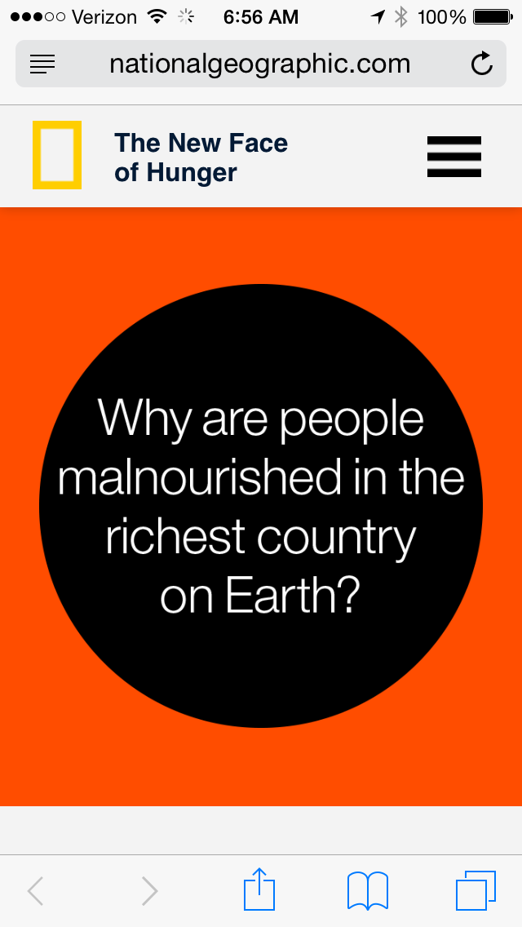
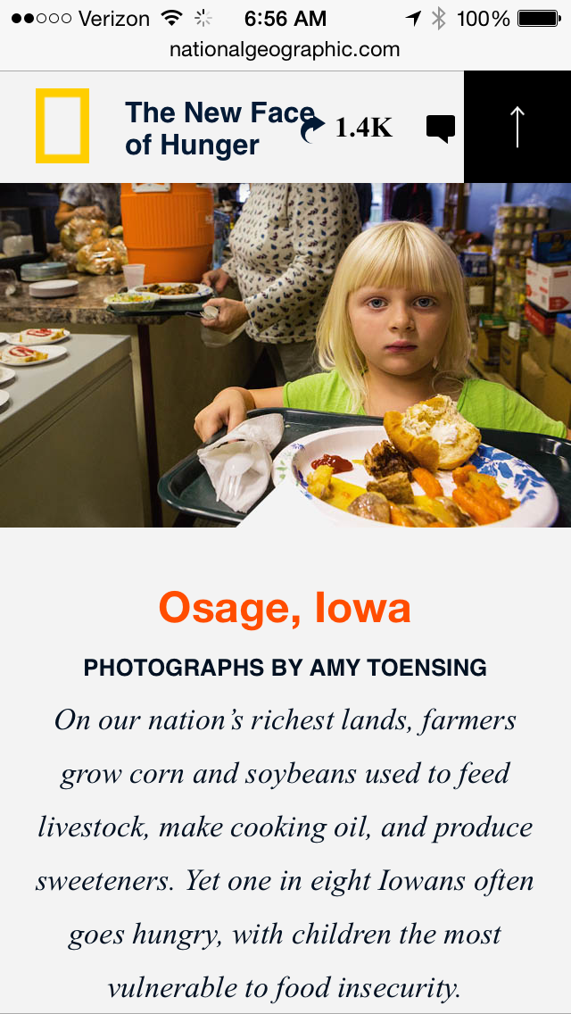
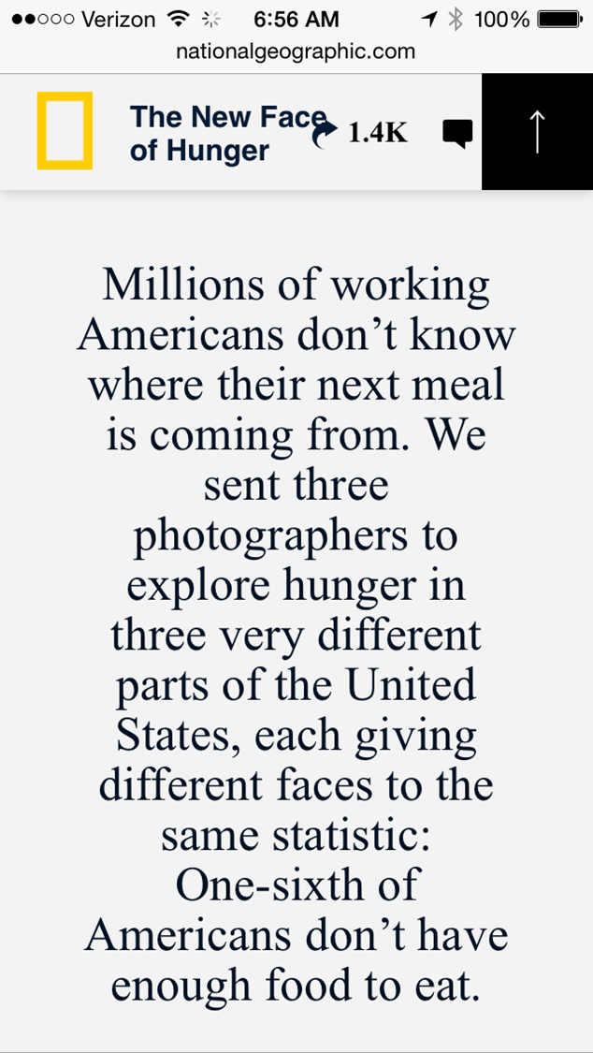
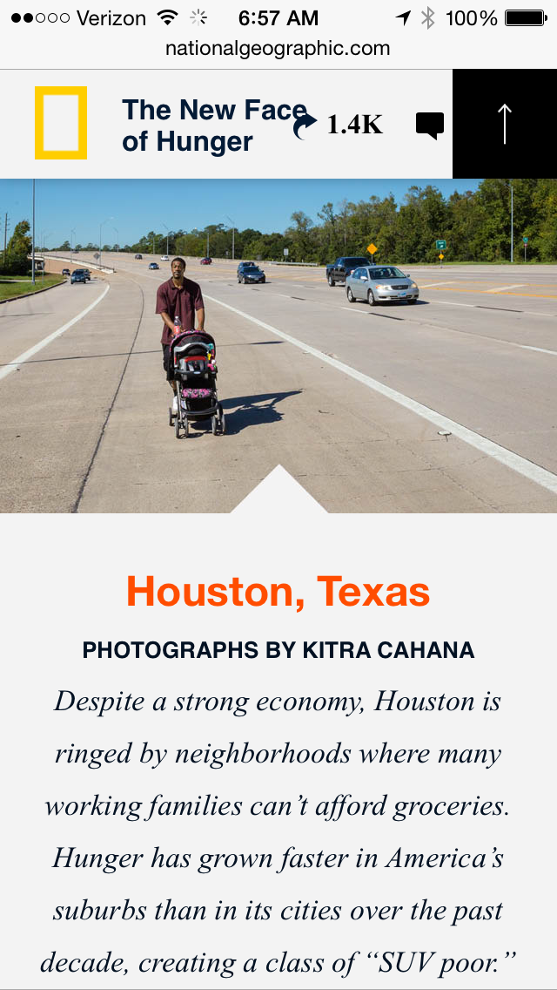
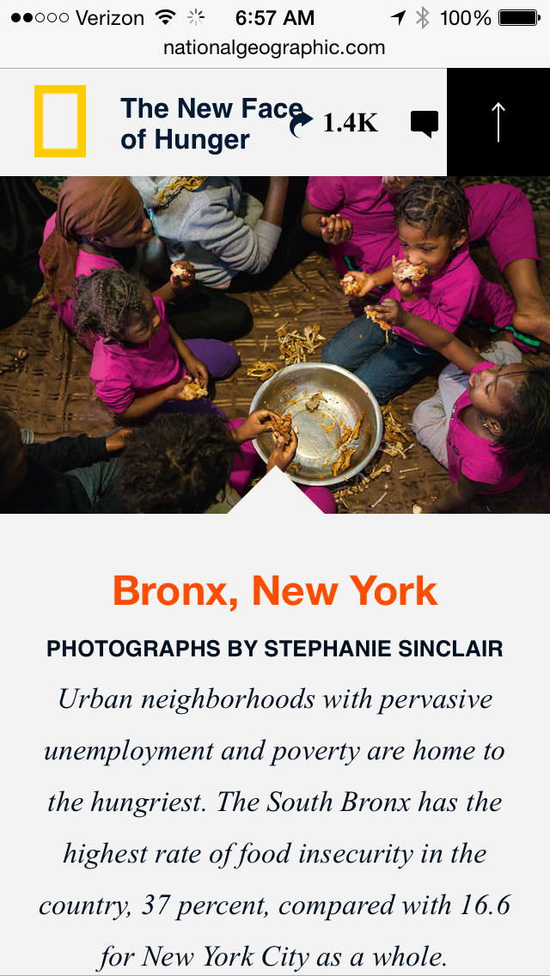

Slide 2

Apple-o-matic
Motivation
15.8 million children lived in food-insecure households in 2012[i]
Intended Outcome
Improve fruit consumption by children
Solution
Provide convenient access to apples!
[i] Ibid. From http://www.feedingamerica.org/hunger-in-america/impact-of-hunger/child-hunger/child-hunger-fact-sheet.html
Notes:
Motivation
Food security is defined as “access by all people at all times to enough food for an active, healthy life”.[0] 15.8 million children lived in food-insecure households in 2012.[i] Many of these American children are not consuming the recommended amount of fruit. Solving childhood food insecurity may improve a variety of societal problems such as obesity. Can we increase fruit consumption and improve kid’s diet balance by increasing availability of apples?
Intended Outcome
Improve student fruit consumption by 20% in participating school.
Empower the community by producing a design with open source deliverables.
Solution
We can provide convenient access to healthy snacks immediately after school when unhealthy (and often unsupervised) snack choices are made at home. Automatic apple vending machines can provide nutrition-on-demand to students at schools and after school centers. These Internet of Things (IoT) enabled devices shall be crowd powered systems functioning as integrated crowd funded virtual food drives with fresh fruit delivered using a (crowd powered) local grocer, teacher or parent.

Slide 3
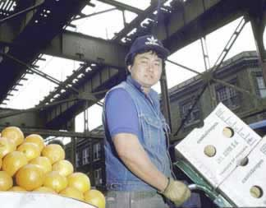



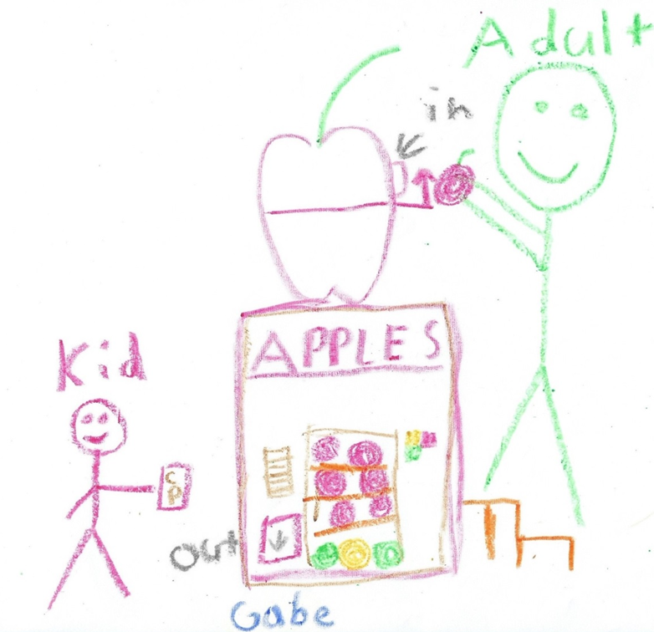
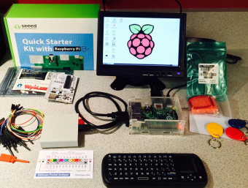

Apple-o-matic
Crowd Powered Systems
+
Internet of Things: RFID
=
Apples for kids
Drawing by Gabe V (6 years old)

Slide 4
More Information
Open Document Below

