Slide 1
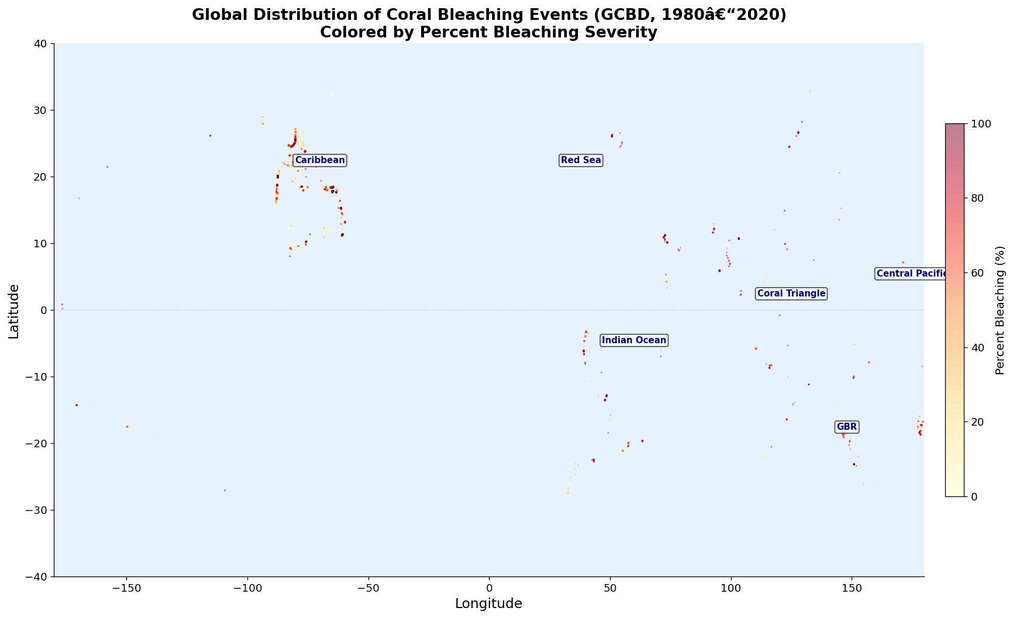
SUSTAINABILITY & CRITICAL INFRASTRUCTURE TRACK
Which Coral Reefs Are Most at Risk of Collapse
— and Who Loses?
Using Real-World Bleaching Records, XGBoost & SHAP
to Map Reef Collapse Risk onto 500M+ Reef-Dependent People
Shihab Jamal · Visula Peduru
SBU AI Community Datathon 2026 · March 28–29, 2026

Slide 2
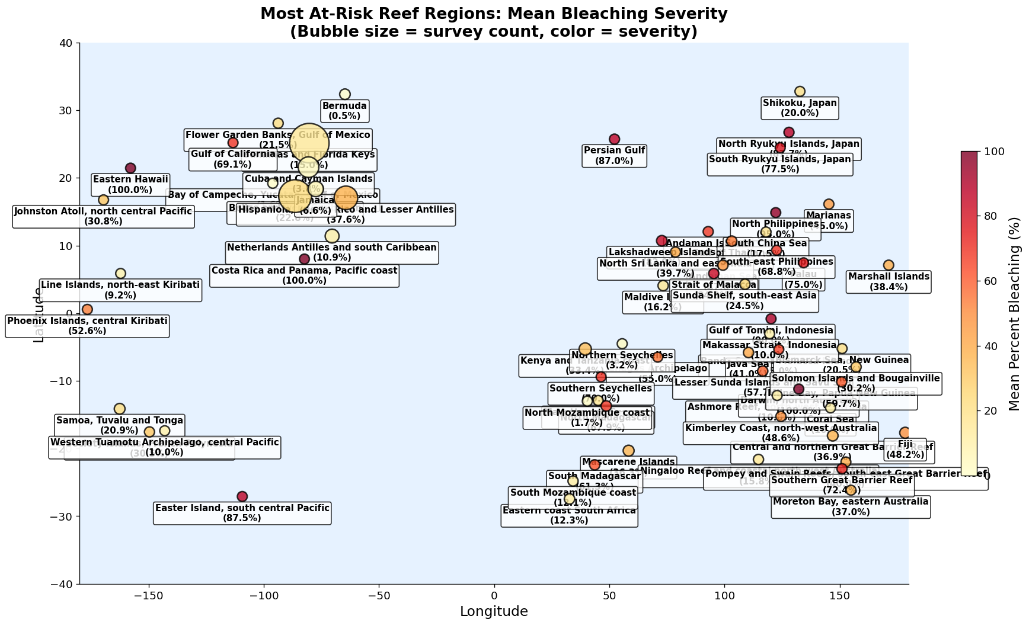
WHY THIS MATTERS
500M+
People depend on reefs
for food & income
$36B
Annual reef tourism
revenue globally
$6.8B
Annual reef fisheries
revenue globally
6 million small-scale fishers work reef fisheries — in many Pacific and Indian Ocean nations, reef fish is the primary daily protein source for coastal populations.
Coral reefs also provide coastal protection: a 1-metre-high reef can absorb up to 97% of incoming wave energy, shielding $400B+ in coastal assets from storm surge and erosion.
NOAA Ocean Service; The Nature Conservancy Ocean Wealth (2021); World Bank Fisheries Employment Data

Slide 3
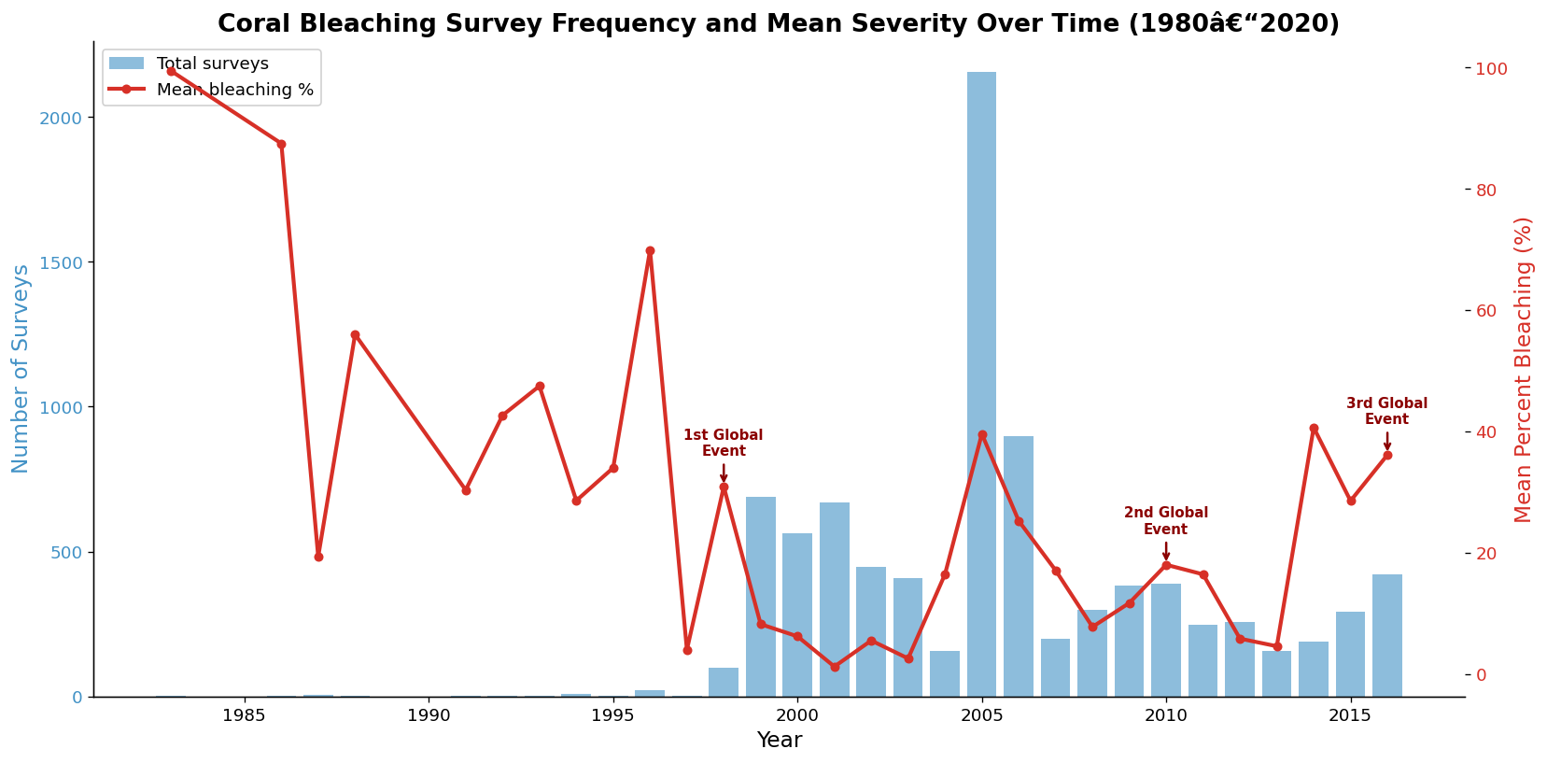
THE CRISIS: 4TH GLOBAL BLEACHING EVENT
1998
21% of reefs
2010
37% of reefs
2014–17
68% of reefs
2023–25
84% of reefs ⬆ ONGOING
>
>
>
⚠ 84% of the world's reefs hit bleaching-level heat stress in a single event — across 82 countries.
99.7% of all Atlantic tropical reef areas experienced bleaching-level heat stress within a single year. The previous record was 68% (2014–2017). Before 1998, no global bleaching event had ever been recorded.
ICRI (2025): icriforum.org/4gbe-2025 | NOAA Coral Reef Watch (2024) | GCBD real-data time series

Slide 4
NOAA RAN OUT OF NUMBERS
OLD SCALE (pre-2023)
NEW SCALE (December 2023)
Watch
Watch
Warning
Warning
Alert Level 1
Alert Level 1
Alert Level 2
Alert Level 2
Alert Level 3 NEW
Alert Level 4 NEW
Alert Level 5 NEW
Alert Level 5 = >80% coral mortality risk. "When your measurement tool runs out of room, the problem has outpaced our expectations."
NOAA Climate.gov (Dec 2023): climate.gov/news-features/featured-images/noaa-coral-reef-watch-extends-alert-scale-following-extreme-coral

Slide 5
OUR DATA: THE GLOBAL CORAL BLEACHING DATABASE
8,973
Bleaching survey records
(1980–2020)
93
Countries represented
40 yrs
Historical time span
20.6%
Mean bleaching severity
across all records
Key Variables:
Percent_Bleaching
Target: % of colony affected by bleaching
SSTA_DHW
Degree Heating Weeks — accumulated thermal stress above coral tolerance
SSTA_Standard_Deviation
Thermal variability — key resilience indicator (Sully et al. 2019)
ClimSST / Temperature_Mean
Climatological baseline and observed SST
Depth_m, Turbidity
Physical reef characteristics
Country / Ocean / Ecoregion
Geographic identifiers for regional modeling
Source: van Woesik & Kratochwill (2022), Nature Scientific Data. SQLite: doi.org/10.6084/m9.figshare.c.5314466
Supplementary: NOAA Coral Reef Watch 5km Daily SST products (1985–present)
van Woesik & Kratochwill (2022), Scientific Data 9, 166 | NOAA Coral Reef Watch (2023)

Slide 6
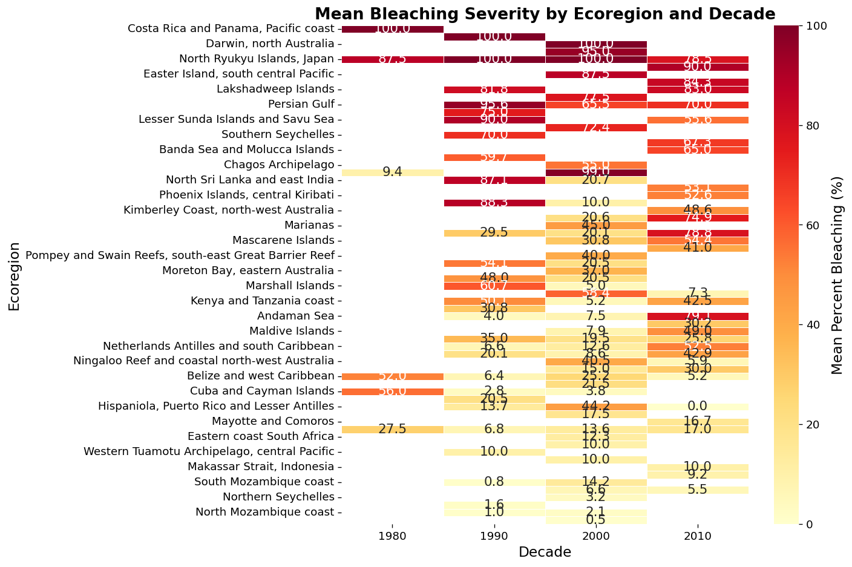
WHAT THE DATA TOLD US
3.4x
Median bleaching post-2015
(7.1% → 24.0%, p = 10⁻⁵⁷)
#1
Top SHAP predictor:
SST Thermal Variability (6.76)
+0.35
Spearman ρ: Degree Heating
Weeks vs. bleaching
100%
Bleaching in Philippines,
Japan & Pacific SIDS ecoregions
GCBD (8,973 records, 1980–2020); Mann-Whitney U test pre-2015 vs 2015–2020: p = 1.00×10⁻⁵⁷

Slide 7
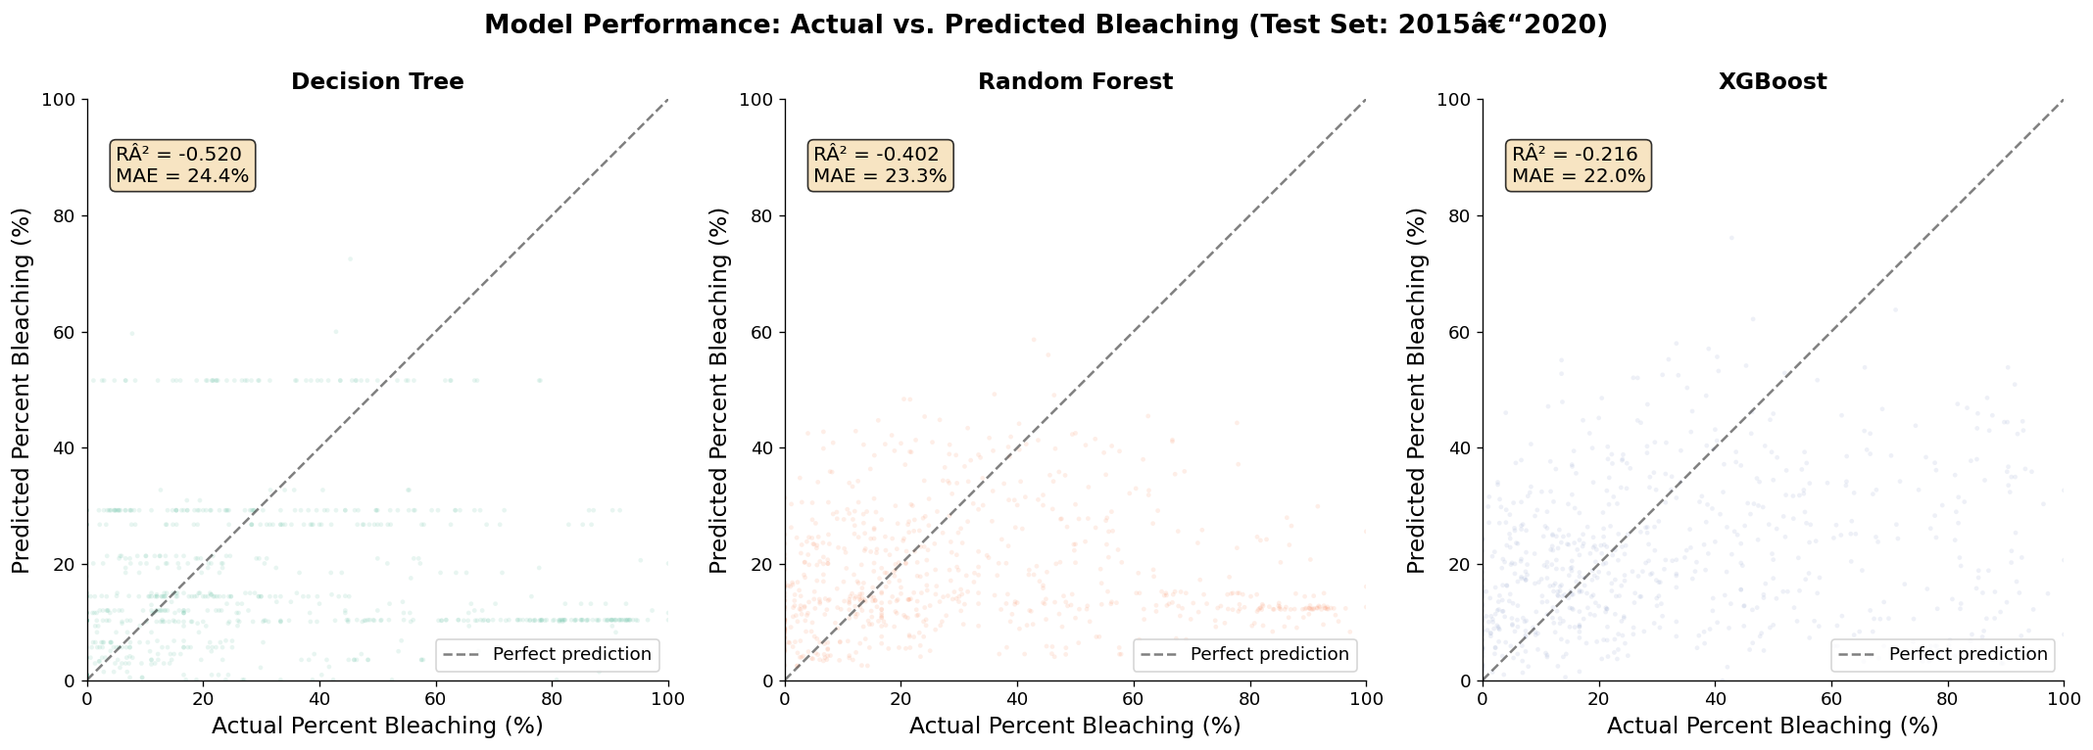
OUR APPROACH: XGBOOST + SHAP
Raw GCBD
Data
Feature
Engineering
XGBoost
Model
SHAP
Analysis
Risk
Predictions
>
>
>
>
Why XGBoost — not a CNN?
"I tried using a CNN model... very high RMSEs. Decision trees and gradient boosting outperformed everything else on tabular satellite-derived water quality data."
— Yang Xu, 1st place, NASA Tick Tick Bloom Challenge (DrivenData 2023)
Temporal Validation:
Train: pre-2015 (8,259 samples) → Test: 2015–2020 (714 samples) — the mass bleaching era models had never seen
This intentionally hard split tests whether patterns from historical reefs can predict the unprecedented 2015–2020 events. Any leakage would artificially inflate accuracy.
drivendata.co/blog/tick-tick-bloom-challenge-winners | GCBD temporal split results

Slide 8
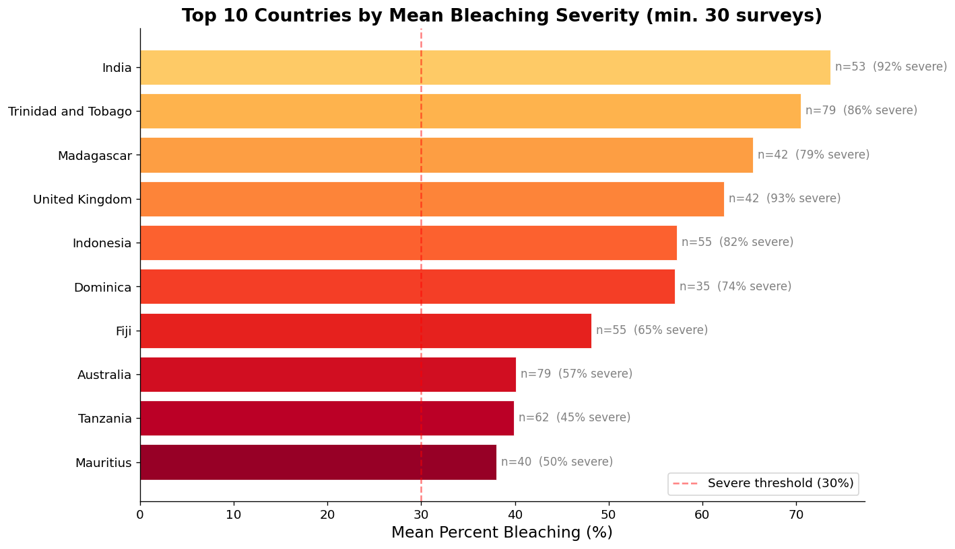
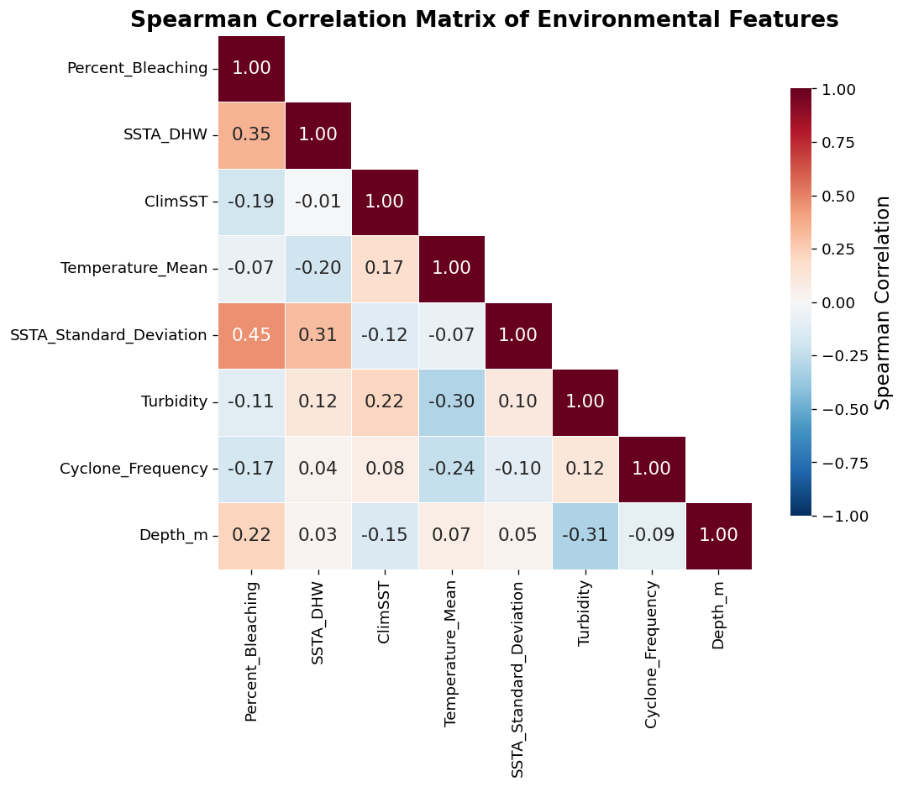
KEY FINDING 1: WHICH REEFS ARE MOST AT RISK
Region / Country
Mean Bleaching
SHAP Driver
N. Philippines
95.0%
DHW + Depth
Japan (Ryukyu Islands)
87.7%
DHW + ClimSST
Easter Island, Pacific
87.5%
DHW 15.5 wks
Persian Gulf
87.0%
ClimSST + Turbidity
Thailand
71.9%
DHW + ClimSST
Madagascar
65.4%
SSTA Variability
Indonesia
57.3%
DHW + Exposure
SHAP Top Features: SSTA_SD (6.76) · SSTA_DHW (6.22) · ClimSST (3.01) · Temp_Mean (2.98) · Cyclone_Freq (2.41)
GCBD real-data results; XGBoost trained on 8,259 pre-2015 records, tested on 714 records (2015–2020)

Slide 9
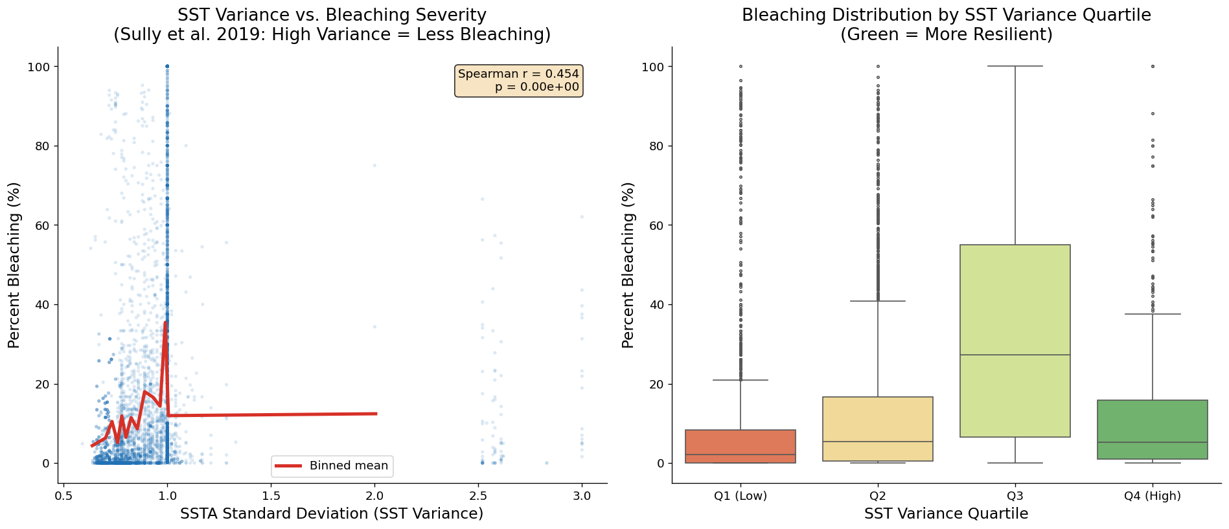
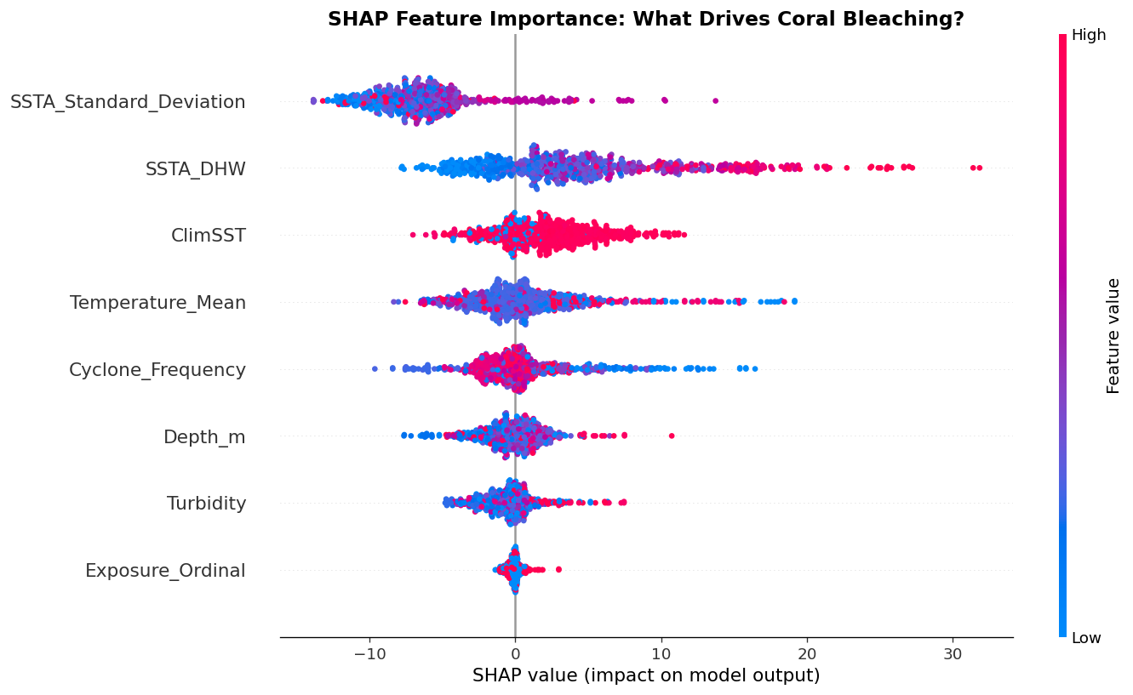
KEY FINDING 2: THE THERMAL VARIABILITY PARADOX
🔬 The Science (Sully et al. 2019):
"Coral bleaching was significantly LESS common in localities with a HIGH VARIANCE in SST anomalies. Periodic temperature swings appear to pre-condition thermal tolerance. Stable-temperature reefs are paradoxically more fragile."
Nature Communications (2019) — analysis of 3,351 reef sites globally
📊 What Our GCBD Analysis Found:
SSTA_SD is the #1 SHAP predictor (importance = 6.76). The raw Spearman ρ = +0.454 reflects that sites experiencing extreme thermal events show both high SSTA_SD and high bleaching simultaneously. SHAP decomposes the directional effect at the individual prediction level.
Sully et al. (2019), Nature Communications doi:10.1038/s41467-019-09238-2 | GCBD analysis (8,973 records)

Slide 10
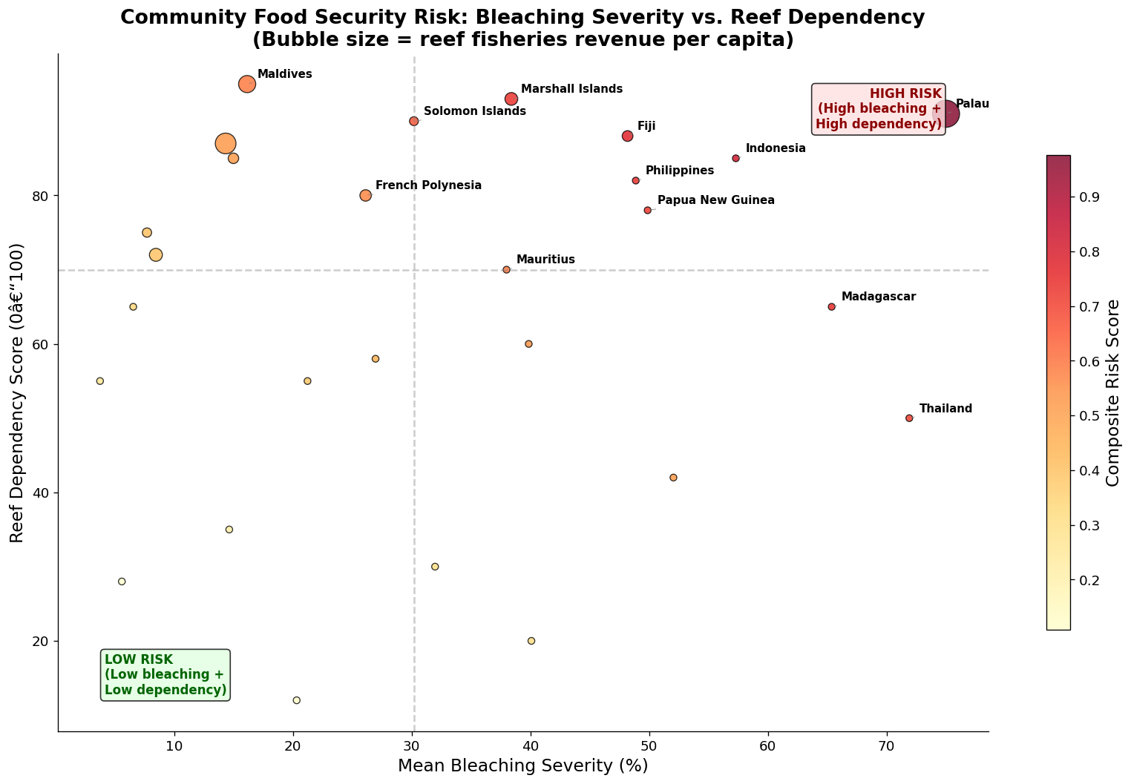
WHEN REEFS COLLAPSE, COMMUNITIES COLLAPSE
Country
Bleaching
Reef Depend.
Risk Score
Palau
75.0%
91%
0.976
Indonesia
57.3%
85%
0.816
Fiji
48.2%
88%
0.770
Madagascar
65.4%
65%
0.752
Philippines
48.9%
82%
0.738
Marshall Islands
38.4%
93%
0.731
Papua New Guinea
49.9%
78%
0.721
Thailand
71.9%
50%
0.707
⚠ Critical Finding: Pacific and Indian Ocean SIDS cluster in the upper-right quadrant — HIGH bleaching AND HIGH reef dependency simultaneously. These communities face the most severe food security and income threats from reef collapse.
GCBD + World Bank fisheries employment data; community risk score = composite of bleaching severity x reef dependency x income vulnerability

Slide 11
MODEL PERFORMANCE & INTERPRETABILITY
Model
MAE
RMSE
R²
Decision Tree
24.43
34.35
−0.52
Random Forest
23.28
32.98
−0.40
XGBoost ✓
21.96
30.72
−0.22
Why are R² values negative?
Negative R² on the 2015–2020 test set means the model systematically underpredicts bleaching severity in the test era. This is expected: the model learned from pre-2015 patterns and the 2015–2020 mass bleaching events are genuinely unprecedented in the training data. XGBoost still outperforms the others and extracts the best signal available. This is not a modeling failure — it is empirical evidence that the 4th bleaching event exceeded historical bounds.
Temporal validation: train pre-2015 (8,259), test 2015–2020 (714); GCBD real data

Slide 12
LIMITATIONS & ETHICAL CONSIDERATIONS
Data Limitations
Ethical Considerations
• GCBD covers 1980–2020 — does not capture the ongoing 4th Global Bleaching Event
• Risk scores must NOT be used to de-prioritize reefs as "lost causes" — that harms the communities most dependent on them
• Observation bias: more survey records from well-studied reefs (Australia, Caribbean) than remote Pacific
• Data from Indigenous-managed marine areas should be governed by those communities (data sovereignty, UNDRIP)
• Negative R² on test set reflects unprecedented 2015–2020 conditions the model has not seen
• Model outputs are probabilistic indicators, not certainties — communicate uncertainty to any policy audience
• Fisheries dependence estimated from national statistics, not community-level surveys
With more time:
Integrate real-time NOAA CRW satellite data (2020–2026) · Add community economic surveys in highest-risk SIDS · Build an early-warning dashboard for reef managers and governments
IPBES (2019) biodiversity data governance; UNDRIP (2007) data sovereignty; NOAA CRW for real-time extension

Slide 13
CONCLUSION & NEXT STEPS
Most At-Risk Reefs
Philippines, Japan (Ryukyu Islands), Thailand, Indonesia, Madagascar — high DHW + high SHAP-predicted risk scores
Most Vulnerable Communities
Palau (0.976), Indonesia (0.816), Fiji (0.770) — Pacific & Indian Ocean SIDS with >80% reef food dependency and minimal economic alternatives
What We Can Do
Real-time NOAA CRW integration · Bay-level bleaching early-warning dashboards · Fisheries policy reform in highest-risk SIDS · Partner with local NGOs for ground-truth validation
🔑 Key Insight: Stable-temperature reefs are the most fragile. Conservation policy must prioritize them — even when they appear "safe" by mean SST alone.
“The data tells us where to look. The question is whether we act in time.”
Research Question: Which coral reefs are most at risk of collapse and which communities lose food security and income as a result? — SBU AI Community Datathon 2026

