Slide 1
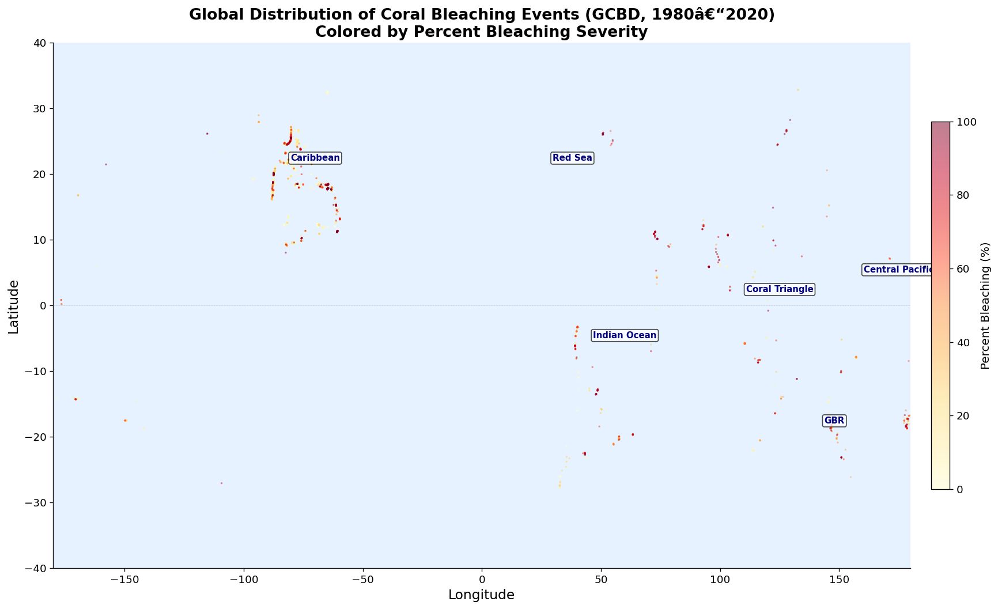
SUSTAINABILITY & CRITICAL INFRASTRUCTURE TRACK
Which Coral Reefs Are Most at Risk
of Collapse — and Who Loses?
Using Real-World Bleaching Records, XGBoost & SHAP
to Map Reef Collapse Risk onto 500M+ Reef-Dependent People
Shihab Jamal · Visula Peduru
SBU AI Community Datathon 2026 · March 28–29, 2026

Slide 2
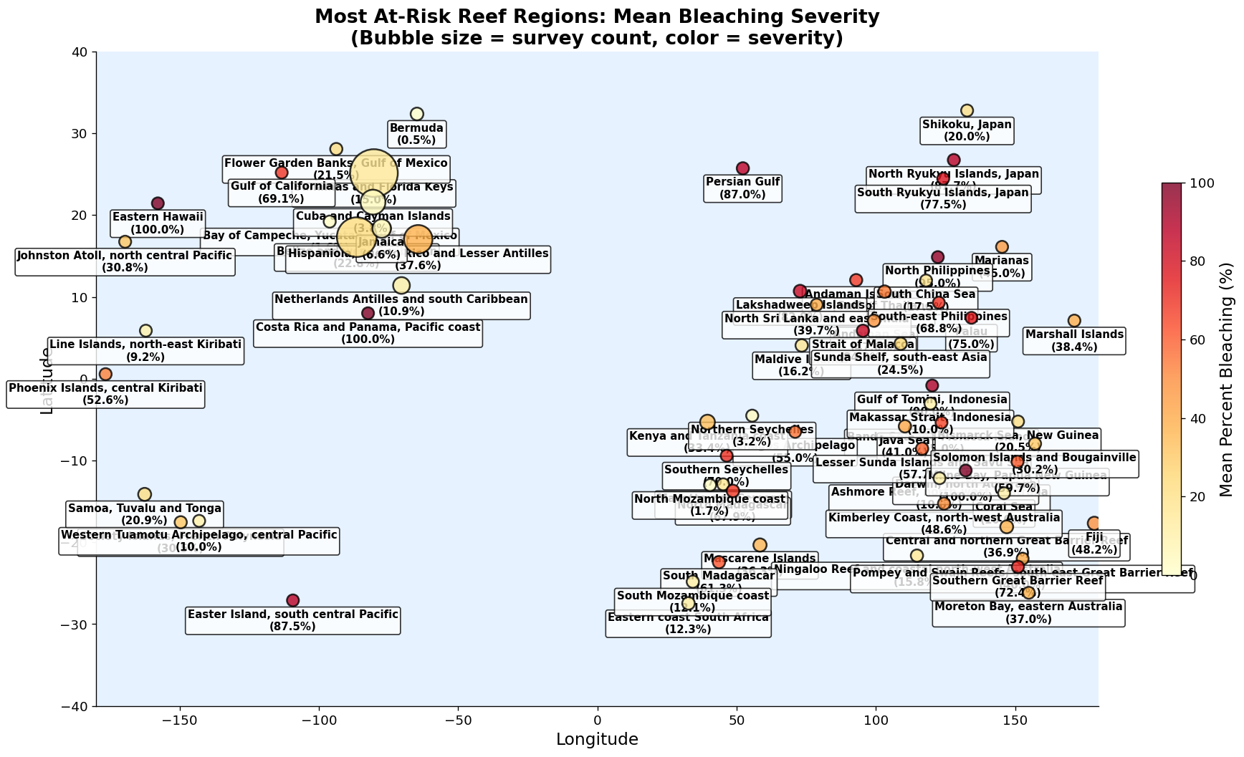
Why This Matters
500M+
$36B
$6.8B
People depend on reefs
for food & income
Annual reef tourism
revenue globally
Annual reef fisheries
revenue globally
6 million small-scale fishers depend on reef ecosystems. In Pacific and Indian Ocean nations, reef fish is the primary daily protein source for coastal populations.
Structural defence: a 1-metre reef absorbs up to 97% of incoming wave energy, protecting $400B+ in coastal assets from storm surge annually.
NOAA Ocean Service; The Nature Conservancy Ocean Wealth (2021); World Bank Fisheries Employment Data

Slide 3
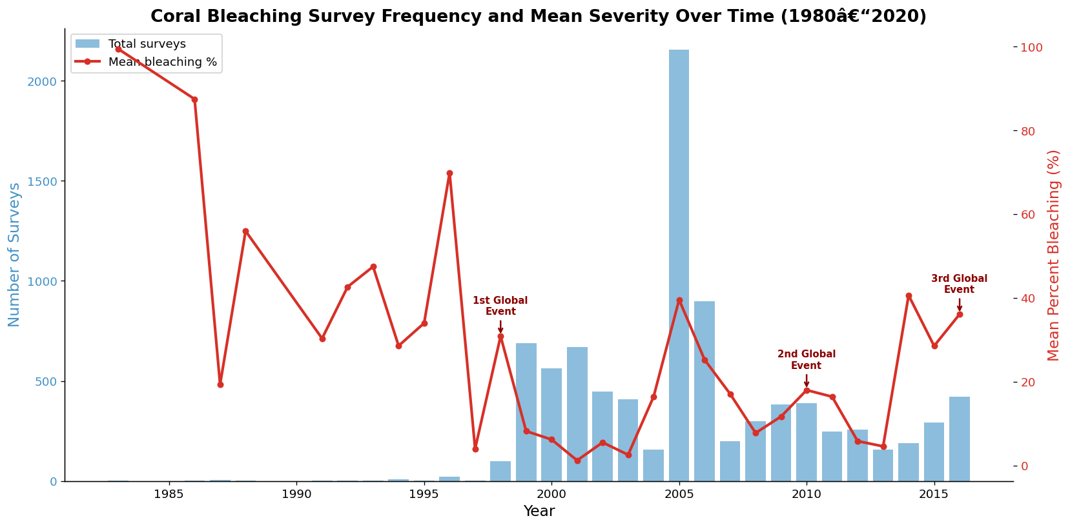
The Crisis: 4th Global Bleaching Event
1998
2010
2014–17
2023–25
21%
›
37%
›
68%
›
84%
1st global event
2nd global event
3rd global event
4th global event ↑ ONGOING
⚠ 84% of the world's reefs hit bleaching-level heat stress across 82 countries — 99.7% of all Atlantic tropical reef areas within a single year.
ICRI (2025): icriforum.org/4gbe-2025 | NOAA Coral Reef Watch (2024) | GCBD time series (8,973 records)

Slide 4
NOAA Ran Out of Numbers
OLD SCALE (pre-2023)
NEW SCALE (December 2023)
Watch
Watch
Warning
Warning
vs.
Alert Level 1
Alert Level 1
Alert Level 2
Alert Level 2
Alert Level 3 ★ NEW
Alert Level 4 ★ NEW
Alert Level 5 ★ NEW
"Alert Level 5 = >80% coral mortality risk. When your measurement tool runs out of room, the problem has outpaced our expectations."
NOAA Climate.gov (December 2023) | NOAA Coral Reef Watch Alert Scale documentation

Slide 5
Our Data: The Global Coral Bleaching Database
8,973
93
40 yrs
20.6%
Survey records
(1980–2020)
Countries
represented
Historical
time span
Mean bleaching
severity (all records)
Variable Description
Percent_Bleaching — Target variable — % of coral colony affected by bleaching
SSTA_DHW — Degree Heating Weeks — accumulated thermal stress above coral tolerance
SSTA_Standard_Deviation — Thermal variability — #1 SHAP predictor and key resilience indicator
ClimSST / Temperature_Mean — Climatological baseline sea surface temperature and observed mean SST
Depth_m, Turbidity — Physical reef characteristics (shelter, water clarity)
Country / Ocean / Ecoregion — Geographic identifiers for regional risk modeling
Source: van Woesik & Kratochwill (2022), Nature Scientific Data. SQLite: doi.org/10.6084/m9.figshare.c.5314466. Supplementary: NOAA Coral Reef Watch 5km daily SST.
van Woesik & Kratochwill (2022), Scientific Data 9, 166 | NOAA Coral Reef Watch (2023)

Slide 6
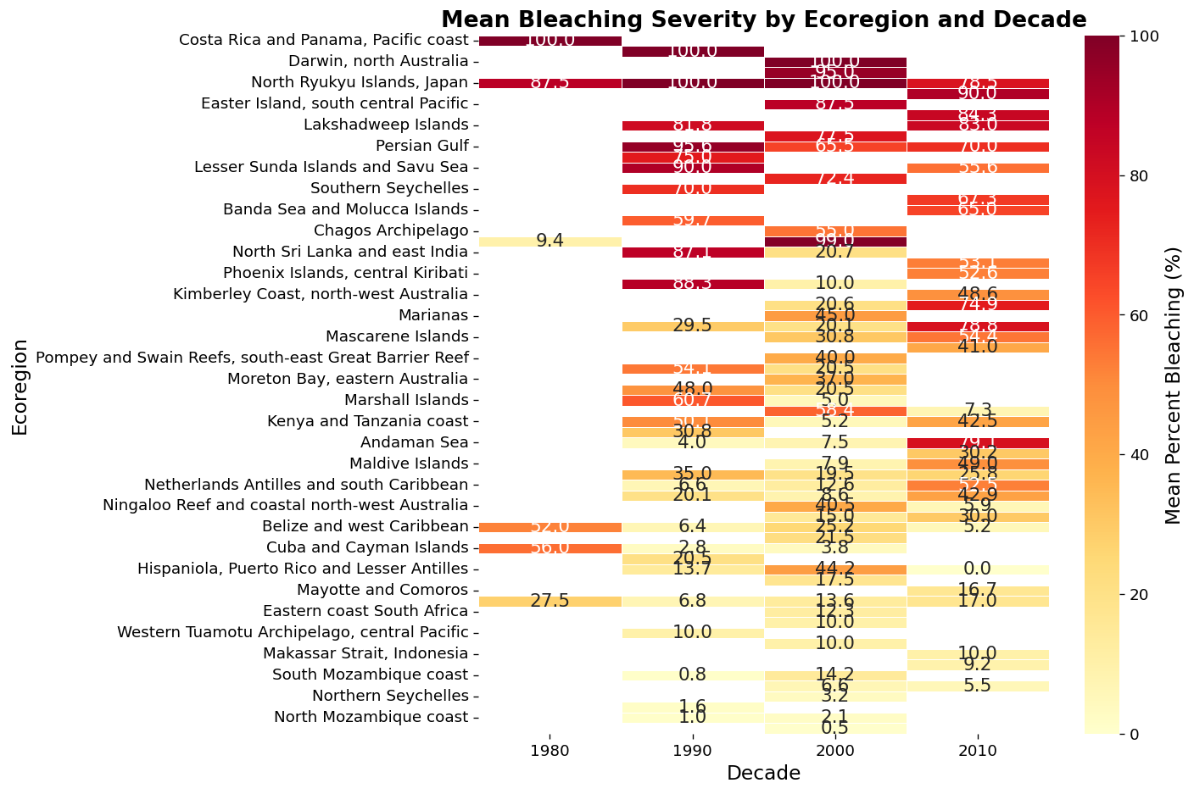
EDA: What the Data Told Us
3.4×
#1
+0.35
100%
Median bleaching post-2015
(7.1% → 24.0%, p = 10⁻⁵⁷)
SHAP predictor: SST Thermal
Variability (score = 6.76)
Spearman ρ: Degree Heating
Weeks vs. bleaching
Bleaching in Philippines,
Japan & Pacific SIDS regions
GCBD (8,973 records, 1980–2020); Mann-Whitney U test pre-2015 vs 2015–2020: p = 1.00×10⁻⁵⁷

Slide 7
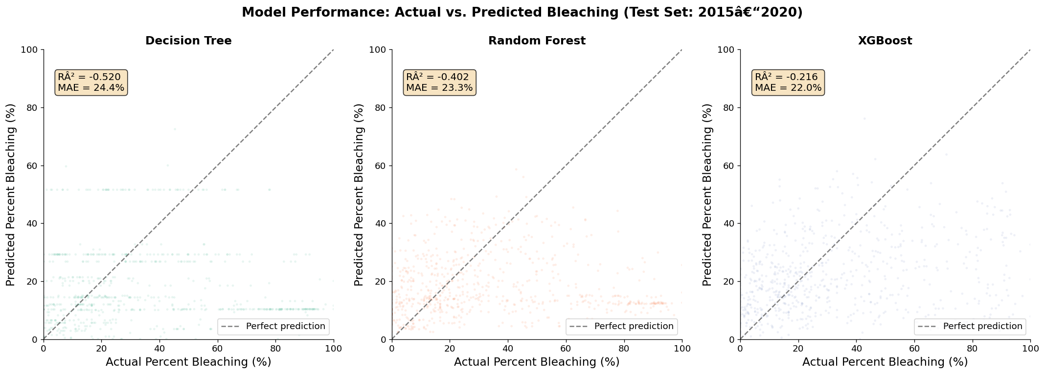
Our Approach: XGBoost + SHAP
Raw GCBD
Data
›
Feature
Engineering
›
XGBoost
Model
›
SHAP
Analysis
›
Risk
Predictions
" I tried using a CNN model… very high RMSEs. Decision trees and gradient boosting outperformed everything else on tabular satellite-derived water quality data.
— Yang Xu, 1st place, NASA Tick Tick Bloom Challenge (DrivenData 2023)
Temporal Validation Strategy
Train: pre-2015 (8,259 samples) → Test: 2015–2020 (714 samples)
This hard temporal split prevents data leakage — and tests whether pre-2015 patterns can predict the unprecedented 2015–2020 mass bleaching events.
drivendata.co/blog/tick-tick-bloom-challenge-winners | GCBD temporal split model results

Slide 8
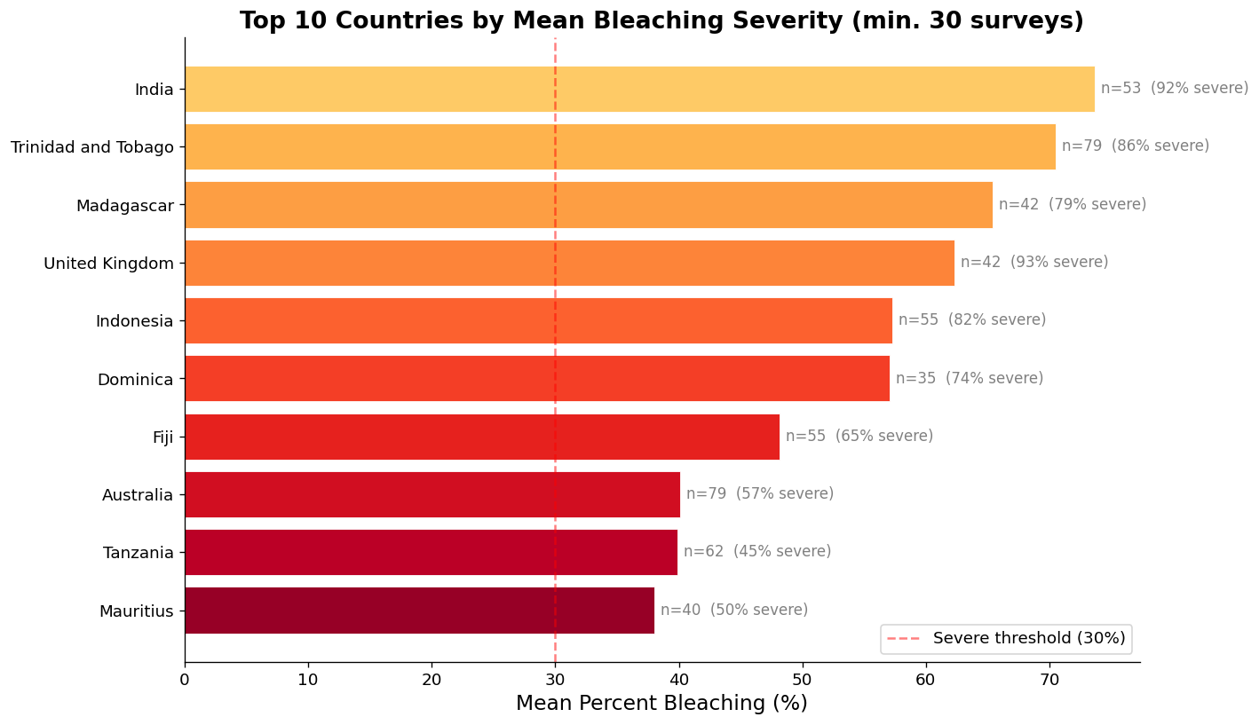
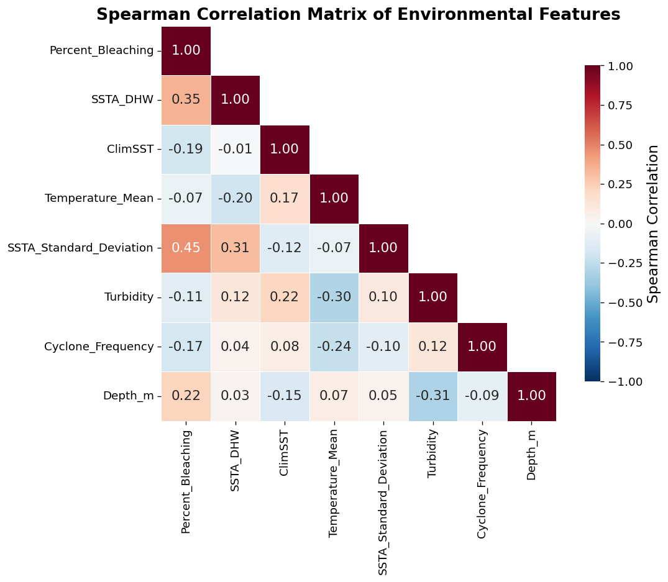
Key Finding 1: Which Reefs Are Most at Risk
Region / Country
Mean Bleaching
SHAP Driver
N. Philippines
95.0%
DHW + Depth
Japan (Ryukyu Islands)
87.7%
DHW + ClimSST
Easter Island, Pacific
87.5%
DHW 15.5 weeks
Persian Gulf
87.0%
ClimSST + Turbidity
Thailand
71.9%
DHW + ClimSST
Madagascar
65.4%
SSTA Variability
Indonesia
57.3%
DHW + Exposure
SHAP Top 5: SSTA_SD (6.76) · DHW (6.22) · ClimSST (3.01) · Temp_Mean (2.98) · Cyclone_Freq (2.41)
GCBD real-data results; XGBoost trained on 8,259 pre-2015 records, tested on 714 records (2015–2020)

Slide 9
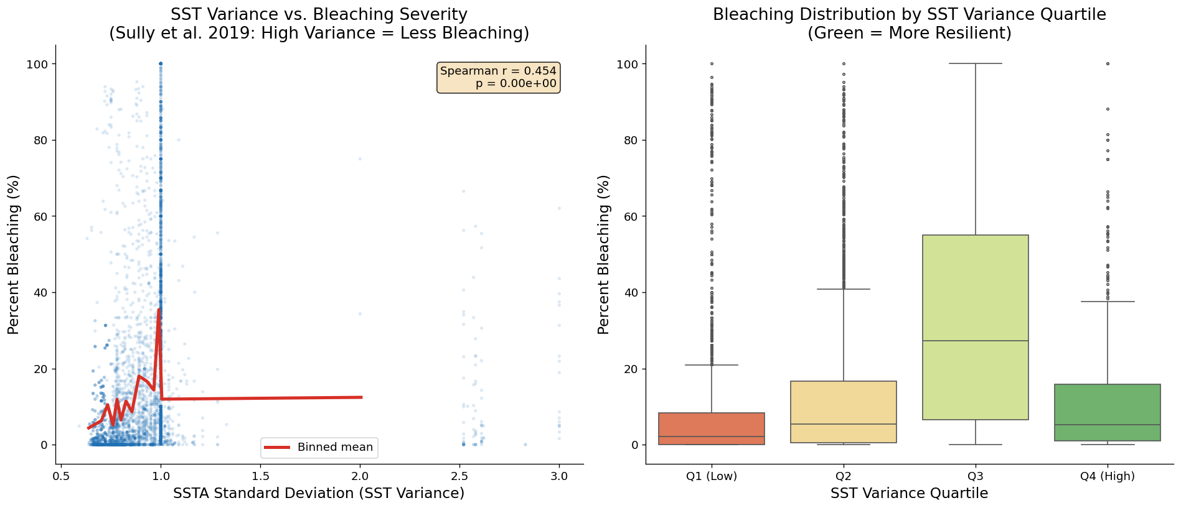
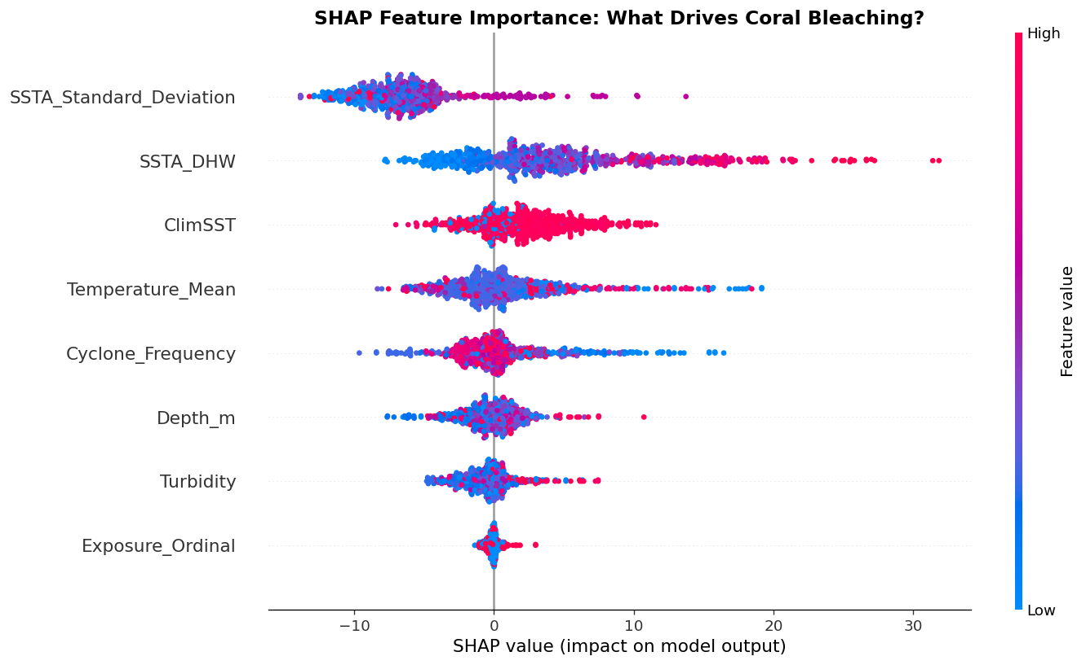
Key Finding 2: The Thermal Variability Paradox
🔬 The Science — Sully et al. (2019), Nature Communications
"Coral bleaching was significantly LESS common in localities with a HIGH VARIANCE in SST anomalies. Periodic temperature swings appear to pre-condition thermal tolerance in corals. Stable-temperature reefs are paradoxically more fragile." — analysis of 3,351 reef sites globally
📊 What Our GCBD Analysis Found
SSTA_SD is the #1 SHAP predictor (importance = 6.76). The raw Spearman ρ = +0.454 reflects that sites experiencing extreme thermal events show both high SSTA_SD and high bleaching simultaneously. SHAP decomposes the directional effect at the individual prediction level — separating acute-event spikes from background variability.
Sully et al. (2019), Nature Communications doi:10.1038/s41467-019-09238-2 | GCBD real-data analysis (8,973 records)

Slide 10
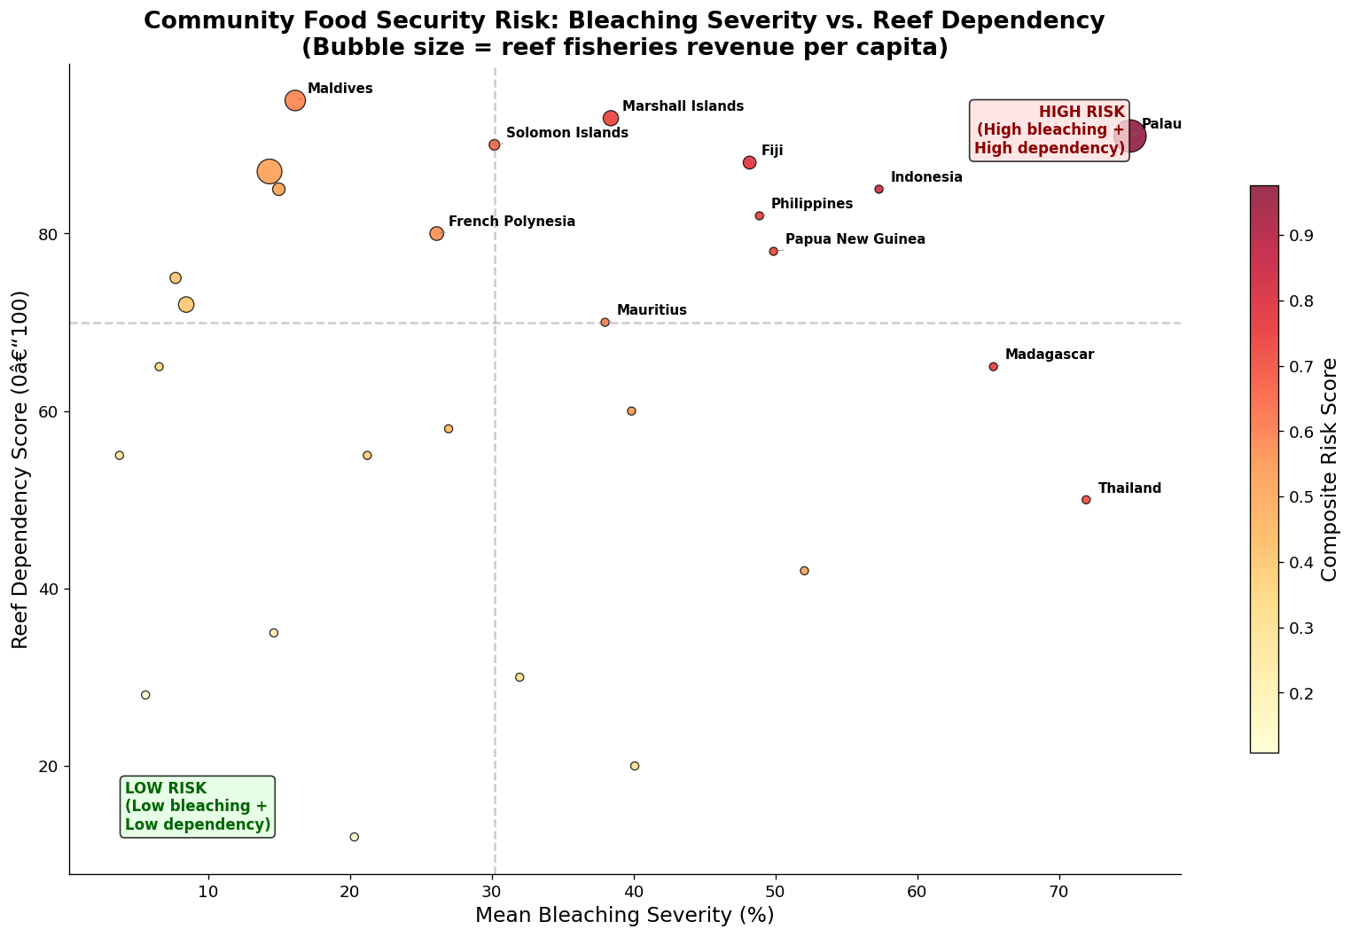
Community Impact: When Reefs Collapse, Communities Collapse
Country
Bleaching
Reef Depend.
Risk Score
Palau
75.0%
91%
0.976
Indonesia
57.3%
85%
0.816
Fiji
48.2%
88%
0.770
Madagascar
65.4%
65%
0.752
Philippines
48.9%
82%
0.738
Marshall Is.
38.4%
93%
0.731
Papua N. Guinea
49.9%
78%
0.721
Thailand
71.9%
50%
0.707
⚠ Critical: Pacific & Indian Ocean SIDS cluster in the upper-right quadrant — HIGH bleaching AND HIGH reef dependency simultaneously. These communities have no alternative protein source or income.
GCBD + World Bank fisheries employment data; risk score = bleaching severity × reef dependency × income vulnerability

Slide 11
Model Performance & Interpretability
Model
MAE
RMSE
R²
Decision Tree
24.43
34.35
−0.52
Random Forest
23.28
32.98
−0.40
XGBoost ✓
21.96
30.72
−0.22
Why are R² values negative?
Negative R² on the 2015–2020 test set means the model underpredicts bleaching severity in the test era.
This is expected: the model learned from pre-2015 patterns, and the 2015–2020 mass bleaching events are genuinely unprecedented. XGBoost still outperforms all alternatives.
This is not a modeling failure — it is empirical evidence that the 4th Global Bleaching Event exceeded every historical bound.
Temporal validation: train pre-2015 (8,259), test 2015–2020 (714); GCBD real data

Slide 12
Limitations & Ethical Considerations
Data Limitations
Ethical Considerations
• GCBD covers 1980–2020 — does not capture the ongoing 4th Global Bleaching Event
• Risk scores must NOT de-prioritize reefs as "lost causes" — that harms communities most dependent on them
• Observation bias: more records from Australia/Caribbean than remote Pacific islands
• Reef data from Indigenous-managed areas should be governed by those communities (UNDRIP, 2007)
• Negative R² on test set reflects unprecedented 2015–2020 conditions not in training data
• Model outputs are probabilistic indicators, not certainties — communicate uncertainty to policy audiences
• Fisheries dependence estimated from national statistics, not community-level surveys
With more time:
Integrate real-time NOAA CRW satellite data (2020–2026) · Add community economic surveys in highest-risk SIDS · Build an early-warning dashboard for reef managers and policymakers
IPBES (2019) biodiversity data governance; UNDRIP (2007) data sovereignty principles; NOAA CRW for real-time extension

Slide 13
Conclusion & Next Steps
Most At-Risk Reefs
Most Vulnerable Communities
What We Can Do
Philippines, Japan (Ryukyu Islands), Thailand, Indonesia, Madagascar — high Degree Heating Weeks + highest SHAP-predicted risk scores
Palau (0.976), Indonesia (0.816), Fiji (0.770) — Pacific & Indian Ocean SIDS with >80% reef food dependency and no viable alternatives
Real-time NOAA CRW data integration · Bay-level bleaching early-warning systems · Fisheries policy reform in highest-risk SIDS · NGO ground-truth validation
🔑 Key Insight: Stable-temperature reefs are the most fragile. Conservation policy must prioritize them — even when they appear "safe" by mean SST alone.
" The data tells us where to look. The question is whether we act in time. "
Research Question: Which coral reefs are most at risk of collapse and which communities lose food security? — SBU AI Community Datathon 2026

