Slide 1
Java – 3
2018. 10. 04
현창종
Notes:
서버구현 기본 프로그램 리눅스 프로그램

Slide 2
Outline
Call by value, Call by reference
Scope
package
Access modifier
Inheritance
interface
Notes:
효율 굿굿

Slide 3
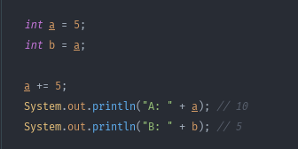
Call by value, Call by reference
Call by value
값 자체를 전달 받음
memory
value
a
5
b
5
Notes:
효율 굿굿

Slide 4
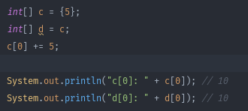
Call by value, Call by reference
Call by reference
레퍼런스를 전달받음
memory
value
c
5
…
d
…
…
Notes:
효율 굿굿

Slide 5
Call by value, Call by reference
Call in Java
Primitive type(int, long, double, Boolean, char) → Call by value
Array type, object → Call by reference
Equals vs ==
Equals → compare object’s contents
== → compare object’s memory
Notes:
효율 굿굿

Slide 6
Scope
Variable’s Scope
Variable’s scope in java
Instance variable → in object (not static function)
Local variable → in block
Global variable → in all block
Notes:
효율 굿굿

Slide 7
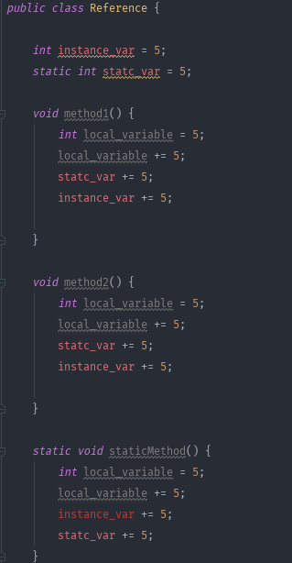
Scope
Variable’s Scope
Variable’s scope in java
Instance variable → in object (not static function)
Can access method
Cannot access static method!
Notes:
효율 굿굿

Slide 8
Scope
Variable’s Scope
Variable’s scope in java
Local variable → in block
Its range is only method block
Notes:
효율 굿굿

Slide 9
Scope
Variable’s Scope
Variable’s scope in java
Global variable → in all block (static keyword)
Using “static” keyword, can make global variable
It can access all method
Notes:
효율 굿굿

Slide 10
Package
Package
Divide classes(.java) by directory
It can help to use same name class(.java)
Encapsulation – Modulation
Notes:
효율 굿굿

Slide 11
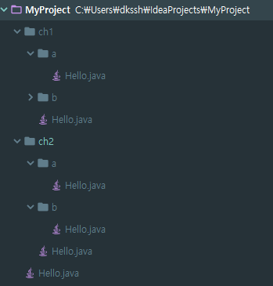
Package
Package
Java…?
Project directory
Source directory(main running)
sub directory → need package
.java → do not need package
Notes:
효율 굿굿

Slide 12

Package
Package
Divide classes(.java) by directory
CMD’s current directory → main project
subdirecroty
ch1 (package ch1)
a (package ch1.a)
b (package ch1.b)
ch2 (package ch2)
a (package ch2.a)
b (package ch2.b)
Notes:
효율 굿굿

Slide 13
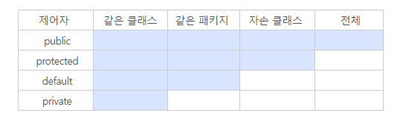
Access Modifier
Access Modifier
The access modifier is used by a member or a class to restrict access
public – can access all “public” variable, method (any class)
protected – can access only the package or other extended class
default – can access only the package
private – can access only class
Reference: http://88240.tistory.com/448, https://wikidocs.net/232
Notes:
효율 굿굿

Slide 14
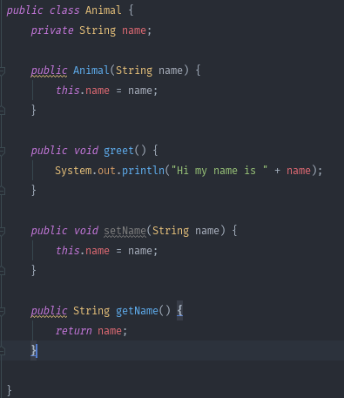
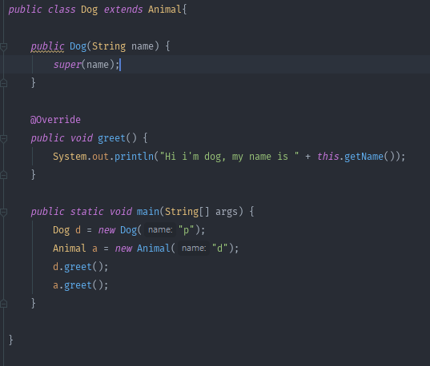
Inheritance
Inheritance
The child inherits something from its parents
It increases the reusability of resources and transforms or adds resources
Using key word “extends”
The child class can inherits only 1 parent class
Notes:
효율 굿굿

Slide 15
Inheritance
Inheritance
Is-a
Animal
Animal dog = new Dog(); // true
Dog dog = new Animal(); // compile error
All Dog can be Animal, but All Animal cannot be Dog
Dog
Notes:
효율 굿굿

Slide 16
Inheritance
Inheritance
Super
Call parent method
Notes:
효율 굿굿

Slide 17
Inheritance
Inheritance
Override
modify parent’s method
Notes:
효율 굿굿

Slide 18
Interface
Interface
If Some class implement a specific interface, that class must implement the methods of the interface
Can implement multiple interface
Keyword: make → “interface”, implement → implement
Usually used Adjectives ( Callable, Clickable…)
When is the interface used?
Forces the implementation(method).
Callback
Functional Programming
Notes:
효율 굿굿

Slide 19
Interface
Interface
If Some class implement a specific interface, that class must implement the methods of the interface
Can implement multiple interface
Keyword: make → “interface”, implement → implement
Usually used Adjectives ( Callable, Clickable…)
When is the interface used?
Forces the implementation(method).
Callback
Functional Programming
Notes:
효율 굿굿

Slide 20
Interface
Interface
난 동물원의 사육사이다. 육식동물이 들어오면 난 먹이를 던져준다. 호랑이가 오면 사과를 던져준다. 사자가 오면 바나나를 던져준다. → 구현해보자..!
Reference: https://wikidocs.net/217
Notes:
효율 굿굿

Slide 21
Homework
Notes:
효율 굿굿

Slide 22
Homework
는 주말에 공개할께용 ^0^ 다음주 금요일까지 풀어오쎄용
Notes:
효율 굿굿

