Slide 1
Project Overview
Notes:
Title and Team Introduction

Slide 2

Title and Team Introduction
Project Academic Context
The project is part of SEHS4697 Big Data and Cloud Analytics course emphasizing real-world data application.
Project Focus and Objective
Focuses on Airbnb host profitability, analyzing pricing, occupancy, and performance in Hong Kong market.
Team and Roles
Group 7 from Class B01 collaborates on data cleaning, modeling, and business interpretation tasks.
Business-Oriented Insight
Project aims to deliver actionable insights benefiting Airbnb hosts and platform’s business decisions.
Notes:
This slide introduces the academic and analytical context of the project, which is conducted as part of the course SEHS4697 Big Data and Cloud Analytics. The project focuses on applying data analytics techniques to a real-world digital platform, Airbnb, with a specific emphasis on host profitability and performance in the Hong Kong market. The title, “Unlocking Airbnb Host Profitability: Pricing, Occupancy, and Host Performance,” reflects the dual objective of understanding both revenue-related outcomes and operational behaviors that drive success for hosts. The study is framed as a group project, highlighting collaborative data analysis, modeling, and interpretation. Group 7 from Class B01 is responsible for this work, and the team consists of AU Tsz Wai, CHxx Hxx Yxx, LAM Chun Lung, NG Hiu Lam, and SUN Ho Tin. Each member contributes to different stages of the analytics pipeline, including data cleaning, modeling, and business interpretation. By clearly stating the course, project title, group number, and team members, this slide establishes academic credibility, clarifies ownership, and sets expectations for the analytical depth and rigor that follow. It also signals that the project is not purely technical, but business-oriented, aiming to derive actionable insights that could be useful for Airbnb hosts and the platform itself. Overall, this opening slide frames the narrative of the presentation and provides the audience with essential context before diving into data, methods, and results.

Slide 3
Data Understanding
Notes:
Dataset Overview

Slide 4

Dataset Overview
Dataset Scope and Size
The dataset includes 6,803 Hong Kong Airbnb listings with 79 variables capturing multiple ecosystem dimensions.
Key Data Types for Analysis
Focus on price, capacity, host response, review scores, availability, and booking features for detailed insights.
Data Source and Timeliness
Data sourced from Inside Airbnb’s September 2025 snapshot ensures up-to-date market conditions.
Notes:
This slide provides an overview of the dataset used in the analysis, which is sourced from Inside Airbnb, a widely used open data platform that offers detailed information on Airbnb listings worldwide. The specific dataset focuses on Hong Kong listings and is based on the September 2025 snapshot, ensuring that the analysis reflects relatively recent market conditions. The dataset contains 6,803 listings and 79 variables, covering multiple dimensions of the Airbnb ecosystem, including host characteristics, property attributes, guest reviews, and availability calendars. From this rich dataset, several key data types are emphasized for analysis. These include price and capacity variables, which are central to understanding revenue potential and pricing strategies. Host status and response behavior variables capture operational quality and professionalism, which are important for predicting Superhost status. Review scores and demand indicators provide proxies for customer satisfaction and market interest, while availability and Instant Bookable features help measure occupancy and booking convenience. By summarizing the scope, scale, and structure of the dataset, this slide demonstrates that the analysis is grounded in comprehensive and relevant data. It also prepares the audience to understand why certain variables were selected for modeling and how they align with the business questions addressed later in the presentation.

Slide 5
Problem Definition
Notes:
Business Questions

Slide 6

Business Questions
Pricing Drivers
Understanding factors that influence listing prices helps hosts set competitive rates to maximize revenue.
Predicting Superhost Status
Identifying host and property features that predict Superhost status enhances trust and listing performance.
Market Segmentation
Clustering listings into market segments enables tailored strategies for pricing, promotions, and ranking.
Impact of Instant Bookable
Evaluating the effect of Instant Bookable feature on occupancy informs host policies and platform design.
Notes:
This slide outlines the four core business questions that guide the entire analytical process. The first question asks what drives listing prices and how hosts can set competitive prices. This is a fundamental revenue management problem, as incorrect pricing can lead to lost demand or underutilized revenue potential. The second question focuses on identifying which host and property attributes best predict Superhost status. Superhost designation is a key signal of quality on Airbnb and is associated with higher trust and potentially better performance. The third question explores whether listings can be clustered into meaningful market segments. Market segmentation allows both hosts and Airbnb to tailor strategies, such as pricing, promotions, and ranking, to different types of listings rather than adopting a one-size-fits-all approach. The fourth question investigates whether Instant Bookable functionality significantly affects occupancy, which has direct implications for host policies and Airbnb’s platform design. Together, these questions balance descriptive, predictive, and prescriptive analytics. They also link data science methods to concrete business decisions, ensuring that the project delivers insights that are not only statistically sound but also practically useful for stakeholders.

Slide 7
Data Preparation
Notes:
Data Cleaning and Feature Engineering

Slide 8

Data Cleaning and Feature Engineering
Price Variable Cleaning
Price strings with currency symbols were cleaned and converted into numeric values for accurate quantitative analysis.
Handling Missing Data
Missing price rows were removed; median imputation was used for review variables to reduce outlier impact.
Categorical Variable Encoding
Categorical variables were converted into factors to enable proper interpretation in statistical models.
Feature Creation
Created binary variable high_occupancy from availability data to indicate higher occupancy based on threshold.
Notes:
This slide explains the key data cleaning and preparation steps undertaken to ensure the dataset was suitable for analysis and modeling. First, price variables originally stored as strings with currency symbols were cleaned and converted into a numeric variable, price_clean, enabling quantitative analysis. Rows with missing prices were removed, as price is a critical outcome and predictor variable. For review-related variables, missing values were handled using median imputation, which helps retain observations while minimizing the influence of outliers. Host response and acceptance rates, originally stored as percentage strings, were converted into numeric formats to allow their inclusion in regression models. Several categorical variables, including host_is_superhost, instant_bookable, room_type, and neighbourhood_cleansed, were converted into factors so they could be properly interpreted by statistical models. Finally, a new binary variable, high_occupancy, was created from availability_365, using a threshold of fewer than 180 available days to indicate higher occupancy. These steps collectively improve data quality, ensure consistency across variables, and align raw data with the analytical goals of the project. Proper data preparation is critical, as model performance and interpretability depend heavily on clean and well-structured inputs.

Slide 9
Analytical Approach
Notes:
Methods Overview

Slide 10
Pricing Analysis
Notes:
Q1 Price Model Performance

Slide 11

Q1 Price Model Performance
Model Target and Predictors
The model predicts cleaned numeric price using variables like accommodates, bathrooms, bedrooms, room type, and neighborhood.
Training and Testing Split
Data was split 70/30 for training and testing to assess out-of-sample prediction performance accurately.
Performance Metrics
Model evaluation used RMSE for average prediction error and R-squared for variance explained by the model.
Predictive Model Usefulness
The predictive model supports pricing guidance and decision making for hosts, beyond descriptive analysis.
Notes:
This slide focuses on the performance of the pricing model developed to predict price_clean. The target variable is the cleaned numeric price, while predictors include accommodates, bathrooms, bedrooms, room_type, and neighbourhood_cleansed. These variables capture capacity, property quality, and location effects, which are widely recognized drivers of Airbnb pricing. The dataset was split into training and testing sets using a 70/30 split to evaluate out-of-sample performance. Model performance is assessed using RMSE, which measures the average prediction error in price units, and R-squared, which indicates the proportion of variance explained by the model. Although specific numerical values are to be filled in, the structure of the evaluation demonstrates a rigorous approach to validating predictive accuracy. This slide emphasizes that the model is not just descriptive but predictive, making it potentially useful for pricing guidance tools or decision support systems for hosts.

Slide 12
Pricing Insights
Notes:
Q1 Price Model Insights

Slide 13

Q1 Price Model Insights
Capacity Impacts Pricing
Higher guest capacity and more bathrooms correlate with increased prices, reflecting demand for space and comfort.
Property Type Premiums
Entire homes or apartments command higher prices than private rooms due to privacy and exclusivity factors.
Location Influence
Certain districts have higher prices driven by accessibility, tourism demand, and neighborhood reputation.
Model Accuracy and Limitations
Model RMSE shows moderate accuracy; unobserved factors like interior design or host reputation affect pricing.
Notes:
This slide translates the pricing model results into intuitive business insights. It highlights that higher capacity, such as accommodating more guests and having more bathrooms, is associated with higher prices, reflecting guests’ willingness to pay for space and comfort. Entire homes or apartments are priced higher than private rooms, consistent with privacy and exclusivity premiums. Location also plays a significant role, with some districts consistently commanding higher prices due to accessibility, tourism demand, or neighborhood reputation. The slide also notes that the model’s RMSE is around a certain percentage of the average price, indicating moderate accuracy. This suggests that while the model captures key structural drivers of price, there are still unobserved factors, such as interior design or host reputation, that affect pricing. Overall, the insights support data-driven pricing strategies while acknowledging inherent market complexity.

Slide 14
Superhost Prediction
Notes:
Q2 Superhost Model Performance

Slide 15

Q2 Superhost Model Performance
Target Variable and Predictors
The model predicts Superhost status using variables like response rate and review scores capturing host behavior and experience.
Handling Class Imbalance
Up-sampling techniques balance the less frequent Superhost class to improve model learning and prediction accuracy.
Evaluation Metrics
Model performance is evaluated using accuracy, precision, and recall to address challenges in imbalanced classification.
Model Confidence
The assessment shows the model can effectively distinguish Superhosts from non-Superhosts based on observable data.
Notes:
This slide presents the performance of the Superhost prediction model. The target variable is host_is_superhost, a binary indicator of whether a host has achieved Superhost status. Predictors include response rate, acceptance rate, review_scores_rating, instant_bookable, number_of_reviews, and host_listings_count, which together capture responsiveness, experience, and scale. Because Superhosts are less common than non-Superhosts, up-sampling was applied to balance the classes and improve model learning. Model evaluation focuses on test accuracy as well as precision and recall, which are especially important in imbalanced classification problems. While specific metric values are to be filled in, the slide demonstrates an awareness of methodological challenges and appropriate evaluation techniques. This performance assessment provides confidence that the model can meaningfully distinguish between Superhosts and non-Superhosts based on observable behaviors.

Slide 16
Superhost Insights
Notes:
Q2 Superhost Model Insights

Slide 17

Q2 Superhost Model Insights
Host Response Importance
Higher host response rates strongly correlate with achieving Superhost status, emphasizing timely communication.
Experience and Scale
More reviews and managing multiple listings indicate that experience and scale contribute to Superhost designation.
Convenience Factor
Instant Bookable feature has a positive but smaller impact, showing convenience plays a supporting role.
Actionable Recommendations
Aspiring Superhosts should prioritize fast responses, consistent service, and active guest engagement.
Notes:
This slide interprets the Superhost model results in practical terms. It shows that higher host response rates are strongly linked with achieving Superhost status, underscoring the importance of timely communication. A greater number of reviews and managing multiple listings are also associated with Superhost designation, suggesting that experience and scale matter. Instant Bookable has a smaller but still noticeable effect, indicating that convenience contributes positively but is not the dominant factor. Based on these findings, the slide offers a clear recommendation: aspiring Superhosts should prioritize fast responses, consistent service quality, and active engagement with guests. These insights are directly actionable and align with Airbnb’s stated criteria for Superhost evaluation, reinforcing the validity of the model.

Slide 18
Market Segmentation
Notes:
Q3 Clustering and Segments

Slide 19

Q3 Clustering and Segments
Clustering Variables
K-means clustering uses price, availability, and recent reviews to segment Airbnb listings effectively.
Optimal Cluster Number
The elbow method indicated two to four clusters, balancing interpretability and differentiation in segments.
Segment Examples
Segments include budget high-demand, mid-priced stable demand, and premium listings with lower demand.
Strategic Implications
Clustering enables targeted marketing, reducing wasted spend by aligning strategies with segment traits.
Notes:
This slide discusses the results of the K-means clustering analysis used to segment Airbnb listings. The clustering is based on scaled values of price_clean, availability_365, and number_of_reviews_l30d, which together capture pricing level, supply, and recent demand. The elbow method suggests an optimal number of clusters between two and four, and a specific k value was chosen to balance interpretability and differentiation. Example segments include budget, high-demand listings; mid-priced listings with stable demand; and premium listings with lower demand. These segments highlight structural differences in the market and suggest that hosts and Airbnb can adopt differentiated strategies. For example, budget listings may benefit from volume-based strategies, while premium listings may focus on exclusivity. The slide emphasizes that clustering helps reduce wasted marketing spend by aligning promotions and rankings with segment-specific characteristics.

Slide 20
Occupancy Analysis
Notes:
Q4 Instant Book and Occupancy

Slide 21

Q4 Instant Book and Occupancy
High Occupancy Definition
High occupancy is defined by availability fewer than 180 days per year, indicating strong booking demand.
Logistic Regression Model
The model includes predictors like instant_bookable, price, and review scores to analyze occupancy likelihood.
Impact of Instant Book
Instant Bookable status positively and significantly increases the probability of achieving high occupancy rates.
Strategic Implications
Findings support promoting Instant Book during host onboarding to boost bookings and reduce booking friction.
Notes:
This slide examines the relationship between Instant Bookable functionality and occupancy. High occupancy is defined using availability_365, with fewer than 180 available days indicating higher occupancy. A logistic regression model is used with predictors including instant_bookable, price_clean, and review_scores_value. The key finding is that Instant Bookable has a positive and meaningful effect on the probability of high occupancy, even after controlling for price and ratings. This suggests that reducing friction in the booking process encourages more bookings. The result supports Airbnb’s strategy of promoting Instant Bookable listings and provides evidence-based justification for encouraging hosts to adopt this feature during onboarding and education.

Slide 22
Conclusion
Notes:
Conclusions and Limitations

Slide 23
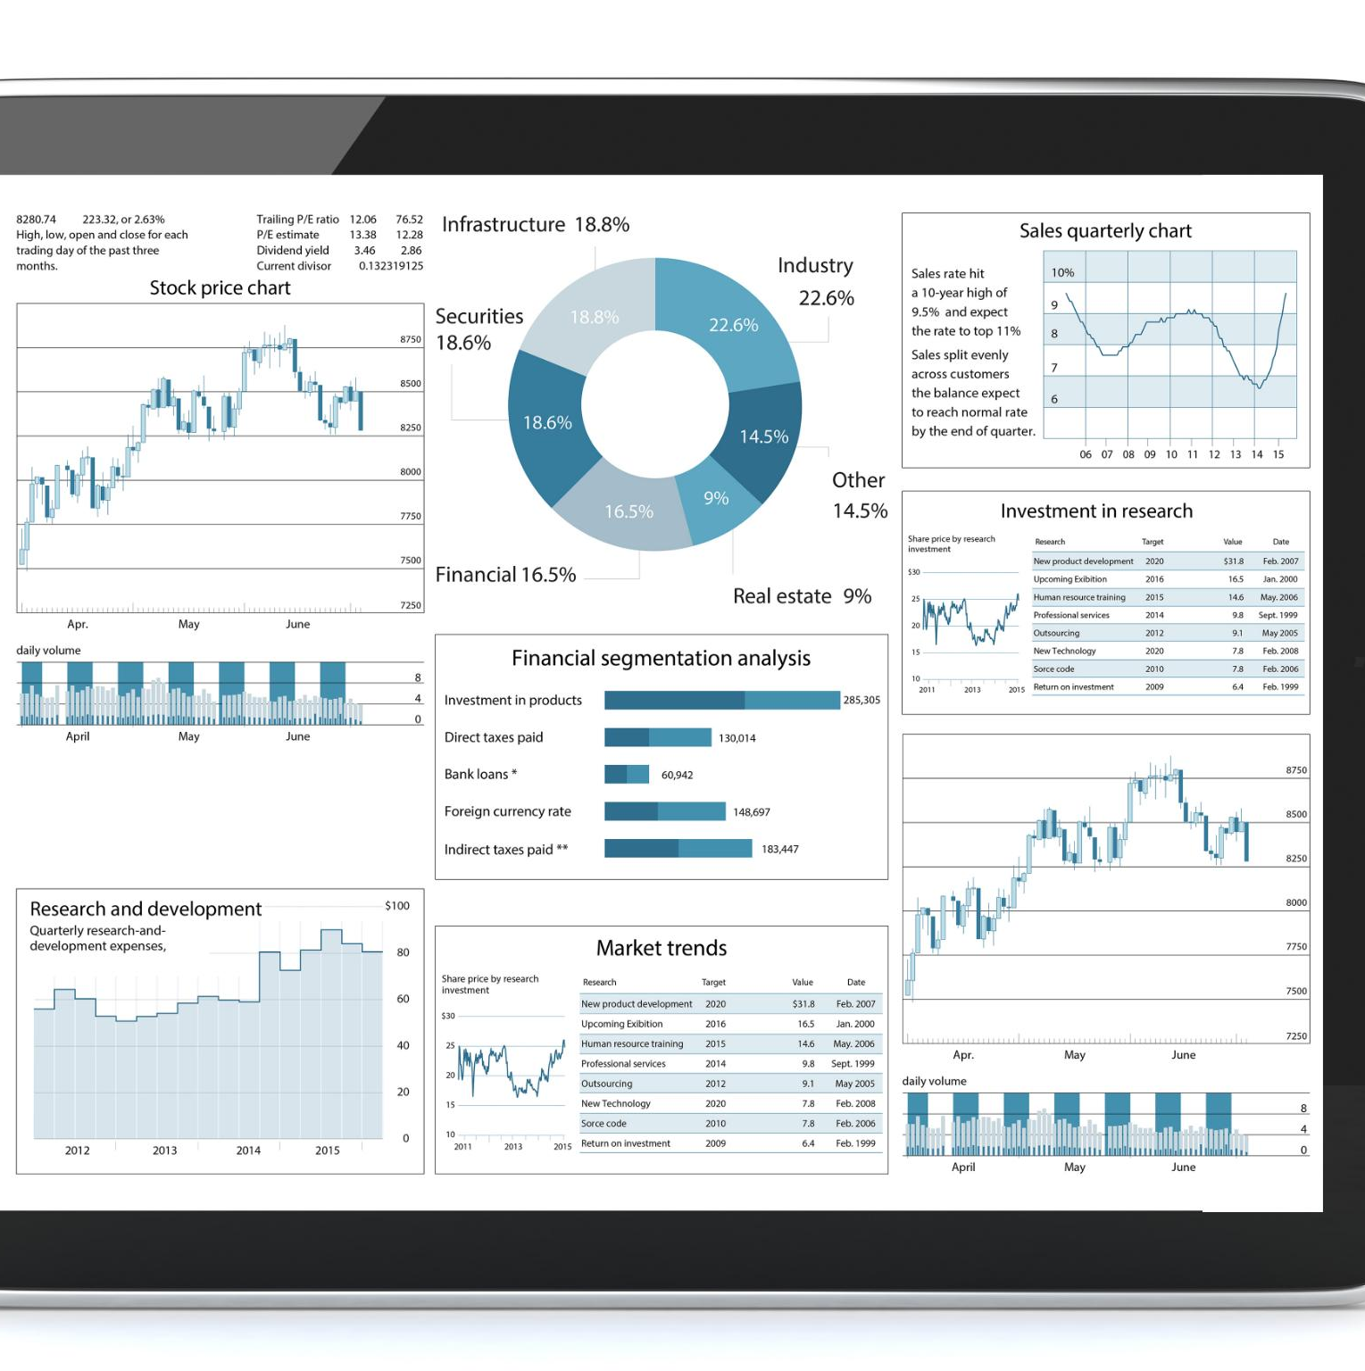
Conclusions and Limitations
Key Pricing Drivers
Pricing is influenced by capacity, property type, and location, validating data-driven pricing strategies.
Superhost Success Factors
Superhost status depends on response behavior and review quality, underscoring the importance of service excellence.
Market Segmentation
Clustering identifies segments like budget high-demand and premium exclusive listings for targeted strategies.
Study Limitations & Future Work
Analysis limited by single data snapshot and observational nature; future work to include text mining and time-series models.
Notes:
This final slide synthesizes the key findings and acknowledges limitations. It concludes that pricing is driven by capacity, property type, and location, supporting the use of data-driven pricing guidance. Superhost status is mainly predicted by response behavior and review performance, highlighting service quality as a critical success factor. Clustering reveals distinct market segments, such as budget high-demand and premium exclusive listings, enabling targeted strategies. Instant Bookable is associated with higher occupancy, making it a clear business lever. However, the analysis is limited by its reliance on a single snapshot of data, its observational nature, and the absence of text or time-series analysis. Future work could incorporate review text mining, temporal trends, and more advanced models to deepen insights and improve predictive power.

