Slide 1

Nui Kids
Two flies are sitting on a pile of dog poop. One suggests to the other “hey, wanna hear a good joke?” the other one replies “sure ok, but nothing disgusting like last time. I'm trying to eat here!”
Whats the most popular lolly? Tell us your favourite by emailing nui.kids86@gmail.com or txt 027 47 50451 yall be replied to and be notified of the results of course

Slide 2

Chewy chocolate chip cookies
You will need:
2 cups all-purpose flour
1/2 teaspoon baking soda
1/2 teaspoon salt 3/4 cup unsalted butter, melted
1 cup packed brown sugar
1/2 cup white sugar 1 tablespoon vanilla extract
1 egg
1 egg yolk
2 cups semisweet chocolate chips
1.preheat the oven to 325 degrees F (165 degrees C). Grease cookie sheets or line with parchment paper.
Sift together the flour, baking soda and salt; set aside.
In a medium bowl, cream together the melted butter, brown sugar and white sugar until well blended. Beat in the vanilla, egg, and egg yolk until light and creamy. Mix in the sifted ingredients until just blended. Stir in the chocolate chips by hand using a wooden spoon. Drop cookie dough 1/4 cup at a time onto the prepared cookie sheets. Cookies should be about 3 inches apart.
Bake for 15 to 17 minutes in the preheated oven, or until the edges are lightly toasted. Cool on baking sheets for a few minutes before transferring to wire racks to cool completely.

Slide 3

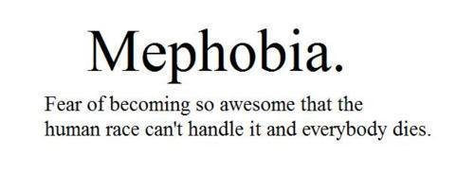
Cats look down on you, dogs look up to you but pigs look you right in the eye,and treat you as an equal.-Winston Churchill
A man had three apples. He was eating the first one and found a worm in it. He started on the second and also found a worm. Frustrated, he turned the light off and ate the third one
Q. Whats worse then finding a worm in your apple? A: half a worm.
Q. what did the grape do when it got stepped on? A. it let out a little w(h)ine

Slide 4
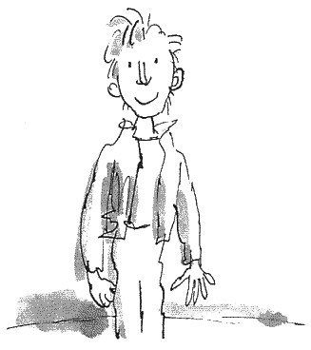
QUIZ
PASS THE TIME BY ASKING THESE QUESTIONS TO SIBLINGS, PARENTS AND FRIENDS
Q: Who picked a peck of pickled peppers?
A:peter did
Q:what finger nail grows the fastest?
A:the middle fingers nail
Q:what is charlie in the chocolate factorys sur name?
A:bucket, charlie bucket.
Q:what countrys do the words pjamas and shampoo come from?
A:india

