Slide 1
LANSim
NETWORK SIMULATOR

Slide 2
What is LANSim?
LANSim is a Cnet-like network simulator.

Slide 3
What is a network simulator?
Network simulators are tools for testing out and debugging new protocols.
They provide an excellent means to show behavior and performance of protocols and topologies.

Slide 4
Objectives Of The Project
To learn the concepts of the internals of how network simulator work.
To obtain a grasp on the operation of communication protocols and network configurations.
To study and implement various algorithms used by network devices operating at various layers of OSI model.

Slide 5
Objectives Of The Project
To get better grasp over multithreading.
To learn the tricks of efficient and flicker-free animation.
To learn the tricks of creating interactive graphical objects.

Slide 6
Current Progress
Implemented a usable graphical user interface with drag and drop interface.
We have implemented the physical layer of OSI.
Data flow animation.
Implemented some of the devices like – Hub and a basic PC (capable of broadcasting).

Slide 7
Introduction to LANSim
BRIEF

Slide 8
Design of LANSim
Interface completely made using SWING libraries.
The core is divided into major parts – backend framework and frontend.
Backend framework consists of a Clock class which acts as conceptual clock of the program.

Slide 9
Pros of LANSim
Programmed in JAVA using only standard libraries, hence very much portable.
Provides drag and drop feature to create connections among nodes.
Pluggable architecture.
Data flow animation.

Slide 10
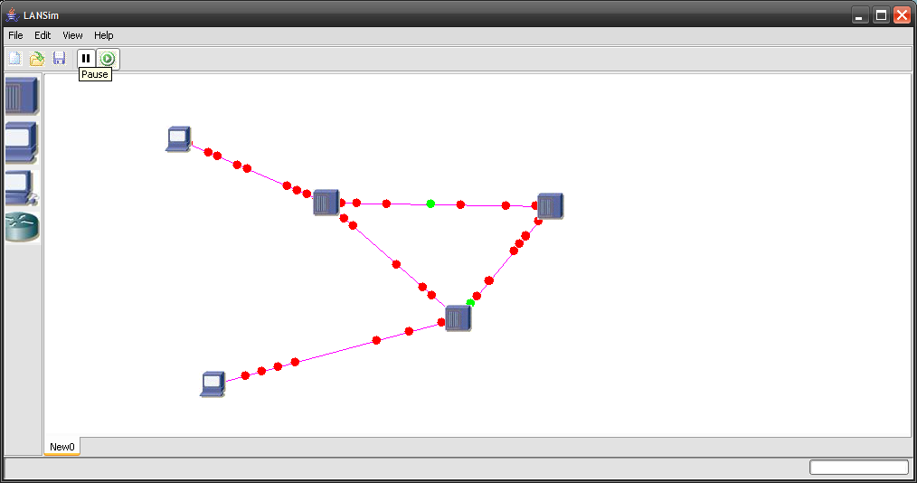
Screenshot

Slide 11
Architecture of LANSim
BACKEND

Slide 12
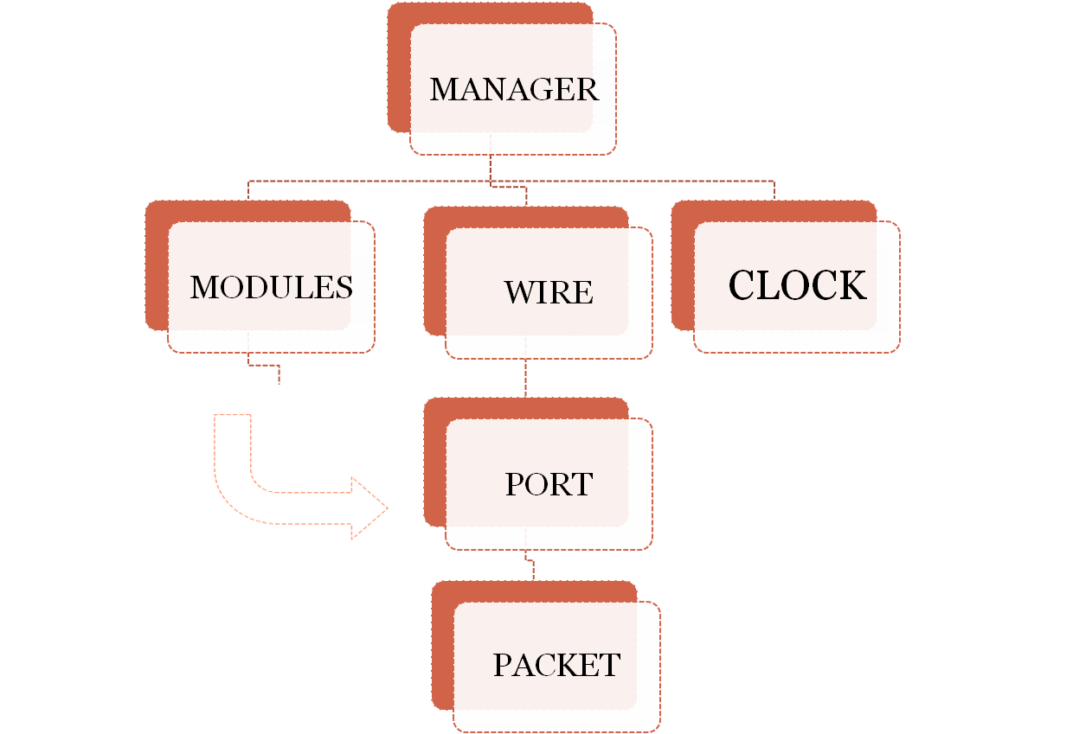
Architecture of Backend

Slide 13
Clock class
Digitizes real-world time into discrete time steps (10⁻⁶ ~ 10⁻³ s) depending upon the speed of network.
It generates tick event that is used to synchronize the simulation.

Slide 14
Manager class
Synchronizes and controls the whole simulation process.
It is the central authority which contains reference to of all modules and wires.
Allocates time to each modules and wires in turn, after every clock-tick is generated.

Slide 15
Module class
It is an interface class from which all modules including the PC and hub modules derive.
It provides generic methods that all modules must implement, like step() which instructs the module to simulate for some supplied no. of time steps.

Slide 16
Wire class
It is a generic representation of all kinds of wired links present in a network.
Particular types of connection links will derive from this base class.

Slide 17
Port class
This does not represent the port (service access point) that Transport layer addresses.
This is a conceptual duplex interface between a module and a wire.
There can be only two ports at either end of wire.
Modules can have any no. of ports.

Slide 18
Packet class
It is a conceptual packet class that is used by framework at the physical layer instead of byte streams.
It can enclose data packets provided by the modules.

Slide 19
Architecture of LANSim
FRONTEND

Slide 20
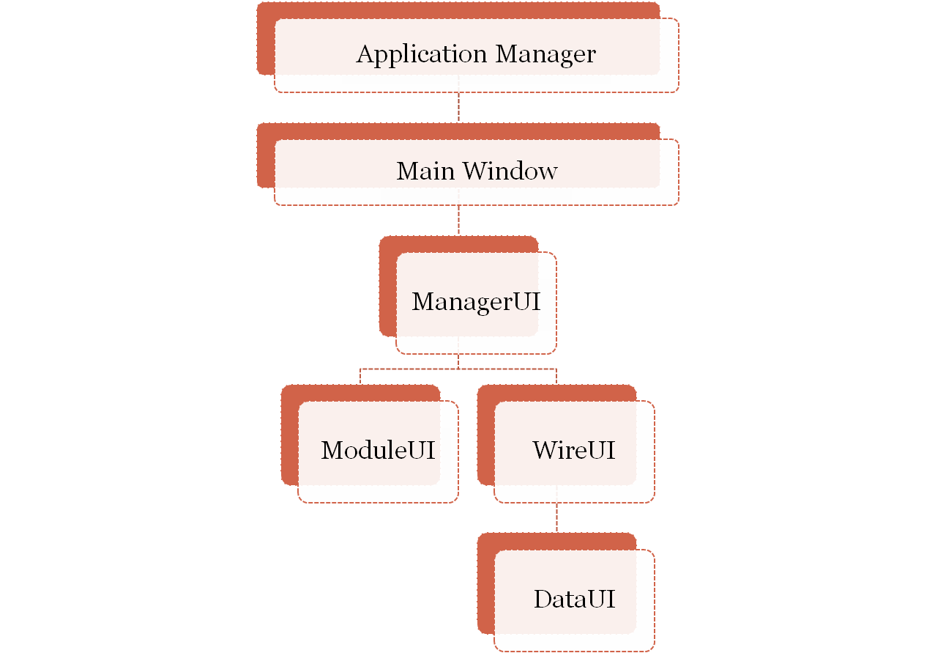
Architecture of Frontend

Slide 21
Application Manager class
This is the starting point of the program.
It is the event handler for Main Window class.
It traps user’s response and hands it down to appropriate classes for which the event is meant.

Slide 22
Main Window class
It is the user interface of the program.
It displays:-
  The component toolbox
  Menu bar
  The client area where the graphical objects are drawn.

Slide 23
ManagerUI class
It is the frontend of Manager class.
It acts as the interface between GUI and the backend framework.
It contains a reference to Manager class object, which controls the whole backend simulation.

Slide 24
ModuleUI class
It is the frontend of Module class.
Handles the rendering of modules.
Handles the interaction with user, e.g. isClicked() method.
Modules can use it to display module specific windows.

Slide 25
WireUI class
It is the frontend of wire.
Handles the rendering of interconnection network.
It is responsible for the data flow animation, which it executes with the help of DataUI.

Slide 26
DataUI class
It handles the rendering of data packets.
Modules can extend this class to create data packets that may look anyway the module wants.

