Slide 2

The Debt Ceiling Politics
Situation | On Jan 19, 2023, outstanding debt reached the statutory limit. This triggered the Treasury to take extraordinary measure to enables US to meet its obligations till July-Aug (best estimate). If debt ceiling is not increased, this will result in US defaulting.
Implication | Republicans are looking leverage this for spending cuts and may take the decision down to the wire. The event conjures up painful memories of the 2021 debt ceiling. This poses a negative risk sentiment with possibilities of rating downgrade if repeated.

Slide 3
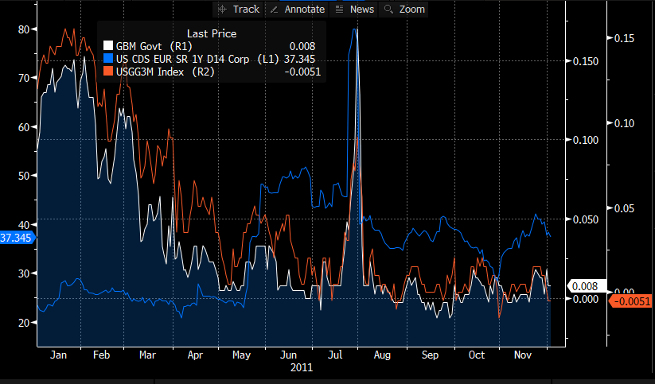
2011 Debt Ceiling Crisis
Secretary Geithner Sends Debt Limit Letter to Congress (1/6/2011)
As US Reaches Debt Limit, Geithner Implements Additional Extraordinary Measures to Allow Continued Funding of Government Obligations (5/16/2011)
Treasury: U.S. Still Projected to Exhaust Borrowing Authority on August 2nd (6/1/2011)
S&P warns that chance of downgrading U.S. credit rating is 50 percent (7/14/2011)
Geithner Op-Ed: 'Compromise Achieved, Reform's the Next Chapter' (8/2/2011)
S&P downgrades U.S. credit rating (8/5/2011)

Slide 4
2023 Debt Ceiling Crisis?
Jan
July
Aug
Sept
Oct
Nov
Secretary Yellen Sends Debt Limit Letter to Congress, extraordinary measure taken (01/19/2023)
Treasury Cash balance set to decline.
Passing debt ceiling in the House need 6 rep and all Democrats.
Republicans looking for spending cuts before agree to any increase.
TD expects the X-date (Treasury runs out of cash) to be July-Aug, while JPM expect to be between Sept to Nov.
Expecting volatility in US T bills pricing as it becomes clear how contentious the issues are.
Notes:
The recent drama about the house speakership, where Kevin McCarthy won support only after 15 rounds of voting reinforce that some hard line members of his caucus can hold the party hostage during the negotiation.
McCarthy likely had to compromise significantly in order to gain support for his Speakership, and the debt ceiling was a major sticking point for the conservative House members.
The Republicans are looking for spending cuts before they agree to any increase. For the house, given the razor thin Republican majority, passing the debt ceiling increase will need only 6 Rep apart from all the 212 Democrats. However, even these 6 Rep may be tough to come by given that 2024 election season would likely be in full swing and there might be some tough Primary challenges.
Trump stated that Rep can undo what Democrats have spent in the last 2 years by simply playing tough in the upcoming debt ceiling negotiation.

Slide 5
Trade Strategies
Avoid holding bills maturing between June – August (ideally after Nov)
Options for cash positions between June and August:
Trade SSA bonds or >1yr bills that matures past November if possible
Utilize overnight RPP to limit risk exposure
Next Steps:
Investigate whether we need to transfer more limits for SSAs and seek limit increase for overnight RPPs

