Slide 1
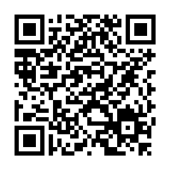
Insurance Redlining
Aaklit Taneja
Access our code at: https://github.com/appleofreak/DataAnalysis/blob/main/chredlin_case.R
Or, scan the QR;
The code has been commented for ease of understanding of every model and statistic used

Slide 2
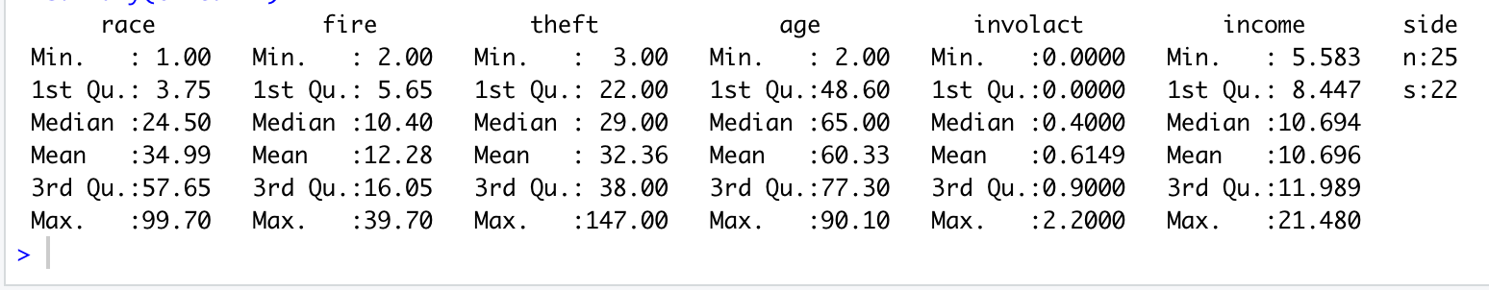
Initial Data Analysis Results
Summary of data:
Inferences from summary
1. Wide range in race variable between minimum and maximum value
2. Assuming all zip codes are not homogenous ie it is not impossible to derive meaning from this data
3. Skewness in theft and income
4. Weird behavior of involact, high number of zeroes, hard to draw any standalone inference

Slide 3
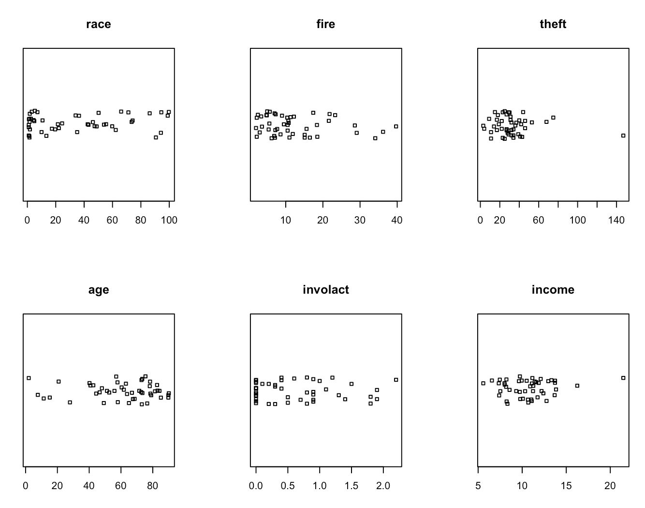
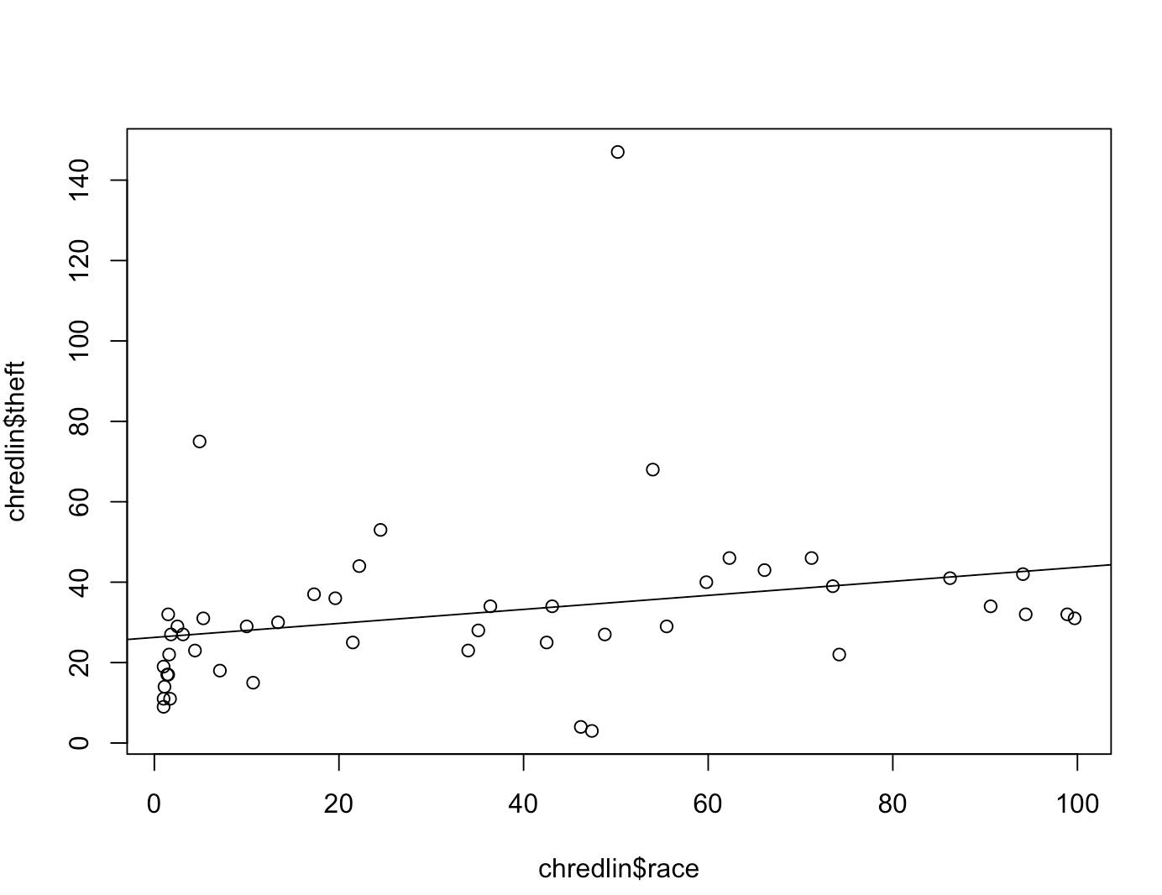
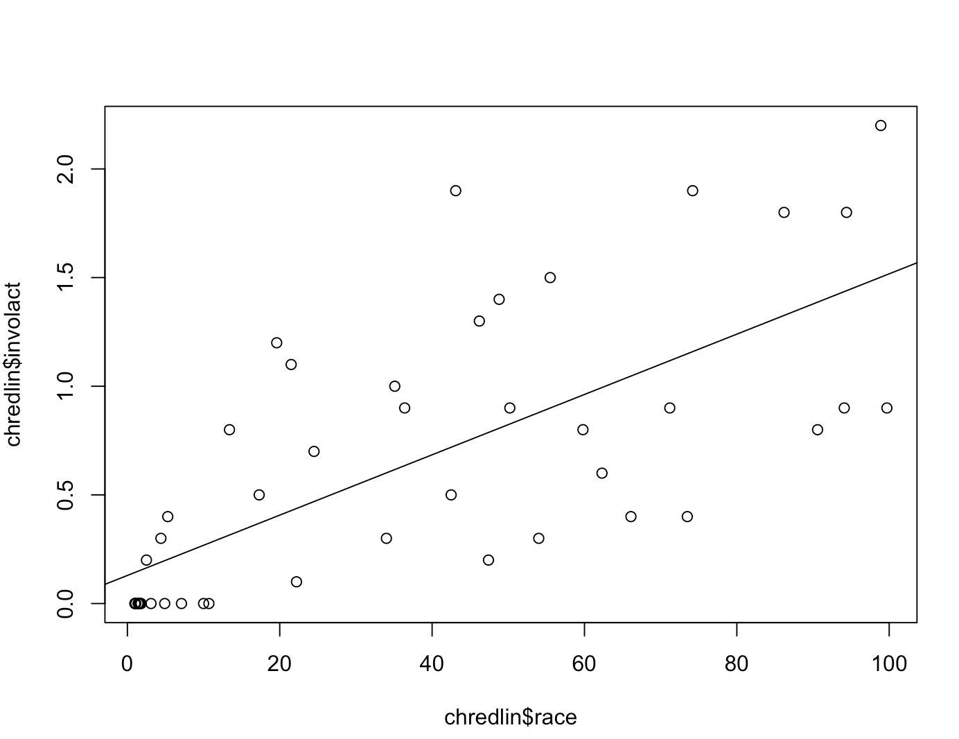
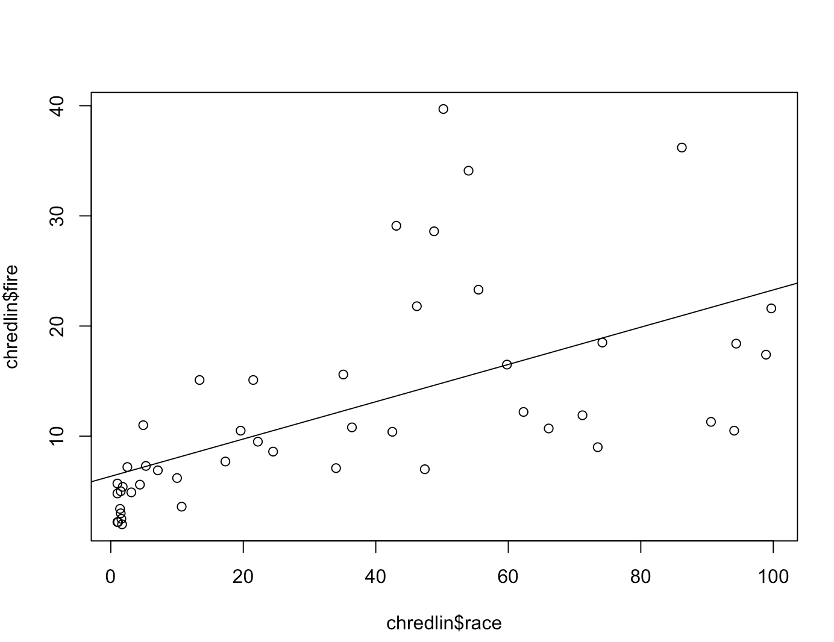
Insurance data Jitter Plots (To prevent overplotting)
We need to draw conclusions mainly from involact and race
We call fire and theft to be risk factors ie something the insurance companies could use as a cover up to hide the fact that they are racist
So then we find the relationship between fire, theft race and involact.
Homeowners in Zip codes with high percentage of minorities are taking the default FAIR plan insurance at a higher rate compared to the others.

Slide 4
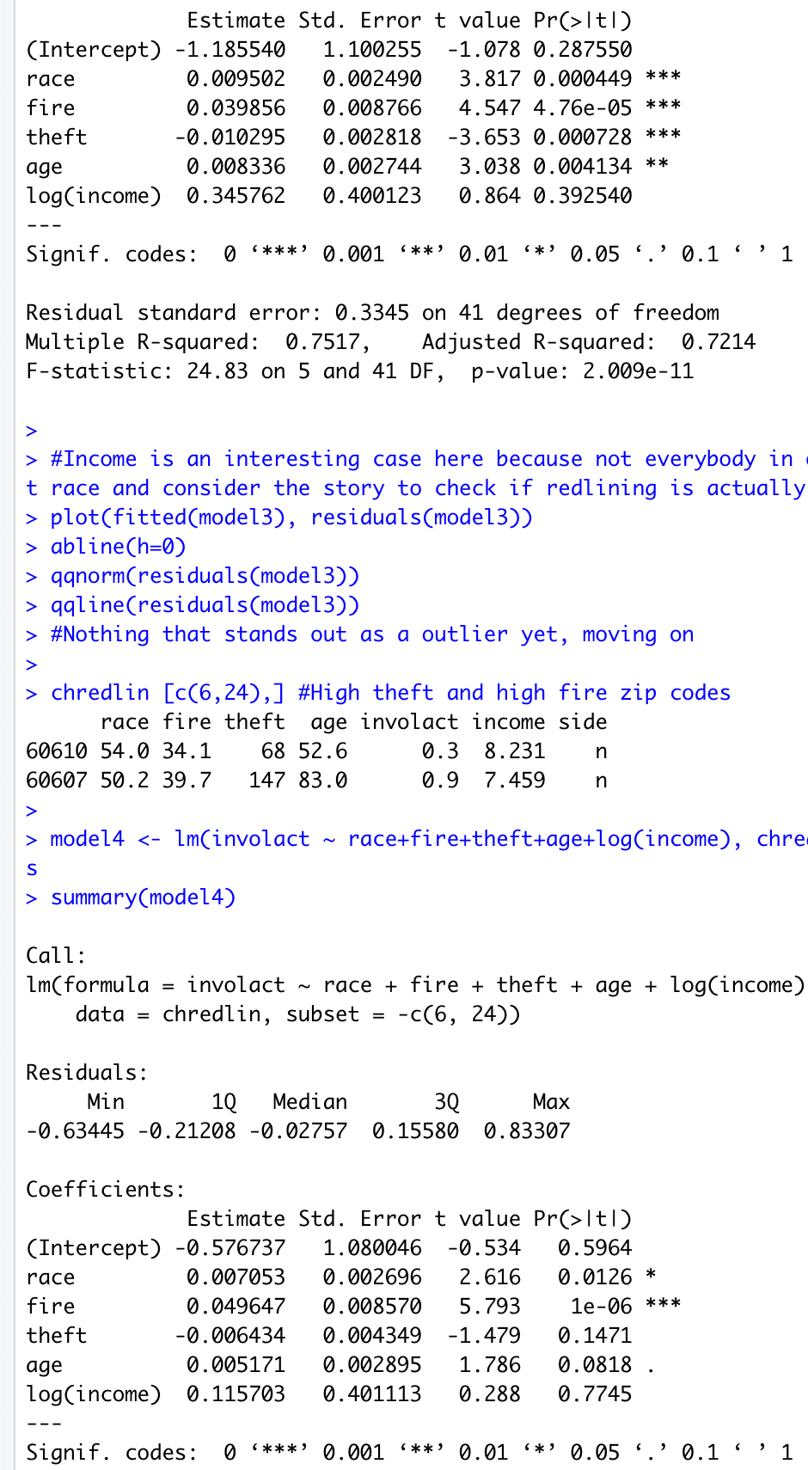
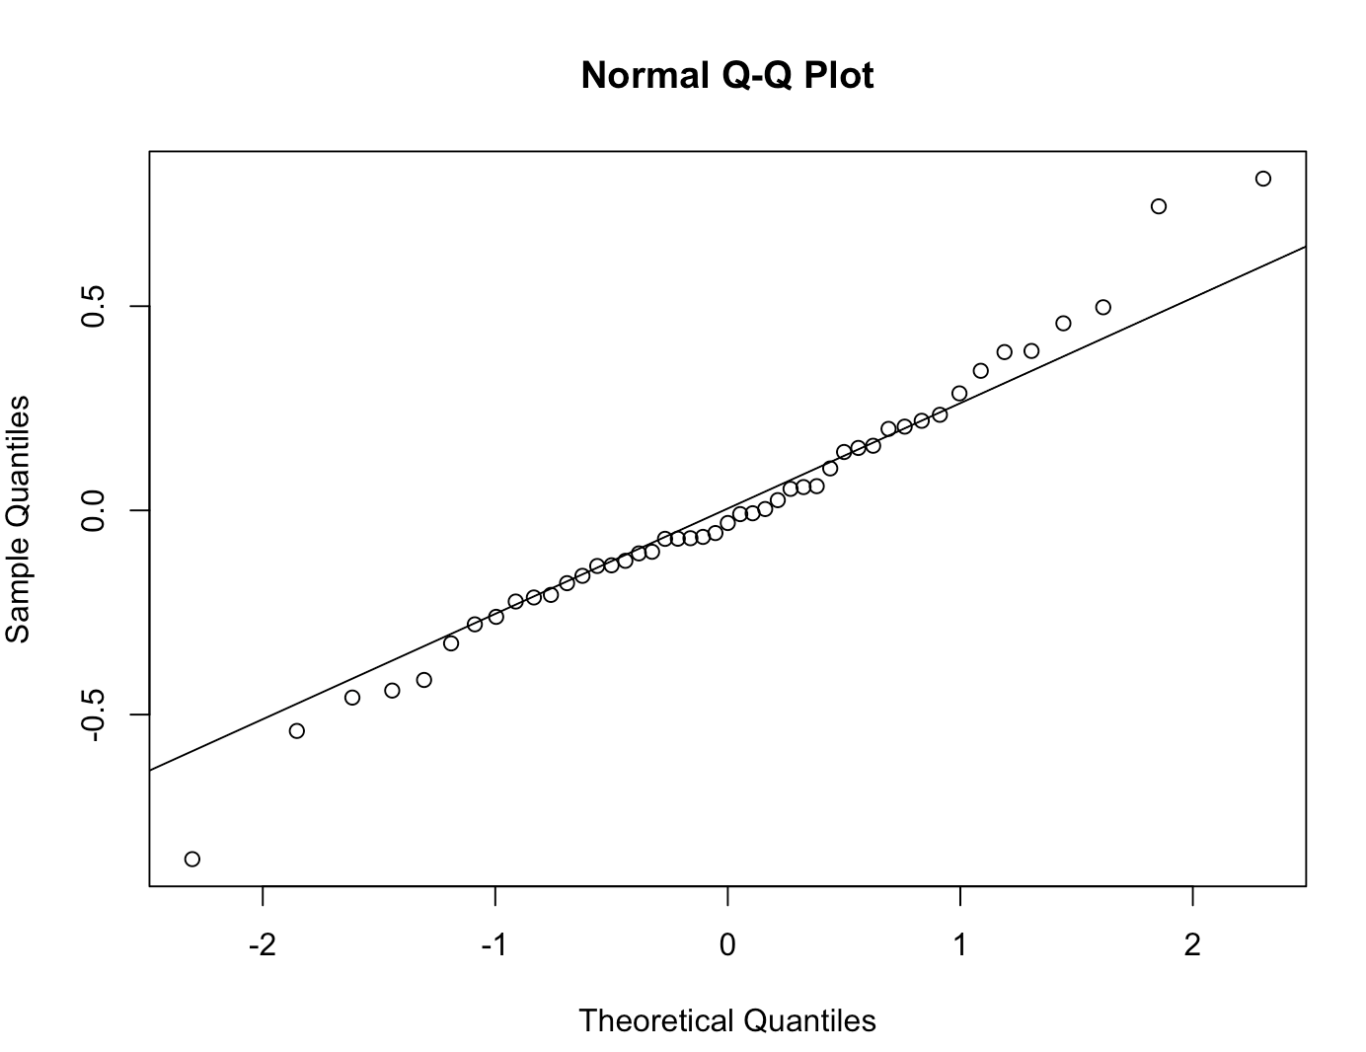
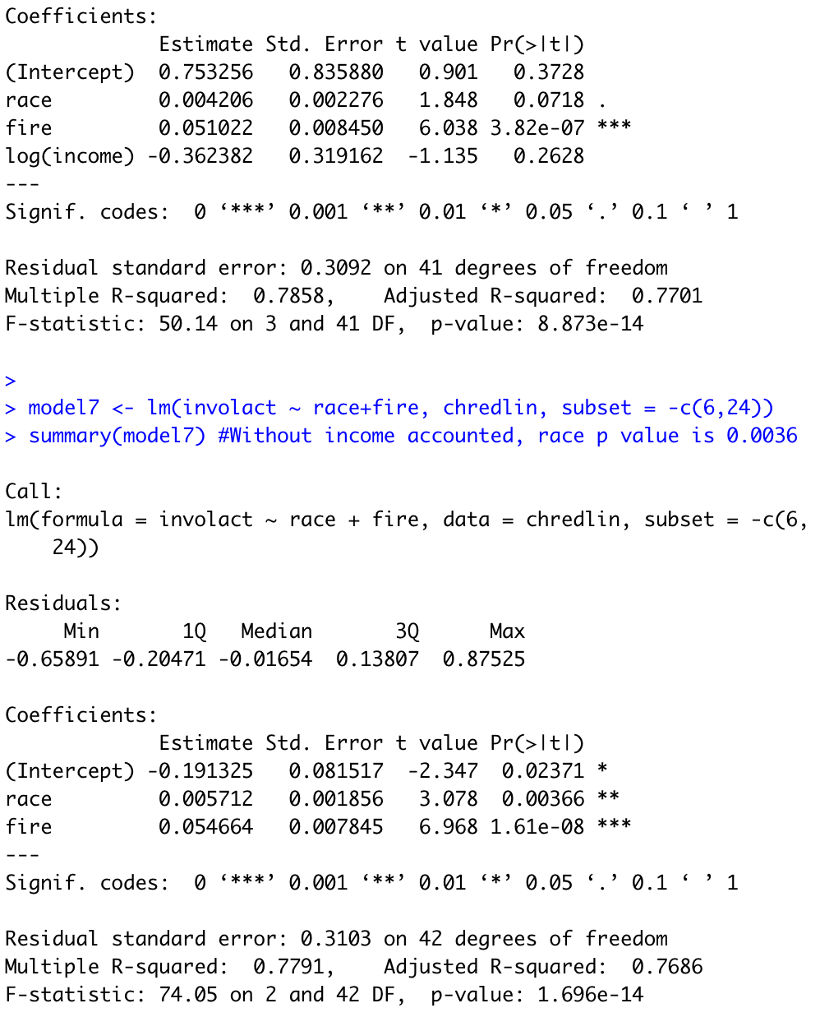
Full model to work backwards to the important variables
Here, we see the effect of race is more significant when we remove income.
Then, we remove the high theft and fire risk pincodes to see if they still remain significant
Check code line 62
This gives us an updated result and a drop in the significance of theft and age to a level where they are now insignificant for the model.

Slide 5
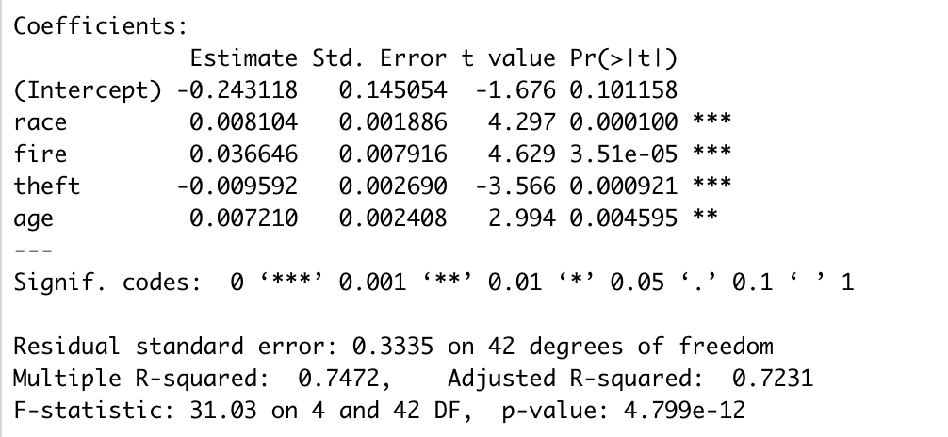
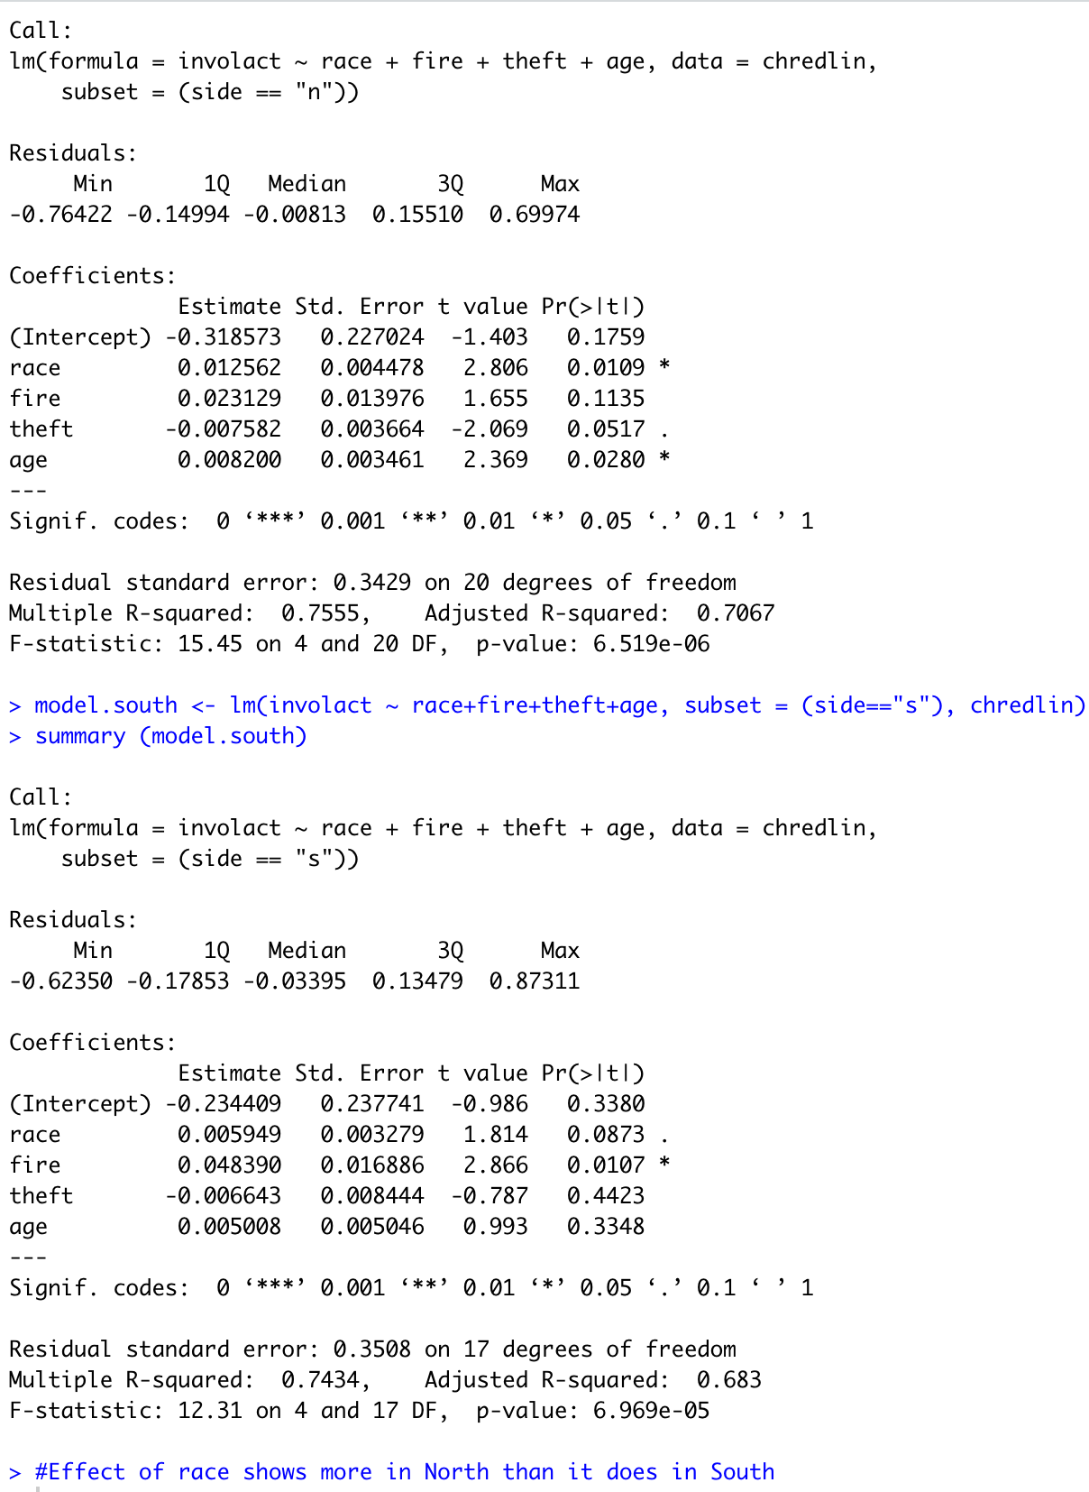
Our best model
But we also found the issue to more prevalent in the North than the South, which is shown as:
Code lines (83-88)
However, we have established a positive relationship between involact and race while controlling other variables.
We also find race to be more significant when income (or log(income) in the model) is dropped.

Slide 6
Conclusions and Considerations
Although there is some relationship between the fire scare and involact, there still seems to be a strong evidence of race for redlining.
Considerations:
Number of people affected is small to be generalized
2. Missing variable, say people having performed poorly during their insurance interviews etc.
3. We saw the division between north and south, what if it is further divided into even smaller segments and we see this is prevalent in a very small part in the north and not widespread at all?

