Slide 1
固定 LO 的二维 Phase Cycling 验证
pump–probe 全场主方程模拟｜+100 fs｜组会内部讨论草稿
目标：确认 detector readout 改写后，phase-order map、关键通道与 phase-step 收敛性如何变化。
2026-08-20
Notes:
[Sources]
- D:/myPrograms/PycharmProjects/QuDPy-clean/bin/examples/ta/ta_three_level_fixed_lo_detector_phase_cycling.py
- D:/myPrograms/PycharmProjects/QuDPy-clean/bin/optical_bloch_plots/ta_three_level_fixed_lo_detector_phase_cycling/delay_100_fs/data/summary.json

Slide 2
RESEARCH QUESTIONS
本轮只回答三个问题
01
readout 是否按固定 probe LO 正确定义？
相互作用 probe phase 独立扫描；探测参考场相位保持 0。
02
目标 S₀,₁ 的 exact 与 weak heterodyne 是否一致？
比较谱形、幅值和残差；S₀,₀ 仅作为背景来源参考。
03
N 取值与 probe cycling 是否改变目标信号？
统一用 relative RMS 检查 N，并比较 pump-only 与二维 S₀,₁。
02
Notes:
[Sources]
- D:/myPrograms/PycharmProjects/QuDPy-clean/bin/optical_bloch_plots/ta_three_level_fixed_lo_detector_phase_cycling/delay_100_fs/data/summary.json

Slide 3
DETECTION MODEL
相互作用 probe phase 与 LO phase 必须分开
pump interaction
probe interaction
detector reference
φ_pu 独立扫描
φ_pr,int 独立扫描
probe LO 固定：φ_pr,LO = 0
[F1] 二维 phase grid
[F2] 固定 LO 条件
•
phase-order 标签只对应进入主方程的 interaction phases。
•
LO 不跟随 interaction probe phase 旋转。
•
因此目标通道标签重新表现为 S₀,₁。
03
Notes:
[Sources]
- D:/myPrograms/PycharmProjects/QuDPy-clean/bin/examples/ta/ta_three_level_fixed_lo_detector_phase_cycling.py
- D:/myPrograms/PycharmProjects/QuDPy-clean/bin/examples/ta/plan_examples/ta_three_level_fixed_lo_detector_phase_cycling.json

Slide 4
SIMULATION CONDITIONS
三能级模型与传播参数
三能级体系
主方程与数值条件
solver
lab_exact；pump+probe 全时非微扰传播
|1⟩ 0.00 eV
↑ 5 D
time grid
−1500…+1500 fs；dt = 0.2 fs；15000 points
|2⟩ 1.55 eV
pure dephasing
Γφ,₁ = 0；Γφ,₂ = 1/120；Γφ,₃ = 1/100 fs⁻¹
↑ 9 D
population
generated system 中无 population relaxation
|3⟩ 3.25 eV
FFT
Hann；subtract mean；zero padding ×4
1↔2: 1.55 eV；μ₁₂ = 5 D
2↔3: 1.70 eV；μ₂₃ = 9 D
显示采用一基能级 |1⟩,|2⟩,|3⟩；对应 solver indices 0,1,2
04
Notes:
[Sources]
- D:/myPrograms/PycharmProjects/QuDPy-clean/bin/optical_bloch_plots/ta_three_level_fixed_lo_detector_phase_cycling/delay_100_fs/data/summary.json
- D:/myPrograms/PycharmProjects/QuDPy-clean/bin/optical_bloch_plots/ta_three_level_fixed_lo_detector_phase_cycling/delay_100_fs/data/fixed_lo_detector_phase_cycling.npz
- D:/myPrograms/PycharmProjects/QuDPy-clean/bin/examples/ta/ta_three_level_fixed_lo_detector_phase_cycling.py

Slide 5
EXPERIMENTAL / NUMERICAL CONDITIONS
脉冲、delay 与 detection window
pump
probe / LO
场强：0.300 MV/cm
场强：0.008 MV/cm
中心能量：1.55 eV
中心能量：1.62 eV
Gaussian σ：12 fs
Gaussian σ：7 fs
中心时刻：−100 fs
中心时刻：0 fs
delay convention
delay = probe center − pump center = +100 fs
phase grids: N_pu = N_pr = 8；N=16 用于收敛与完整 phase-order map
fixed LO phase = 0；detection window = 1.40–1.80 eV；field threshold = 10⁻⁶
05
Notes:
[Sources]
- D:/myPrograms/PycharmProjects/QuDPy-clean/bin/examples/ta/plan_examples/ta_three_level_fixed_lo_detector_phase_cycling.json
- D:/myPrograms/PycharmProjects/QuDPy-clean/bin/optical_bloch_plots/ta_three_level_fixed_lo_detector_phase_cycling/delay_100_fs/data/summary.json

Slide 6
ANALYSIS PIPELINE
读取已有 checkpoint，detector 与投影可重复分析
saved P(t)
FFT → P(ω)
E_sig / detector
2D DFT
S_mpu,mpr
本轮 detector/readout 与画图修改不触发主方程重跑；源 checkpoint 数保持 344。
[F3] E_sig(ω)
[F4] exact detector
[F5] weak heterodyne
[F6] 2D Fourier projection
•
exact：比较 pump-on / pump-off 的总探测场强度。
•
weak：只保留固定 LO 与 ΔP 的线性交叉项。
•
projection normalization 使用实际 N_pu × N_pr。
06
Notes:
[Sources]
- D:/myPrograms/PycharmProjects/QuDPy-clean/bin/examples/ta/ta_three_level_fixed_lo_detector_phase_cycling.py
- D:/myPrograms/PycharmProjects/QuDPy-clean/bin/optical_bloch_plots/ta_three_level_fixed_lo_detector_phase_cycling/delay_100_fs/data/fixed_lo_detector_phase_cycling.npz
- D:/myPrograms/PycharmProjects/QuDPy-clean/bin/optical_bloch_plots/ta_three_level_fixed_lo_detector_phase_cycling/delay_100_fs/data/summary.json

Slide 7
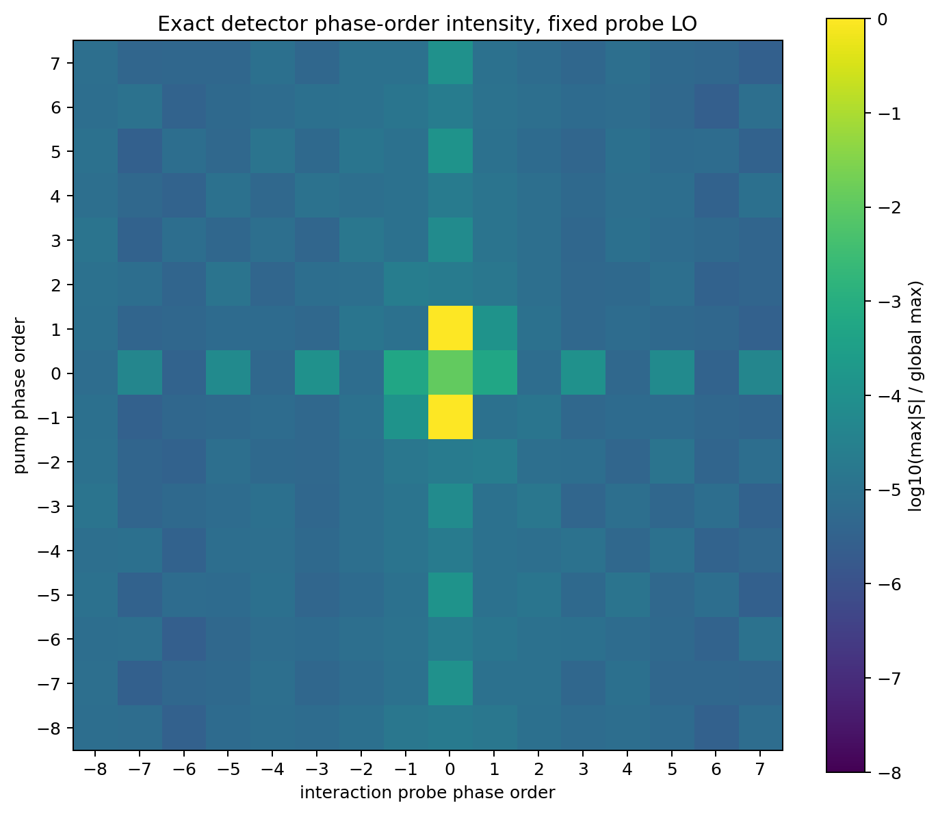
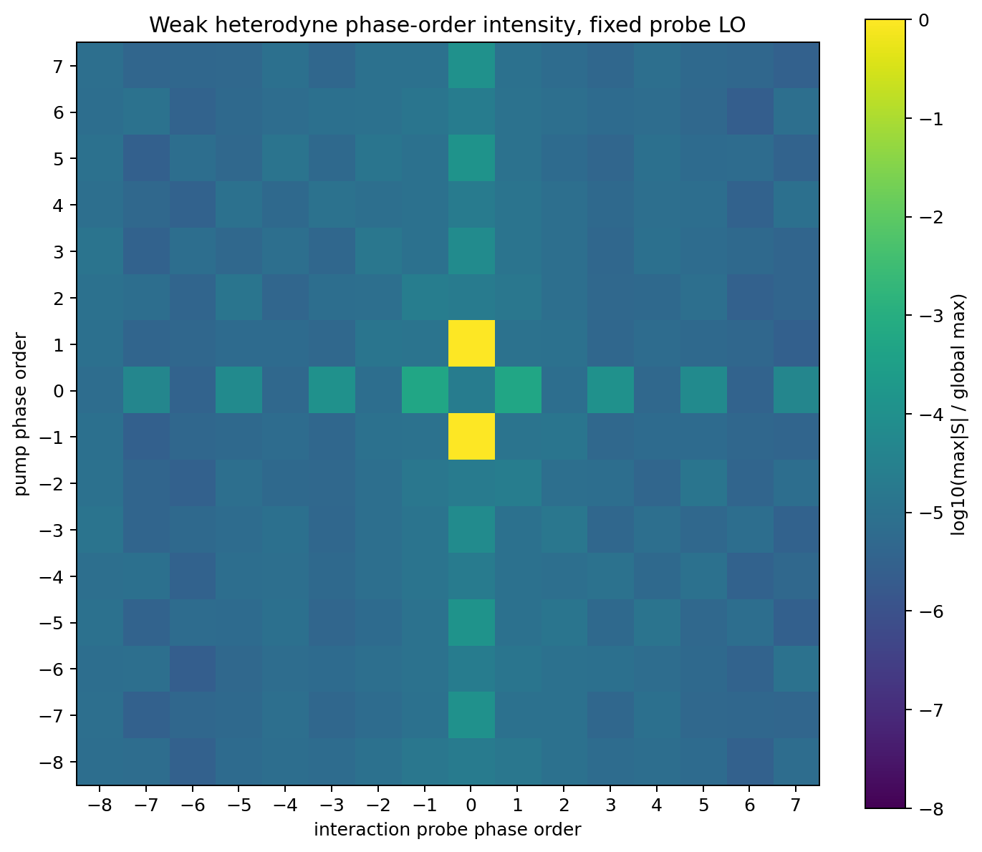
PHASE-ORDER MAP
按 S_mpu,mpr 记号：全局强项为 S₋₁,₀ / S₁,₀
第 1 下标 = pump order（纵轴）；第 2 下标 = interaction-probe order（横轴）
Exact detector
Weak heterodyne
黄色点 (x=0, y=±1) → S±1,0
S₀,±1 位于 (x=±1, y=0)
exact max：|S±1,0| = 1.162×10⁻²；|S₀,±1| = 6.097×10⁻⁶（约相差 1906 倍）
图：exact_detector_phase_order_map.png / heterodyne_phase_order_map.png
07
Notes:
[Sources]
- D:/myPrograms/PycharmProjects/QuDPy-clean/bin/optical_bloch_plots/ta_three_level_fixed_lo_detector_phase_cycling/delay_100_fs/figures/exact_detector_phase_order_map.png
- D:/myPrograms/PycharmProjects/QuDPy-clean/bin/optical_bloch_plots/ta_three_level_fixed_lo_detector_phase_cycling/delay_100_fs/figures/heterodyne_phase_order_map.png
- D:/myPrograms/PycharmProjects/QuDPy-clean/bin/optical_bloch_plots/ta_three_level_fixed_lo_detector_phase_cycling/delay_100_fs/data/phase_order_map.csv
- D:/myPrograms/PycharmProjects/QuDPy-clean/bin/optical_bloch_plots/ta_three_level_fixed_lo_detector_phase_cycling/delay_100_fs/data/summary.json

Slide 8
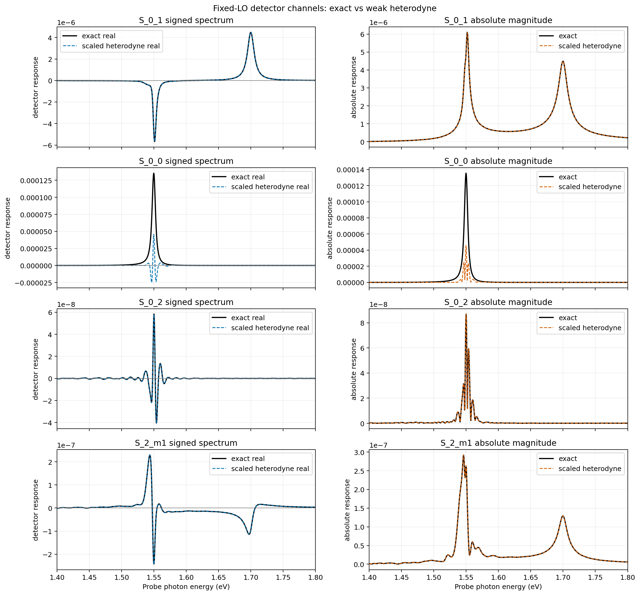
PRIMARY CHANNELS
主要通道的 exact 与 weak heterodyne 对比素材
N=16 exact S₀,₁
peak：1.55176 eV
max |S|：6.097×10⁻⁶
∫|S|dE：3.318×10⁻⁷ eV
absorption peak：+4.483×10⁻⁶ @ 1.70006 eV
emission |peak|：5.667×10⁻⁶ @ 1.55113 eV
best-fit scale = 2.001
scaled relative RMS = 0.112%
|corr| = 0.999999
完整原图包含 S₀,₁、S₀,₀、S₀,₂、S₂,₋₁。
完整图：primary_channels_exact_vs_heterodyne.png
08
Notes:
[Sources]
- D:/myPrograms/PycharmProjects/QuDPy-clean/bin/optical_bloch_plots/ta_three_level_fixed_lo_detector_phase_cycling/delay_100_fs/figures/primary_channels_exact_vs_heterodyne.png
- D:/myPrograms/PycharmProjects/QuDPy-clean/bin/optical_bloch_plots/ta_three_level_fixed_lo_detector_phase_cycling/delay_100_fs/data/channel_metrics.csv
- D:/myPrograms/PycharmProjects/QuDPy-clean/bin/optical_bloch_plots/ta_three_level_fixed_lo_detector_phase_cycling/delay_100_fs/data/exact_vs_heterodyne_metrics.csv
- D:/myPrograms/PycharmProjects/QuDPy-clean/bin/optical_bloch_plots/ta_three_level_fixed_lo_detector_phase_cycling/delay_100_fs/data/summary.json

Slide 9
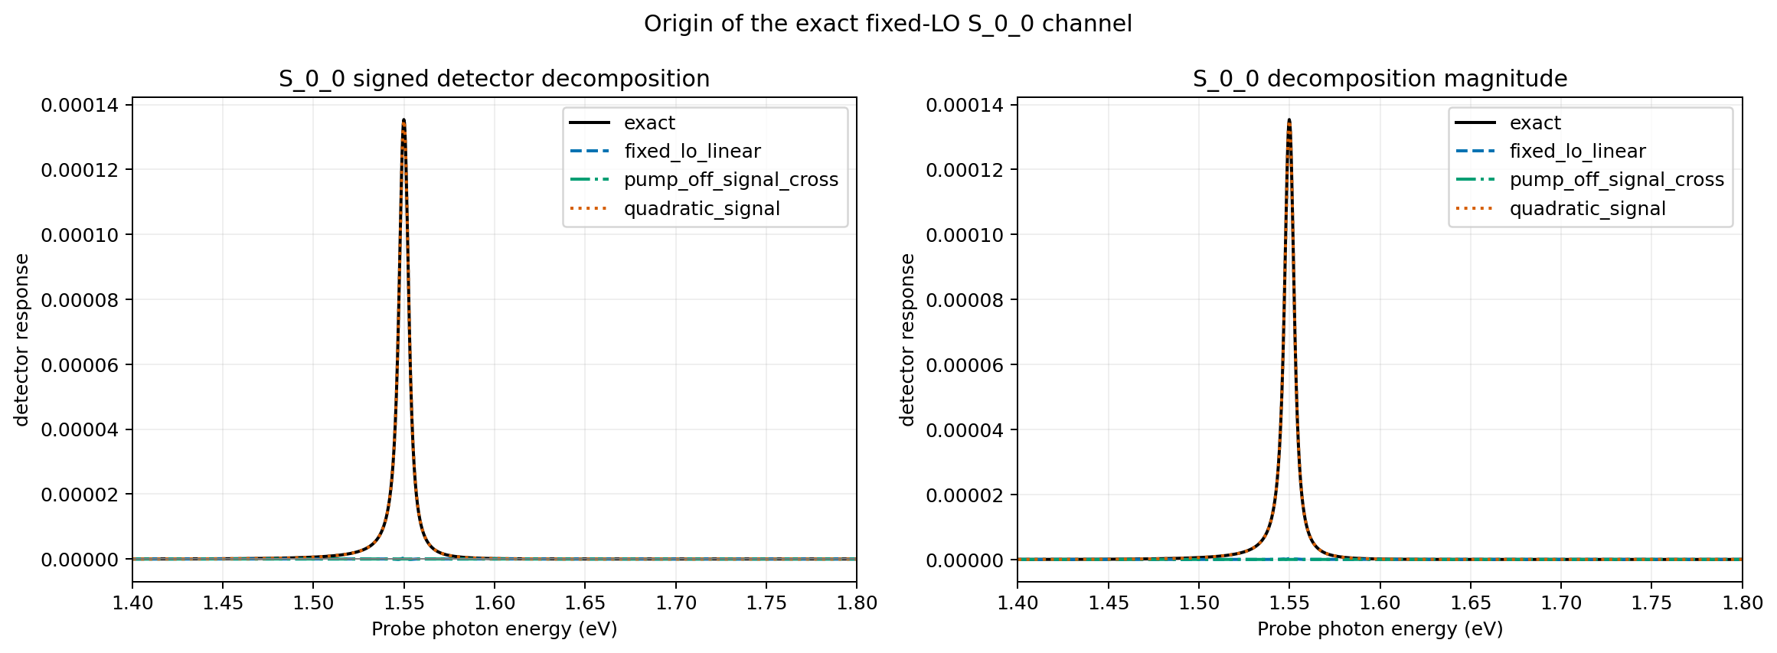
DETECTOR DECOMPOSITION
exact S₀,₀ 几乎全部来自二次信号强度项
关键量
exact max |S₀,₀|
1.354×10⁻⁴
max |S₀,₀| / max |S₀,₁|
22.20
quadratic peak fraction
99.81%
[F7] exact detector decomposition
解释：这不是 weak-heterodyne 线性项的放大版本。
图：exact_S_0_0_detector_decomposition.png
09
Notes:
[Sources]
- D:/myPrograms/PycharmProjects/QuDPy-clean/bin/optical_bloch_plots/ta_three_level_fixed_lo_detector_phase_cycling/delay_100_fs/figures/exact_S_0_0_detector_decomposition.png
- D:/myPrograms/PycharmProjects/QuDPy-clean/bin/optical_bloch_plots/ta_three_level_fixed_lo_detector_phase_cycling/delay_100_fs/data/exact_S_0_0_detector_decomposition.csv
- D:/myPrograms/PycharmProjects/QuDPy-clean/bin/optical_bloch_plots/ta_three_level_fixed_lo_detector_phase_cycling/delay_100_fs/data/summary.json

Slide 10
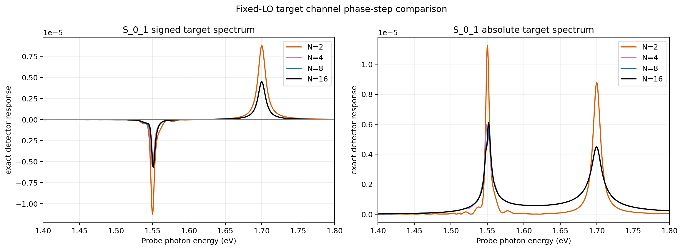
PHASE-STEP COMPARISON
统一用 relative RMS：N=8 对目标 S₀,₁ 刚好达到 5%
N=2
relative RMS = 101.2%
N=4
relative RMS = 13.86%
N=8
relative RMS = 4.96%
N=16
relative RMS = 0% (reference)
[F8] N=2 alias condition
目标 S₀,₁：N=8 可用于当前探索；N=16 作为收敛参考。
图：target_S_0_1_N2_N4_N8_N16.png
10
Notes:
[Sources]
- D:/myPrograms/PycharmProjects/QuDPy-clean/bin/optical_bloch_plots/ta_three_level_fixed_lo_detector_phase_cycling/delay_100_fs/figures/target_S_0_1_N2_N4_N8_N16.png
- D:/myPrograms/PycharmProjects/QuDPy-clean/bin/optical_bloch_plots/ta_three_level_fixed_lo_detector_phase_cycling/delay_100_fs/data/target_S_0_1_N_comparison.csv
- D:/myPrograms/PycharmProjects/QuDPy-clean/bin/optical_bloch_plots/ta_three_level_fixed_lo_detector_phase_cycling/delay_100_fs/data/N2_alias_table.csv
- D:/myPrograms/PycharmProjects/QuDPy-clean/bin/optical_bloch_plots/ta_three_level_fixed_lo_detector_phase_cycling/delay_100_fs/data/summary.json

Slide 11
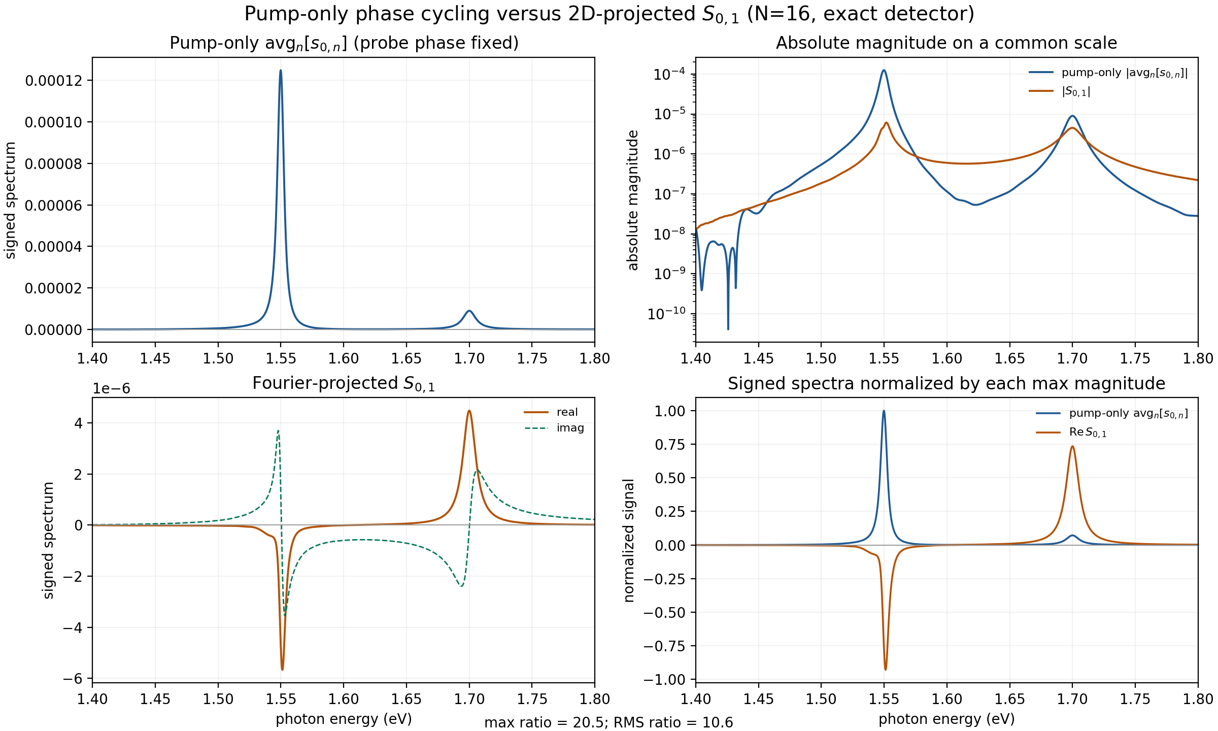
PUMP-ONLY vs 2D S₀,₁
只做 pump cycling 不能替代 probe-order 投影
比较定义
pump-only：probe phase 固定为 0；对 N 个 pump phases 无权平均。
2D S₀,₁：同时扫描 pump/probe，并对 probe order +1 加 Fourier 权重。
max 幅值比
20.49
RMS 比
10.56
∫|S|dE 比
4.00
pump-only 平均保留所有 probe orders 的叠加，主要由 S₀,₀ 主导；二维投影才隔离 S₀,₁。
图/数据：pump_only_phase_cycling_vs_S_0_1.png / .csv
11
Notes:
[Sources]
- D:/myPrograms/PycharmProjects/QuDPy-clean/bin/optical_bloch_plots/ta_three_level_fixed_lo_detector_phase_cycling/delay_100_fs/figures/pump_only_phase_cycling_vs_S_0_1.png
- D:/myPrograms/PycharmProjects/QuDPy-clean/bin/optical_bloch_plots/ta_three_level_fixed_lo_detector_phase_cycling/delay_100_fs/data/pump_only_phase_cycling_vs_S_0_1.csv
- D:/myPrograms/PycharmProjects/QuDPy-clean/bin/optical_bloch_plots/ta_three_level_fixed_lo_detector_phase_cycling/delay_100_fs/data/fixed_lo_detector_phase_cycling.npz

Slide 12
DISCUSSION
当前判断与下一步
当前判断
建议的下一轮条件
•
固定 LO 定义下，目标 phase-order 为 S₀,₁。
•
保持 fixed LO，扫描 delay = −100 / 0 / +100 fs。
•
S₀,₁ 与 weak heterodyne 在缩放后高度一致。
•
目标 S₀,₁ 可先用 N=8，N=16 保留为收敛参考。
•
exact S₀,₀ 很大，但主要是 |ΔE_sig|² / I_off。
•
校准 C_rad / 几何因子后再解释 exact 绝对强度。
•
S±1,0 全局最强；是否可见取决于实验空间/相位匹配。
•
比较 pump-only 与二维 cycling，确认 probe-order 投影的实验必要性。
限制：当前 C_rad = 1，只验证相对谱形与 phase-order 结构，不解释绝对 detector intensity。
12
Notes:
[Sources]
- D:/myPrograms/PycharmProjects/QuDPy-clean/bin/optical_bloch_plots/ta_three_level_fixed_lo_detector_phase_cycling/delay_100_fs/data/summary.json
- D:/myPrograms/PycharmProjects/QuDPy-clean/bin/examples/ta/ta_three_level_fixed_lo_detector_phase_cycling.py

Slide 13
EDITING INDEX
图表与公式索引
主题 → 建议图
PPT 占位符 → Word 公式
phase-order 全局结构
exact_detector_phase_order_map.png
heterodyne_phase_order_map.png
F1 二维 phase grid
目标 S₀,₁
primary_channels_exact_vs_heterodyne.png
F2 fixed LO condition
F3 emitted signal field
exact S₀,₀ 来源
exact_S_0_0_detector_decomposition.png
F4 exact detector readout
phase-step 收敛
target_S_0_1_N2_N4_N8_N16.png
F5 weak heterodyne readout
pump-only vs 2D S₀,₁
pump_only_phase_cycling_vs_S_0_1.png
F6 2D Fourier projection
F7 exact detector decomposition
exact–weak 残差（备选）
exact_vs_heterodyne_residual.png
F8 N=2 alias condition
完整 LaTeX：TA_fixed_LO_formula_reference.docx
13
Notes:
[Sources]
- D:/myPrograms/PycharmProjects/QuDPy-clean/bin/optical_bloch_plots/ta_three_level_fixed_lo_detector_phase_cycling/delay_100_fs/figures
- D:/myPrograms/PycharmProjects/QuDPy-clean/docs/presentations/TA_fixed_LO_formula_reference.docx

Slide 14
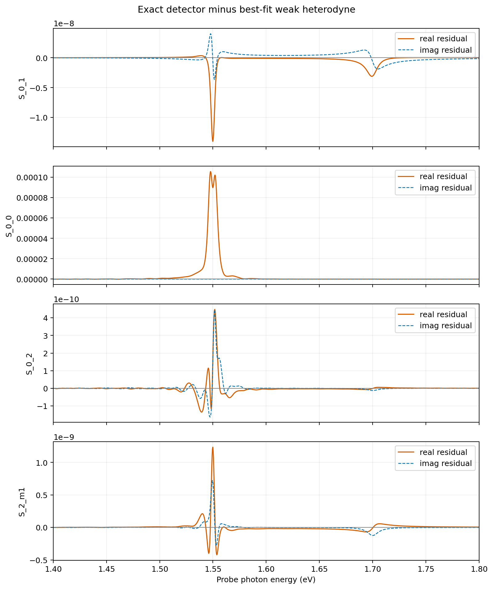
RESIDUAL APPENDIX
Exact detector − best-fit weak heterodyne：完整残差素材
图中通道
•
S₀,₁：目标通道残差
•
S₀,₀：exact detector 二次项影响
•
S₀,₂：弱二级 probe-order 通道
•
S₂,₋₁：混合 phase-order 通道
保留完整原图，供讨论时按主题自行拆分或重排。
完整图：exact_vs_heterodyne_residual.png
14
Notes:
[Sources]
- D:/myPrograms/PycharmProjects/QuDPy-clean/bin/optical_bloch_plots/ta_three_level_fixed_lo_detector_phase_cycling/delay_100_fs/figures/exact_vs_heterodyne_residual.png
- D:/myPrograms/PycharmProjects/QuDPy-clean/bin/optical_bloch_plots/ta_three_level_fixed_lo_detector_phase_cycling/delay_100_fs/data/exact_vs_heterodyne_metrics.csv
- D:/myPrograms/PycharmProjects/QuDPy-clean/bin/optical_bloch_plots/ta_three_level_fixed_lo_detector_phase_cycling/delay_100_fs/data/summary.json

