Slide 1

Welcome to Intel, Lincoln High!

Slide 2
Network Connection

Slide 3
Breaking RSA keys by factoring large integers
RSA is an algorithm used for encrypting small amount of data. Its security relies on the difficulty of factoring large integers.
RSA keys consist of two mathematically related keys; one public, one private. The public key is used to encrypt; the private key to decrypt.
The keys are created by selecting 2 prime numbers (p, q) and multiplying them together to create a modulus (n). This value is used during encryption and decryption.
Public key = (e, n) – e is called the “public exponent”, while n is the modulus.
Private key = (d, n) – d is called the “private exponent”, while n is the modulus.
RSA encrypts a message (m) with modular exponentiation
c = m^{e} mod n
t = c^{d} mod n
Numerous algorithms exist for factoring large integers – none of them is very efficient.
Quadratic sieve, general number field sieve, Shor’s algorithm (quantum computers)
Sample factoring sizes (Mathematica on PC with fast Intel CPU)
29 digit (96 bit) primes – 24 seconds
34 digit (112 bit) primes – 17 minutes
38 digit (128 bit) primes – 5 hours
77 digit (256 bit) primes - ???
$$\text{p}\text{ = 81062740962650321912}\text{927940413460767294905049690882957317791589477247907657353}$$
How large must the primes be?
Notes:
Current NSA/NIST short term PQ guidance requires 3072 bit moduli. Therefore each prime must be 1536 bits or ~463 digits each. This results in a ~925 digit modulus.

Slide 4
Breaking an RSA modulus
The following RSA moduli (n) are 19 digits (64 bits) in length. Each is the product of two 10 digit (32 bit) primes (p and q).
12785807110187128253
11093526529096043129
5237296872527729327
8064468924802598797
10893869754249487897
One way to break RSA is to factor n into its composite primes, p and q. After doing this, computing the private key is trivial.
For more details on how to compute the private exponent, see the RSA article on Wikipedia.
Please visit http://www.wolframalpha.com and attempt to factor as many of the values of n into their two primes.
15042446205670026307
13824190742314325837
11560497213300020009
9941983630402385719
13893150275564265751

Slide 5
Encrypting words with RSA
This activity limits words to 4 characters for ease of computation. The same method could be extended to any length string.
We will be using 11 bit primes. This results in 22 bit moduli.
p = 1163, q = 1601, p * q = n = 1861963
Because RSA is a mathematical algorithm, we must first convert words to numbers.
Convert each character to a number between 0 and 26. For example: ‘`’ = 0, ‘A’ = 1, ‘B’ = 2,…‘Z’ = 26.
Take each of these numbers and use them as base 27 digits. This amounts to:
num = (19683 * ChNum1) + (729 * ChNum2) + (27 * ChNum3) + ChNum4.
Encrypt this number using RSA cipher = num^{e} mod n.

Slide 6
 | ` | A | B | C | D | E | F | G | H | I | J | K | L | M
1 | 0 | 1 | 2 | 3 | 4 | 5 | 6 | 7 | 8 | 9 | 10 | 11 | 12 | 13
27 | 0 | 27 | 54 | 81 | 108 | 135 | 162 | 189 | 216 | 243 | 270 | 297 | 324 | 351
729 | 0 | 729 | 1458 | 2187 | 2916 | 3645 | 4374 | 5103 | 5832 | 6561 | 7290 | 8019 | 8748 | 9477
19683 | 0 | 19683 | 39366 | 59049 | 78732 | 98415 | 118098 | 137781 | 157464 | 177147 | 196830 | 216513 | 236196 | 255879
531441 | 0 | 531441 | 1062882 | 1594323 | 2125764 | 2657205 | 3188646 | 3720087 | 4251528 | 4782969 | 5314410 | 5845851 | 6377292 | 6908733
 |  | N | O | P | Q | R | S | T | U | V | W | X | Y | Z
1 |  | 14 | 15 | 16 | 17 | 18 | 19 | 20 | 21 | 22 | 23 | 24 | 25 | 26
27 |  | 378 | 405 | 432 | 459 | 486 | 513 | 540 | 567 | 594 | 621 | 648 | 675 | 702
729 |  | 10206 | 10935 | 11664 | 12393 | 13122 | 13851 | 14580 | 15309 | 16038 | 16767 | 17496 | 18225 | 18954
19683 |  | 275562 | 295245 | 314928 | 334611 | 354294 | 373977 | 393660 | 413343 | 433026 | 452709 | 472392 | 492075 | 511758
531441 |  | 7440174 | 7971615 | 8503056 | 9034497 | 9565938 | 10097379 | 10628820 | 11160261 | 11691702 | 12223143 | 12754584 | 13286025 | 13817466
Work up the rows
Step 4
Step 2
Step 1
Step 3
Words to numbers
Example: “DAVE”
Find the value in the “19683” row associated with “D”.
Column 4 = 78732. This is your current value.
Find the value in the “729” row associated with “A”.
Column 1 = 729.
Add this to your current value. The result is 79461.
Find the value in the “27” row associated with “V”
Column 22 = 594.
Add this to your current value. The result is 80055.
Find the value in the “1” row associated with “E”.
The answer is 5.
Ad this to your current value. The result is 80060.
The result is 80060. NOTE: This value must be less than your modulus. If it isn’t, you need a larger modulus.

Slide 7
Encrypting “DAVE”
We just calculated the numerical encoding for “DAVE” as 80060.
Our RSA public key is {3, 1861963}. So…
Compute 80060³ mod 1861963. This results in 559749. This is our encrypted word.
If we decode this number into a word, we get “AAKVL”.

Slide 8
Decrypting 559749
If we encode “AAKVL” as a number (using the table), we get 559749.
Remember, 559749, is the RSA encryption of “DAVE” using the public key, {e,n} = {3, 1861963}.
The associated private key is {d,n} = {1239467, 1861963}. So…
Compute 559749¹²³⁹⁴⁶⁷ mod 1861963. This results in 80060. This is our decrypted word. However, it is still encoded as a number.

Slide 9
 | ` | A | B | C | D | E | F | G | H | I | J | K | L | M
1 | 0 | 1 | 2 | 3 | 4 | 5 | 6 | 7 | 8 | 9 | 10 | 11 | 12 | 13
27 | 0 | 27 | 54 | 81 | 108 | 135 | 162 | 189 | 216 | 243 | 270 | 297 | 324 | 351
729 | 0 | 729 | 1458 | 2187 | 2916 | 3645 | 4374 | 5103 | 5832 | 6561 | 7290 | 8019 | 8748 | 9477
19683 | 0 | 19683 | 39366 | 59049 | 78732 | 98415 | 118098 | 137781 | 157464 | 177147 | 196830 | 216513 | 236196 | 255879
531441 | 0 | 531441 | 1062882 | 1594323 | 2125764 | 2657205 | 3188646 | 3720087 | 4251528 | 4782969 | 5314410 | 5845851 | 6377292 | 6908733
 |  | N | O | P | Q | R | S | T | U | V | W | X | Y | Z
1 |  | 14 | 15 | 16 | 17 | 18 | 19 | 20 | 21 | 22 | 23 | 24 | 25 | 26
27 |  | 378 | 405 | 432 | 459 | 486 | 513 | 540 | 567 | 594 | 621 | 648 | 675 | 702
729 |  | 10206 | 10935 | 11664 | 12393 | 13122 | 13851 | 14580 | 15309 | 16038 | 16767 | 17496 | 18225 | 18954
19683 |  | 275562 | 295245 | 314928 | 334611 | 354294 | 373977 | 393660 | 413343 | 433026 | 452709 | 472392 | 492075 | 511758
531441 |  | 7440174 | 7971615 | 8503056 | 9034497 | 9565938 | 10097379 | 10628820 | 11160261 | 11691702 | 12223143 | 12754584 | 13286025 | 13817466
Work up the rows
Step 4
Step 2
Step 1
Step 3
Numbers to words
Example: Decrypted value is 80060
Goal: Identify letters that map to your remaining value at each step/row. When you are finished, you will have a remainder of 0.
Find largest value less than 80060 in the “19683” row.
Column 4 = 78732. This is “D”.
Subtract the value in the cell from 80060. This results in 1328.
Find largest value less than 1328 in the “729” row.
Column 1 = 729. This is “A”.
Subtract the value in the cell from 1328. This results in 599.
Find largest value less than 599 in the “27” row.
Column 22 = 594. This is “V”.
Subtract the value in the cell from 599. This results in 5.
Find the letter that 5 is associated with in the “1” row. This is “E”.
The result is “DAVE”.

Slide 10
Encode/Decode Table
 | ` | A | B | C | D | E | F | G | H | I | J | K | L | M
1 | 0 | 1 | 2 | 3 | 4 | 5 | 6 | 7 | 8 | 9 | 10 | 11 | 12 | 13
27 | 0 | 27 | 54 | 81 | 108 | 135 | 162 | 189 | 216 | 243 | 270 | 297 | 324 | 351
729 | 0 | 729 | 1458 | 2187 | 2916 | 3645 | 4374 | 5103 | 5832 | 6561 | 7290 | 8019 | 8748 | 9477
19683 | 0 | 19683 | 39366 | 59049 | 78732 | 98415 | 118098 | 137781 | 157464 | 177147 | 196830 | 216513 | 236196 | 255879
531441 | 0 | 531441 | 1062882 | 1594323 | 2125764 | 2657205 | 3188646 | 3720087 | 4251528 | 4782969 | 5314410 | 5845851 | 6377292 | 6908733
 |  | N | O | P | Q | R | S | T | U | V | W | X | Y | Z
1 |  | 14 | 15 | 16 | 17 | 18 | 19 | 20 | 21 | 22 | 23 | 24 | 25 | 26
27 |  | 378 | 405 | 432 | 459 | 486 | 513 | 540 | 567 | 594 | 621 | 648 | 675 | 702
729 |  | 10206 | 10935 | 11664 | 12393 | 13122 | 13851 | 14580 | 15309 | 16038 | 16767 | 17496 | 18225 | 18954
19683 |  | 275562 | 295245 | 314928 | 334611 | 354294 | 373977 | 393660 | 413343 | 433026 | 452709 | 472392 | 492075 | 511758
531441 |  | 7440174 | 7971615 | 8503056 | 9034497 | 9565938 | 10097379 | 10628820 | 11160261 | 11691702 | 12223143 | 12754584 | 13286025 | 13817466
Remember: Row 5 (531441) is only used during decoding, and only if your word is 5 characters long.
Otherwise start at row 4 (19683).

Slide 11
Steps for solving the challenges.
Encode your word (i.e. convert it to an integer) using the Encode/Decode table. We’ll call the resulting integer “c”.
Encode/Decode table can be found on page 9.
Use the example on page 5.
Decrypt “c” by performing the RSA exponentiation with the private key:
Compute c¹²³⁹⁴⁶⁷ mod 1861963. We’ll call the resulting integer “t”.
Feel free to use the online calculator at: https://www.mtholyoke.edu/courses/quenell/s2003/ma139/js/powermod.html
Search Google for “power mod calculator”.
See page 11 for example.
Decode “t” (i.e. convert it to characters) using the Encode/Decode table. The result is your decrypted word!
Encode/Decode table can be found on page 9.
Use the example on page 8.

Slide 12
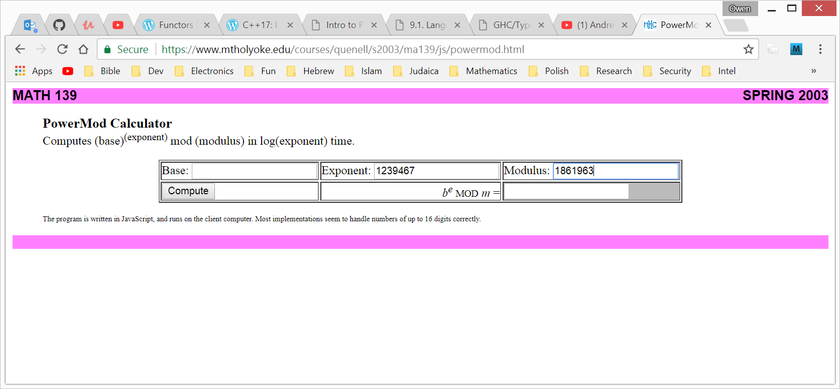
Your encoded
value “c” here.

Slide 13
Backup

Slide 14
Threat Modeling
The process of identifying the relevant threats and associated security objectives that must be met to protect a system.
Relevant threats may result in security defects exploitable by an attacker.
Mitigated security objectives become system requirements.
Consists of identification of multiple system properties
Assets – What must be protected?
Adversaries – Who wishes to compromise the system and why?
Attack surface – What parts of the system can be used to stage an attack?
Threats – What specific attack scenarios exist?
Security objectives – How will these threats be dispositioned (e.g. mitigated or not)?
Effective threat modeling requires adversarial mindedness
Thinking like the bad guys
Those who possess a devious and/or competitive mindset often provide the most valuable feedback.
Playing a security game.

Slide 15
Breaking RSA encryption – A scenario
Intel is creating a system to protect purchased high definition blockbuster video titles that a user purchases and downloads to their PC, tablet, or phone.
Each movie is encrypted with a 16 byte AES-GCM key.
This key is delivered along with the movie content after purchase.
Exposure of this key results in the movie being decrypted and thus viewable by anybody.
The only party authorized to view the movie, and thus decrypt it, is the purchaser.
RSA encryption is often a very good choice for encrypting AES keys.
When the user signs up for the video service, they create an RSA key pair, store the private key locally, and give the public key to the movie service provider to use when they purchase movies.
When they purchase a movie, the AES-GCM key is encrypted using the RSA public key, and decrypted by the user’s RSA private key, thus allowing them to decrypt and watch the movie.
What can go wrong!?!

Slide 16
Threat model (only a portion)
Assets
Purchased movie
Movie encryption key
RSA private key
Adversaries
???
Attack surface
The internet connection
The user’s computer
Threats
Adversary is able to deduce the RSA private key through integer factorization
???
Security Objectives
Protect the RSA private key from brute force attack by making it a minimum of 308 digits (2048 bits) in length.
???

