Slide 1
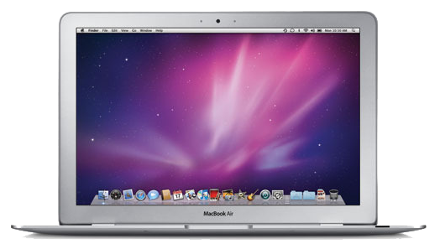
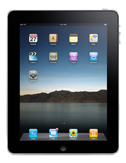

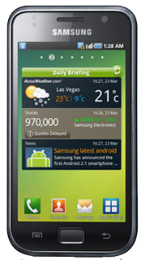
Audience
Government
User
NY Resident
Non NY Resident
Connectivity
content
Web
Mobile
SMS
App
NYC
Users

