Slide 1
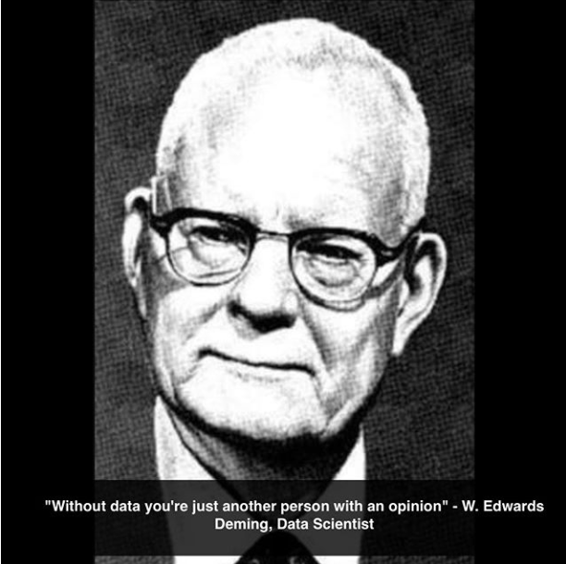
Big Data HILL
3 itf BIT

Slide 2
Poll!
Who has ever went to get feedback on an exam?
For another reason than a negotiation?

Slide 3
Poll!
Who can explain now what E = mc² stands for?
Who can find a Wikipedia page that explains E = mc²?
Who can give an example application of E = mc²?

Slide 4
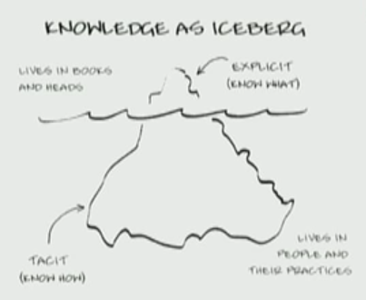
Knowledge
Explicit knowledge:
Can be looked up
Tacit knowledge:
(understood or implied without being stated.)
Is an attitude

Slide 5
Poll!
What is the function of Hive in a Hadoop cluster?
You can use google…

Slide 6
Poll!
Given what you just looked up, do you think you can create a POC using hive in 8 hours?
By Thursday 20-9, 23:59, I want emails:
Groups of 3-4 people
List of virtual machines you’ll be needing
RAM, HD, OS
On Friday 19-10 we’ll start at 8:30 and by 16:00 every group will present what they made
Grading is based on comparison between groups

Slide 7
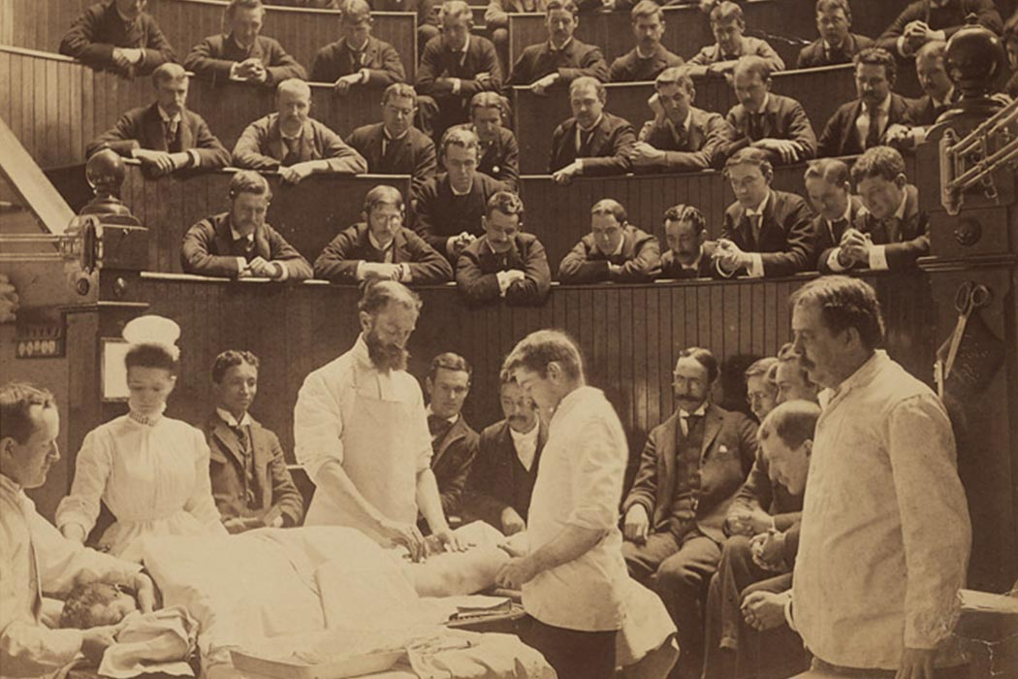
Poll!
Who would have their appendix removed here?

Slide 8
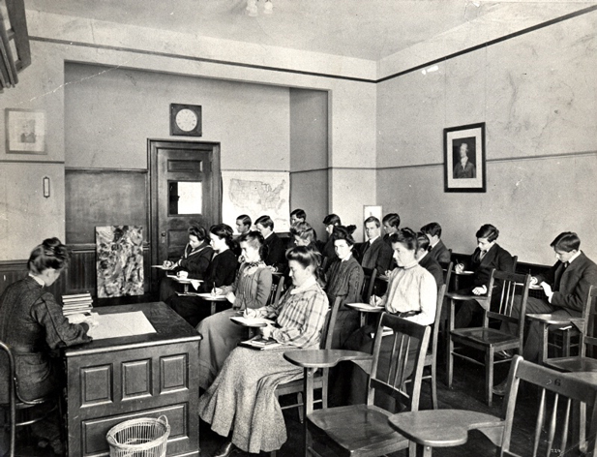
Poll!
Who has ever had a class in a classroom like this?

Slide 9

His Fordship
The book: children are made in an artificial womb, and indoctrinated to become what is needed by society
In 1926, Ford began mass production, needing workers to do the same thing over and over
This theory worked, and can still be applied to everyday tasks (like ironing)
Education was modelled against this, and created many of the same type of labourers

Slide 10
We’re still doing that
All of you have had the same C#, the same SQL, the same Cisco CCNA
And that’s not a bad thing, because these are things you need to know
But that ends now.
Next year, all of you will be doing different jobs
So you’ll all have a different experience in this one course

Slide 11
Poll!
Who liked sports in their middle school education?
Who was good at sports at their middle school?
Who did sports out of the school-context?

Slide 12
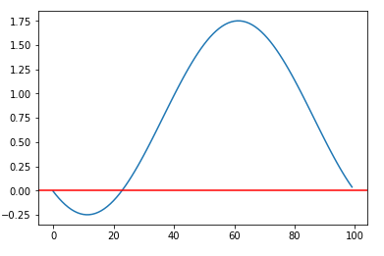
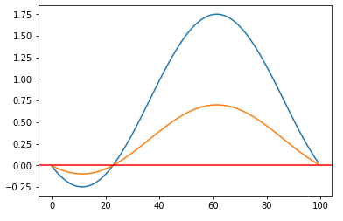
Hitting the spot

Slide 13
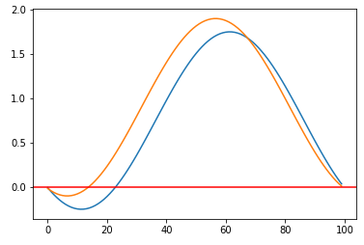
Hitting the spot
Notes:
E.g. tennis players practising on backhand because it is bad – forehand goes worse too
You won’t end up doing what you’re not good at, so get better at what you ARE good at

Slide 14
Task
Find one subject now, that all of you would like to spend a day working with
Can be in or out of a school context
You need to be able to get data about this subject (numbers and keywords)
Data needs to be available
At the end of the day, you produce one presentation that a random member of class will give enthusiastically
Grading for the entire class will be based on the level of enthusiasm this one person can muster
(Random selection won’t be random: the least cooperative student will be picked)

Slide 15
You have one minute

Slide 16
We’re not that cruel
What was the point?
There is no common denominator between all of you
And that’s a good thing

Slide 17

The concept

Slide 18
Why the previous slide?
https://en.wikipedia.org/wiki/Post-it_note
https://en.wikipedia.org/wiki/Bootlegging_(business)
Permitted bootlegging
They allow 10 to 15 percent of the working time for own product related interests.
Another famous example is Google, … up to 20% of their work time in personal projects … Gmail, Google News, Orkut and AdSense were originally created by employees in their work time.

Slide 19
HILL
High impact learning that lasts
Isn’t a set of strict guidelines, but a different approach to teaching
It doesn’t see the teacher as the one person who knows everything
Who also determines what you need to know to get good grades
It sees the student as responsible for learning
You decide what your strengths are, and say how you will improve on them
You set your goals, and say what needs to be done to achieve these
The teacher is now a coach
Who you need to keep informed, and who will get annoyed when you’re not working hard enough
Notes:
Fismo’s.

Slide 20


Slide 21
Spinning
You’ll be doing one or more projects related to big data
Any of the topics; Hadoop, data science, Neo4j, artificial intelligence, …
You can do group projects, but follow-up and feedback is individual
When starting a project, you need to define your personal goal in this project
Both technically and personally
Before starting the project
While doing this project, keep me updated
I need to see your heartrate
Notes:
When spinning
You’re not going anywhere
You can drive with your eyes closed
You can quit halfway and pickup later
But you need to keep your heartrate up

Slide 22
The end product
A working end product is a nice to have, but not need
You can try to get one of the speakers to “sponsor” a project
The ending evaluation is during the exam period
Give a personal presentation of what you’ve been doing
Also present whatever you created
Answer questions on your progress
Grading is based on
How well you do with the Hadoop-challenge
The quality of your statistical analysis (see later)
Your heartrate during the semester
How much you’ve grown

Slide 23
August?
I’ll tell you when you’re in the danger-zone of not passing
If you don’t step up, there is a chance to retake in August
Come and see me after grading, we’ll go over what needs to be done to pass in August
Retake the statistical analysis?
Redo the Hadoop-day? And how?
Start another project?

Slide 24
When | Who | What
5/10/2018, 8:30 | Caroline Vanderheyden | Statistiek
12/10/2018, 8:30 | Caroline Vanderheyden | Statistiek
19/10/2018, 8:30 |  | Hadoop-dag
26/10/2018, 13:00 | Matthias Vallaey (Big industries / Cronos) | Big Data Use Cases
9/11/2018, 9:00 | Jorge De Corte (Simon DLS / Isaac) | Deep learning
16/11/2018, 13:00 | Big Industries / Cronos | Big Data Hands-on Session
30/11/2018, 9:00 | Vectr Consulting / Cronos | Introduction AI, knowledge graphs and neo4j
Notes:
Peter Karsmakers?

Slide 25
Also, python
The session on deep learning: Python
The Big Data Hands-on Session: Python
Data cleaning for data science: R or Python
Data presentation: Jupyter in Python
You need to know Python
https://courses.edx.org/courses/course-v1:Microsoft+DEV330x+1T2018/course/
https://courses.edx.org/courses/course-v1:BerkeleyX+Data8.1x+1T2018/course/
https://www.datacamp.com/courses/intro-to-python-for-data-science

Slide 26
The next four weeks
Learn statistics (classes)
Only two weeks, other weeks you don’t have to be at school
Learn Python (online)
Combine the two:
Make a Jupyter-notebook that visualizes all the concepts form the statistics course using a (small) personal dataset
Your fitbit, car mileage, favorite sportsteam last year, membership of KSA-group, heartrate during movie marathons, …
Share the notebook through your shared github repo

Slide 27
Practically
We’ll be using Github as our primary communication-page
Set up a repository, and add “mjochen” as collaborator
Add your own folder-structure
For every project, statistical analysis, …
For every project you’ll be starting, create a new markdown-file
General idea of project
Your (expected) contribution
What you’ll hope to learn

Slide 28
Feedback
Create a markdown-file called “Feedback” on Github
Ask for feedback on regular intervals, or get called to a feedback-moment if your heartrate is going down
All feedback you get is oral, in the form of a conversation
After this talk, you write down what you remember in that file
If necessary, I’ll add or change what is needed

Slide 29
Practically
Take note of all speakers and classes
On Toledo, some are the entire Friday, some only the afternoon
Create a Github-page
And share with mjochen
Start a Python-course
Post link on github
Start preparing Hadoop-day

