Slide 1
Mizuho Analysis Tool
User Manual
v1.3.0

Slide 2
Agenda
Features
How to use
Open application
Analysis page
Detection page

Slide 3
Features
Load different images, and select region to analyze
Export csv file

Slide 4
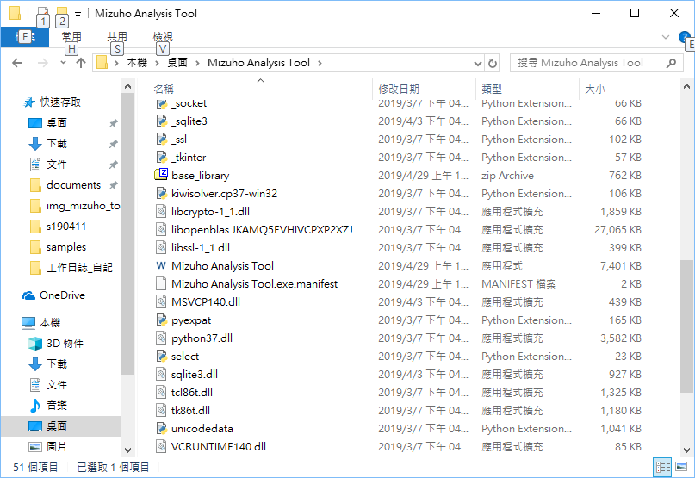
How to Use – Open Application
Open this executable

Slide 5
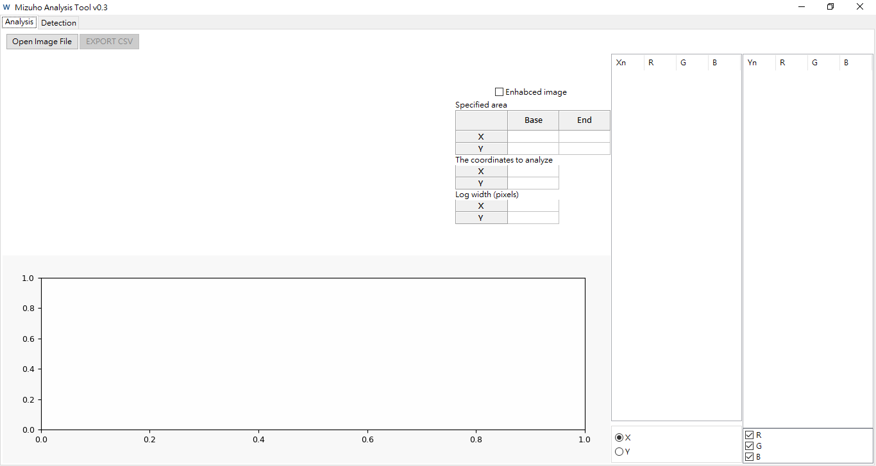
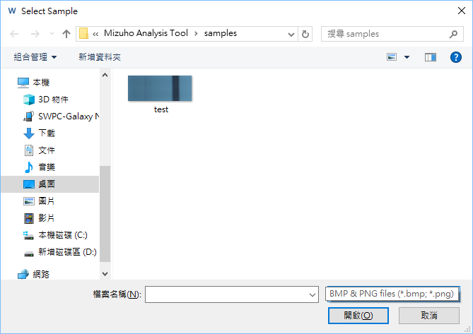
How to Use – Analysis Page
Default path
Click here to load image
Supported format:
BMP & PNG

Slide 6
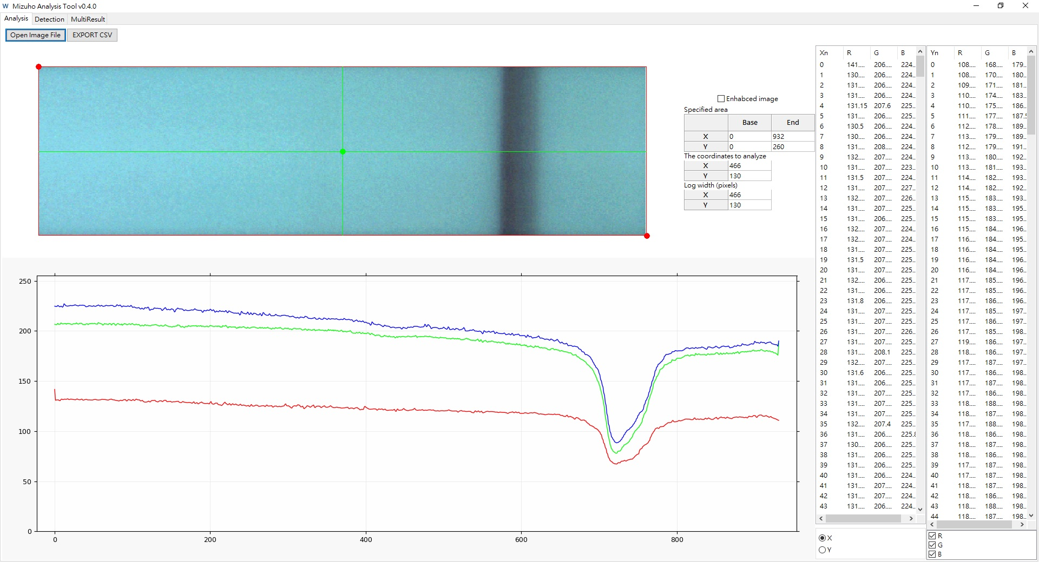
How to Use – Analysis Page
Image loaded

Slide 7
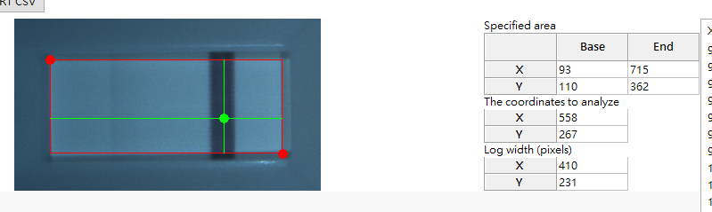
How to Use – Analysis Page
Base
Change analysis param
2 ways
Drag circles on the image
Edit in the forms
New logs
Generated automatically
After changing any analysis parameter
More image interaction on image
Mouse wheel – zoom in/out
Red circles
Log width (Y)
Log width (Y)
Green circle
End

Slide 8
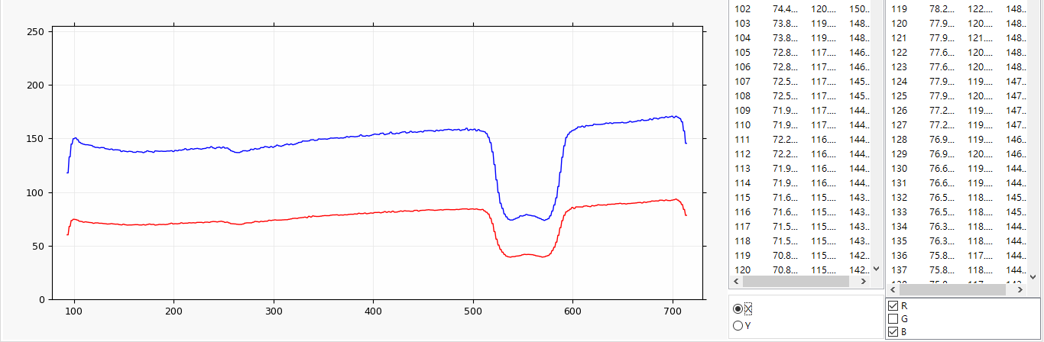
How to Use – Analysis Page
(X) Analysis logs (Y)
Chart
Chart display config

Slide 9
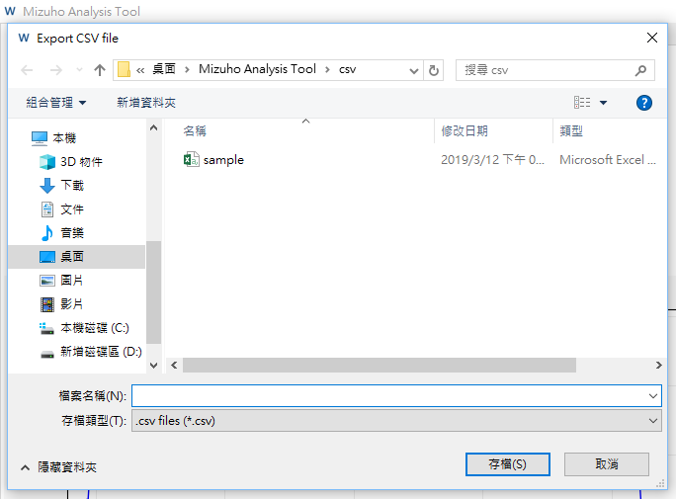
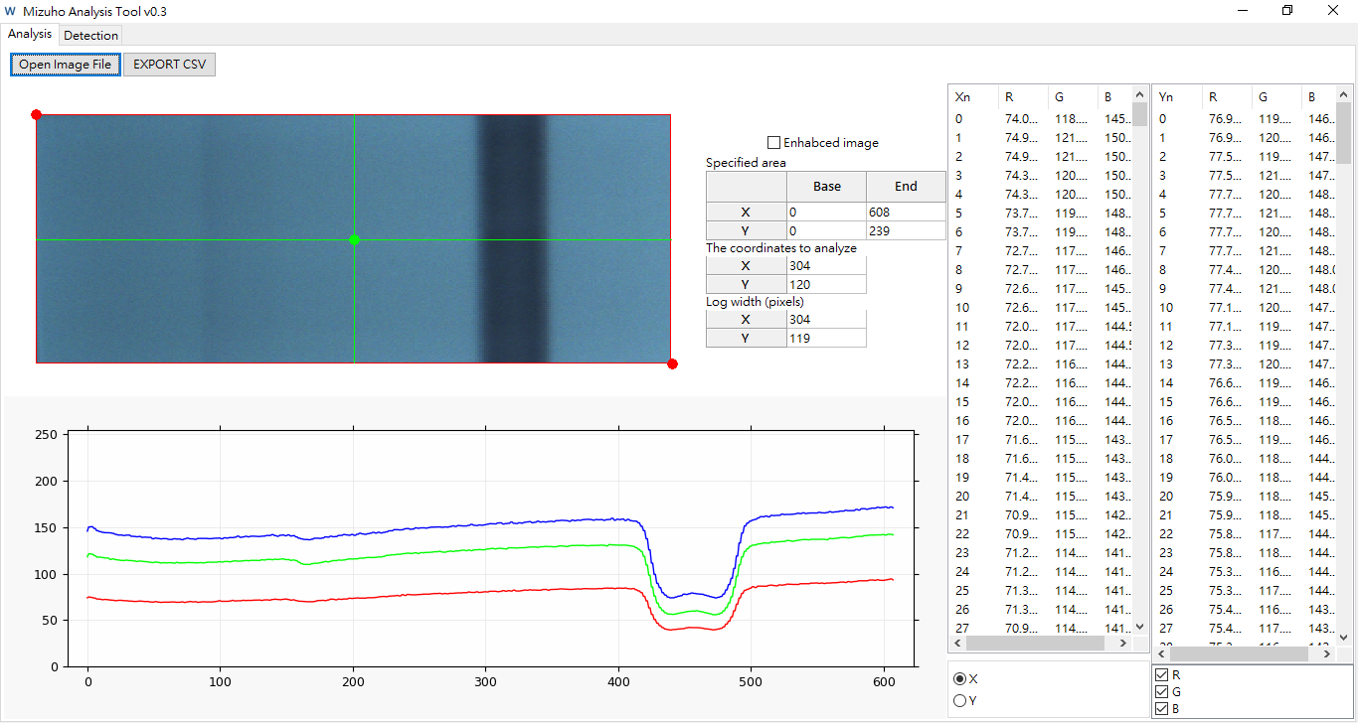
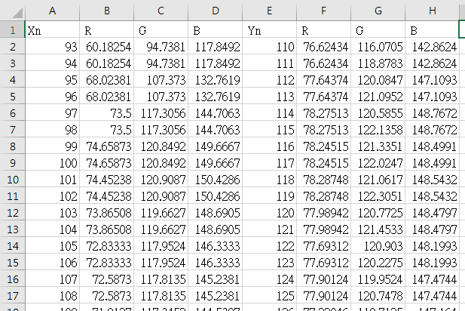
How to Use – Analysis Page
Click here to
export csv file

Slide 10
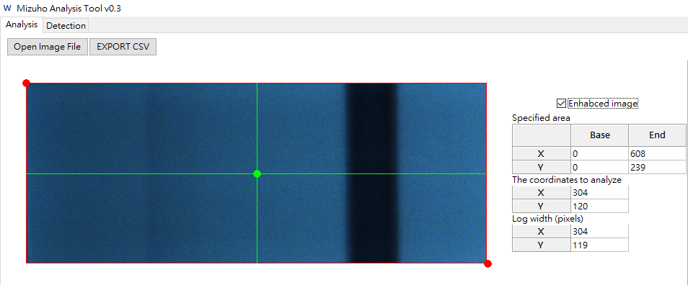
How to Use – Analysis Page
Use with enhanced image
Just click the check box to switch
This will generate new logs with enhanced image automatically

Slide 11
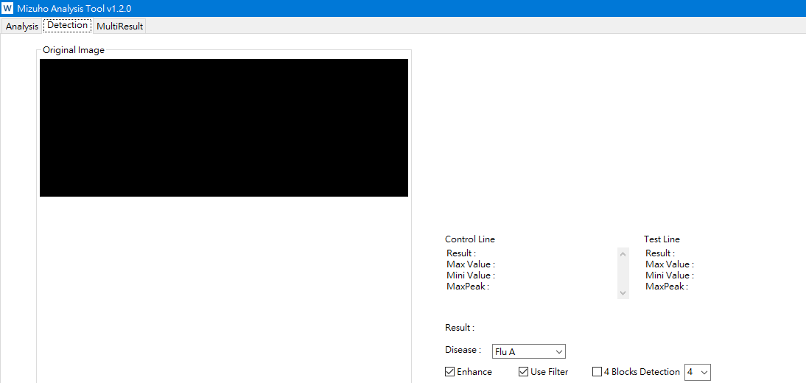
How to Use – Detection Page
Prerequisite
Load image from analysis page & select analysis region
Navigate to this page via tabs

Slide 12
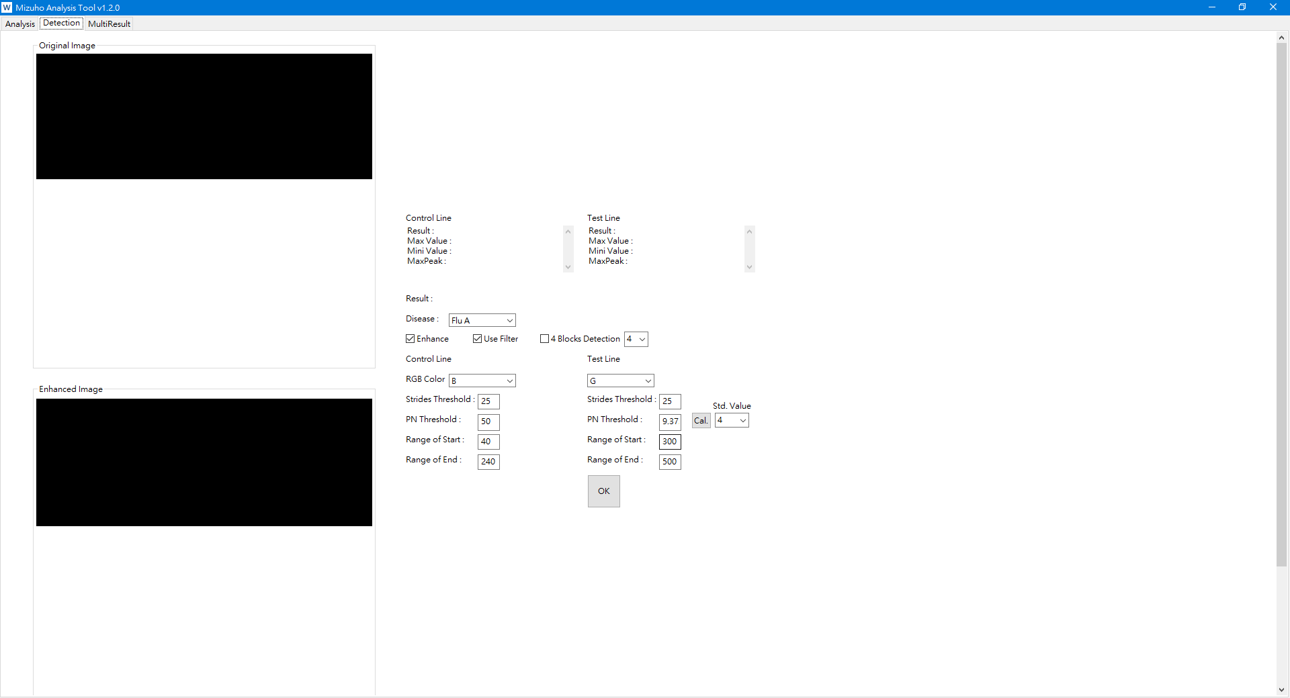
How to Use – Detection Page
Original image
scrollable
Enhanced image

Slide 13
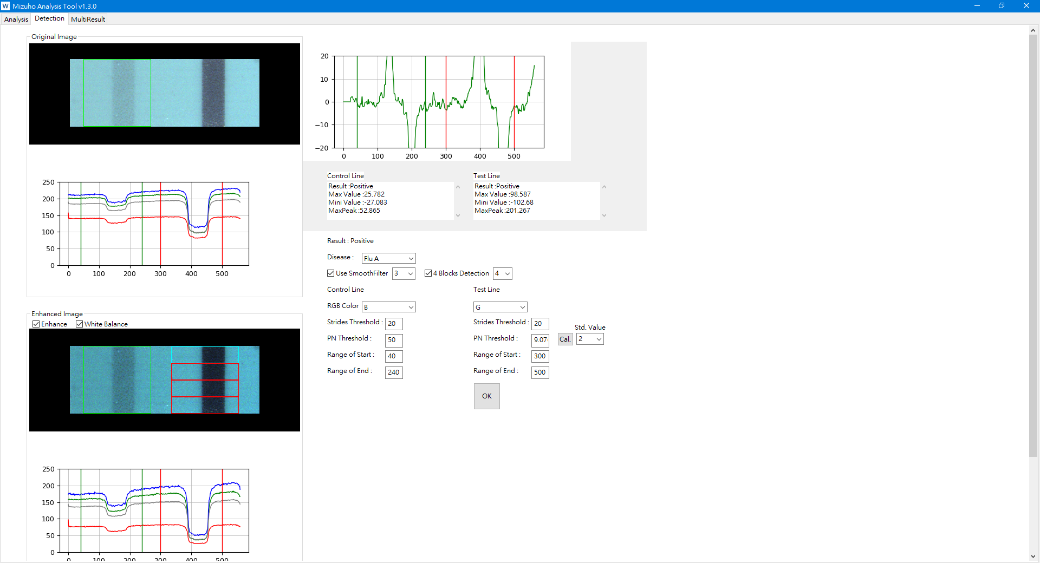
How to Use – Detection Page
Result Area
After clicking OK button , the Result Area will
update.
Parameters
After changing parameters, please click OK
button to update the result on the Result
Area.
Result Area
Parameters

Slide 14
How to Use – Detection Page
Parameters Instruction
Disease:
Choose disease type.
Enhance:
Enhancing the image or not.
RGB Color:
Choosing the color to analysis.
Use Filter:
User can use filter or not.
Use SmoothFilter:
User can use smooth filter or not
White Balance:
User can use white balance algorithm or not.
4 Blocks Detection:
User can use 4 Blocks Detection or not.
Strides Threshold:
The stride size to calculate the difference of two value ( value is from average y-axis).
It is recommended to keep the default value.
Range of start:
The start coordination of x to analysis.
Range of end:
The end coordination of x to analysis.
P/N Threshold:
Peak diff value greater than the P/N threshold will be judged to positive.
It is recommended to keep the default value.

Slide 15
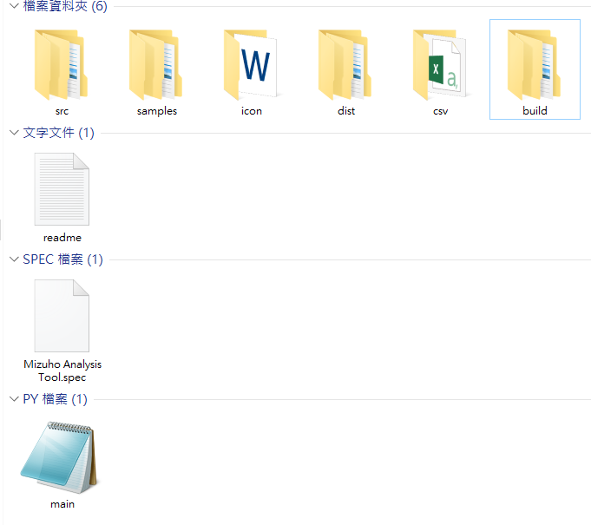
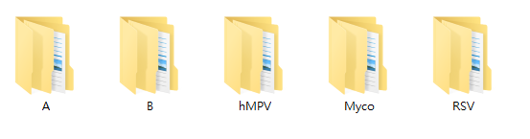
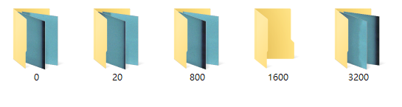
How to Use – MultiResult Page
Prerequisite
Put images into the correct file
Click into file named samples.
Select correct file of flu.
Select correct file of concentration. If it’s negative put the
image into the file of “0”.

Slide 16
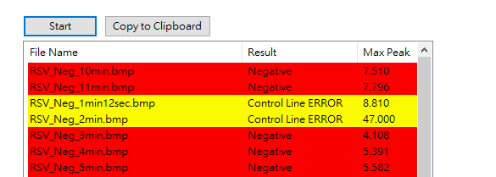
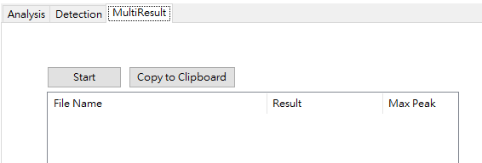
How to Use – MultiResult Page
Navigate to this page via tabs, and click the start button.
After clicking start button, there will show the result on the board
If the line is labeled by
Red color : In the wrong file
Green color : In the correct file
Yellow : Control Line ERROR

Slide 17
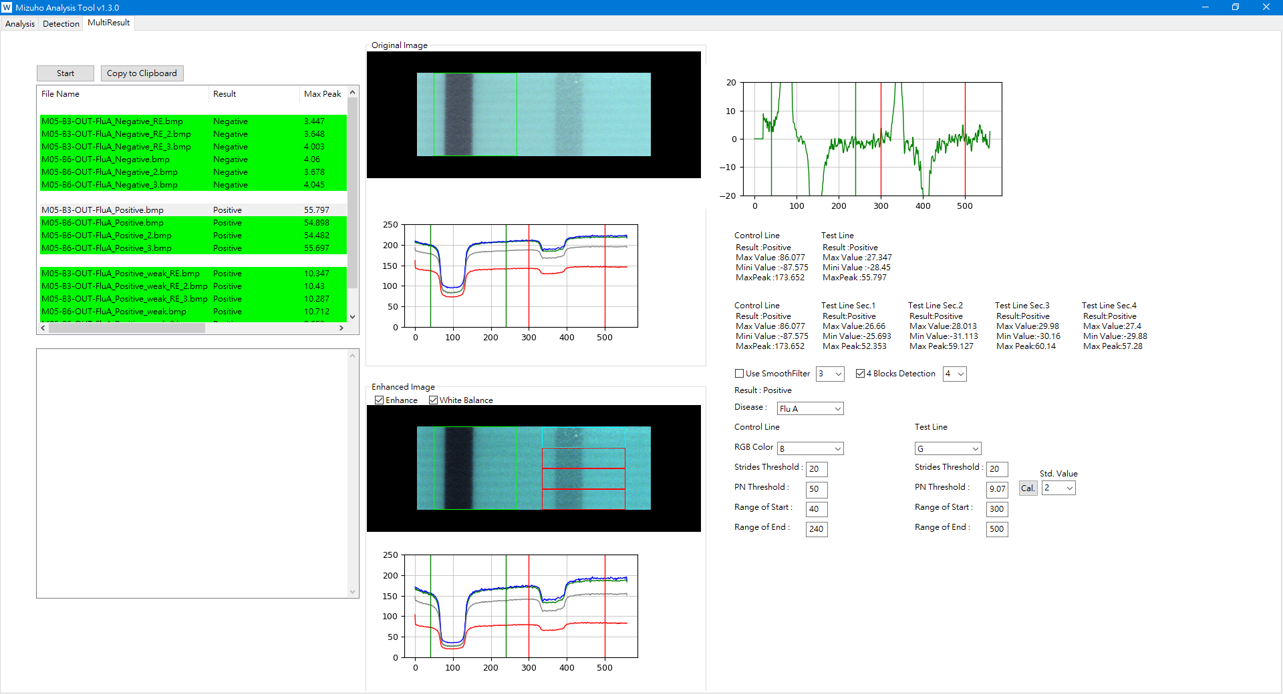
How to Use – MultiResult Page
After slecting parameters, click Start button will show the result.
It will show the result with no "4 Blocks Detection".
After clicking this button, it will show the copy of result on the clicpboard.
It will show the result of "4 Blocks Detection".
Use "4 Blocks Dtection" or not.
Please refer to the thirteenth page for the purpose of these functions.

