Slide 1
Weekly Report
- week 11
2014.11.20
2014.12.03
2014.12.03
Project Name
Project Name
Project Name
By Your Name
By Your Name
By Your Name
Frank
March 21, 2022

Slide 2
Plan This Week
 | 3/7 | 3/8 | 3/9 | 3/10 | 3/11
9~10 am | 一週報告整理 | Get event logs from Viavi | Tracing event code: EVT_RGR_LVL1_CONFIG_REQUEST | Analysis event logs, Make weekly report | Tracing event code: EVT_OAM_DU_CONFIG
10~11 am |  |  |  |  | Tracing event code: EVT_RLC_FLW_CTRL_INFO_INDICATION 1
11~12 pm |  |  | Tracing event code: EVT_L1_MSG_INDICATION
01~02 pm | Tracing event code: EVT_RGR_LVL1_CONFIG_REQUEST | Analysis event logs, Make weekly report | Tracing event code: EVT_L1_MSG_INDICATION | Tracing event code: EVT_L1_MSG_INDICATION
02~03 pm | Weekly Meeting |  | Get event logs from Viavi
03~04 pm |  |  |  | Tracing event code: EVT_OAM_DU_CONFIG | Make weekly report
04~05 pm
05~06 pm | Tracing event code: EVT_RGR_LVL1_CONFIG_REQUEST

Slide 3
Plan Next Week
 | 3/14 | 3/15 | 3/16 | 3/17 | 3/18
9~10 am | 一週報告整理 | Tracing event code: EVT_RLC_REQ_FLW_CTRL_INFO | Make event logs analysis script with Python | Analysis event logs, Make weekly report | Analysis event logs, Make weekly report
10~11 am
 |  |  |  |  | Make event logs analysis script with Python
11~12 pm
01~02 pm | Tracing event code: EVT_RLC_REQ_FLW_CTRL_INFO | Tracing event code: EVT_NRUP_EGTPU_INDICATION | Get event logs from Viavi | Get event logs from Viavi
02~03 pm | Weekly Meeting
03~04 pm |  |  |  |  | Make weekly report
04~05 pm
05~06 pm | Tracing event code: EVT_RLC_REQ_FLW_CTRL_INFO

Slide 4
Current Status
Current Status
分析以下兩種情形，事件在queue中的等待時間
CPU core numbers = 2 Pool numbers = 1
CPU core numbers = 3 Pool numbers = 1
CPU core numbers = 3 Pool numbers = 2 (1 for real time task, 1 for non real time task)
控制變因:
測試環境(Viavi)
CPU頻率1.3GHz
UE個數(16, 32)
UE個數/TTI(1, 4)

Slide 5
Current Status
Task | Date | Status | Comment
CPU Profile analyze | 3/7 | Done

Slide 6
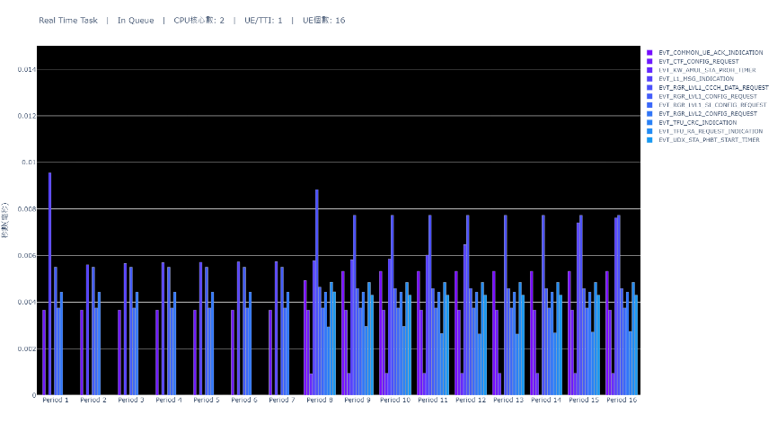
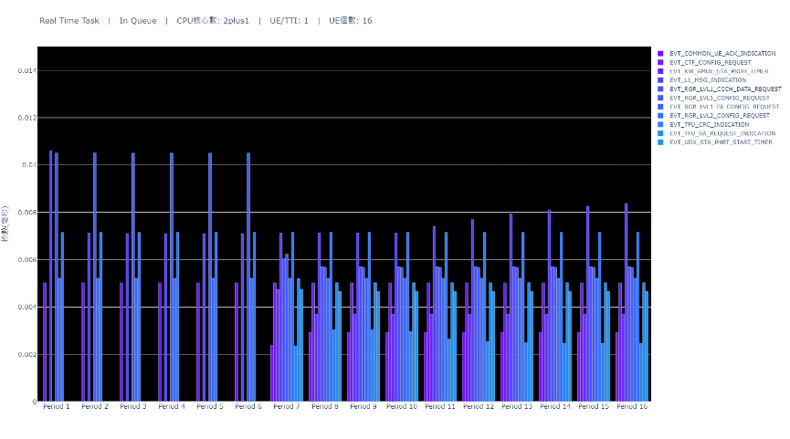

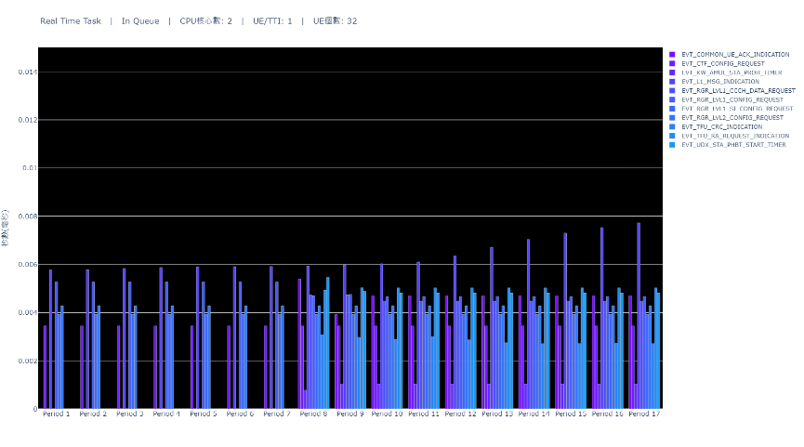
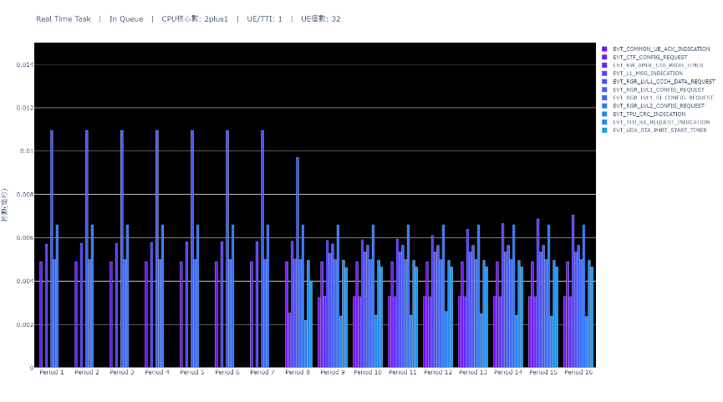
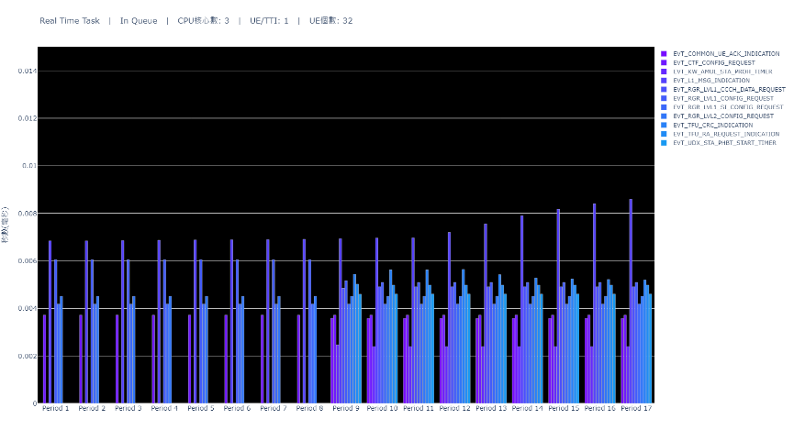
Real Time Task Waiting Time(x-1-x)

Slide 7

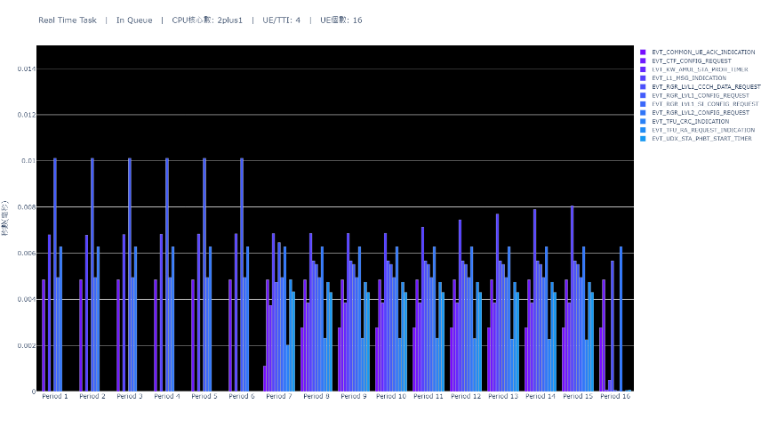
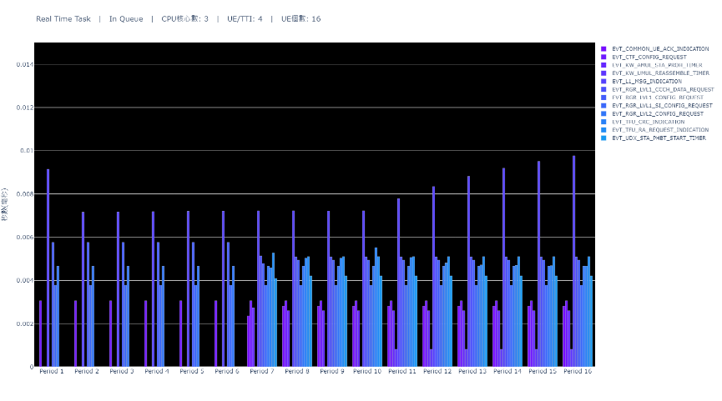
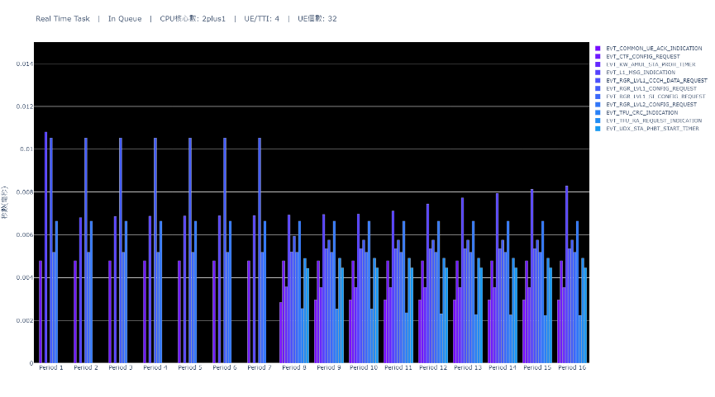
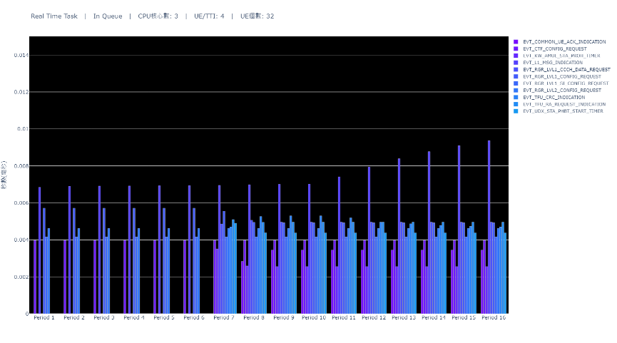
Real Time Task Waiting Time(x-4-x)

Slide 8
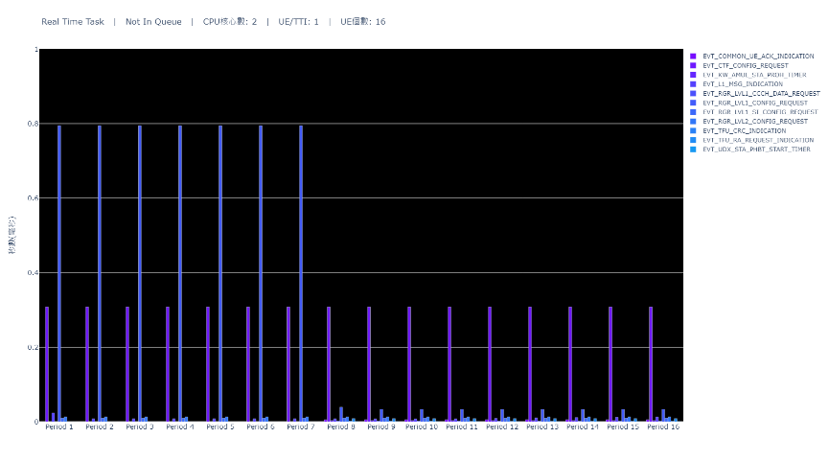
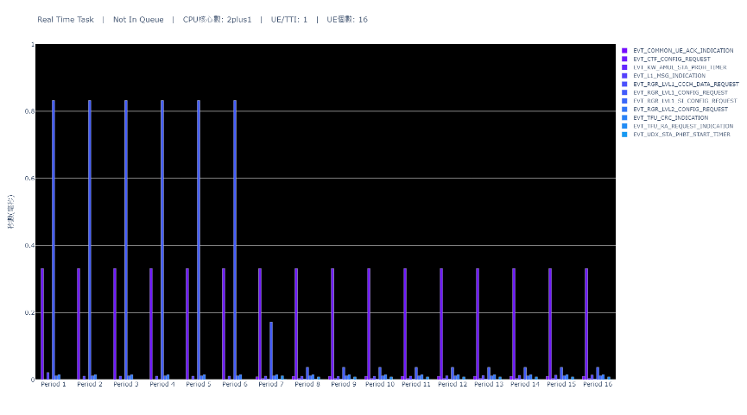

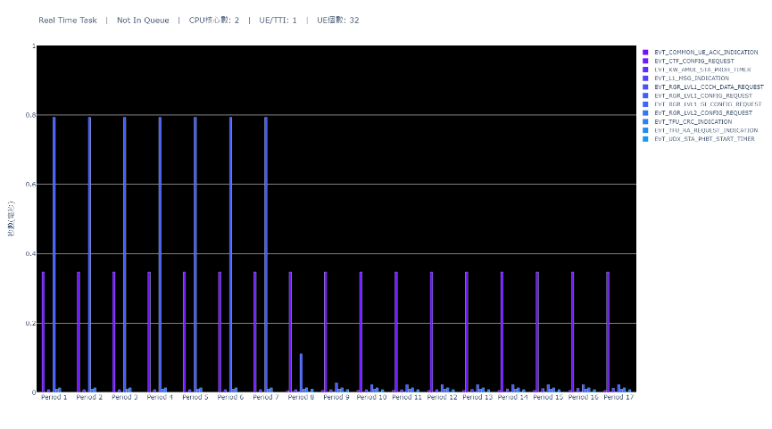
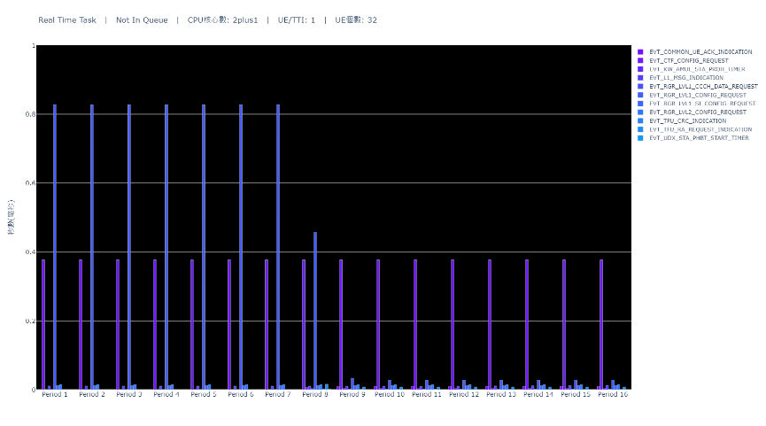
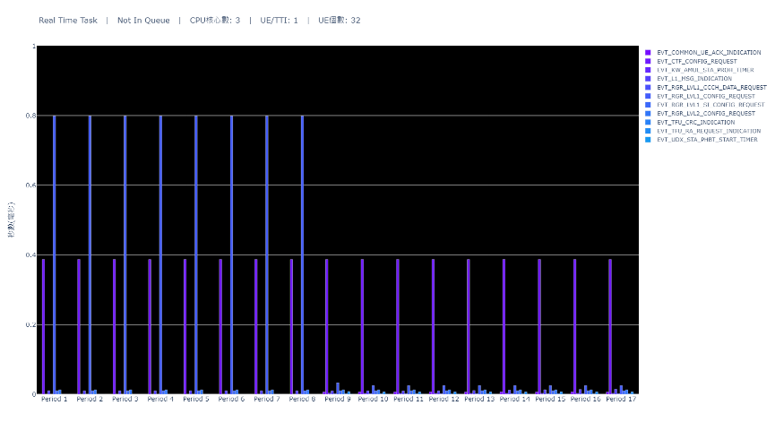
Real Time Task Execute Time(x-1-x)

Slide 9

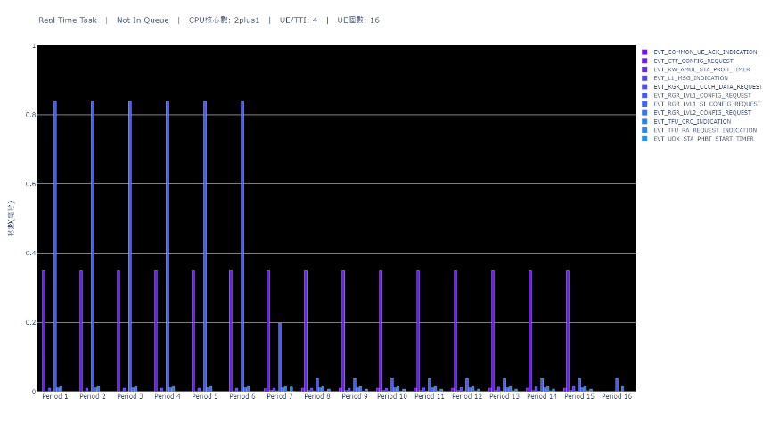


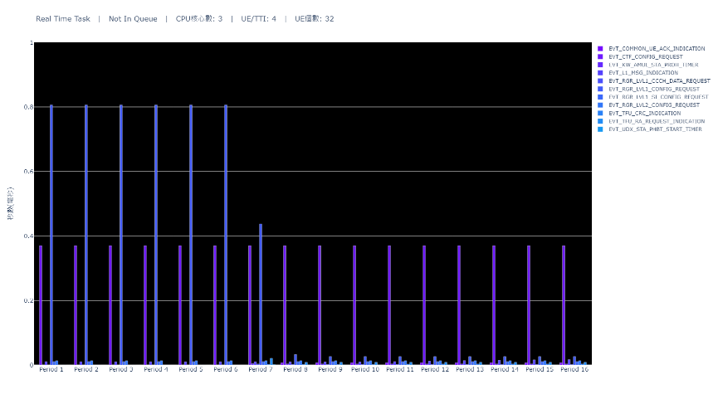
Real Time Task Execute Time(x-4-x)

Slide 10
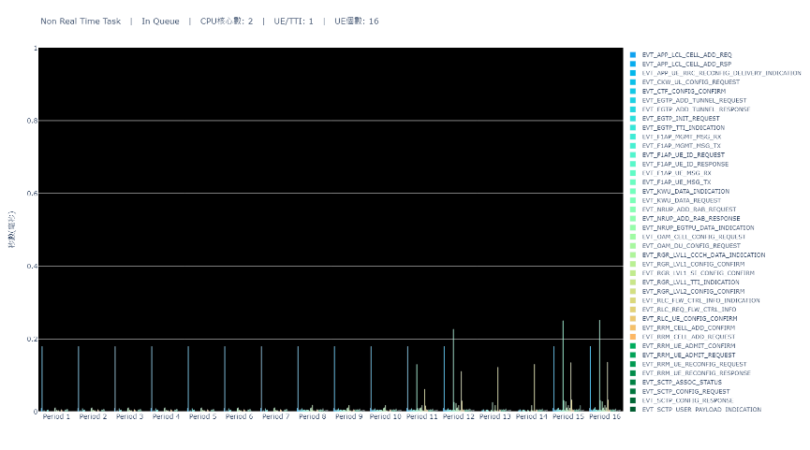
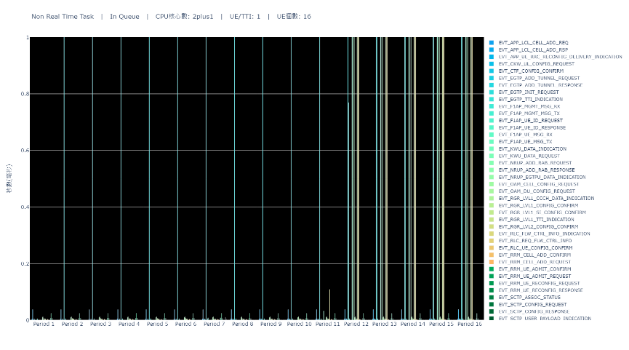
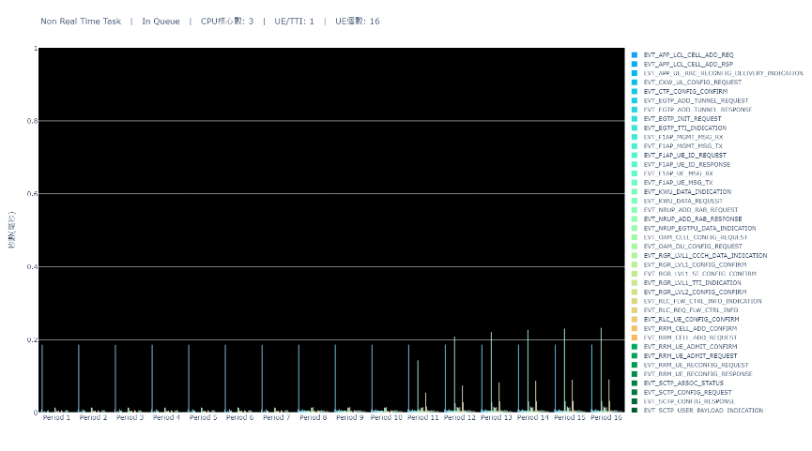

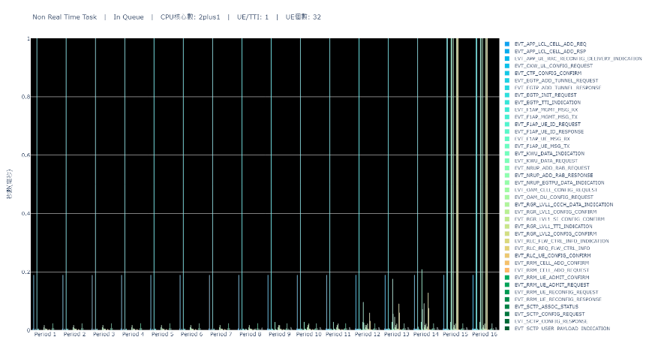

Non Real Time Task Waiting Time(x-1-x)

Slide 11

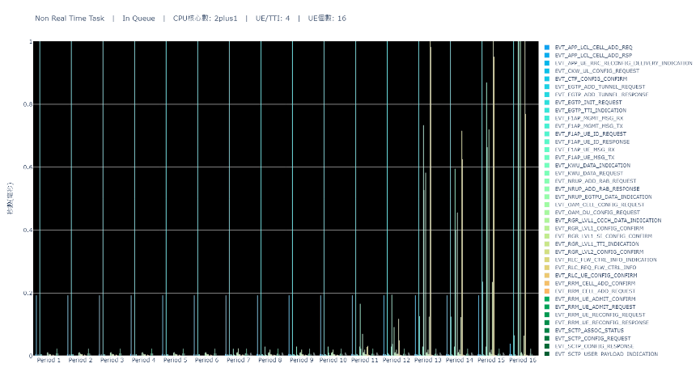

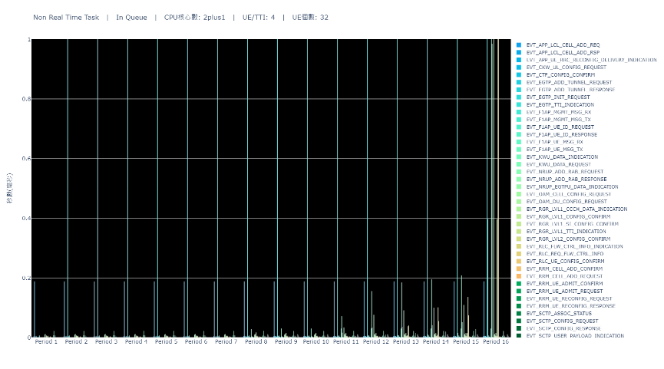

Non Real Time Task Waiting Time(x-4-x)

Slide 12
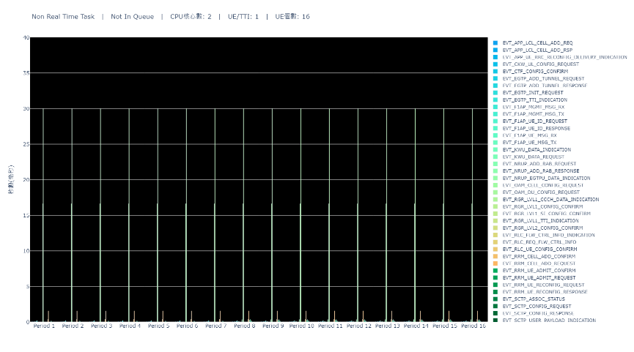
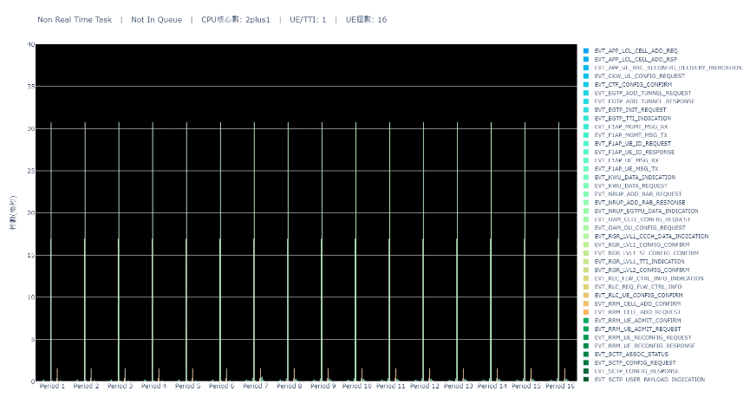

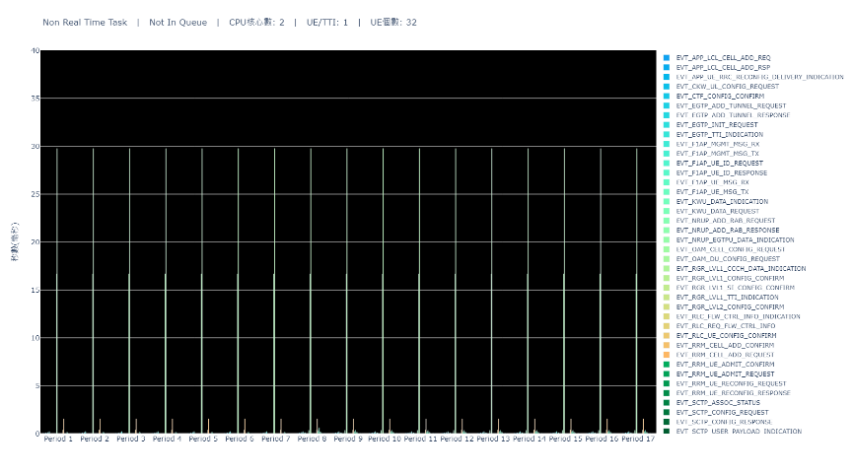
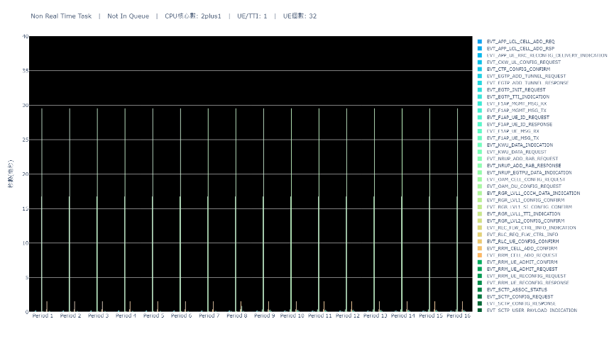

Non Real Time Task Execute Time(x-1-x)

Slide 13

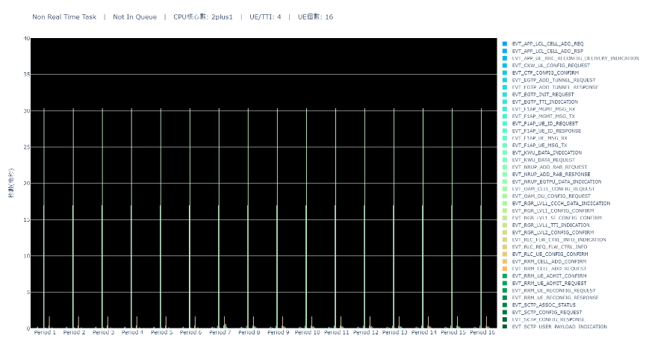
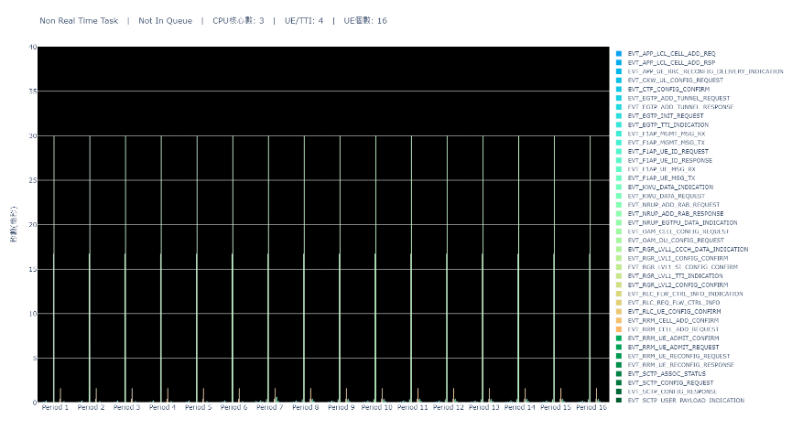


Non Real Time Task Execute Time(x-4-x)

