Slide 1
Weekly Report
- week 11
2014.11.20
2014.12.03
2014.12.03
Project Name
Project Name
Project Name
By Your Name
By Your Name
By Your Name
Frank
March 21, 2022

Slide 2
Plan Next Week
 | 3/22 | 3/23 | 3/24 | 3/25 | 3/26
9~10 am | 一週報告整理 | Tracing event code (real time task) | Statistics on key events (key events: the events have strong relationship with operational variable) | Analysis event logs, Make weekly report | Analysis event logs, Make weekly report
10~11 am
11~12 pm
01~02 pm | Weekly Meeting | Tracing event code (non real time task) | Get event logs from Viavi | Get event logs from Viavi | Get event logs from Viavi
02~03 pm
03~04 pm | Weekly Meeting
04~05 pm
05~06 pm | Tracing event code

Slide 3
Current Status
Task | Date | Status | Comment
CPU profile analyze | 3/21 | Done
Current Status
分析以下兩種情形，事件在queue中的等待時間
CPU core numbers = 2 Pool numbers = 1
CPU core numbers = 3 Pool numbers = 1
CPU core numbers = 3 Pool numbers = 2 (1 for real time task, 1 for non real time task)
控制變因:
測試環境(Viavi)
CPU頻率1.3GHz
UE個數(16, 32)
UE個數/TTI(1, 4)
3 cores:
1UE/TTI Each core about 58%
4UE/TTI Each core about 65%
2 cores:
1UE/TTI Each core about 74%
4UE/TTI Each core about 84%
Crash Situation → 4UE/TTI, 32UES Unable to start CU and DU
2(for real time task) + 1(for non real time task) cores:
1UE/TTI 2 core about 13% (for real time task) 1 core about 95~100% (for non real time task)
4UE/TTI 2 core about 18% (for real time task) 1 core about 95~100% (for non real time task)

Slide 4
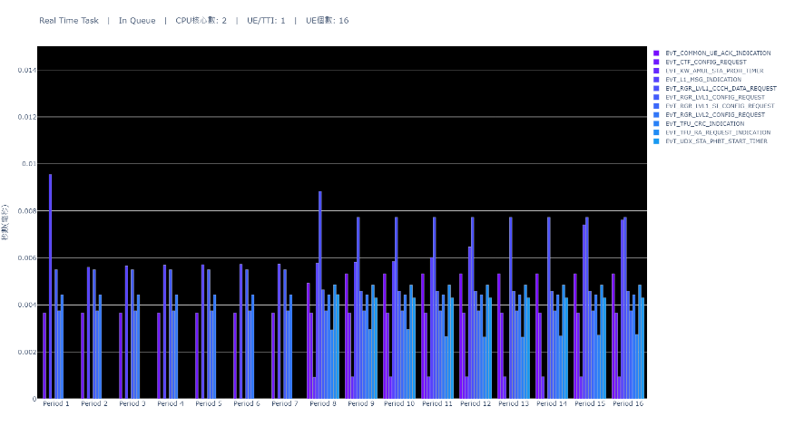
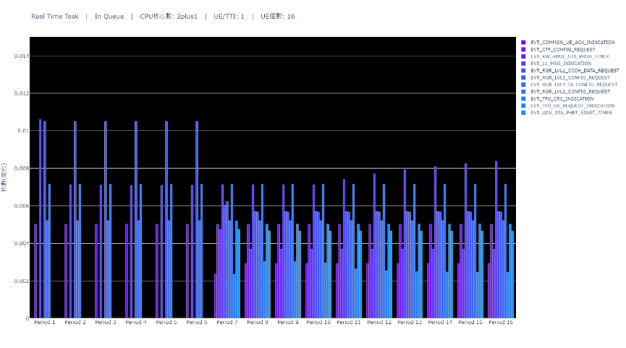

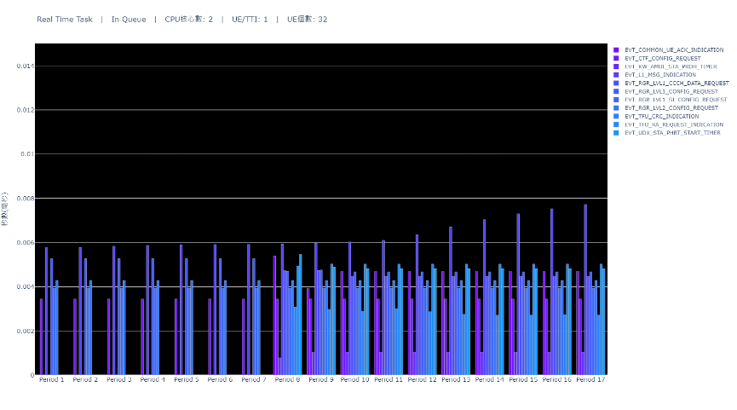
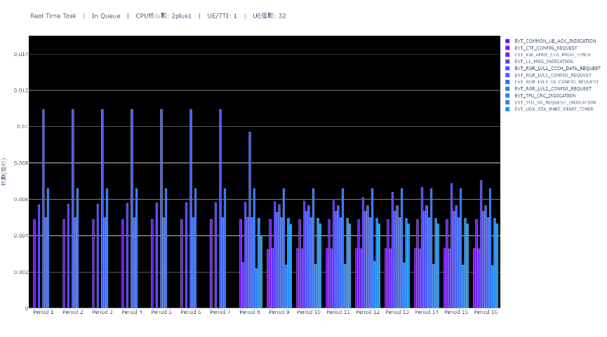
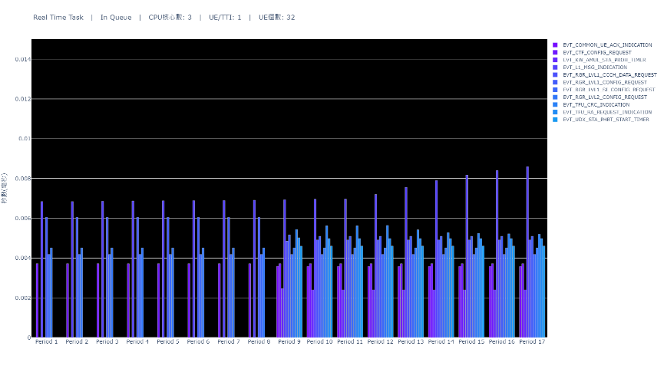
Real Time Task Waiting Time(x-1-x)

Slide 5

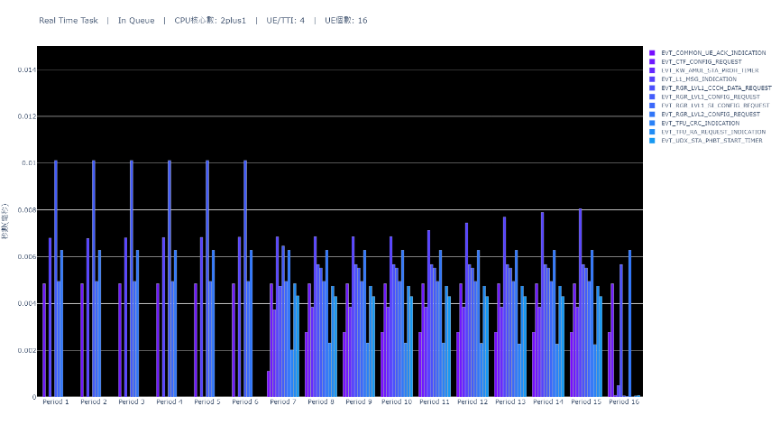
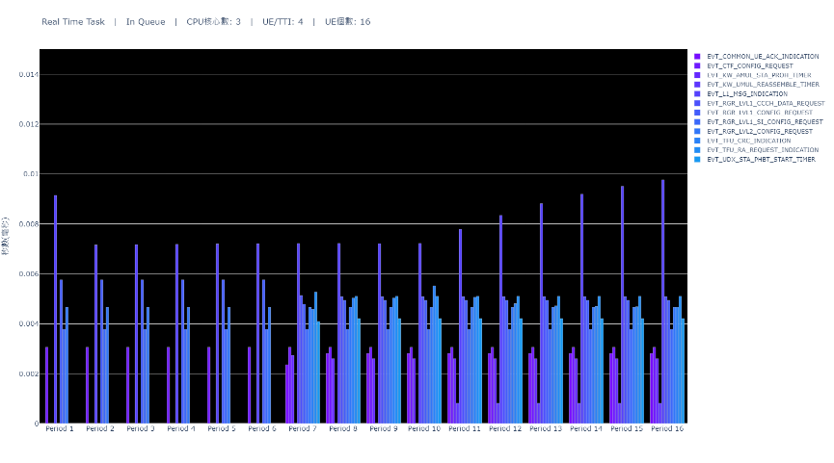
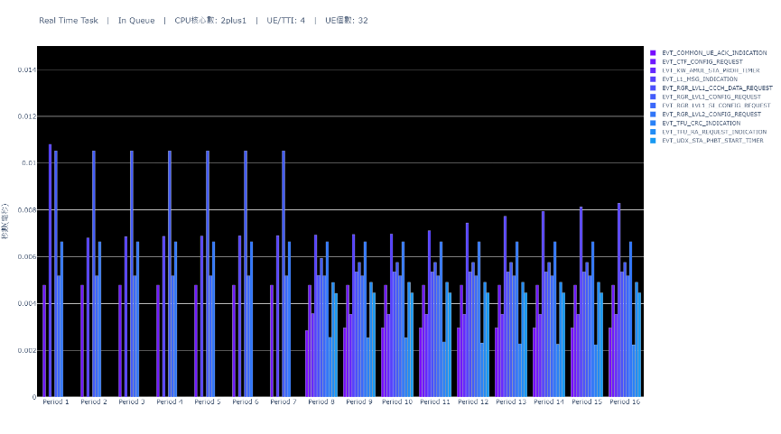
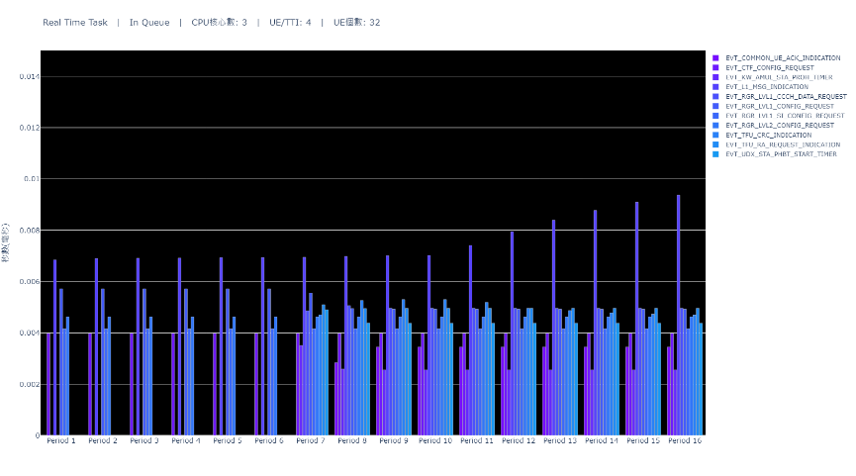
Real Time Task Waiting Time(x-4-x)

Slide 6
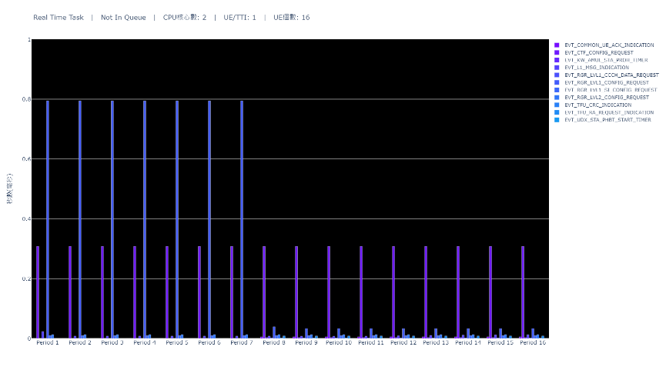
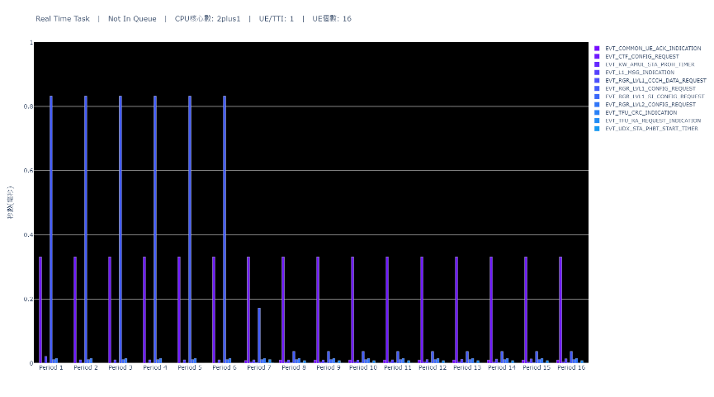

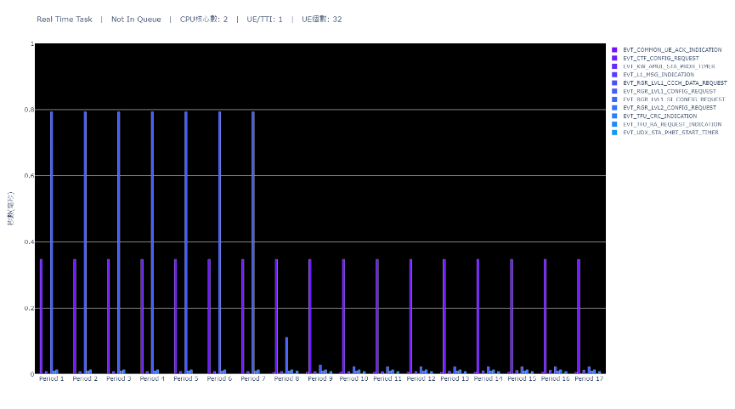
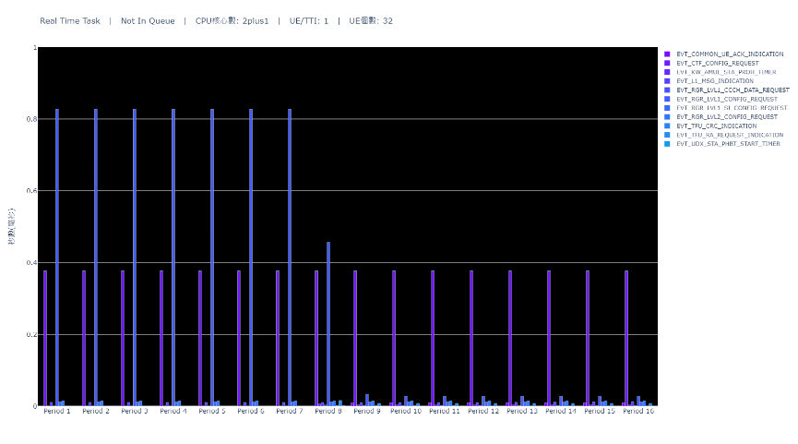
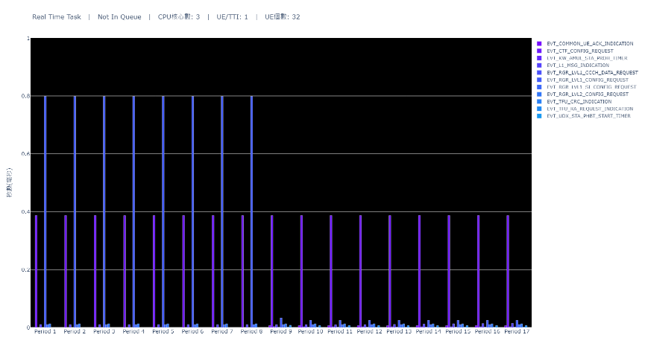
Real Time Task Execute Time(x-1-x)

Slide 7

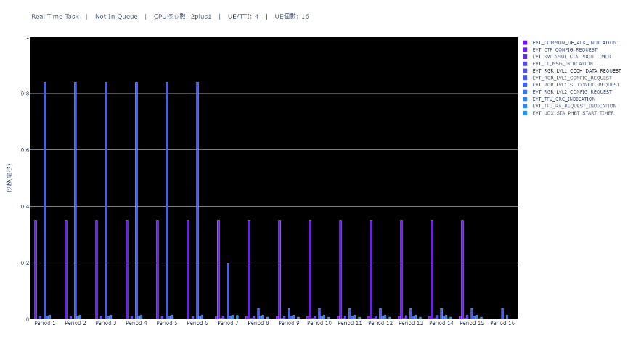


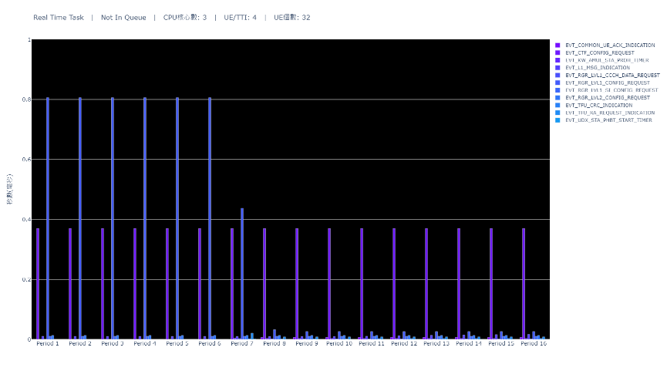
Real Time Task Execute Time(x-4-x)

Slide 8
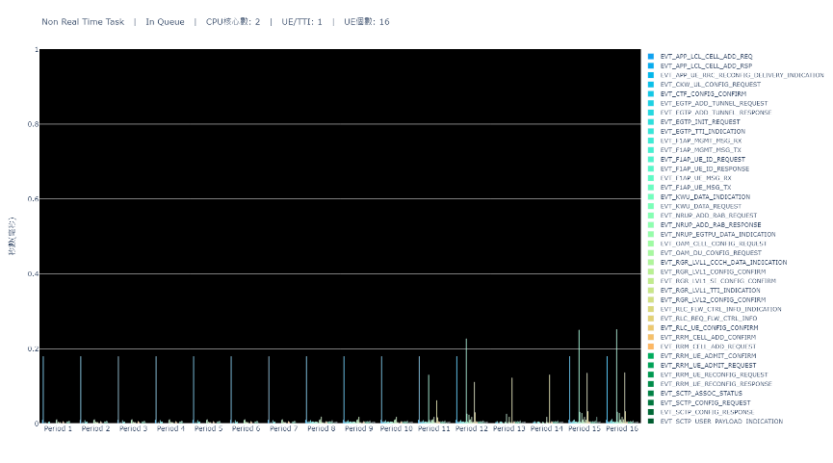
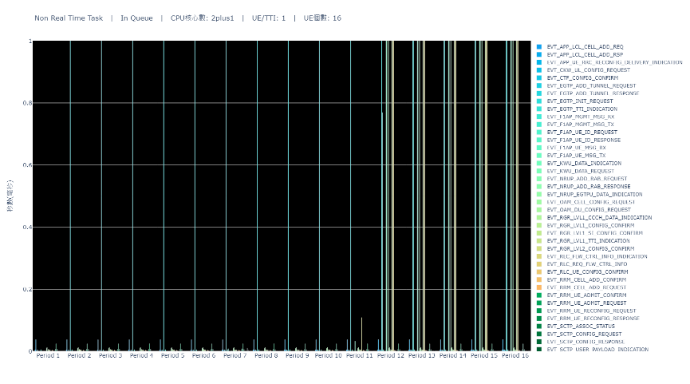
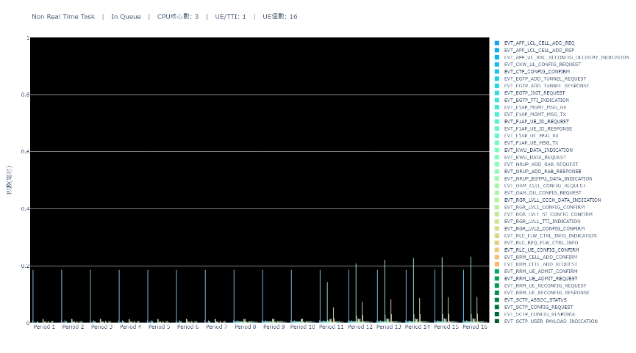

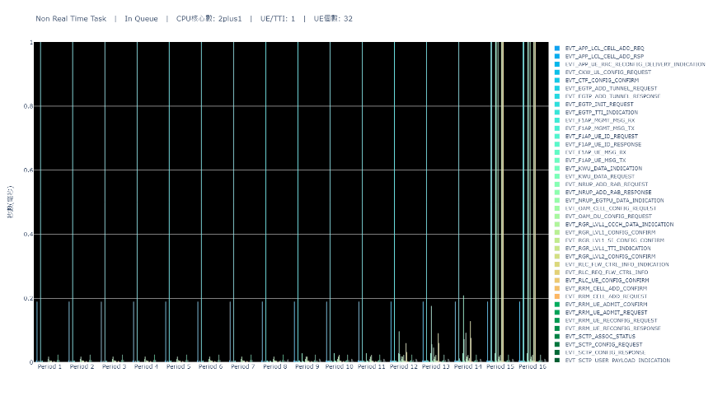

Non Real Time Task Waiting Time(x-1-x)

Slide 9

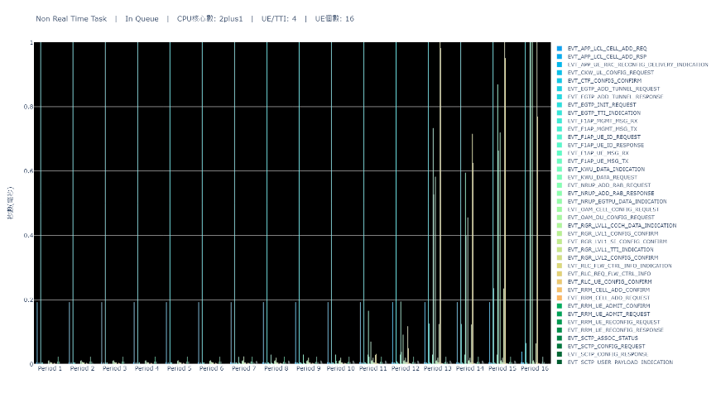

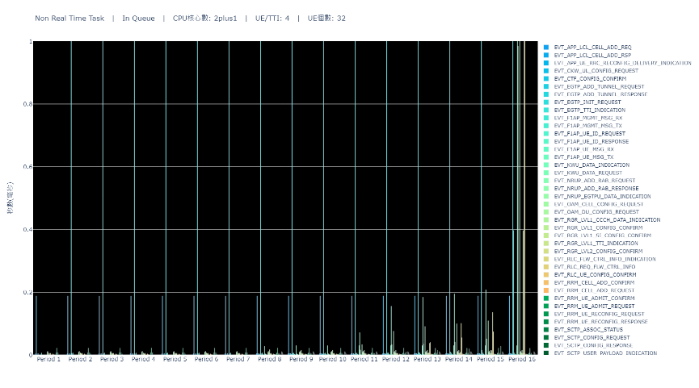

Non Real Time Task Waiting Time(x-4-x)

Slide 10
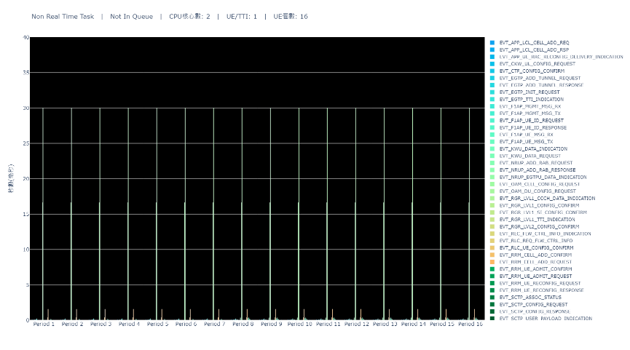
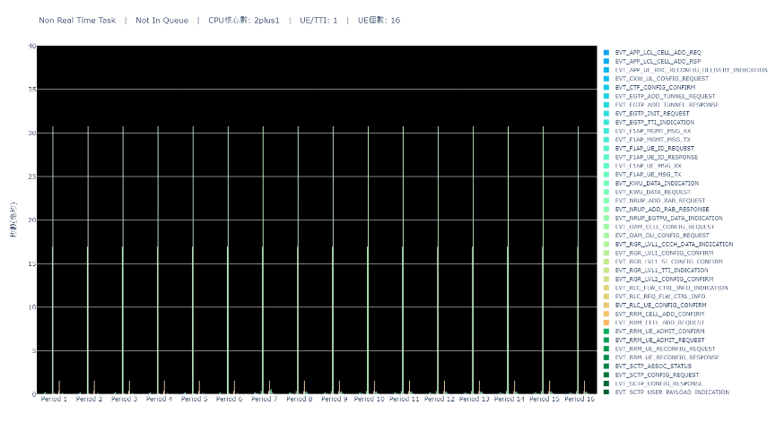

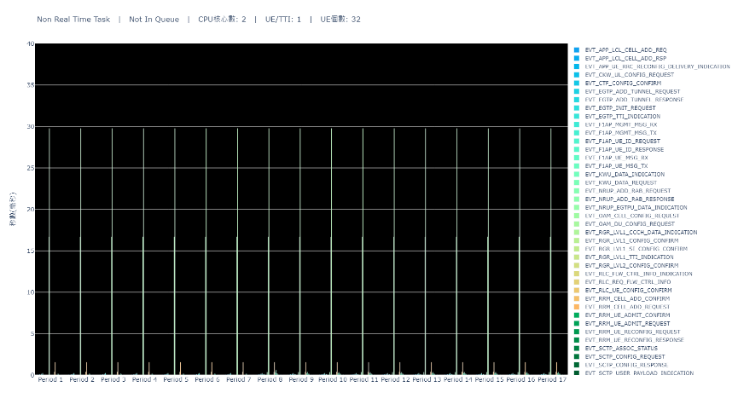
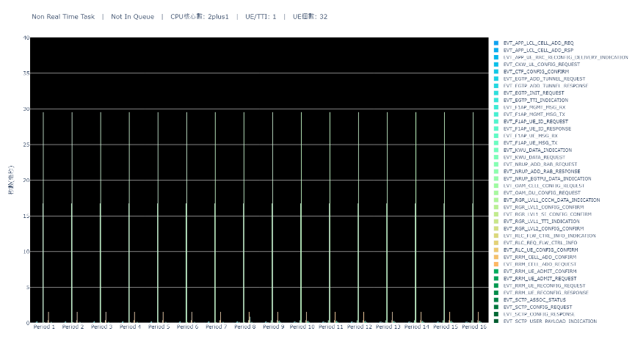

Non Real Time Task Execute Time(x-1-x)

Slide 11

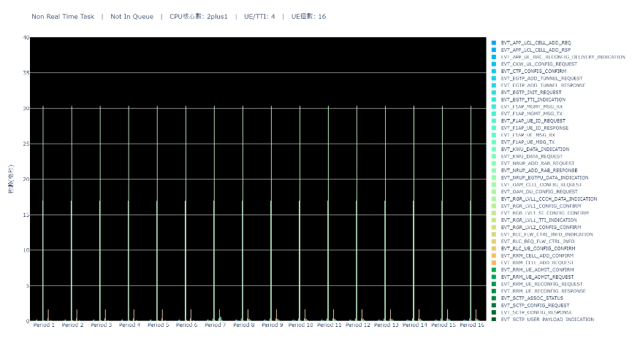
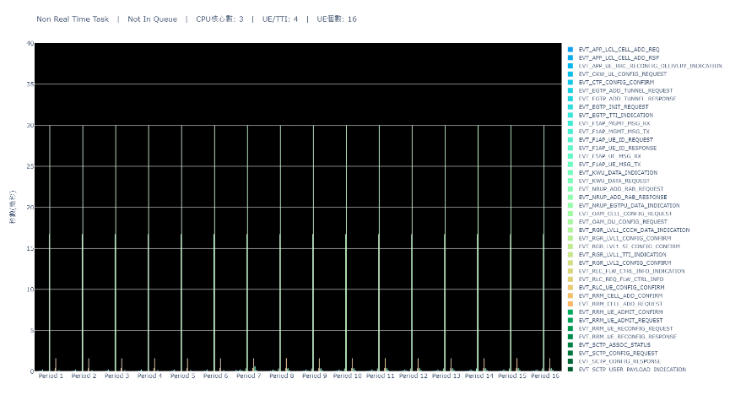


Non Real Time Task Execute Time(x-4-x)

Slide 12
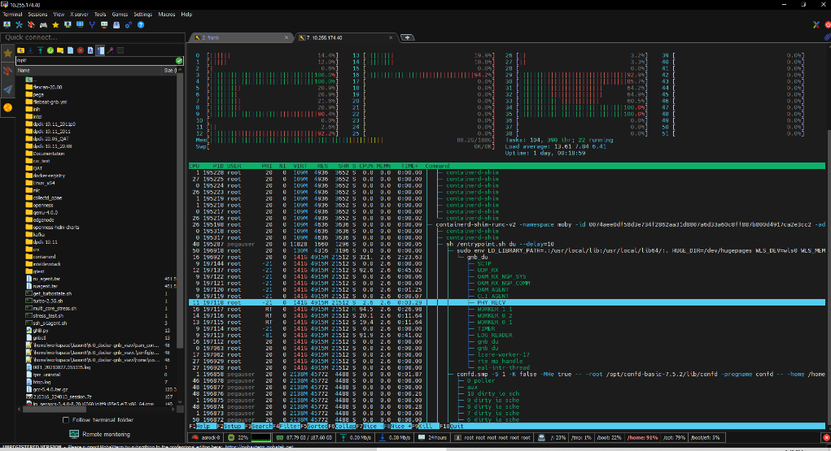
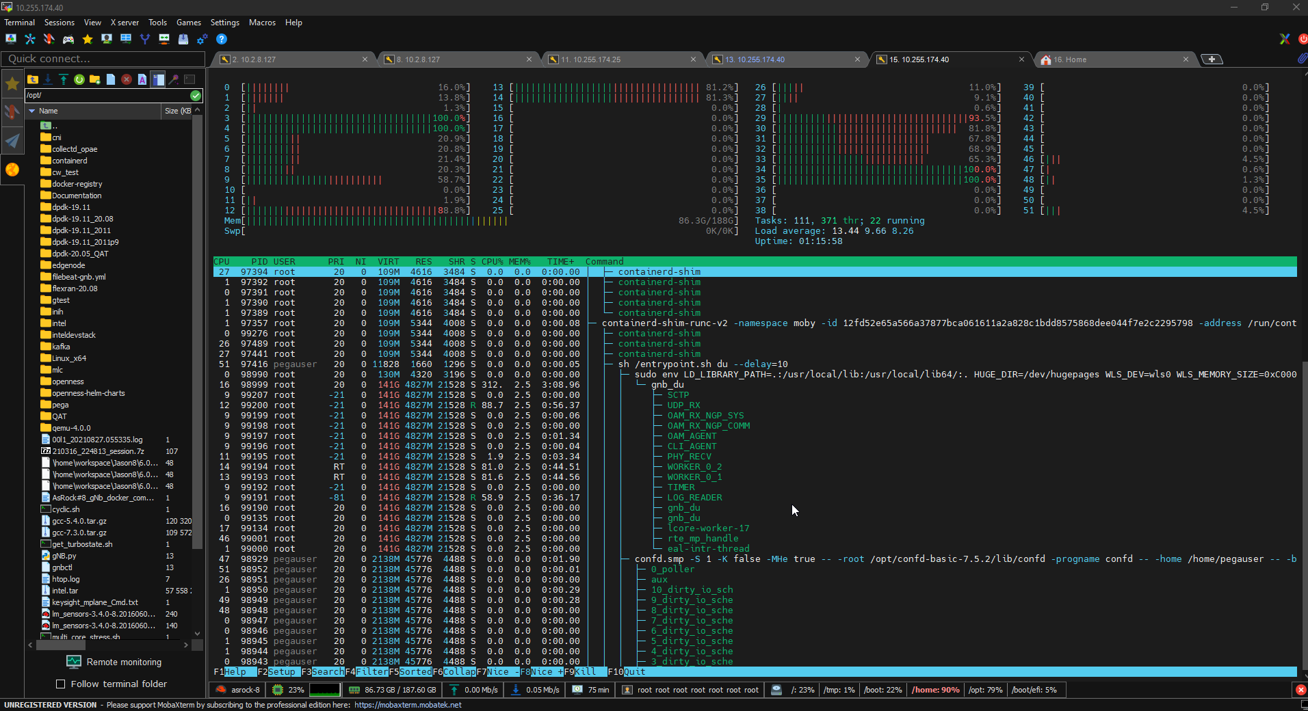
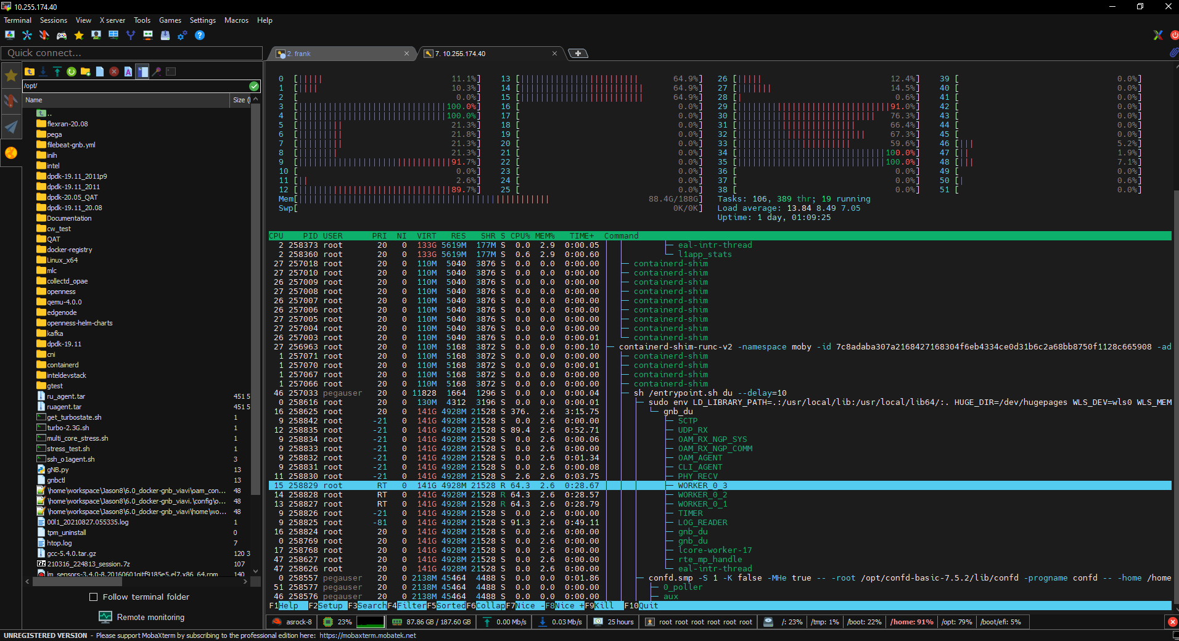
CPU Usage
2 + 1 cpu cores
4 UE/TTI
32 UES
2 cpu cores
4 UE/TTI
16 UES
3 cpu cores
4 UE/TTI
32 UES

