Slide 1
帳單查詢發票API

Slide 2
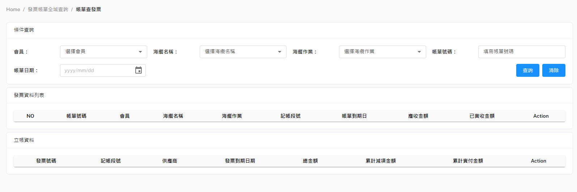
帳單查發票 - POST Body
Method: POST
URL: http://10.193.130.8:8000/api/v1/searchInvoiceWKMasterByBillMaster
{
"PartyName": "str",
"SubmarineCable": "str",
"WorkTitle": "str",
"BillingNo": "str",
"BillMilestone": "str",
"startDueDate": "2023XXXX",
"endDueDate": "2023XXXX"
}

Slide 3
帳單查發票 - Response
[
{
"BillMaster": {
"WorkTitle": "Upgrade",
"BillingNo": "01UP-KT2304181348",
"PONo": "",
"PartyName": "KT",
"DueDate": "2023-06-02T00:00:00",
"ReceivedAmountSum": 66437.27,
"IsPro": false,
"URI": "s3://cht-deploy-bucket-1/KT.pdf",
"SubmarineCable": "NCP",
"BillMasterID": 8,
"IssueDate": "2023-04-21T00:00:00",
"FeeAmountSum": 66442.16,
"BankFees": 4.89,
"Status": "COMPLETE ",
"BillMilestone": "2022.B_BM0"
},
"InvoiceWKMaster": [
{
"IssueDate": "2023-04-10T12:00:00",
"DedAmount": null,
"DueDate": "2023-06-09T12:00:00",
"PaidAmount": 0.0,
"InvoiceNo": "88561",
"PartyName": "",
"CreateDate": "2023-04-18T10:53:44",
"WKMasterID": 23,
"IsPro": false,
"PaidDate": null,
"SupplierName": "Ciena-US",
"IsRecharge": false,
"Status": "PAYING",
"SubmarineCable": "NCP",
"IsLiability": true,
"WorkTitle": "Upgrade",
"IsCreditMemo": null,
"ContractType": "SC",
"TotalAmount": 123028.76,
"BillMasterIDList": [8],
"BillMilestone": "2022.B_BM0"
},
{...},
{...}
]
},
{...},
{...}
]

