Slide 1
帳單API

Slide 2
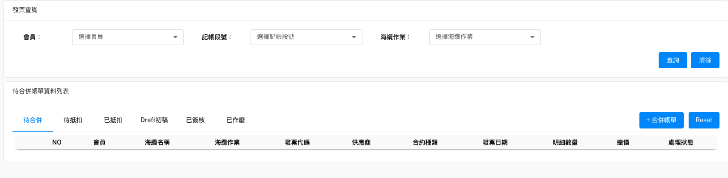
待合併(查詢發票主檔)
必加
Method: GET
URL: http://localhost:8000/api/v1/getInvoiceMaster&InvoiceDetail/{urlCondition}
urlCondition:
Status=TO_MERGE
Status=TO_MERGE&PartyName=會員名稱&SupplierName=供應商名稱&SubmarineCable=海纜名稱&WorkTitle=海纜作業...
回傳內容格式請參閱下一頁

Slide 3
[
{
"InvoiceMaster": {
"InvoiceNo": "DT0170168-1",
"WKMasterID": 1,
"PartyName": "CHT",
"SubmarineCable": "SJC2",
"ContractType": "SC",
"DueDate": "2022-11-08T12:00:00",
"IsPro": false,
"InvMasterID": 9,
"SupplierName": "NEC",
"WorkTitle": "Construction",
"IssueDate": "2022-09-09T12:00:00",
"Status": "TO_MERGE"
},
"InvoiceDetail": [
{
"WKDetailID": 1,
"InvDetailID": 33,
"PartyName": "CHT",
"SupplierName": "NEC",
"WorkTitle": "Construction",
"FeeItem": "BM12 Branching Units (100%)-Service",
"LBRatio": 7.1428571429,
"Difference": 0,
"InvMasterID": 9,
"WKMasterID": 1,
"InvoiceNo": "DT0170168-1",
"SubmarineCable": "SJC2",
"BillMilestone": "BM12",
“FeeAmountPre”1000,
“FeeAmountPost”: 400
},
{
"WKDetailID": 1,
"InvDetailID": 33,
"PartyName": "CHT",
"SupplierName": "NEC",
"WorkTitle": "Construction",
"FeeItem": "BM12 Branching Units (100%)-Service",
"LBRatio": 7.1428571429,
"Difference": 0,
"InvMasterID": 9,
"WKMasterID": 1,
"InvoiceNo": "DT0170168-1",
"SubmarineCable": "SJC2",
"BillMilestone": "BM12",
"FeeAmountPre": 1000,
"FeeAmountPost": 600
},
]
},
{…},
{…},
]

Slide 4
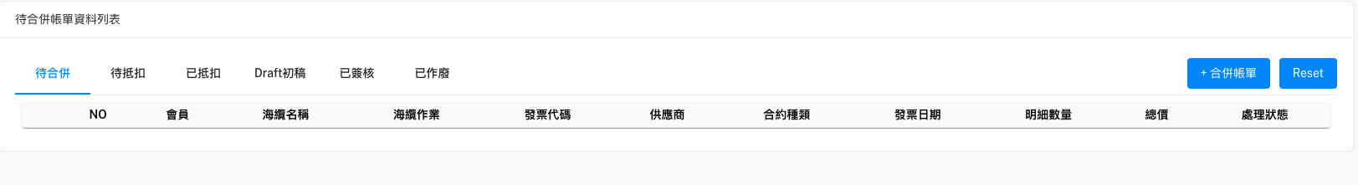
待合併(按"+合併帳單")
{
"message": "success",
"BillMaster": {
"BillingNo": str,
"PartyName": str,
"SubmarineCable": str,
"WorkTitle": str,
"IssueDate": datetime,
"DueDate": datetime,
"FeeAmountSum": float,
"ReceivedAmountSum": float,
"IsPro": bool,
"Status": str
},
"BillDetail": [
{
"WKMasterID": int,
"InvDetailID": int,
"PartyName": str,
"SupplierName": str,
"SubmarineC": str,
"WorkTitle": ablestr,
"BillMilestone": str,
"FeeItem": str,
"OrgFeeAmount": float,
"DedAmount": float,
"FeeAmount": float,
"ReceivedAmount": float,
"OverAmount": float,
"ShortAmount": float,
"BankFees": float,
"ShortOverReason": str,
"WriteOffDate": datetime,
"ReceiveDate": datetime,
"Note": str,
"ToCBAmount": str,
"Status": str
},
{...},
{...}
],
}
Method: POST
URL: http://localhost:8000/api/v1/getBillMaster&BillDetailStream
Post Body:
{
"InvoiceMaster": [
{...},
{...},
{...}
]
}
回傳值

Slide 5
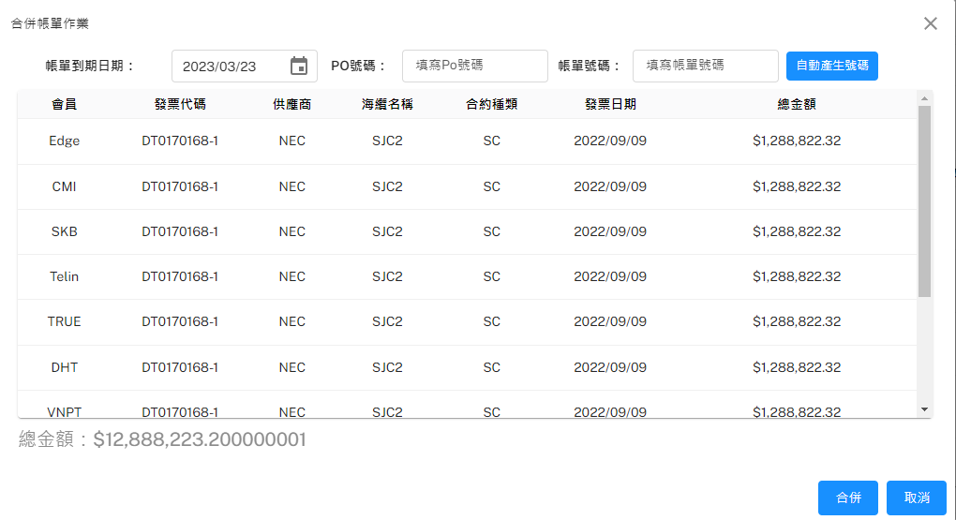
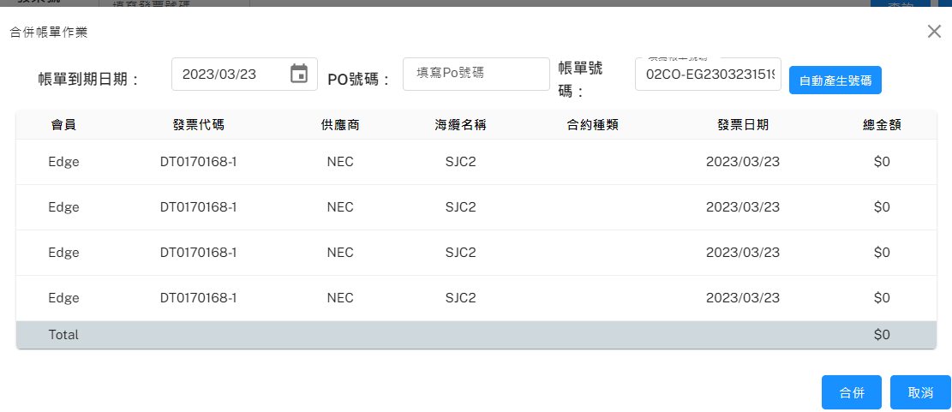
做完CB抵扣後退回-待合併(合併後送出)
POST Body:
{
"PONo": "string"
"DueDate": "2023-03-14 00:00:00",
"BillMaster": {
"BillingNo": str,
"PartyName": str,
"SubmarineCable": str,
"WorkTitle": str,
"IssueDate": datetime,
"DueDate": datetime,
"FeeAmountSum": float,
"ReceivedAmountSum": float,
"IsPro": bool,
"Status": str
},
"BillDetail": [
{
"WKMasterID": int,
"InvDetailID": int,
"InvoiceNo": str,
"PartyName": str,
"SupplierName": str,
"SubmarineCable": str,
"WorkTitle": ablestr,
"BillMilestone": str,
"FeeItem": str,
"OrgFeeAmount": float,
"DedAmount": float,
"FeeAmount": float,
"ReceivedAmount": float,
"OverAmount": float,
"ShortAmount": float,
"BankFees": float,
"ShortOverReason": str,
"WriteOffDate": datetime,
"ReceiveDate": datetime,
"Note": str,
"ToCBAmount": str,
"Status": str
},
{...},
{...}
],
}
Step1. 檢查帳單號碼是否已存在
Method: POST
URL: http://localhost:8000/api/v1/checkBillingNo
Post Body:
{
“BillingNo”: "輸入框內的帳單號碼"
}
回傳內容:
如果帳單號碼已存在: {"isExist": false}
如果帳單號碼不存在: {"isExist": true}
Step2. 送出(奌擊合併鈕後)
Method: POST
URL:http://localhost:8000/api/v1/initBillMaster&BillDetail
回傳內容
自動產生帳單號碼
Method: POST
URL: http://localhost:8000/api/v1/checkBillingNo/convert
POST Body:
{
"BillingNo": “oldBillingNo"
}
回傳內容: {"BillingNo": “newBillingNo"}

Slide 6
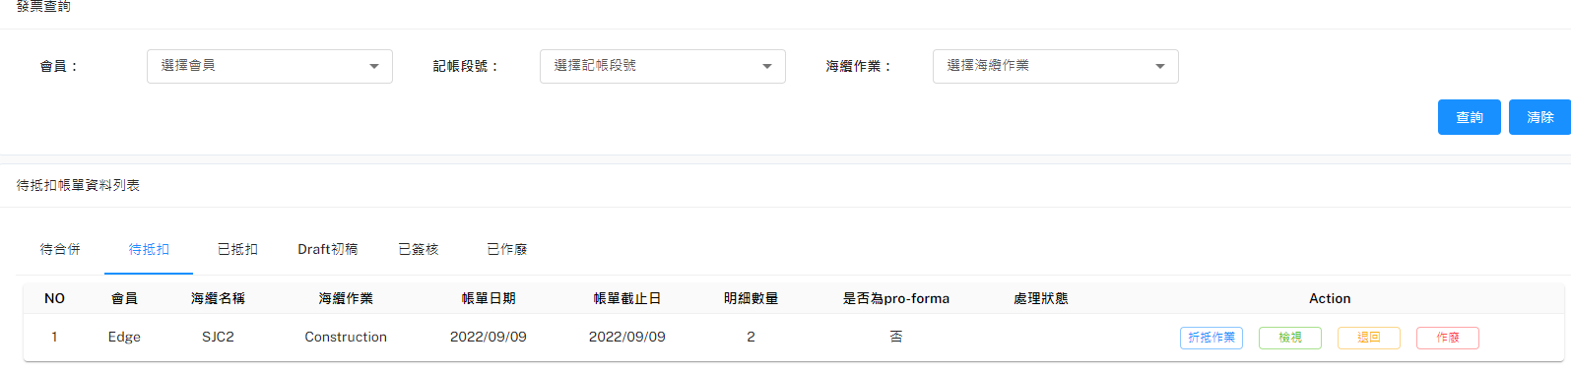
待抵扣(查詢帳單主檔)
[
{
"BillMaster": {
"BillMasterID": 1,
"BillingNo": "string",
"PONo": "string",
"SupplierName": "string",
"SubmarineCable": "string",
"WorkTitle": "string",
"PartyName": "string",
"IssueDate": "2023-03-14 00:00:00",
"DueDate": "2023-03-20 00:00:00",
"FeeAmountSum": 123.45,
"ReceivedAmountSum": 123.45,
"IsPro": 1,
"Status": "string"
},
"BillDetail": [
{
"BillDetailID": 1,
"BillMasterID": 2,
"WKMasterID": 3,
"InvDetailID": 4,
"PartyName": "string",
"SupplierName": "string",
"SubmarineCable": "string",
"WorkTitle": "string",
"BillMilestone": "string",
"FeeItem": "string",
"OrgFeeAmount": 123.45,
"DedAmount": 123.45,
"FeeAmount": 123.45,
"ReceivedAmount": 123.45,
"OverAmount": 123.45,
"ShortAmount": 123.45,
"BankFees": 123.45,
"ToCBAmount": 123.45,
"ShortOverReason": "string",
"WriteOffDate": "2023-03-14 00:00:00",
"ReceiveDate": "2023-03-14 00:00:00",
"Note": "string",
"Status": "string"
},
{...},
{...}
]
},
{...},
{...}
]
Method: GET
URL: http://localhost:8000/api/v1/getBillMaster&BillDetail/{urlCondition}
urlCondition:
all
PartyName=會員名稱&SupplierName=供應商&SubmarineCable=海纜名稱…
回傳值

Slide 7
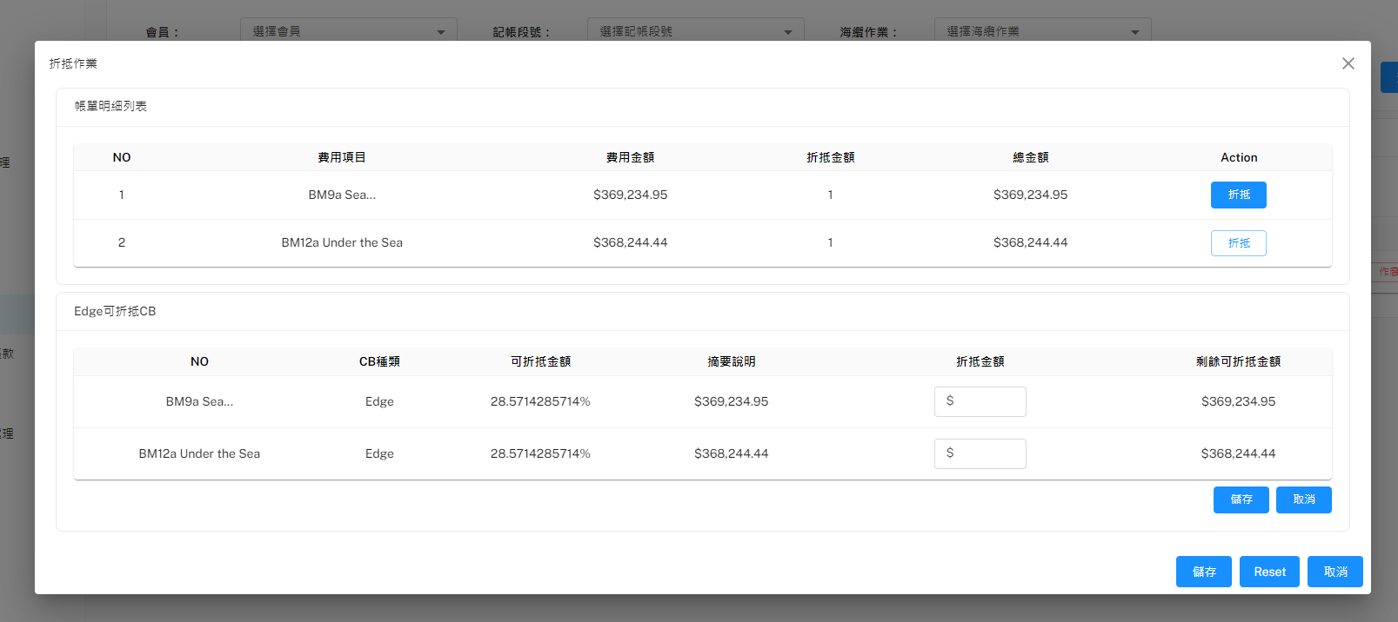
待抵扣(帳單折抵)
Method: GET
URL: http://localhost:8000/api/v1/CreditBalance/{urlCondition}
urlCondition:
SubmarineCable=海纜名稱&WorkTitle=海纜作業&BillMilestone=記帳段號&PartyName=會員名稱
根據前頁的回傳值(帳單明細)

Slide 8
待抵扣(帳單折抵完送出)
{
"BillMaster": {...},
"Deduct": [
{
"BillDetailID": 1,
"CB": [
{
"CBID": 1,
"TransAmount": 1000
},
{...},
{...}
]
},
{...},
{...}
]
}
Method: POST
URL: http://localhost:8000/api/v1/generateBillMaster&BillDetail
POST Body

Slide 9
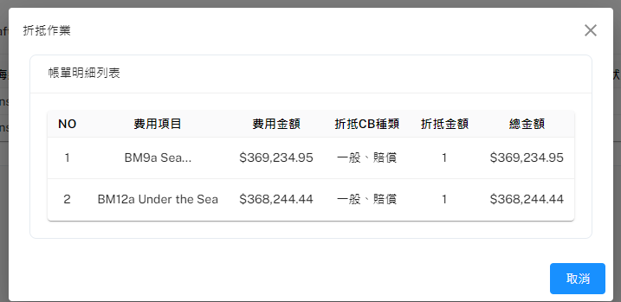
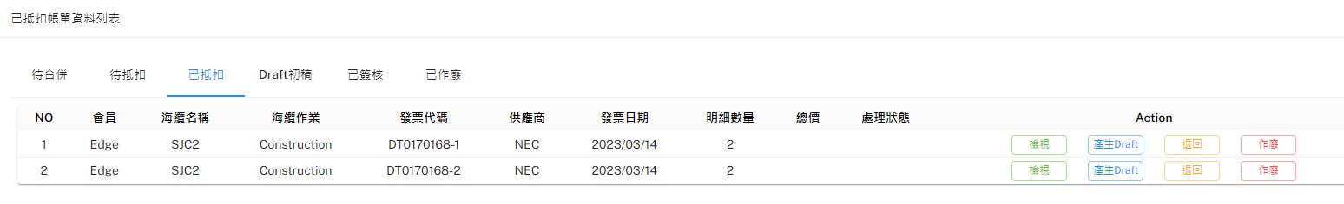
已抵扣(檢視帳單主檔)
[
{
"BillMaster": {
"BillMasterID": 1,
"BillingNo": "string",
"PartyName": "string",
"SubmarineCable": "string",
"WorkTitle": "string",
"IssueDate": "2023-01-01 00:00:00",
"DueDate": "2023-01-01 00:00:00",
"FeeAmountSum": 123.45,
"ReceivedAmountSum": 123.45,
"IsPro": 0,
"Status": "string"
},
"data": [
{
"BillDetail": {
"BillDetailID": 1,
"BillMasterID": 1,
"WKMasterID": 1,
"InvDetailID": 1,
"PartyName": "string",
"SupplierName": "string",
"SubmarineCable": "string",
"WorkTitle": "string",
"BillMilestone": "string",
"FeeItem": "string",
"OrgFeeAmount": 123.45,
"DedAmount": 123.45,
"FeeAmount": 123.45,
"ReceivedAmount": 123.45,
"OverAmount": 123.45,
"ShortAmount": 123.45,
"BankFees": 123.45,
"ShortOverReason": "string",
"WriteOffDate": "2023-03-01 00:00:00",
"ReceiveDate": "2023-03-01 00:00:00",
"Note": "string",
"ToCBAmount": 123.45,
"Status": "string"
},
"CB": [
{
"CBID": 1,
"CBType": "string",
"BillingNo": "string",
"BLDetailID": 1,
"SubmarineCable": "string",
"WorkTitle": "string",
"BillMilestone": "string",
"InvoiceNo": "string",
"CurrAmount": 123.45,
"PartyName": "string",
"CreateDate": "2023-04-01 00:00:00",
"LastUpdDate": "2023-04-01 00:00:00",
"Note": "string"
},
{...},
{...}
]
},
{...},
{...}
]
},
{...},
{...}
]
Method: GET
URL: http://localhost:8000/api/v1/getBillMaster&BillDetailWithCBData/{urlCondition}
urlCondition:
all
SupplierName=供應商名稱&SubmarineCable=海纜名稱&WorkTitle=海纜作業&PartyName=會員名稱
回傳值

Slide 10
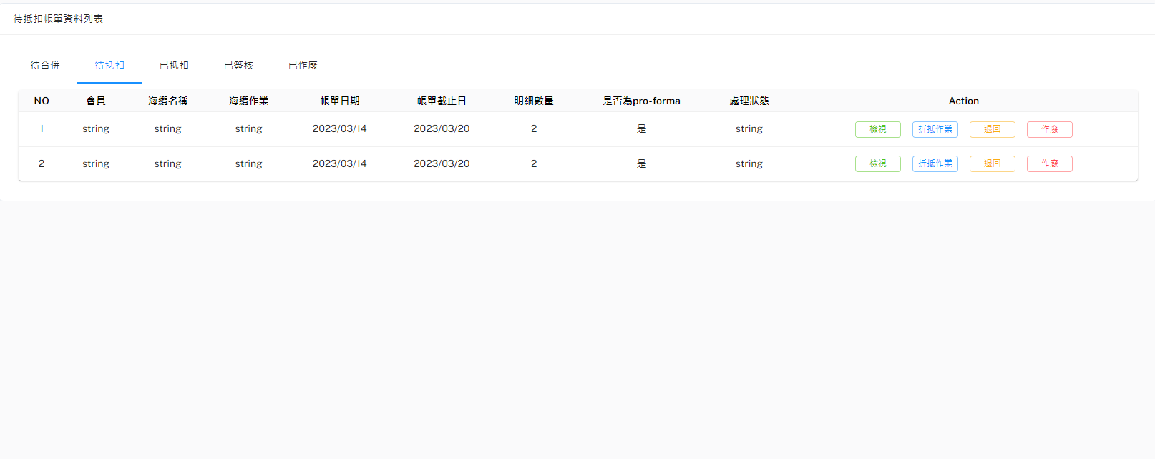
各頁籤顯示資料URL(待底扣往後的頁籤)
http://localhost:8000/api/v1/getBillMaster&BillDetail/Status=INITIAL
[
{
"BillMaster": {…},
"BillDetail": [
{…},
{…}
]
},
{…},
{…}
]
http://localhost:8000/api/v1/ getBillMaster&BillDetailWithCBData/Status=RATED
http://localhost:8000/api/v1/getBillMaster&BillDetail/Status=SIGNED
http://localhost:8000/api/v1/getBillMaster&BillDetail/Status=INVALID

