Slide 1
帳單API_待合併防呆

Slide 2
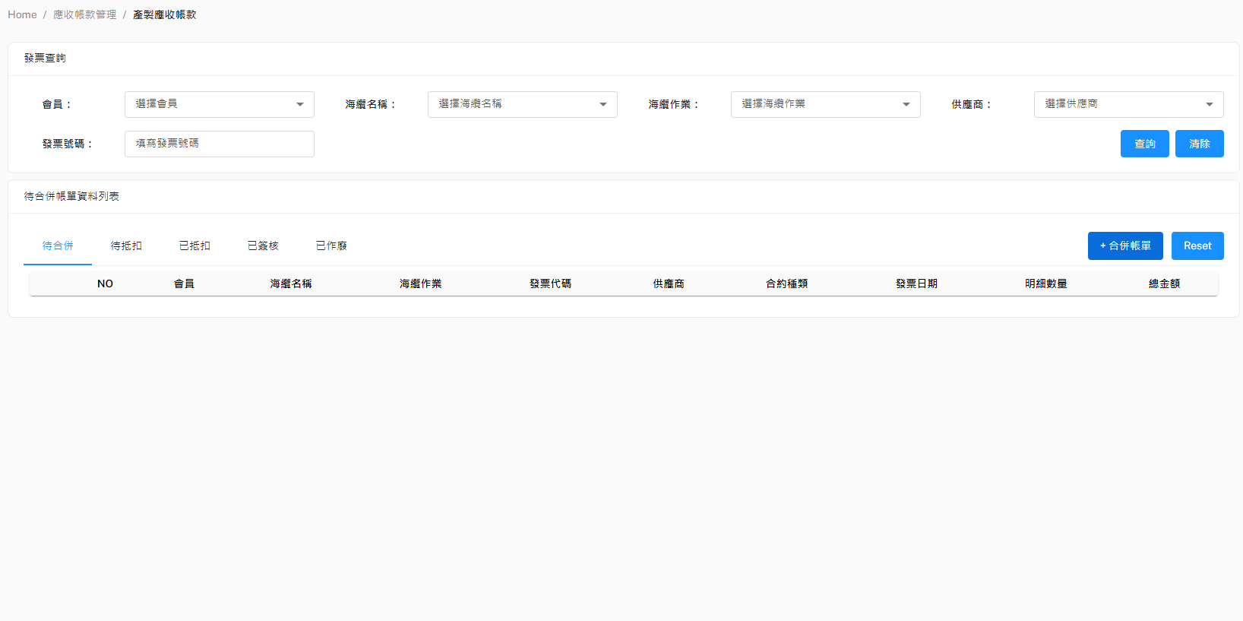
Method: POST
URL: http://localhost:8000/api/v1/checkInitBillMaster&BillDetail
POST Body:
{
"InvoiceMaster": [
{...},
{...},
{...}
]
}
如果有不一樣的會員、海纜名稱、海纜作業就會出現下面三個裡的其中幾項訊息，都有不一樣的則三個會都出現
{
"PartyName": "PartyName is not unique",
"SubmarineCable": "SubmarineCable is not unique",
"WorkTitle": "WorkTitle is not unique"
}
正常，可合併帳單
{
"isUnique": true
}

