Slide 1
發票退回作廢API

Slide 2
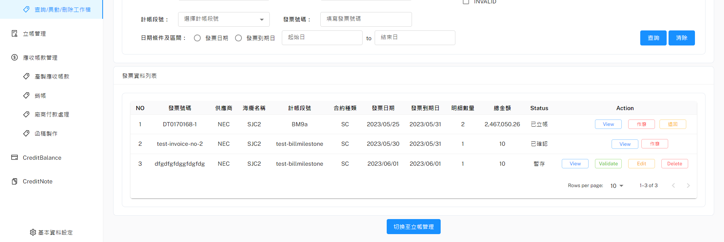
Button顯示條件(Status)
檢視, 作廢
VALIDATED(已確認)
檢視, 作廢, 退回(重新立帳)
BILLED(已立帳)
檢視
PAYING(付款中)
COMPLETE(完成付款結案)
INVALID(作廢)
檢視, Validate, Edit, Delete
TEMPORARY(暫存)

Slide 3
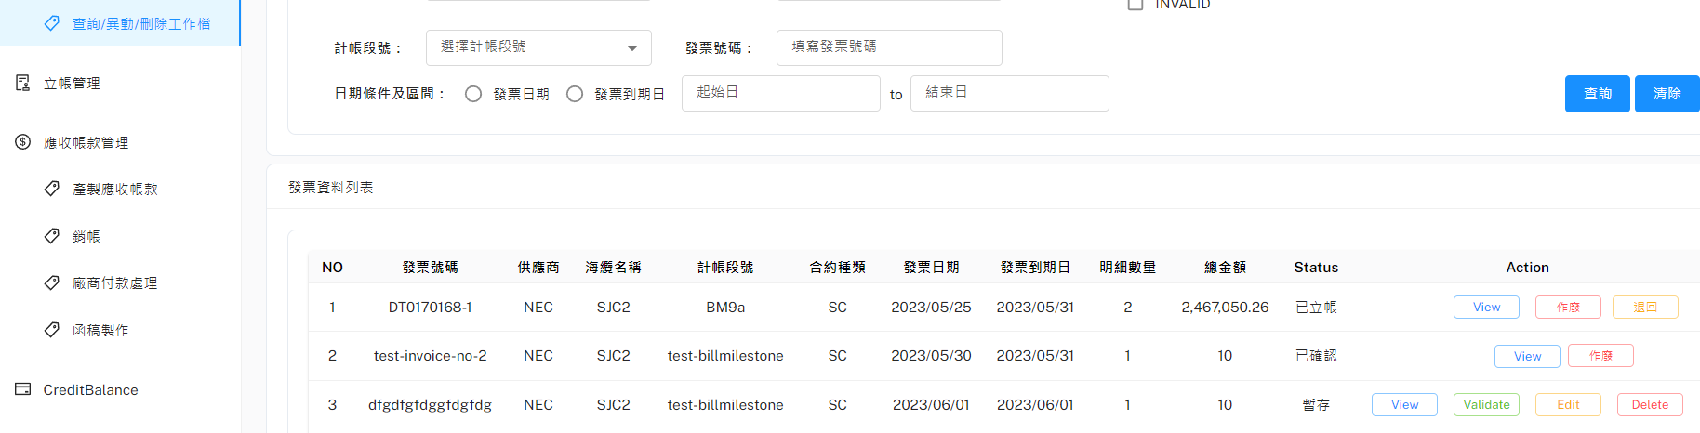
退回 – Situation 1(有帳單存在不能退回)
URL: http://10.193.130.8:8000/api/v1/returnToValidated
POST Body:
{
"WKMasterID": int
}
Response:
{
"ifReturn": false,
"BillMaster": {
"INITIAL": [
{
"BillingNo": "02CO-CI2305261632",
"SubmarineCable": "SJC2",
"PartyName": "CHT",
"DueDate": "2023-05-31T00:00:00",
"ReceivedAmountSum": 0,
"BankFees": null / float,
"Status": "INITIAL",
"WorkTitle": "Construction",
"BillMasterID": 1,
"PONo": "",
"IssueDate": "2023-05-26T00:00:00",
"FeeAmountSum": 176217.88,
"IsPro": false,
"URI": null / float
}
],
"RATED": [{...}, {...}...],
"SIGNED": [{...}, {...}...],
"TO_WRITEOFF": [{...}, {...}...],
"COMPLETE": [{...}, {...}...]
}
}
顯示彈窗告訴使用者，不能退回，並根據"帳單狀態"分別顯示各個狀態尚有哪些帳單存在

Slide 4
退回 – Situation 2(無帳單存在可退回)
URL: http://10.193.130.8:8000/api/v1/returnToValidated
POST Body:
{
"WKMasterID": int
}
Response:
{
"ifReturn": true,
}

Slide 5
作廢 – Situation 1(有帳單存在不能作廢)
URL: http://10.193.130.8:8000/api/v1/invalidInvoice/afterBilled
POST Body:
{
"WKMasterID": int
}
Response:
{
"ifReturn": false,
"BillMaster": {
"INITIAL": [
{
"BillingNo": "02CO-CI2305261632",
"SubmarineCable": "SJC2",
"PartyName": "CHT",
"DueDate": "2023-05-31T00:00:00",
"ReceivedAmountSum": 0,
"BankFees": null / float,
"Status": "INITIAL",
"WorkTitle": "Construction",
"BillMasterID": 1,
"PONo": "",
"IssueDate": "2023-05-26T00:00:00",
"FeeAmountSum": 176217.88,
"IsPro": false,
"URI": null / float
}
],
"RATED": [{...}, {...}...],
"SIGNED": [{...}, {...}...],
"TO_WRITEOFF": [{...}, {...}...],
"COMPLETE": [{...}, {...}...]
}
}
顯示彈窗告訴使用者，不能退回，並根據"帳單狀態"分別顯示各個狀態尚有哪些帳單存在

Slide 6
作廢 – Situation 2(無帳單存在可作廢)
URL: http://10.193.130.8:8000/api/v1/invalidInvoice/afterBilled
POST Body:
{
"WKMasterID": int
}
Response:
{
"ifReturn": true,
}

