Slide 1
發票查帳單API

Slide 2
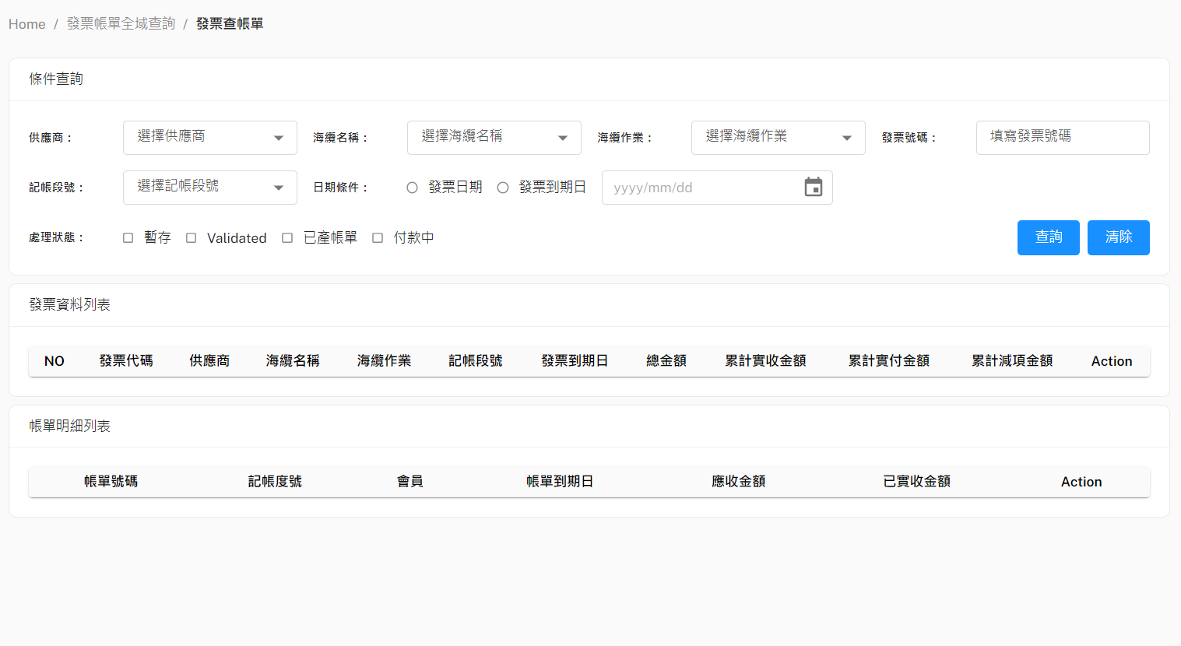
發票查帳單
Method: POST
URL: http://10.193.130.8:8000/api/v1/searchBillMasterByInvoiceWKMaster
{
"SupplierName": "String",
"SubmarineCable": "String",
"WorkTitle": "String",
"InvoiceNo": "String",
"BillMilestone": "String",
"startDueDate": "20230410" (注意: 日期格式一定要如左所示),
"endDueDate": "20230410" (注意: 日期格式一定要如左所示),
"Status": [
"TEMPORARY"(暫存),
"VALIDATED"(已確認),
"BILLED"(已立帳),
"PAYING"(付款中),
"COMPLETE"(完成付款結案),
"INVALID"(作廢)
]
}

