Slide 1
發票查帳單API

Slide 2
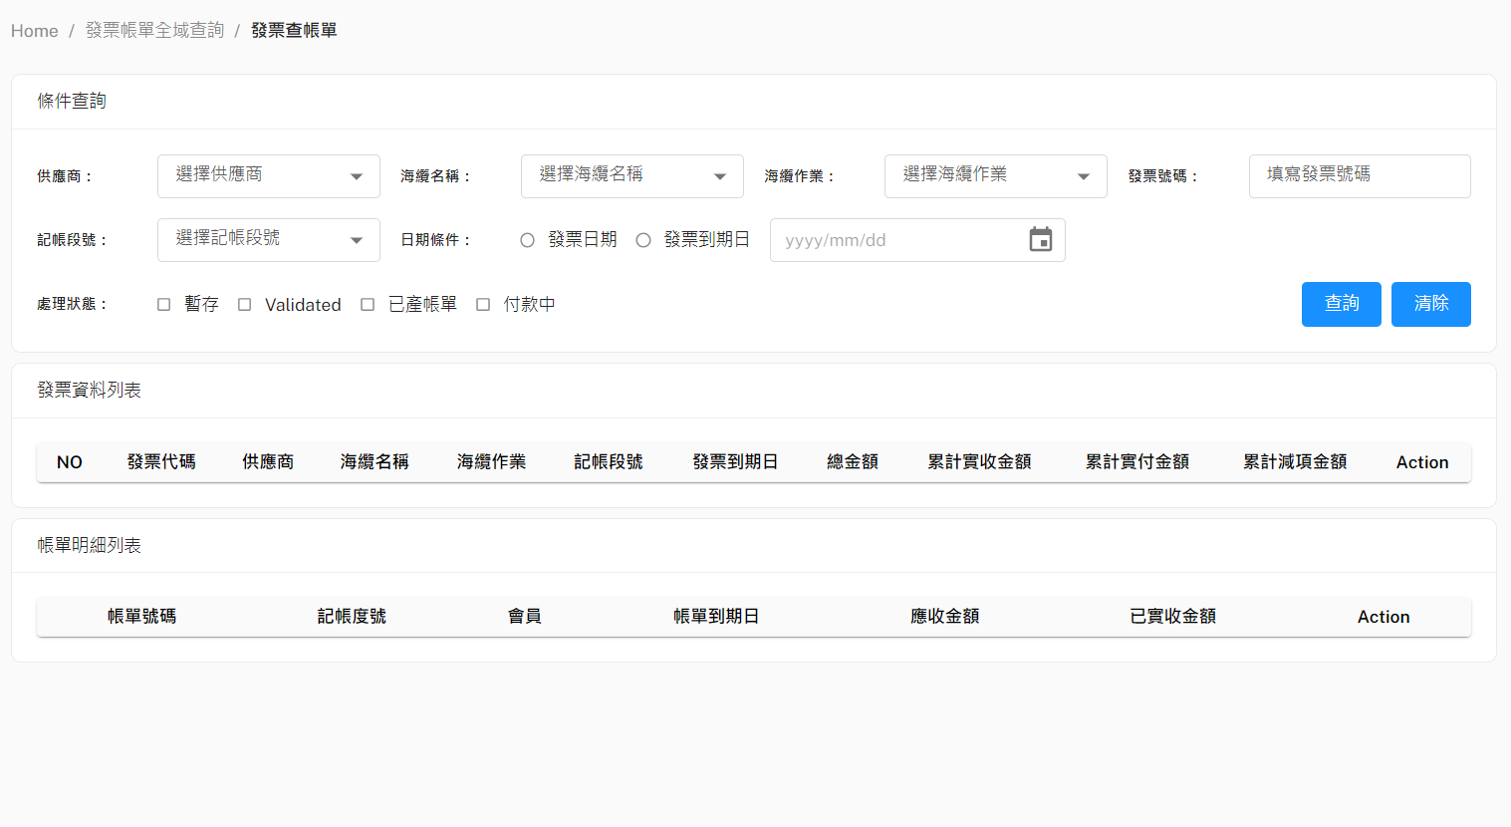
發票查帳單-POST Body
Method: POST
URL: http://10.193.130.8:8000/api/v1/searchBillMasterByInvoiceWKMaster
{
"SupplierName": "String",
"SubmarineCable": "String",
"WorkTitle": "String",
"InvoiceNo": "String",
"BillMilestone": "String",
"startDueDate / startIssueDate": "20230410" (注意: 日期格式一定要如左所示),
"endDueDate / endIssueDate ": "20230410" (注意: 日期格式一定要如左所示),
"Status": [
"TEMPORARY"(暫存),
"VALIDATED"(已確認),
"BILLED"(已立帳),
"PAYING"(付款中),
"COMPLETE"(完成付款結案),
"INVALID"(作廢)
]
}
IssueDate / DueDate

Slide 3
發票查帳單-Response
[
{
"InvoiceWKMaster": {
"IssueDate": "2023-04-10T12:00:00",
"DedAmount": float / null,
"DueDate": "2023-06-09T12:00:00",
"PaidAmount": 6072.0,
"InvoiceNo": "16170",
"PartyName": "",
"CreateDate": "2023-04-11T11:53:42",
"WKMasterID": 19,
"IsPro": false,
"PaidDate": "2023-06-09T10:17:19",
"SupplierName": "Ciena-JP",
"IsRecharge": false,
"Status": "COMPLETE",
"SubmarineCable": "TPE",
"IsLiability": true,
"WorkTitle": "Upgrade",
"IsCreditMemo": null,
"ContractType": "SC",
"TotalAmount": 6072.0,
"BillMilestone": "11_BM3"
},
"BillMaster": [
{
"WorkTitle": "Upgrade",
"BillingNo": "03UP-CU2304271121",
"BillMilestone": "String",
"PONo": "",
"PartyName": "CU",
"DueDate": "2023-05-24T00:00:00",
"ReceivedAmountSum": 5795.11,
"IsPro": false,
"URI": "s3://cht-deploy-bucket-1/(CU) TPECR-CU041901_credit(PDF).pdf",
"BillMasterID": 12,
"SubmarineCable": "TPE",
"IssueDate": "2023-04-27T00:00:00",
"FeeAmountSum": 5810.0,
"BankFees": 14.89,
"Status": "COMPLETE"
},
{...},
]
},
{...}
]

