Slide 1
產製函稿API

Slide 2
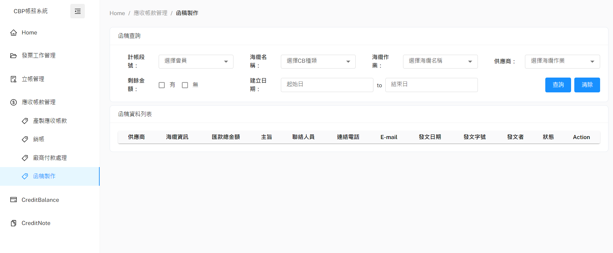
查詢
URL: http://10.193.130.8:8000/api/v1/payment/{urlCondition}

Slide 3
getPayDraftStream

