Slide 1
帳單API

Slide 2
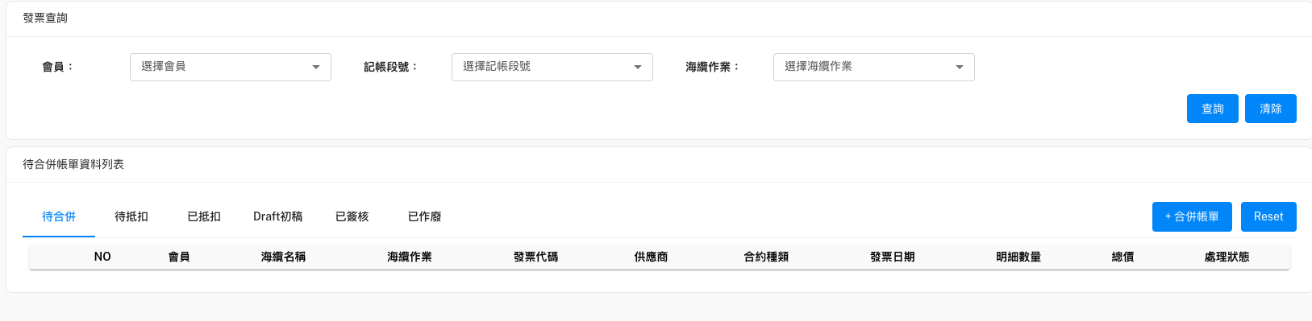
待合併(查詢發票主檔)
必加
Method: GET
URL: http://localhost:8000/api/v1/InvoiceMaster/Status=TO_MERGE&PartyName=會員名稱&SupplierName=供應商名稱&SubmarineCable=海纜名稱&WorkTitle=海纜作業...
回傳內容格式請參閱下一頁

Slide 3
[
{
"InvoiceMaster": {
"InvoiceNo": "DT0170168-1",
"WKMasterID": 1,
"PartyName": "CHT",
"SubmarineCable": "SJC2",
"ContractType": "SC",
"DueDate": "2022-11-08T12:00:00",
"IsPro": false,
"InvMasterID": 9,
"SupplierName": "NEC",
"WorkTitle": "Construction",
"IssueDate": "2022-09-09T12:00:00",
"Status": "TO_MERGE"
},
"InvoiceDetail": [
{
"WKDetailID": 1,
"InvDetailID": 33,
"PartyName": "CHT",
"SupplierName": "NEC",
"WorkTitle": "Construction",
"FeeItem": "BM12 Branching Units (100%)-Service",
"LBRatio": 7.1428571429,
"Difference": 0,
"InvMasterID": 9,
"WKMasterID": 1,
"InvoiceNo": "DT0170168-1",
"SubmarineCable": "SJC2",
"BillMilestone": "BM12",
"FeeAmountPre": 1487661.54,
"FeeAmountPost": 106261.54
},
{…},
{…},
]
},
{…},
{…},
]

Slide 4
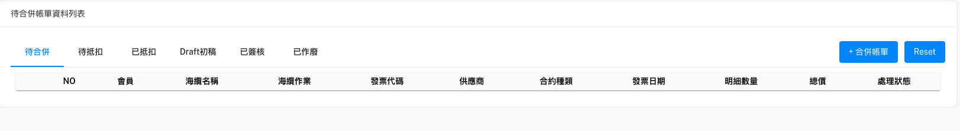
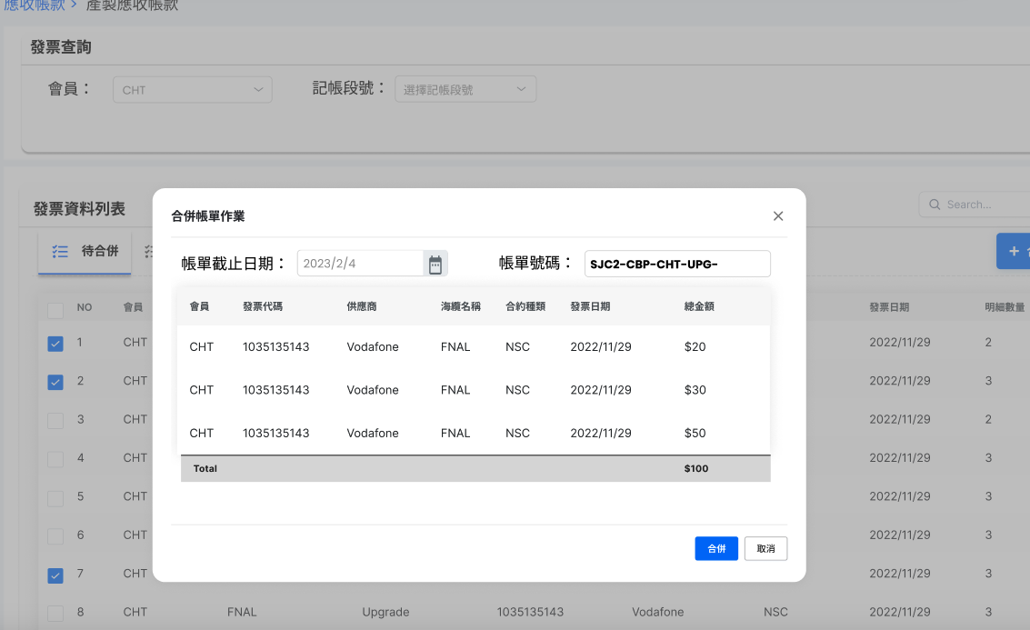
待合併(按"+合併帳單")
{
"message": "success",
"BillMaster": {
"BillingNo": str,
"PartyName": str,
"SubmarineCable": str,
"WorkTitle": str,
"IssueDate": datetime,
"DueDate": datetime,
"FeeAmountSum": float,
"ReceivedAmountSum": float,
"IsPro": bool,
"Status": str
},
"BillDetail": [
{
"WKMasterID": int,
"InvDetailID": int,
"PartyName": str,
"SupplierName": str,
"SubmarineC": str,
"WorkTitle": ablestr,
"BillMilestone": str,
"FeeItem": str,
"OrgFeeAmount": float,
"DedAmount": float,
"FeeAmount": float,
"ReceivedAmount": float,
"OverAmount": float,
"ShortAmount": float,
"BankFees": float,
"ShortOverReason": str,
"WriteOffDate": datetime,
"ReceiveDate": datetime,
"Note": str,
"ToCBAmount": str,
"Status": str
},
{...},
{...}
],
}
Method: POST
URL: http://localhost:8000/api/v1/getBillMaster&BillDetailStream
Post Body:
{
"BillingNo": "testNo.",
"InvoiceMaster": [
{...},
{...},
{...}
]
}
回傳值

Slide 5
做完CB抵扣後退回-待合併(合併後送出)
POST Body:
{
"BillMaster": {
"BillingNo": str,
"PartyName": str,
"SubmarineCable": str,
"WorkTitle": str,
"IssueDate": datetime,
"DueDate": datetime,
"FeeAmountSum": float,
"ReceivedAmountSum": float,
"IsPro": bool,
"Status": str
},
"BillDetail": [
{
"WKMasterID": int,
"InvDetailID": int,
"PartyName": str,
"SupplierName": str,
"SubmarineC": str,
"WorkTitle": ablestr,
"BillMilestone": str,
"FeeItem": str,
"OrgFeeAmount": float,
"DedAmount": float,
"FeeAmount": float,
"ReceivedAmount": float,
"OverAmount": float,
"ShortAmount": float,
"BankFees": float,
"ShortOverReason": str,
"WriteOffDate": datetime,
"ReceiveDate": datetime,
"Note": str,
"ToCBAmount": str,
"Status": str
},
{...},
{...}
],
}
Method: POST
URL: http://localhost:8000/api/v1/initBillMaster&BillDetail
Step1. 檢查帳單號碼
Method: GET
URL: http://localhost:8000/api/v1/checkBillingNo/{BillingNo}
回傳內容: 1. {"message": "BillingNo is not exist"} 2. {"message": "BillingNo is exist"}

Slide 6
待抵扣(查詢帳單主檔)
必加
Method: GET
URL: http://localhost:8000/api/v1/BillMaster/PartyName=會員名稱&SubmarineCable=海纜名稱&WorkTitle=海纜作業
回傳內容格式請參閱下一頁

