Slide 1
帳單API
銷帳

Slide 2
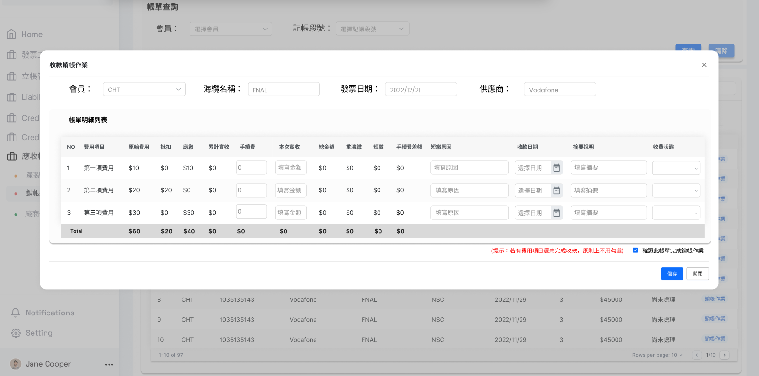
ReceivedDate
BankFees
ReceivedAmount
ShortOverReason
Note
Status

