Slide 1
CBP API Document
Update time: 2023-01-09

Slide 2
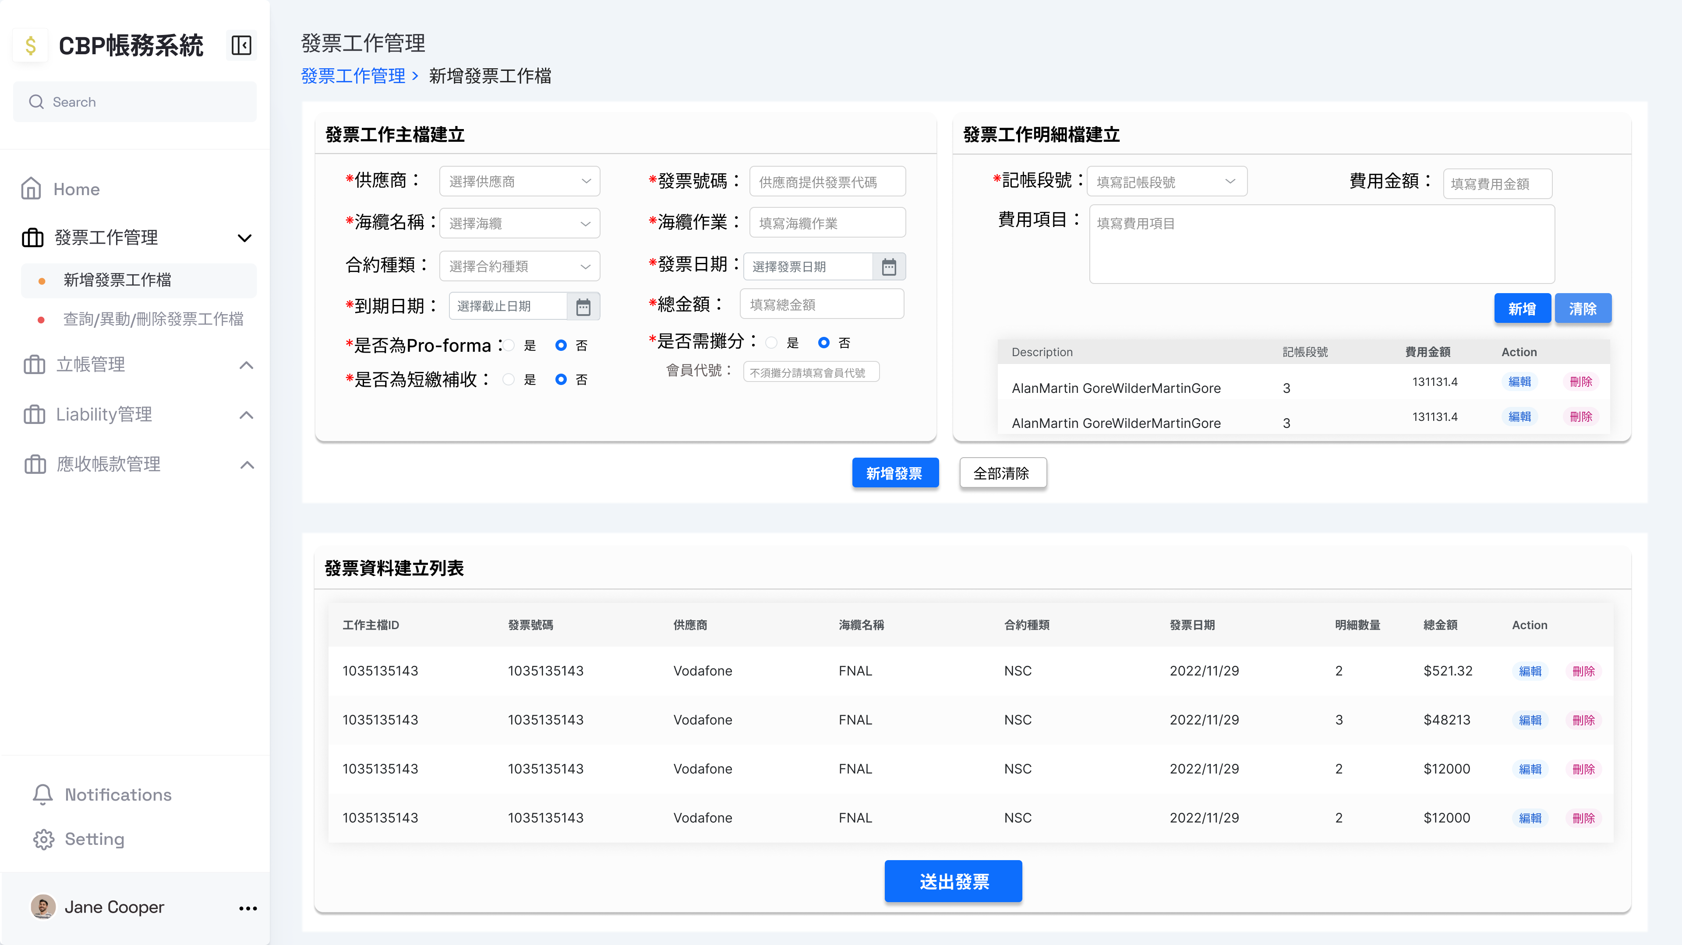
新增發票工作檔
{ "InvoiceWKMaster": { "InvoiceNo": "DT0170168-1", "Description": "COMMERCIAL INVOICE for SJC2 CABLE SYSTEM[ % of Contract Price=BM9a 3.96%,BM12 5.00% ", "SupplierName": "NEC", "SubmarineCable": "SJC2", "WorkTitle": "Construction", "ContractType": "SC", "IssueDate": "2022-09-09 00:00:00", "DueDate": "2022-11-08 00:00:00", "PartyName": "CHT", "Status": ”TEMPORARY", "IsPro": 0, "IsRecharge": 0, "IsLiability": 0, "TotalAmount": 5582012.72 }, "InvoiceWKDetail": [ { "BillMilestone": "BM9a", "FeeAmount": 1288822.32, "FeeItem": "BM9a Sea cable manufactured (except 8.5km spare cable))- Equipment" }, { "BillMilestone": "BM9a", "FeeAmount": 1178227.94, "FeeItem": "BM9a Sea cable manufactured (except 8.5km spare cable))- Service" }, { "BillMilestone": "BM12", "FeeAmount": 1627300.92, "FeeItem": "BM12 Branching Units (100%)-Equipment" }, { "BillMilestone": "BM12", "FeeAmount": 1487661.54, "FeeItem": "BM12 Branching Units (100%)-Service" } ] }
若有n張發票，請發送n個requests，每個request內容如右邊格式
Method: POST
URL: http://127.0.0.1:8000/api/v1/generateInvoiceWKMaster&InvoiceWKDetail&InvoiceMaster&InvoiceDetail

Slide 3
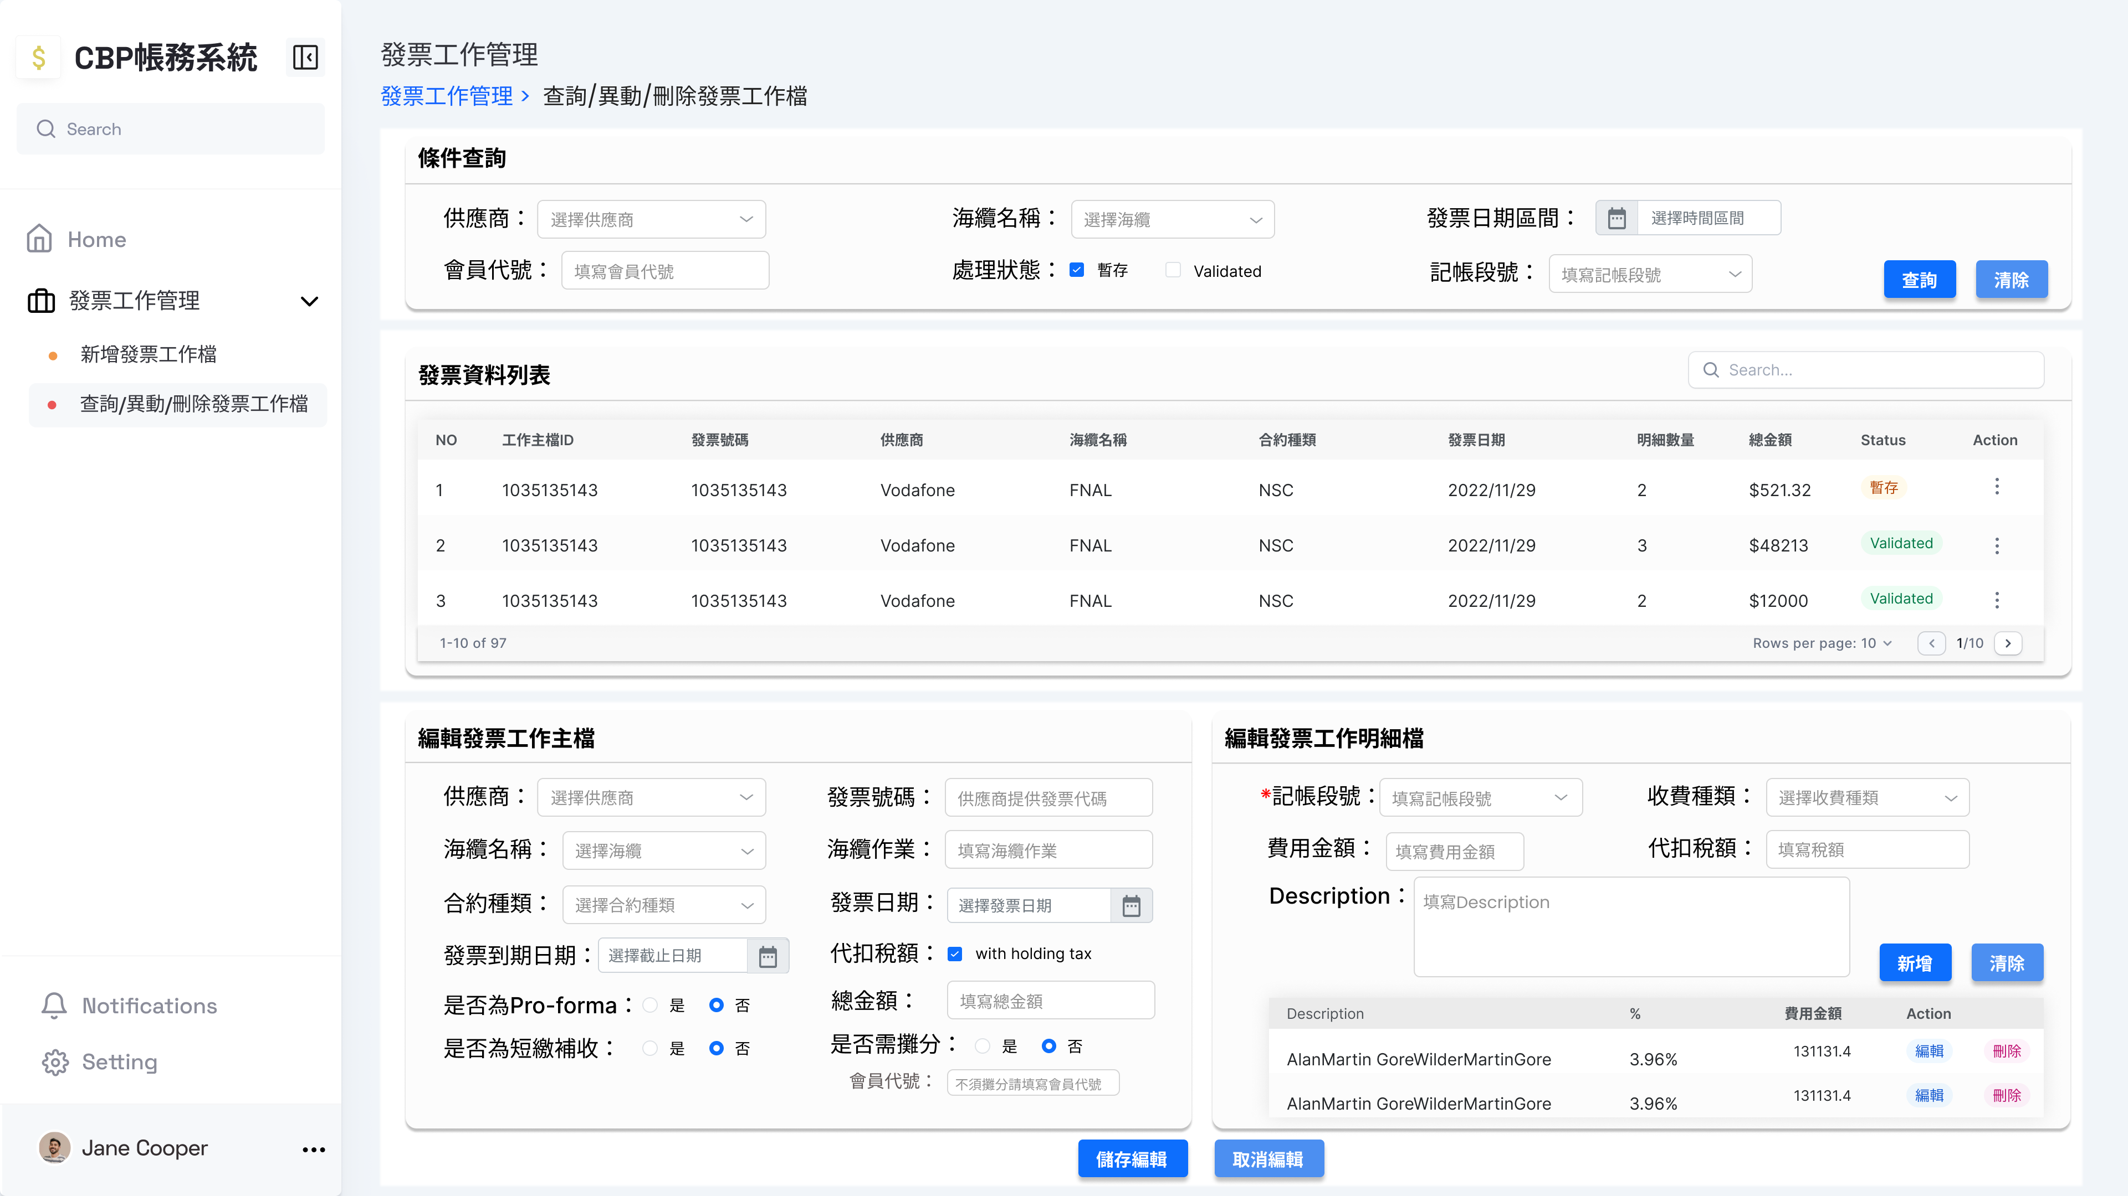
異動發票工作檔
Body Content:
```JSON
{
"WKMasterID": int(ex. 1, 2, …)
}
```
{ "InvoiceWKMaster": { "WKMasterID": 1, "InvoiceNo": "DT0170168-1", "Description": "COMMERCIAL INVOICE for SJC2 CABLE SYSTEM[ % of Contract Price=BM9a 3.96%,BM12 5.00% ", "SupplierName": "NEC", "SubmarineCable": "SJC2", "WorkTitle": "Construction", "ContractType": "SC", "IssueDate": "2022-09-09 00:00:00", "DueDate": "2022-11-08 00:00:00", "PartyName": "CHT", "Status": "TEMPORARY", "IsPro": 0, "IsRecharge": 0, "IsLiability": 0, "TotalAmount": 5582012.72 }, "InvoiceWKDetail": [ { "BillMilestone": "BM9a", "FeeAmount": 1288822.32, "FeeItem": "BM9a Sea cable manufactured (except 8.5km spare cable))- Equipment" }, { "BillMilestone": "BM9a", "FeeAmount": 1178227.94, "FeeItem": "BM9a Sea cable manufactured (except 8.5km spare cable))- Service" }, { "BillMilestone": "BM12", "FeeAmount": 1627300.92, "FeeItem": "BM12 Branching Units (100%)-Equipment" }, { "BillMilestone": "BM12", "FeeAmount": 1487661.54, "FeeItem": "BM12 Branching Units (100%)-Service" } ] }
Method: POST URL: http://127.0.0.1:8000/api/v1/deleteInvoiceWKMaster
Method: POST URL: http://127.0.0.1:8000/api/vi/deleteInvoiceWKDetail
Method: POST URL: http://127.0.0.1:8000/api/v1/deleteInvoiceMaster
Method: POST URL: http://127.0.0.1:8000/api/v1/deleteInvoiceDetail
Method: POST URL: http://127.0.0.1:8000/api/v1/generateInvoiceWKMaster&InvoiceWKDetail&InvoiceMaster&InvoiceDetail
必須帶有"WKMasterID"

Slide 4
更動發票工作檔狀態
Body Content:
```JSON
{
"WKMasterID": int(ex. 1, 2, …)
"Status":
}
```
Method: POST URL: http://127.0.0.1:8000/api/v1/updateInvoiceWKMasterStatus&InvoiceMasterStatus
Status:
TEMPORARY
VALIDATED
INVALID

Slide 5
刪除發票工作檔
Body Content:
```JSON
{
"WKMasterID": int(ex. 1, 2, …)
}
```
Method: POST URL: http://127.0.0.1:8000/api/v1/deleteInvoiceWKMaster
Method: POST URL: http://127.0.0.1:8000/api/vi/deleteInvoiceWKDetail
Method: POST URL: http://127.0.0.1:8000/api/v1/deleteInvoiceMaster
Method: POST URL: http://127.0.0.1:8000/api/v1/deleteInvoiceDetail

Slide 6

發票工作主檔查詢
http://127.0.0.1:8000/api/v1/searchInvoiceWKMaster/SupplierName=供應商&SubmarineCable=海纜名稱&PartyName=會員代號&Status=處理狀態&BillMilestone=計帳段號&startCreateDate=20230101&endCreateDate=20230131
http://127.0.0.1:8000/api/v1/searchInvoiceWKMaster/SupplierName=供應商&SubmarineCable=海纜名稱&PartyName=會員代號&Status=處理狀態&BillMilestone=計帳段號& SupplierName=供應商&SubmarineCable=海纜名稱&PartyName=會員代號&Status=處理狀態&BillMilestone=計帳段號&startIssueDate=20230101&endIssueDate=20230131
http://127.0.0.1:8000/api/v1/searchInvoiceWKMaster/searchInvoiceWKMaster/SupplierName=供應商&SubmarineCable=海纜名稱&PartyName=會員代號&Status=處理狀態&BillMilestone=計帳段號& SupplierName=供應商&SubmarineCable=海纜名稱&PartyName=會員代號&Status=處理狀態&BillMilestone=計帳段號&startDueDate=20230101&endDueDate=20230131
如果任條件都沒有: http://127.0.0.1:8000/api/v1/searchInvoiceWKMaster/all
如果起訖日都一樣，則給一樣的日期
(ex. startCreateDate=xxx&endCreateDate=xxx)

Slide 7
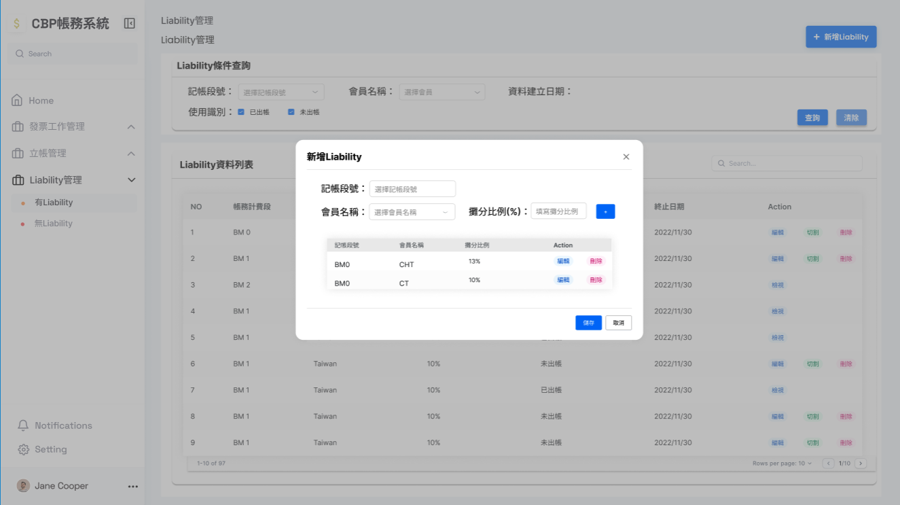
新增Liability
n個就發n個request
Body Content:
```JSON
{
"BillMilestone": "計帳段號",
"PartyName": "會員名稱",
"LBRatio": float,
"CreateDate": 建立日期(datetime),
}
```
Method: POST URL: http://127.0.0.1:8000/api/v1/addLiability

Slide 8
Get/Search Liability
Method: POST URL:http://127.0.0.1:8000/api/v1/getLiability/{urlCondition}
URL Condition 代入方式參閱發票工作主檔查詢

Slide 9
新增Liability
n個就發n個request
Body Content:
```JSON
{
"BillMilestone": "計帳段號",
"PartyName": "會員名稱",
"LBRatio": float,
"CreateDate": 建立日期(datetime),
}
```
不要帶『LBRawID』
Method: POST URL: http://127.0.0.1:8000/api/v1/addLiability

Slide 10
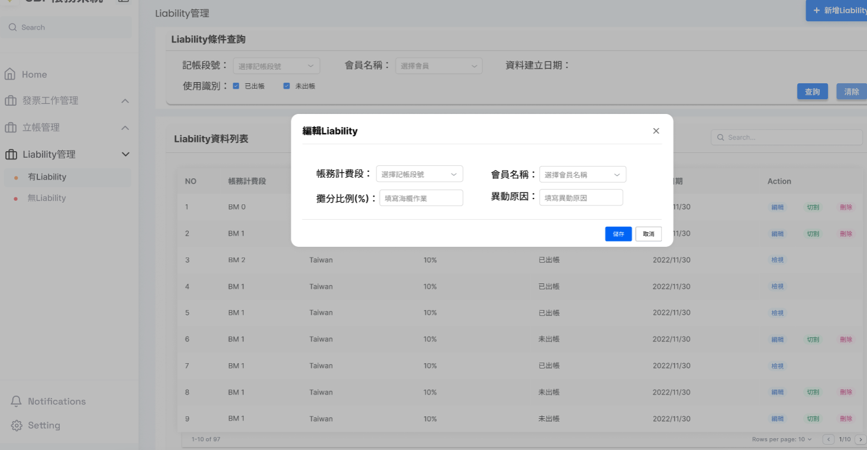
更新Liability
Body Content:
```JSON
{
"LBRawID": int
"BillMilestone": "計帳段號",
"PartyName": "會員名稱",
"LBRatio": float,
"ModifyNote": "異動原因",
"CreateDate": 建立日期(datetime),
"EndDate": datetime
}
```
Method: POST URL: http://127.0.0.1:8000/api/v1/updateLiability

Slide 11
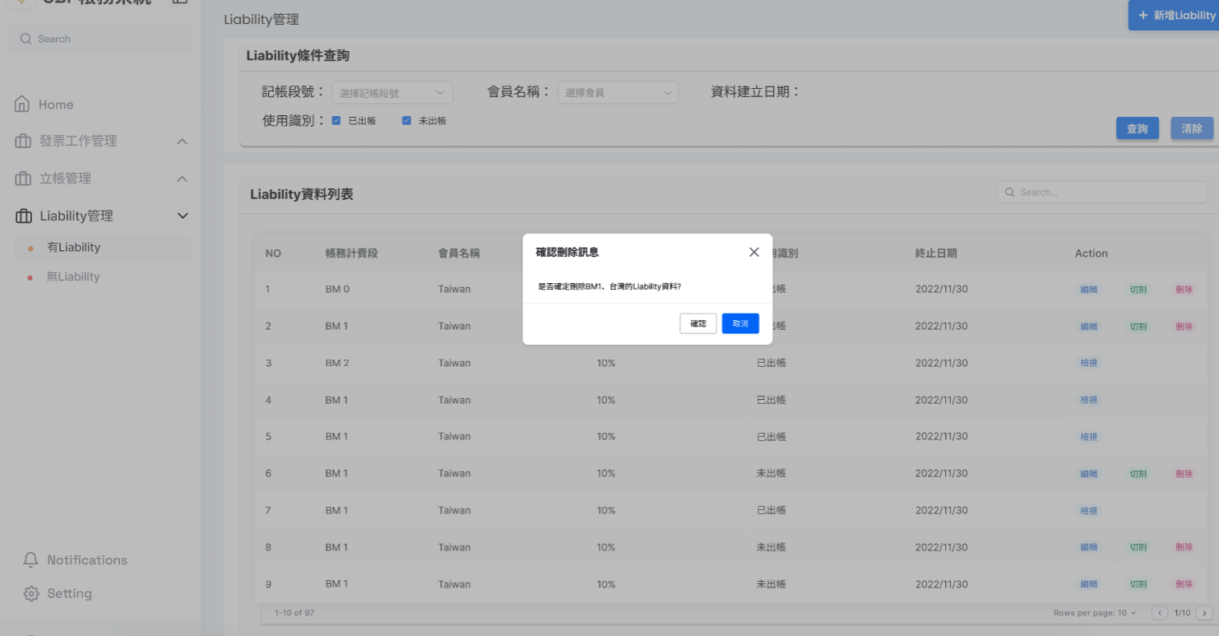
刪除Liability
Body Content:
```JSON
{
"LBRawID": int
}
```
Method: POST URL:http://127.0.0.1:8000/api/v1/deleteLiability

Slide 12
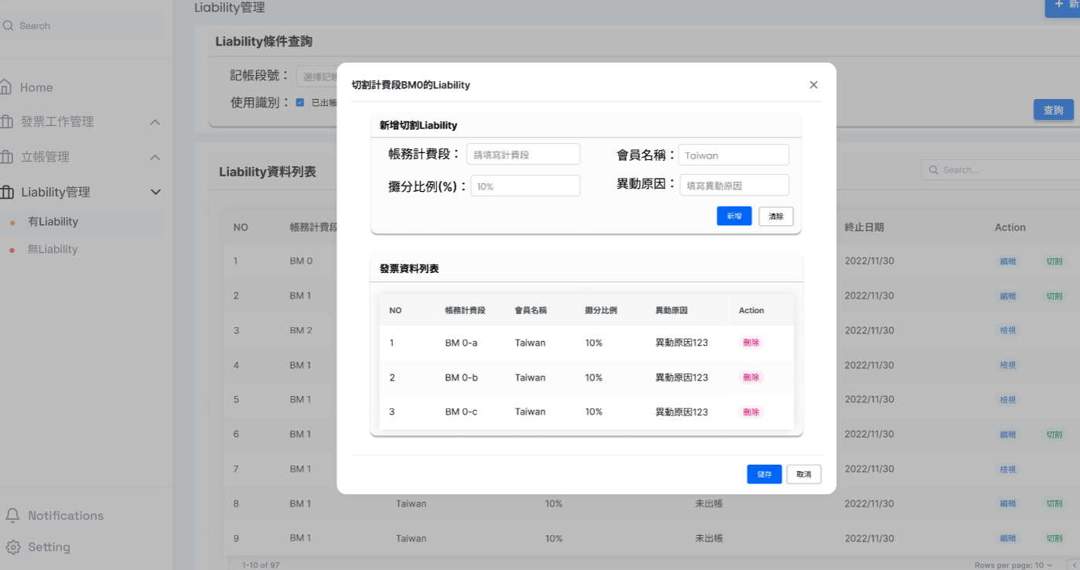
分段Liability
Body Content:
```JSON
{
"LBRawID": int
}
```
Method: POST URL:http://127.0.0.1:8000/api/v1/deleteLiability
Body Content:
```JSON
{
"BillMilestone": "計帳段號",
"PartyName": "會員名稱",
"LBRatio": float,
"CreateDate": 建立日期(datetime),
}
```
不要帶『LBRawID』
Method: POST URL: http://127.0.0.1:8000/api/v1/addLiability

