Slide 1
Progress Review
16019243 – N. Appleton

Slide 2
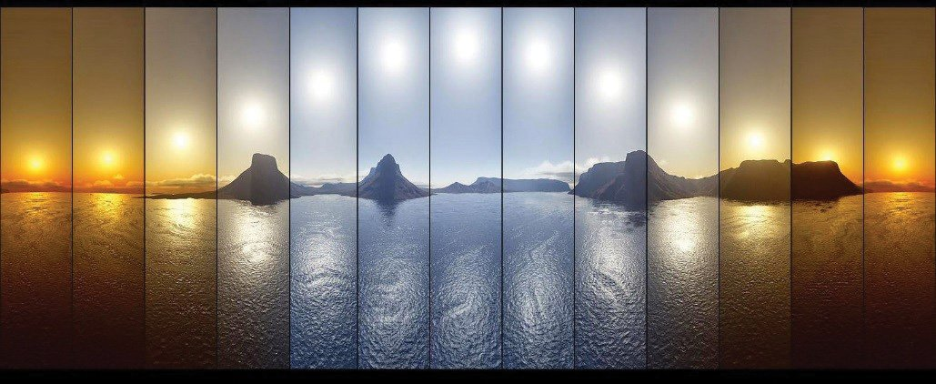
Background
Light Affects:
Sleep
Attentiveness
Cancer
“Light affect our sleep more powerfully than any drug”
(Czeisler, 2013)
Bipolar disorder
seasonal affective disorder
type 2 diabetes
We thrive best under more naturally lit environments
This research is completely neglected in the built environment (Grose, 2014)
There are no existing, economical solutions
Can a modular natural-lighting solution be economically produced?

Slide 3
Methods
Develop Requirements
Determine how the device should function
What would make a successful device?
Develop Hardware & Simulator
Create PCBs that will fulfil the requirements
Produce a simulator that can synthesis spectral outputs
Calibrate Simulator
Calibrate synthesised outputs
Use measured outputs from the device
Determine Desired Spectra
Calculate and produce spectra to be used on the device
Ensure as close to solar outputs as possible
Test Desired Spectra
Use spectrometer to test the accuracy of the device outputs
Using automation suite to extract spectral data from images
Analyse effectiveness of device
Test device against requirements
Use outputs to determine sleep effects
Notes:
Melanopic lux

Slide 4
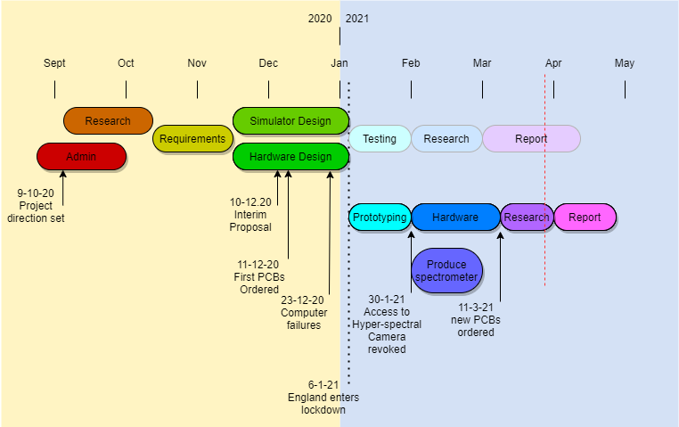
timeline
Notes:
Due to the pandemic, lots of strategies have been employed: adaptable gantt charts, emphasis on simulator, alternative study questions
Kanban style agile workflow using clickup

Slide 5
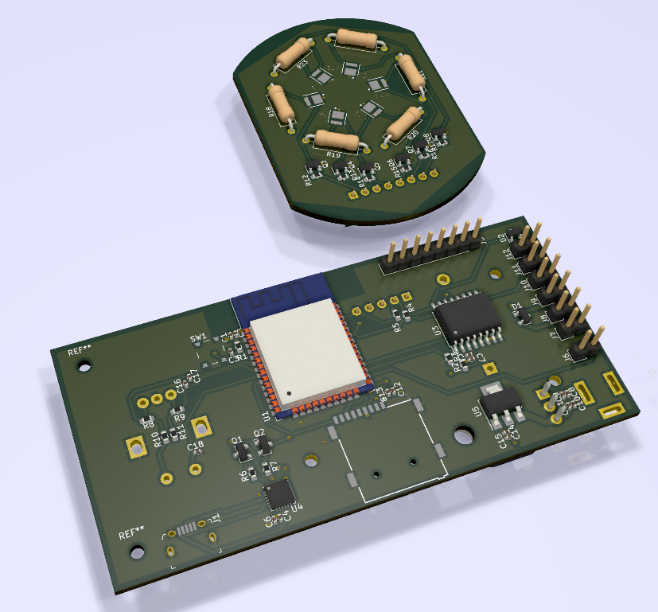
Results

Slide 6
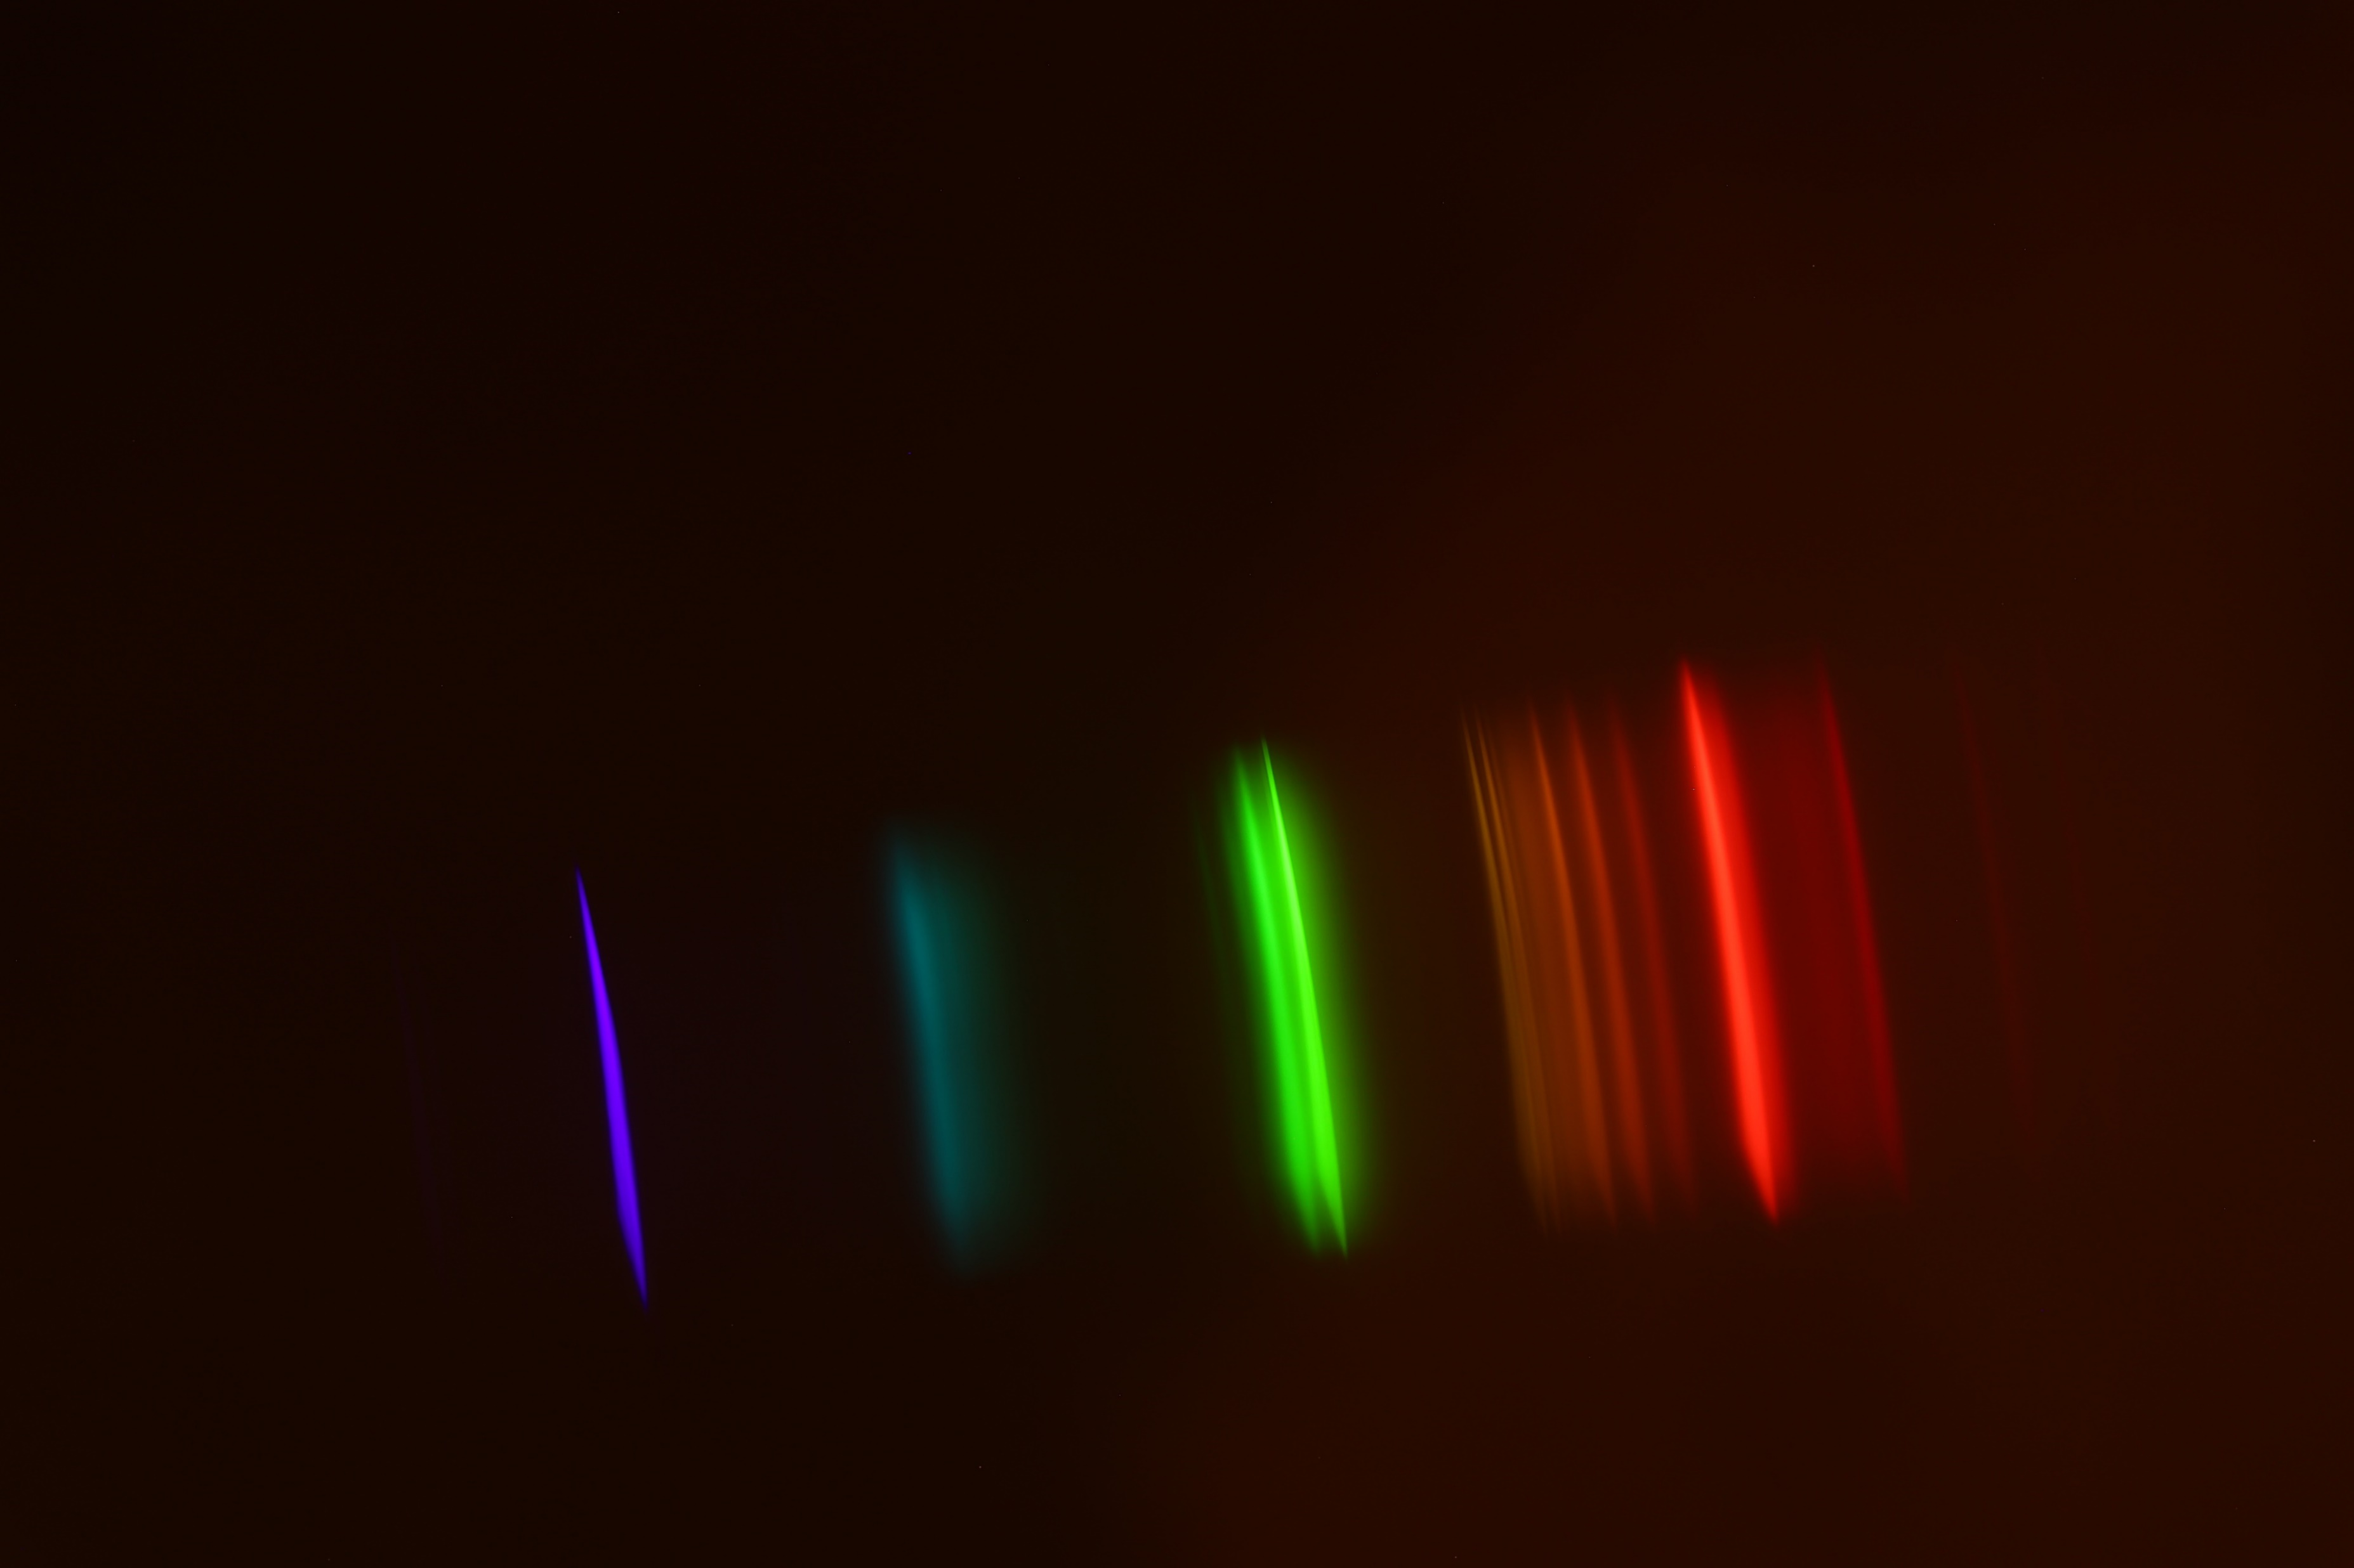
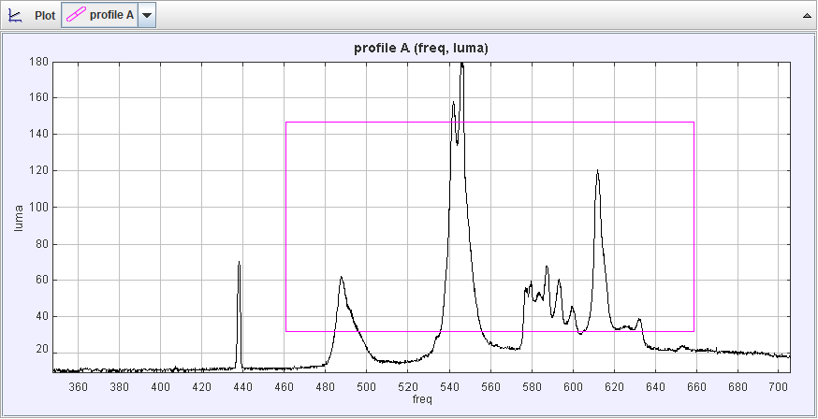
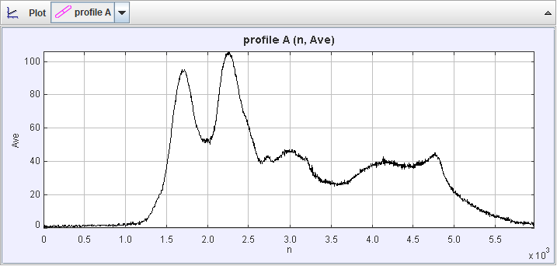
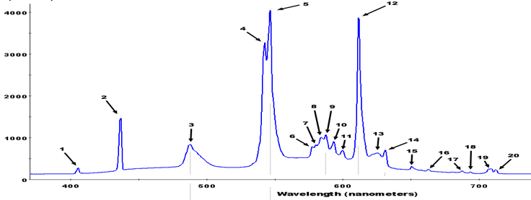
Results
Compact Fluorescent Lamp
Output of device when all LEDs are at full brightness

Slide 7
Evaluation
So far:
developed working hardware
Overcome a lack of access to equipment
Proven that the measurement method is robust
Developed an accurate simulation suit
Developed automation software to aid with recordings
Notes:
While the hardware is relatively simple, the completion of the design reflects the adaptability of the project management.
The current results do not yet fit into the state-of-the art, however the measuring techniques have been confirmed to be as accurate as professional equipment.
I am confident that the device will be shown to fit the requirements specification and work effectively to prevent melatonin secretion
The brightness of the device may be the only shortcoming

Slide 8
Next steps
What’s left:
Optimise device output spectra using simulator and measurements
Analyse melanotic effect of light
Verify that spectra can be faded between “realistically”

Slide 9
References
Czeisler, C. A. (2013). Perspective: casting light on sleep deficiency. Nature, 497(7450), S13-S13.
Grose, M. (2014). Artificial light at night: a neglected population health concern of the built environment. Health promotion journal of Australia: official journal of Australian Association of Health Promotion Professionals, 25(3), 193-195.

