Slide 1
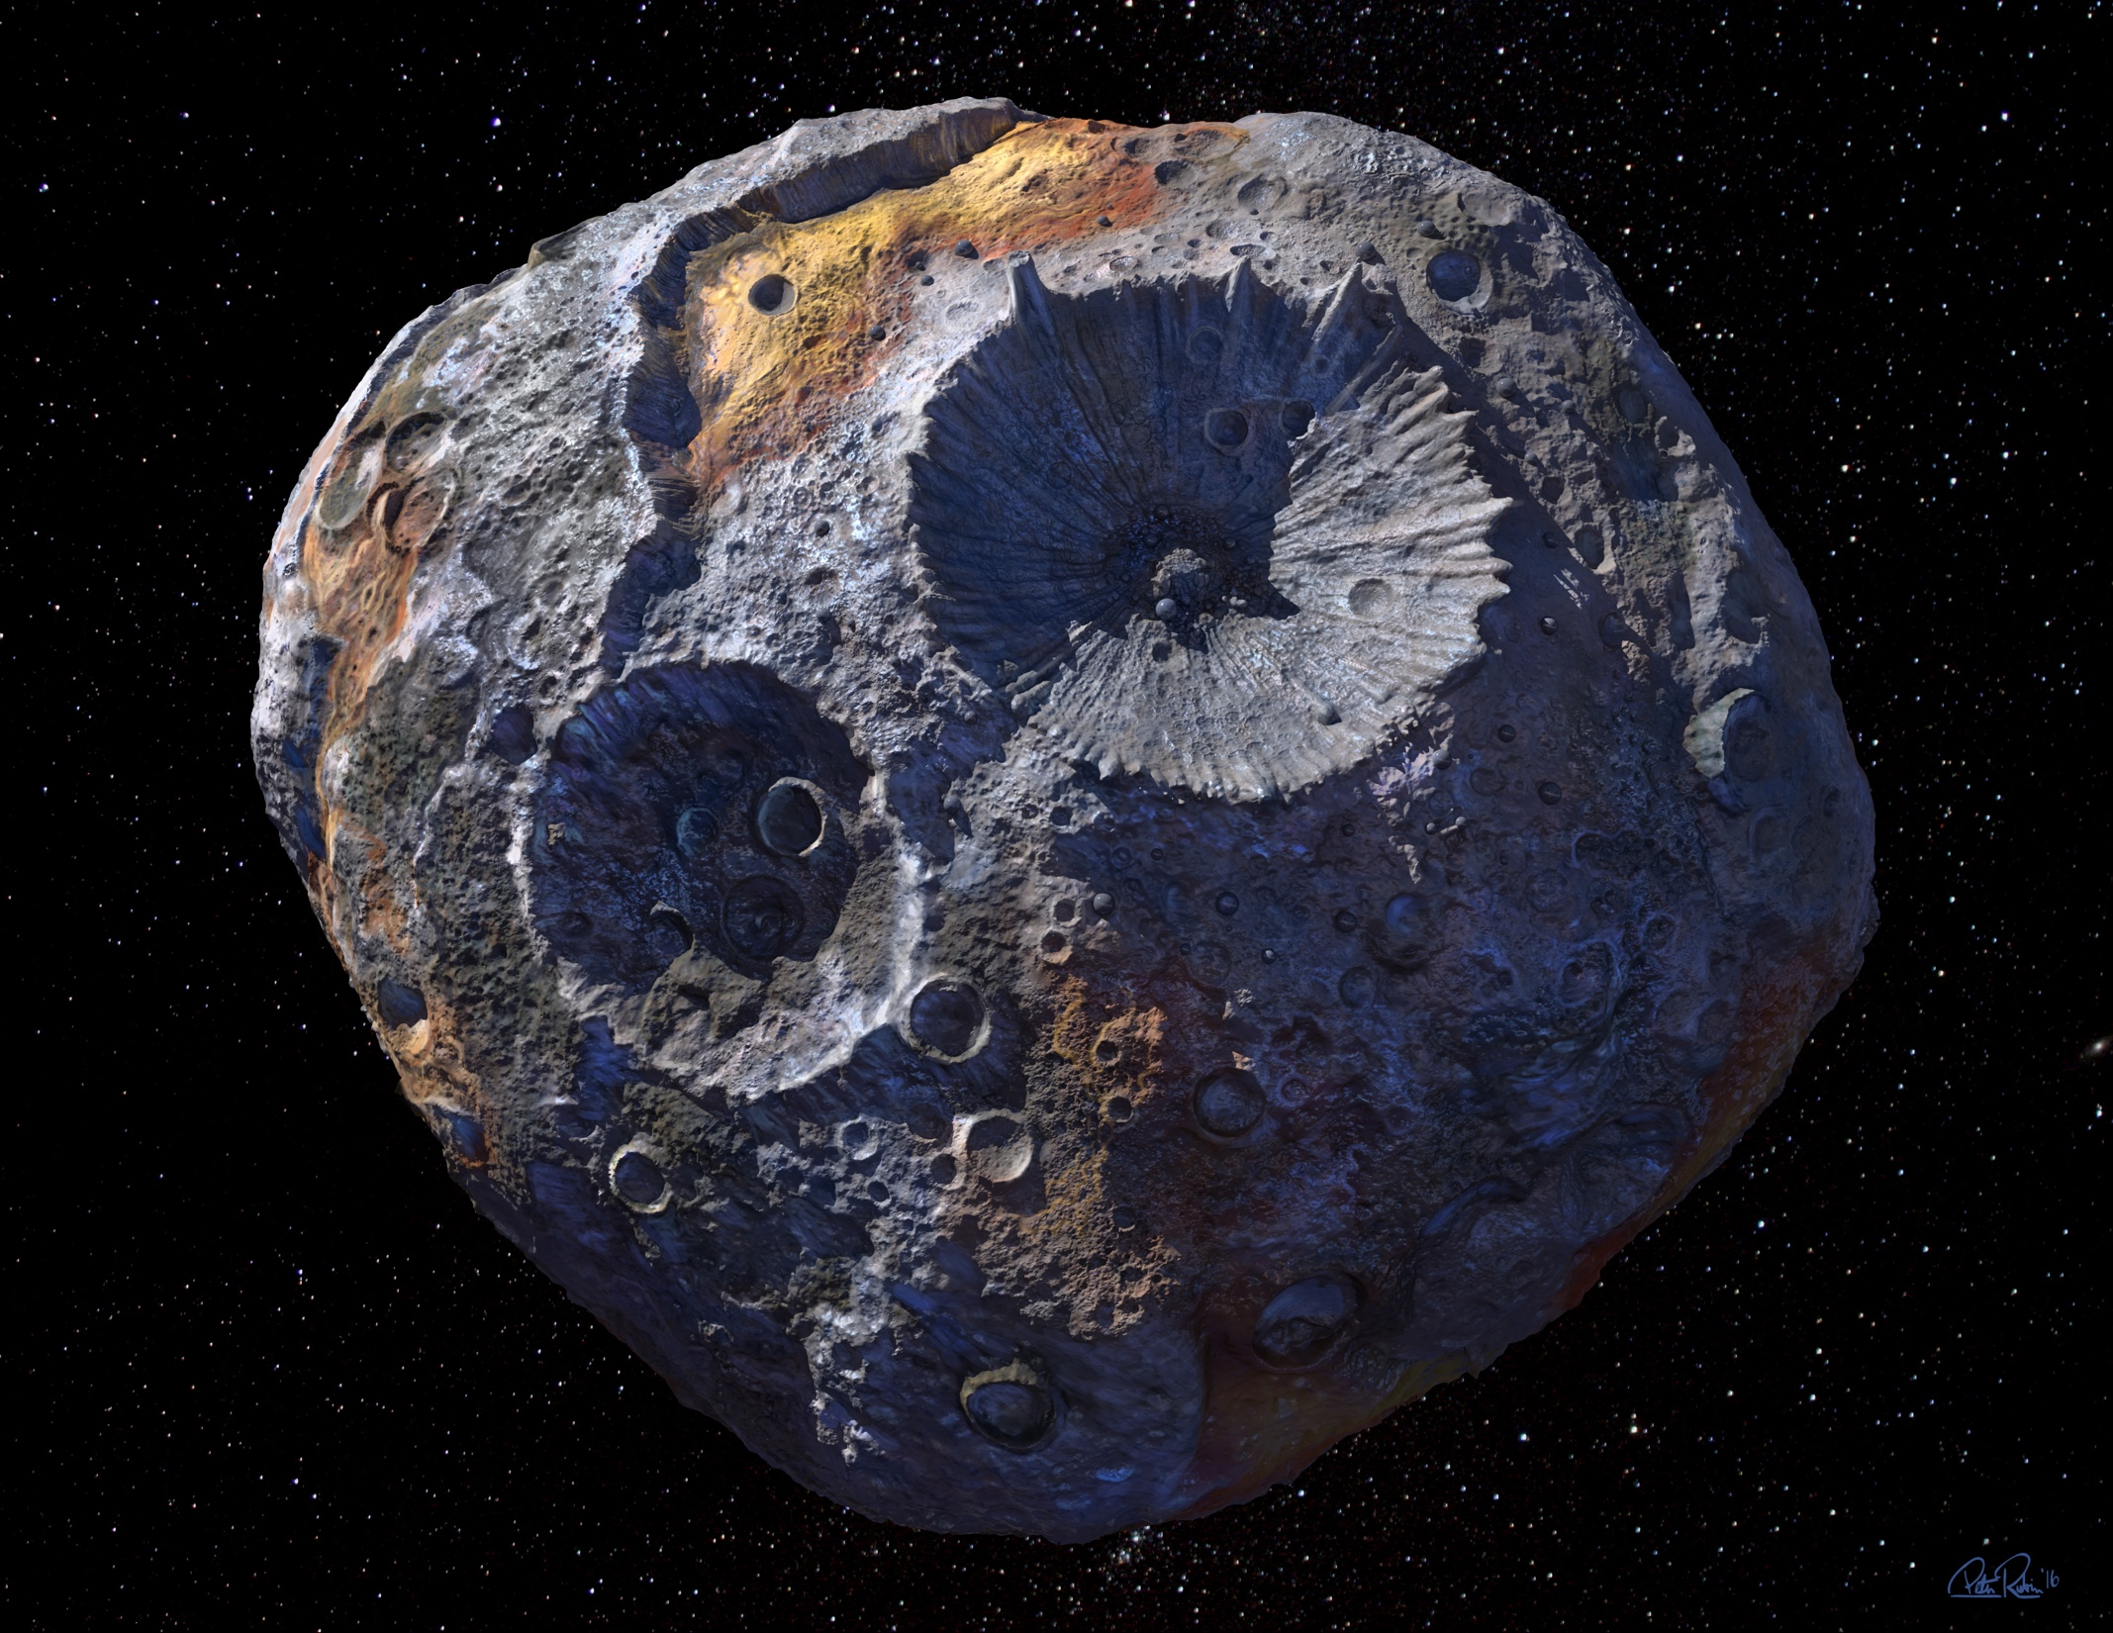
Psyche – the gem of the solar system

Slide 2
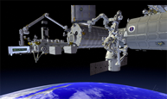
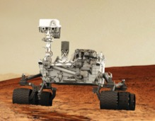
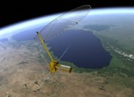
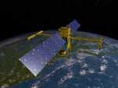
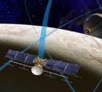
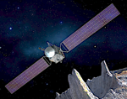
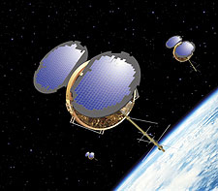
Upcoming Launches
COSMIC-2
April – June 2018
ECOSTRESS
June 2018
Mars 2020
Mars Helicopter
NISAR 2021
SWOT 2021
Europa Clipper 2022
PSYCHE 2022

Slide 3

Prepare for next generation of explorers’ ways of working
Notes:
The next generation of explorers, including you all, have much more knowledge. They will know what it looks like on their smartphones and NASA apps. They will expect it to work and be amazed with what they find. And we want their help. They are the future scientists and engineers. Whether they work for NASA or not, we want their help and participation.

