Slide 1
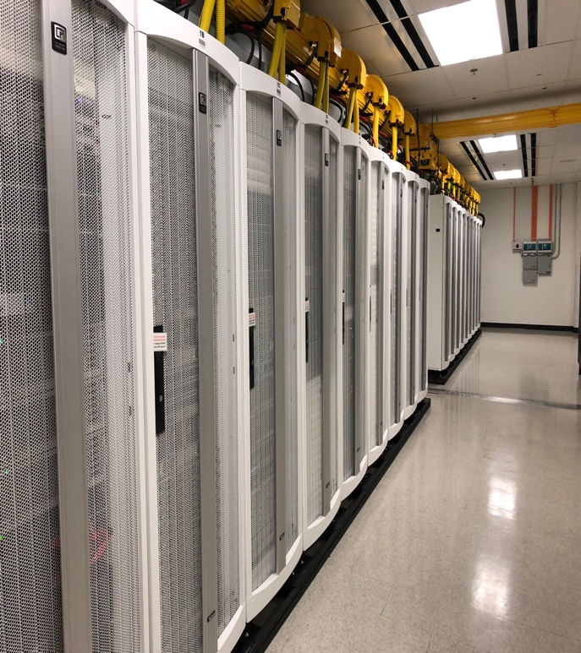
JPL Perspective on Software Defined Everything
Everyone becomes a “programmer”
Rapid experimentation in joint software and hardware development
Focus on software training, experimentation
JPL code sharing mentality has grown 100%
Software containers save time/money/risk
Investigating in API management
Automation is expected and built-in
Software defined… spacecraft, radios, …
Building software-defined, auto-adjustable, self-healing networks
Notes:
Programming everything, APIs, Software Defined Networks, containers, DevOps, Open Source, intelligent self-healing network,
everything distributed

Slide 2

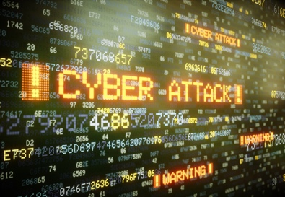
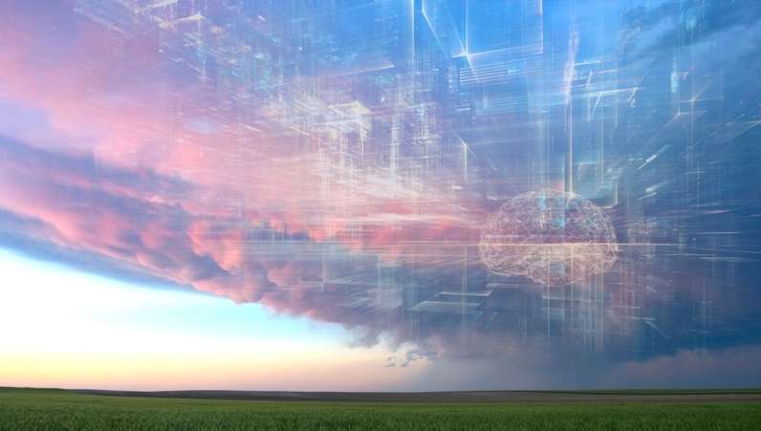
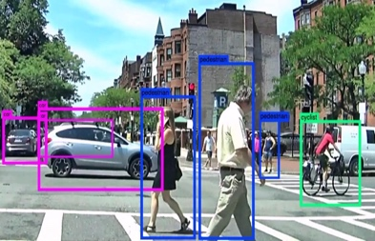

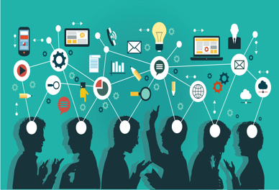
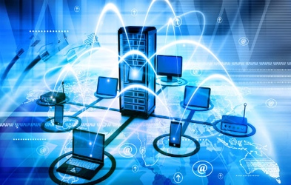
Surfing the next major technology waves – Ubiquitous Computing
New Habits
Cyber Security challenges
Applied AI
Built in
intelligence
everywhere
Accelerated Computing
Ubiquitous Computing
Software Defined Everything
Mobile, smart devices, AR, IoT, NUI
These waves will impact everyone
These waves will impact primarily developers
Participate at: techwaves@jpl.nasa.gov or https://goto.jpl.nasa.gov/techwaves
Notes:
Other potentials:
From IDC: Technologies covered include distributed cloud, pervasive AI, composable applications, blockchain, diversified IoT, and more.
Everything as code, Automating Cyber Security for diversity and scale, Intelligent automation
1. Preparing for Software Defined Everything
Programming, SDN, containers, DevOps, Open Software, Intelligent network, devices
2. Accelerating the computing
Cloud, Serverless, cloud edge, HPC, GPUs, Quantum
3. Living mobile in a mixed reality
Mobile, smart devices, AR, IoT, NUI, customization
4. Automating Intelligence: Measuring & Automating Everything
AI, chatbots, NLP, automation, data, APIs, analytics, combinations
5. Handling Cyber Security challenges at scale
Scale, authentication, encryption, BlockChain
6. Adjusting to changing workforce expectations and habits
Work from anywhere, gaming, sharing, open source, reduced footprint, cord-cutting

