Slide 1
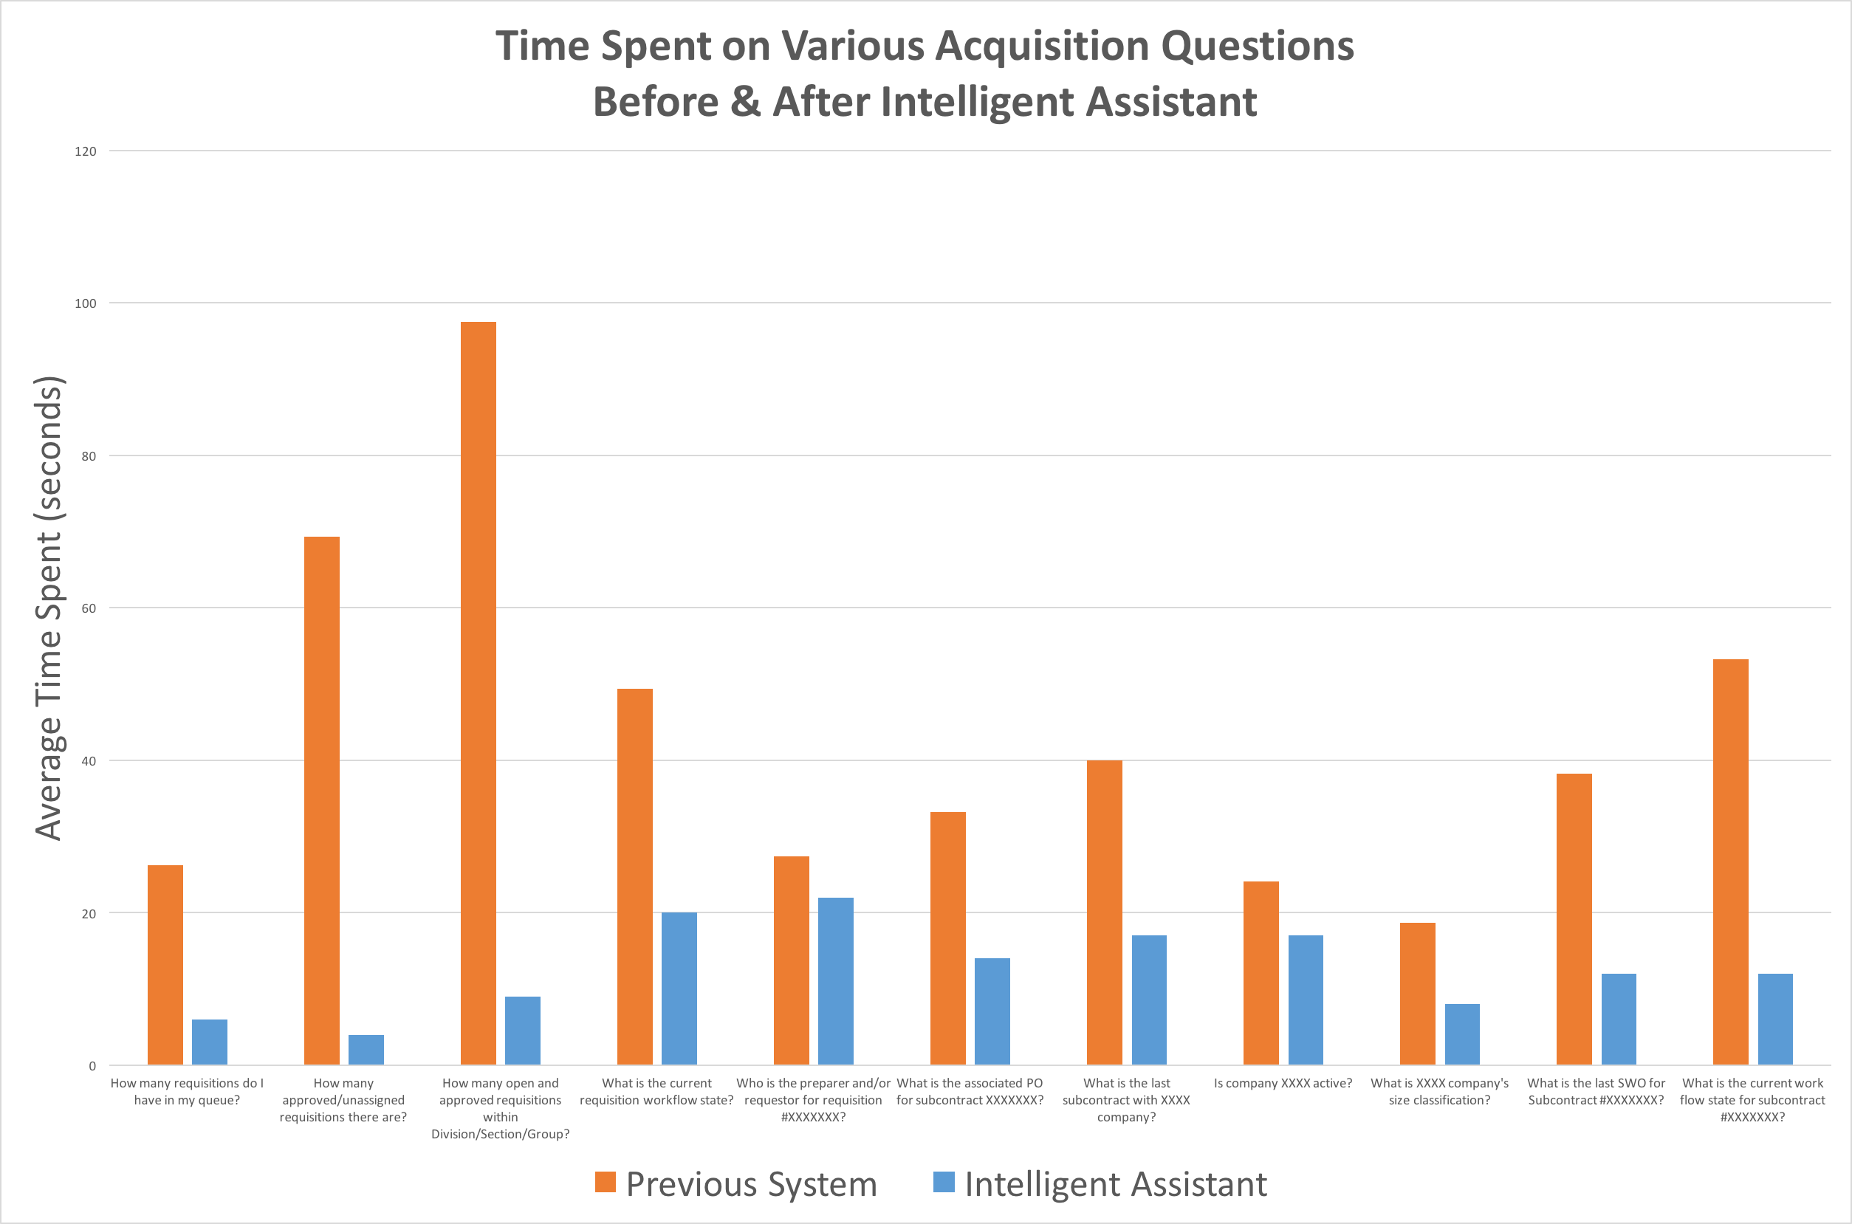
JPL’s Acquisition Intelligent Assistant Results

