Slide 1


Reduction of System
Development Manhour

Slide 2
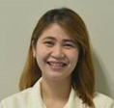
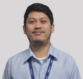
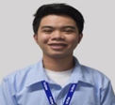
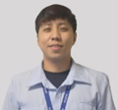
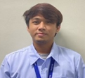
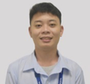
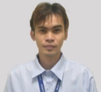
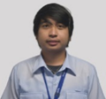

CIRCLE INTRODUCTION
CIRCLE MEMBERS
Monique san
Secretary
Lemmy san
Expectant Trainer
Eubs san
Circle Member
Era san
Circle Member
JM san
Team Leader
Arvs san
Circle Member
Arjay san
Circle Member
Eron san
Circle Member
Bro Devs PH Group Composition:
1-Leader, 1- Expectant Trainer and 4 members

Slide 3
TEAM SKILLS (Before the Activity)

Slide 4
Theme Selection

