Slide 1

Skeleton Tutorial
Daniel S. Katz
Zhao Zhang

Slide 2
Tech Prerequisite
Mac or Linux
Python3
git clone https://github.com/applicationskeleton/Skeleton.git
cd Skeleton/src
Test case:
./skeleton.py sample-input/bag.input Shell
Should print:

Slide 3
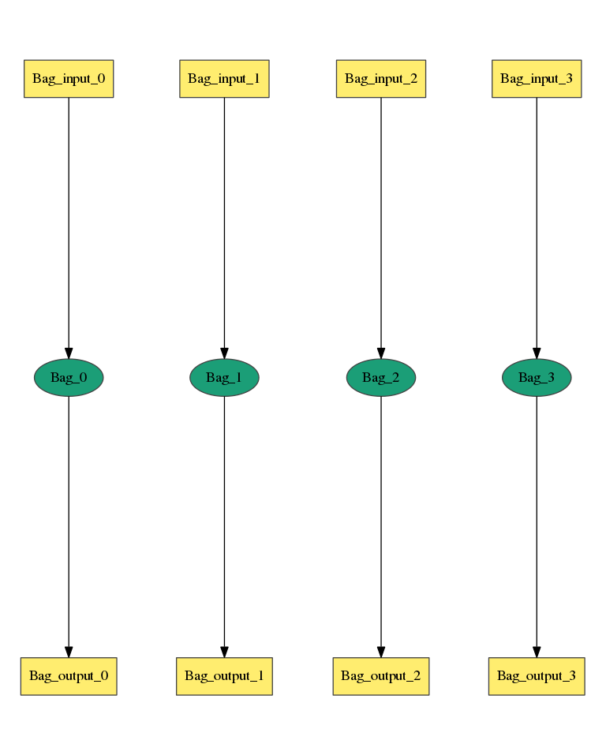
Bag of Task
Num_Stage = 1
Stage_Name = Stage_1
Task_Type = serial
Num_Processes = 1
Num_Tasks = 4
Task_Length = uniform 5
Read_Buffer = 65536
Write_Buffer = 65536
Input_Files_Each_Task = 1
Input_1.Source = filesystem
Input_1.Size = uniform 2100000
Output_Files_Each_Task = 1
Output_1.Size = uniform 4200000
Interleave_Option = 0
https://github.com/applicationskeleton/Skeleton/blob/master/src/sample-input/bag.input

Slide 4
Bag of Task
Output
task serial 1 1.1 65536 65536 1 1 0 Stage_1_Input/Stage_1_Input_0_1 Stage_1_Output/Stage_1_Output_0_1 4200000
task serial 1 1.1 65536 65536 1 1 0 Stage_1_Input/Stage_1_Input_0_2 Stage_1_Output/Stage_1_Output_0_2 4200000
task serial 1 1.1 65536 65536 1 1 0 Stage_1_Input/Stage_1_Input_0_3 Stage_1_Output/Stage_1_Output_0_3 4200000
task serial 1 1.1 65536 65536 1 1 0 Stage_1_Input/Stage_1_Input_0_4 Stage_1_Output/Stage_1_Output_0_4 4200000

Slide 5
Bag of Task
Now you can ask more
Num_Stage = 1
Stage_Name = Stage_1
Task_Type = parallel
Num_Processes = 6
Num_Tasks = 4
Task_Length = normal [20, 3]
Read_Buffer = 65536
Write_Buffer = 65536
Input_Files_Each_Task = 1
Input_1.Source = filesystem
Input_1.Size = uniform 2100000
Output_Files_Each_Task = 1
Output_1.Size = uniform 4200000
Interleave_Option = 0
Task_Type as parallel?

Slide 6
Bag of Task
Now you can ask more
Num_Stage = 1
Stage_Name = Stage_1
Task_Type = serial
Num_Processes = 1
Num_Tasks = 4
Task_Length = normal [20, 3]
Read_Buffer = 65536
Write_Buffer = 65536
Input_Files_Each_Task = 1
Input_1.Source = filesystem
Input_1.Size = uniform 2100000
Output_Files_Each_Task = 1
Output_1.Size = uniform 4200000
Interleave_Option = 0
Task_Length as a statistical distribution?

Slide 7
Bag of Task
Now you can ask more
Num_Stage = 1
Stage_Name = Stage_1
Task_Type = serial
Num_Processes = 1
Num_Tasks = 4
Task_Length = polynomial [20, 3] Input_1
Read_Buffer = 65536
Write_Buffer = 65536
Input_Files_Each_Task = 1
Input_1.Source = filesystem
Input_1.Size = uniform 2100000
Output_Files_Each_Task = 1
Output_1.Size = uniform 4200000
Interleave_Option = 0
Task_Length as a polynomial function of input file size?
a*x^b

Slide 8
Bag of Task
Now you can ask more
Output size as a polynomial of task_length?
a*x^b
Num_Stage = 1
Stage_Name = Stage_1
Task_Type = serial
Num_Processes = 1
Num_Tasks = 4
Task_Length = normal [20, 3]
Read_Buffer = 65536
Write_Buffer = 65536
Input_Files_Each_Task = 1
Input_1.Source = filesystem
Input_1.Size = uniform 2100000
Output_Files_Each_Task = 1
Output_1.Size = polynomial [10, 2] Length
Interleave_Option = 0

Slide 9
Interleave_option
0
1
2
3

Slide 10
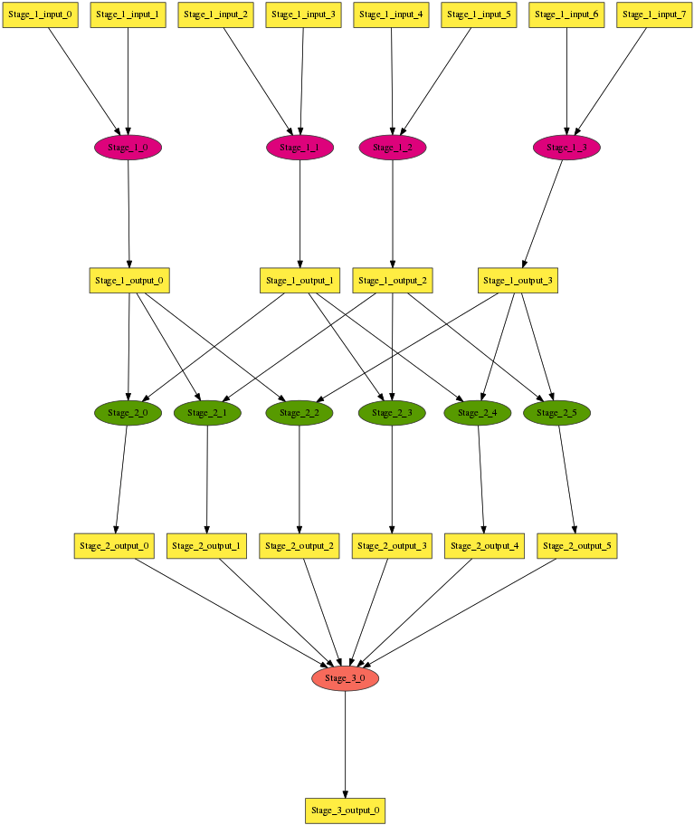
Multi-stage Workflow
Num_Stage = 3
Stage_Name = Stage_1
…
Stage_Name = Stage_2
…
Write_Buffer = 65536
Input_Files_Each_Task = 2
Input_Task_Mapping = combination Stage_1.Output_1 2
…
Stage_Name = Stage_3
…
Input_Files_Each_Task = 6
Input_Task_Mapping = combination Stage_2.Output_1 6
…
https://github.com/applicationskeleton/Skeleton/blob/master/src/sample-input/multi-stage.input

Slide 11
Mapping Files to Tasks
Do not specify Input_Task_Mapping:
Natural order
8 files, 4 tasks =>
f0, f1 : t0
f2, f3 : t1
f4, f5 : t2
f6, f7 : t3

Slide 12
Mapping Files to Tasks
Specify Input_Task_Mapping:
Input_Task_Mapping = combination Stage_1_output_1 2
4 files, 6 tasks =>
f0, f1 : t0
f0, f2 : t1
f0, f3 : t2
f1, f2 : t3
f1, f3 : t4
f2, f3 : t5
https://github.com/applicationskeleton/Skeleton/blob/master/src/sample-input/multi-stage.input

Slide 13
Mapping Files to Tasks
Specify Input_Task_Mapping:
Input_Task_Mapping = external sample-input/mapping.sh
cat sample-input/mapping.sh
echo Stage_1_Output_0_1 Stage_1_Output_0_2
echo Stage_1_Output_0_1 Stage_1_Output_0_3
echo Stage_1_Output_0_1 Stage_1_Output_0_4
echo Stage_1_Output_0_2 Stage_1_Output_0_3
echo Stage_1_Output_0_2 Stage_1_Output_0_4
echo Stage_1_Output_0_3 Stage_1_Output_0_4
The ith line maps to the ith task
https://github.com/applicationskeleton/Skeleton/blob/master/src/sample-input/external-mapper.input

Slide 14
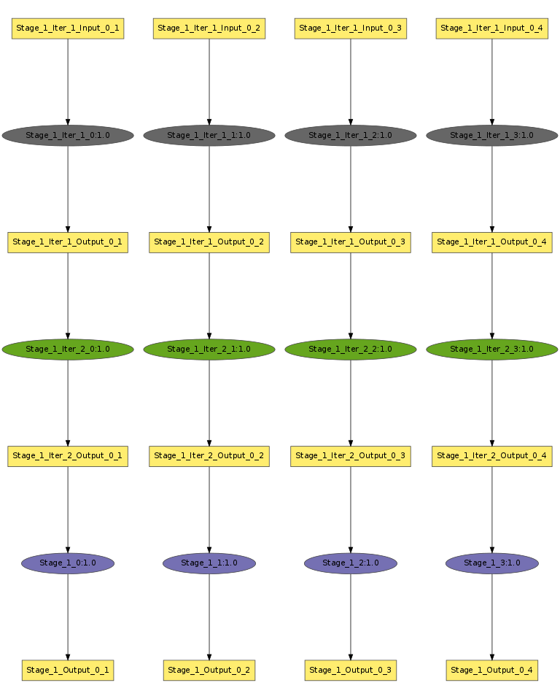
Single Stage Iterative Workflow
Num_Stage = 1
Stage_Name = Stage_1
Task_Type = serial
Num_Tasks = 4
Task_Length = uniform 10
Num_Processes = 1
Read_Buffer = 65536
Write_Buffer = 65536
Input_Files_Each_Task = 1
Input_1.Source = filesystem
Input_1.Size = uniform 1048576
Output_Files_Each_Task = 1
Output_1.Size = uniform 1048576
Interleave_Option = 0
Iteration_Num = 3
Iteration_Stages = Stage_1
Iteration_Substitute = Stage_1.Input_1, Stage_1.Output_1
Stage_3.Input_1 and Stage_4.Output_1 should have IDENTICAL number of files
https://github.com/applicationskeleton/Skeleton/blob/master/src/sample-input/single-stage-iterative.input

Slide 15
Multi Stage Iterative Workflow
Stage_Name = Stage_3
Task_Type = serial
Num_Tasks = 6
Task_Length = uniform 32
Num_Processes = 1
Read_Buffer = 65536
Write_Buffer = 65536
Input_Files_Each_Task = 1
Input_1.Source = Stage_2.Output_1
Output_Files_Each_Task = 1
Output_1.Size = uniform 1048576
Interleave_Option = 0
Iteration_Num = 3
Iteration_Stages = Stage_3, Stage_4
Iteration_Substitute = Stage_3.Input_1, Stage_4.Output_1
Stage_Name = Stage_4
Task_Type = serial
Num_Tasks = 6
Task_Length = uniform 32
Num_Processes = 1
Read_Buffer = 65536
Write_Buffer = 65536
Input_Files_Each_Task = 1
Input_1.Source = Stage_3.Output_1
Output_Files_Each_Task = 1
Output_1.Size = uniform 1048576
Interleave_Option = 0
Stage_3.Input_1 and Stage_4.Output_1 should have IDENTICAL number of files
https://github.com/applicationskeleton/Skeleton/blob/master/src/sample-input/multiple-stage-iterative.input

Slide 16
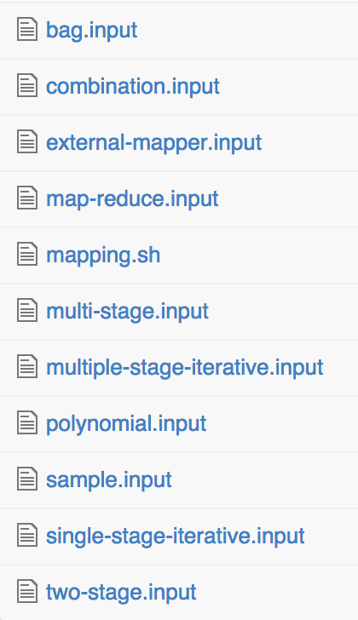
Complete List of Sample Inputs

Slide 17
Pegasus Dependency
Pegasus library requires python 2.7 or higher
Visualizing DAX requires graphviz
Usage:
cd Skeleton/src
./skeleton.py sample-input/bag.input DAX > bag.dax
../util/plot.sh bag.dax
open bag.png

Slide 18
Questions

