Slide 1
Application Skeletons: Constructing and Using Abstract Many Task Applications in eScience
Daniel S. Katz¹, Andre Merzky², Zhao Zhang³, Shantenu Jha²
¹Computation Institute, University of Chicago & Argonne National Laboratory
²RADICAL Laboratory, Rutgers University
³AMPLab, University of California, Berkeley
d.katz@ieee.org, andre.merzky.net, zhaozhang@eecs.berkeley.edu, shantenu.jha@rutgers.edu

Slide 2
Motivation
Computer scientists who build tools and systems need to work on real scientific applications to prove the effectiveness of their tools and systems
And often vary them – change problem size, etc.
However, accessing and building real applications can be hard (and isn’t really the core of their work)
Some applications (source) are privately accessible
Some data is difficult to access
Some applications use legacy code and are dependent on out-of-date libraries
Some applications are hard to understand without domain science expertise
Real applications may be difficult to scale or modify to demonstrate system trends and characteristics

Slide 3
Part of the AIMES Project
AIMES: Abstractions and Integrative Middleware for Extreme Scales
Goal
Improve principles and practice of distributed dynamic resource federation
Motivation
Identify abstractions; implement to study & support federation
Improve dynamic and distributed execution on heterogeneous distributed computing infrastructure (DCI)
“How will my application perform on this DCI?”
“How can I best adapt my application to a DCI?”
“How can the set of resources DCI best adapt to my application?”
“Why did the system allocate this DCI to my application?
“What “variables” matter most … matter least?
Understand how distributed workload execution can be managed
Hypothesis: Using middleware that supports the integration of application-level and resource-level information
Questions: What are the relevant decisions, and at what level should they be made?

Slide 4
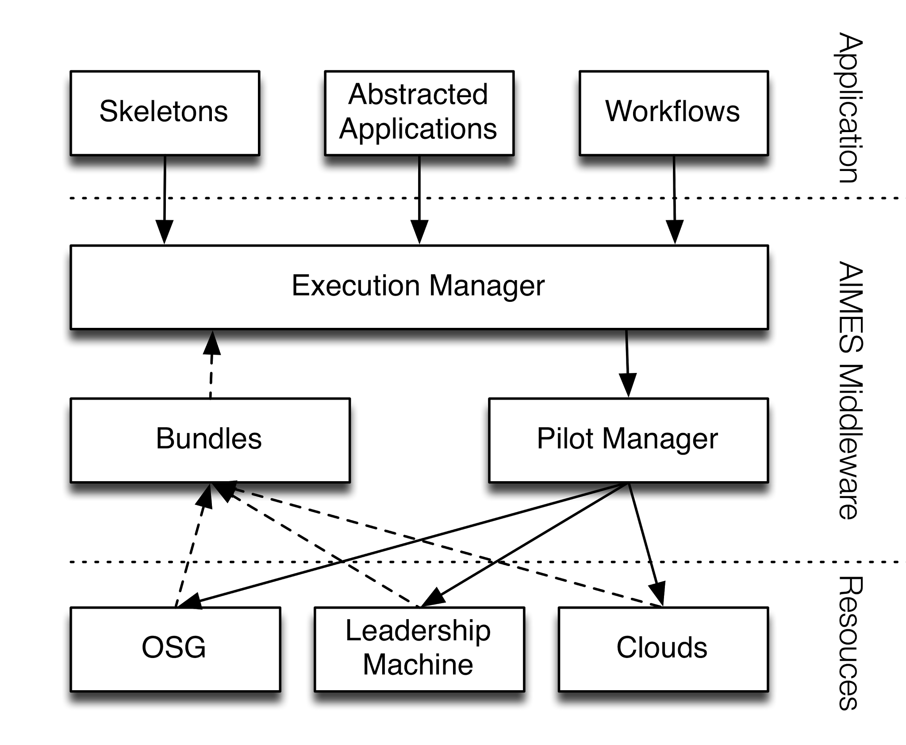
AIMES Approach
Use abstractions that can be flexibly composed and support a range of experiments, including
Skeletons represent primary DCI application characteristics
Resource Bundles provide real-time info on state of diverse resources
Pilot Jobs enable dynamical distributed resource federation & management
Execution strategy: temporally ordered set of decisions that need to be made when executing a given workload
Experiment to understand requirements & trade-offs

Slide 5
Skeleton Target
We want to build a tool so that
Users can quickly and easily produce a synthetic distributed application that represents the key distributed characteristics of a real application
The synthetic application should have task type (serial or parallel), runtime, I/O buffer, I/O quantity, computation and I/O interleaving pattern and intertask communication that are similar to those of the real application
The synthetic application is easy to run in a distributed environment: grids, clusters, and clouds
The synthetic application should be executable with common distributed computing middleware (e.g., Swift and Pegasus) as well as the ubiquitous Unix shell

Slide 6
Classes of Distributed Applications
Bag of Tasks: a set of independent tasks
MapReduce: a set of distributed application with key-value pairs as intermediate data format
Iterative MapReduce: MapReduce application with iteration requirement
Campaign: an iterative application with a varying set of tasks that must be run to completion in each iteration
Multi-stage Workflow: a set of distributed applications with multiple stages that use POSIX files as intermediate data format
Concurrent Tasks: a set of tasks that have to be executed at the same time (not supported by current work)
Note that most/all of these are many-task applications

Slide 7
Contributions
An application abstraction that gives users good expressiveness and ease of programming to capture the key performance elements of distributed applications
A versatile Skeleton task implementation that is configurable (number of tasks, serial or parallel tasks, amount of I/O and computation, I/O buffer size, computation and I/O interleaving options)
An interoperable Skeleton implementation that works with mainstream workflow frameworks and systems (Swift, Pegasus, and Shell)
The usage of Skeleton applications to simplify system optimization implementation and highlight their impacts

Slide 8
Challenge
Balance the ease of programming and usage with the performance gap between Skeleton applications and real applications

Slide 9
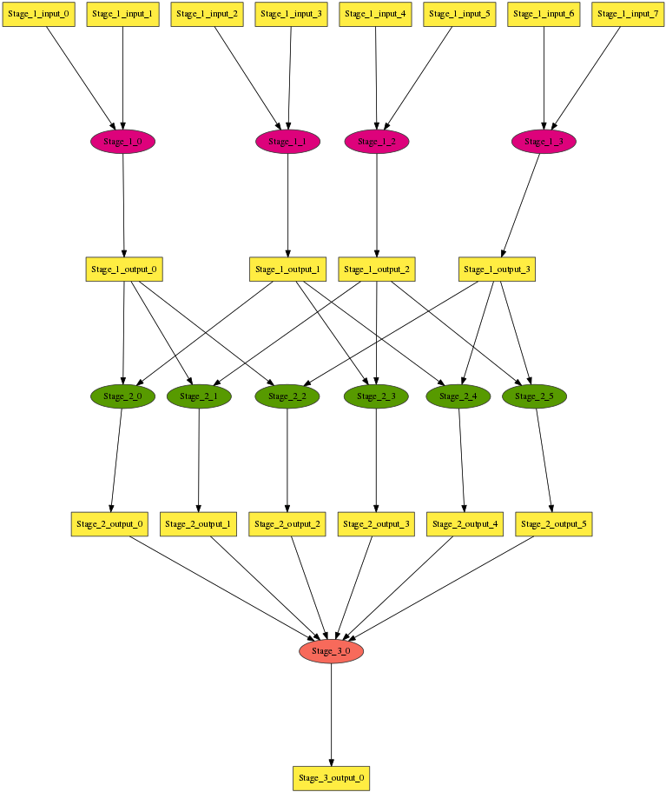
An Multi-Stage Application Example
Applications have stages
Each stage has tasks
Tasks have types (serial/parallel)
Tasks have computation lengths
Input/Output files have sizes
I/O is through buffers
Input files can be (pre) existing files or Output files from previous stages
Computation and I/O can be interleaved
Each stage has input/output files
Input files map to tasks with patterns

Slide 10
Skeleton Abstraction
Application Skeletons abstract an application using a top-down approach: an application is composed of stages, each of which is composed of tasks.
An application can be defined by a configuration file containing:
Number of stages
For each stage
Task types (serial/parallel)
Tasks (number and computation length)
Number of processes for each task
Input files (number, sizes, and mapping to tasks)
Output files (number, sizes)
I/O buffer size
Computation and I/O interleaving option

Slide 11
Skeleton Tool Design
The Skeleton tool is implemented as a parser.
Preparation Scripts
Configuration File
Skeleton
Tool
Executables
Application (Pegasus DAG, Swift Script, Shell commands)

Slide 12
Task Executable
All tasks implemented as one standalone C program via parameters
C program can be compiled as serial with GCC, as parallel with MPICC compiler.
An execution example:
task serial 1 5 65536 65536 1 1 0 Stage_1_Input/Stage_1_Input_0_1 Stage_1_Output/Stage_1_Output_0_1 4200000
Path_to_Task Task_Type Num_Processes Task_Length Read_Buffer Write_Buffer Num_Input Num_Output Interleave_Option [Input_File] [Output_File Output_Size]

Slide 13
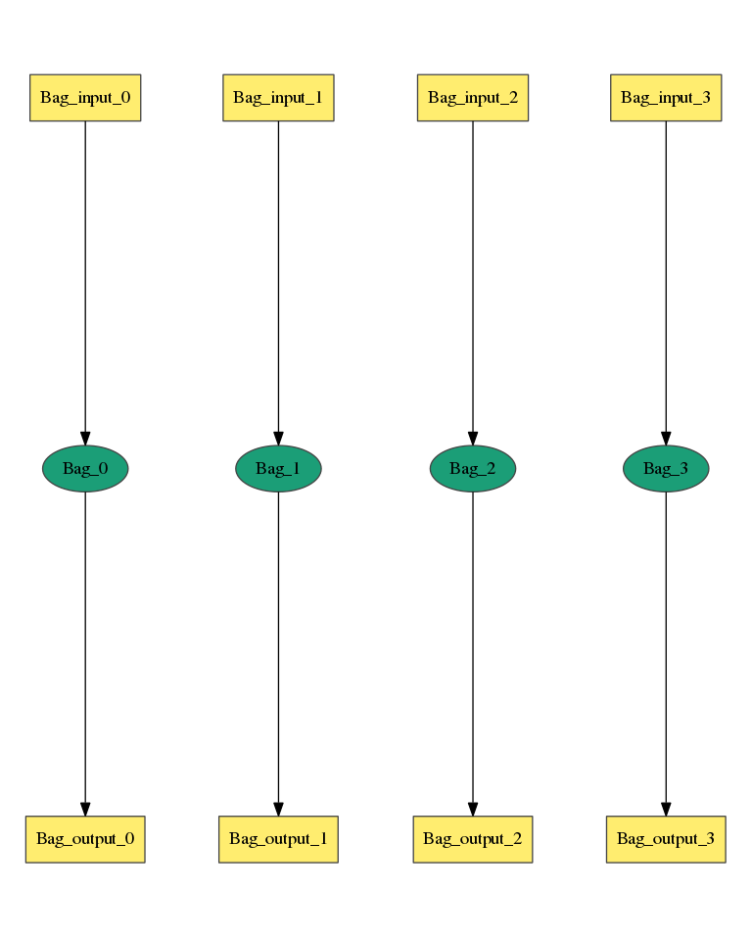
A Bag of Task Application Example
Num_Stage = 1
Stage_Name = Bag
Task_Type = serial
Num_Processes = 1
Num_Tasks = 4
Task_Length = uniform 5
Read_Buffer = 65536
Write_Buffer = 65536
Input_Files_Each_Task = 1
Input_1.Source = filesystem
Input_1.Size = uniform 2100000
Output_Files_Each_Task = 1
Output_1.Size = uniform 4200000
Interleave_Option = 0
https://github.com/applicationskeleton/Skeleton/blob/master/src/sample-input/bag.input

Slide 14
A Bag of Task Application Example
Other options
Task_Type can be parallel
Task_Type = parallel
Task_Length can be a statistical distribution
Task_Length = normal [20, 3]
Task_Length can be a polynomial function of input file size
Task_Length = polynomial [20, 3] Input_1
20*Input_1.Size^3
Output size can be a polynomial function of Task_Length
Ouptut_1.Size = polynomial [10, 2] Length
10*Length^2
Interleaving_Option can be ...

Slide 15
A Bag of Task Application Example
Interleaving_Option can be
0
1
2
3

Slide 16
A Multi-stage Workflow
Num_Stage = 3
Stage_Name = Stage_1
…
Stage_Name = Stage_2
…
Write_Buffer = 65536
Input_Files_Each_Task = 2
Input_Task_Mapping = combination Stage_1.Output_1 2
…
Stage_Name = Stage_3
…
Input_Files_Each_Task = 6
Input_Task_Mapping = combination Stage_2.Output_1 6
…
https://github.com/applicationskeleton/Skeleton/blob/master/src/sample-input/multi-stage.input

Slide 17
Input_Task_Mapping
Specify Input_Task_Mapping:
Input_Task_Mapping = combination Stage_1_output_1 2
Equivalent to “N choose k” mathematically
4 files, 6 tasks =>
file0, file1 : task0
file0, file2 : task1
file0, file3 : task2
file1, file2 : task3
file1, file3 : task4
file2, file3 : task5
https://github.com/applicationskeleton/Skeleton/blob/master/src/sample-input/multi-stage.input

Slide 18
Input_Task_Mapping
If Input_Task_Mapping is not specified
Input_Files_Each_Task = 2
Input_1.Source = Stage_1.Output_1
Input_2.Source = Stage_1.Output_1
Files are mapped to tasks in a natural order
file0, file1 : task0
file2, file3 : task1
file4, file5 : task2
file6, file7 : task3

Slide 19
Input_Task_Mapping
External mapping option
Input_Task_Mapping = external sample-input/mapping.sh
cat sample-input/mapping.sh
echo Stage_1_Output_0_1 Stage_1_Output_0_2
echo Stage_1_Output_0_1 Stage_1_Output_0_3
echo Stage_1_Output_0_1 Stage_1_Output_0_4
echo Stage_1_Output_0_2 Stage_1_Output_0_3
echo Stage_1_Output_0_2 Stage_1_Output_0_4
echo Stage_1_Output_0_3 Stage_1_Output_0_4
The ith line maps to the ith task
https://github.com/applicationskeleton/Skeleton/blob/master/src/sample-input/external-mapper.input

Slide 20
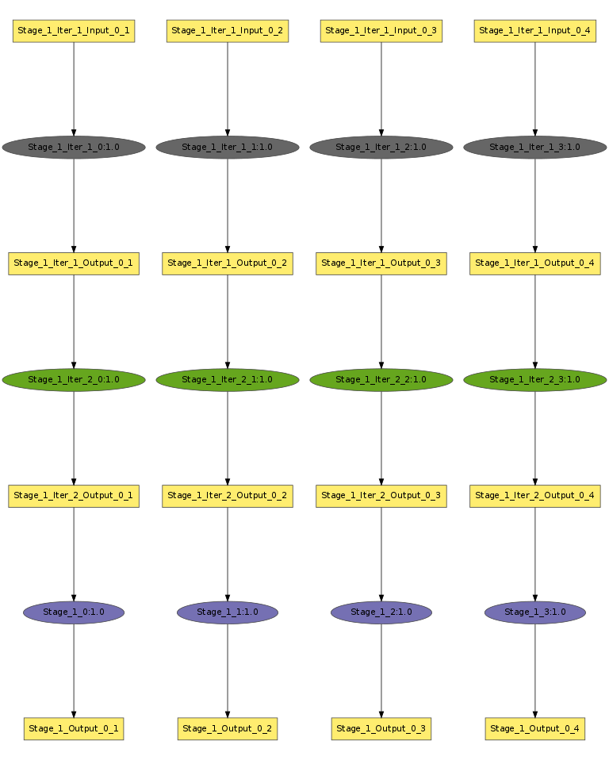
A Single Stage Iterative Application
Num_Stage = 1
Stage_Name = Stage_1
Task_Type = serial
Num_Tasks = 4
Task_Length = uniform 10
Num_Processes = 1
Read_Buffer = 65536
Write_Buffer = 65536
Input_Files_Each_Task = 1
Input_1.Source = filesystem
Input_1.Size = uniform 1048576
Output_Files_Each_Task = 1
Output_1.Size = uniform 1048576
Interleave_Option = 0
Iteration_Num = 3
Iteration_Stages = Stage_1
Iteration_Substitute = Stage_1.Input_1, Stage_1.Output_1
Stage_1.Input_1 and Stage_1.Output_1 should have IDENTICAL number of files
https://github.com/applicationskeleton/Skeleton/blob/master/src/sample-input/single-stage-iterative.input

Slide 21
A Multi Stage Iterative Application
Stage_Name = Stage_3
Task_Type = serial
Num_Tasks = 6
Task_Length = uniform 32
Num_Processes = 1
Read_Buffer = 65536
Write_Buffer = 65536
Input_Files_Each_Task = 1
Input_1.Source = Stage_2.Output_1
Output_Files_Each_Task = 1
Output_1.Size = uniform 1048576
Interleave_Option = 0
Iteration_Num = 3
Iteration_Stages = Stage_3, Stage_4
Iteration_Substitute = Stage_3.Input_1, Stage_4.Output_1
Stage_Name = Stage_4
Task_Type = serial
Num_Tasks = 6
Task_Length = uniform 32
Num_Processes = 1
Read_Buffer = 65536
Write_Buffer = 65536
Input_Files_Each_Task = 1
Input_1.Source = Stage_3.Output_1
Output_Files_Each_Task = 1
Output_1.Size = uniform 1048576
Interleave_Option = 0
Stage_3.Input_1 and Stage_4.Output_1 should have IDENTICAL number of files
https://github.com/applicationskeleton/Skeleton/blob/master/src/sample-input/multiple-stage-iterative.input

Slide 22
Determining Skeleton Parameters Manually
Steps
Place I/O files on RAM disk, use Unix time command to measure run time
Use Unix strace command to find number of reads and writes, total data read and written
Align I/O calls in sequence order¹ to determine I/O concurrency, I/O buffer size, and interleaving option
¹Z. Zhang, D. S. Katz, M. Wilde, J. Wozniak, I. Foster. MTC Envelope: Defining the Capability of Large Scale Computers in the Context of Parallel Scripting Applications, Proceedings of 22nd International ACM Symposium on High-Performance Parallel and Distributed Computing (HPDC'13), 2013

Slide 23
Determining Skeleton Parameters Automatically
Wrap task in a profiler (uses Linux perf, hardware and kernel counters, system tools)
Measure resource consumption over time as profile: timed sequence of CPU cycles, memory and disk I/O operations
Dependencies between compute and I/O implicitly captured in profile in order of the sequence
Profiles are system independent
Assuming comparable optimization at software and hardware levels
Profile metrics are suitable as input for emulation

Slide 24
Skeleton Apps vs. Real Apps
Applications:
Case 1: a 6x6 degree image mosaic in Montage
Case 2: the first 256 queries of NRxNR test in BLAST
Case 3: partial seismic study of CyberShake postprocessing on site Test
Platform configuration:
64 compute nodes on IBM Blue Gene/P
Tasks are launched with AMFORA[1]
Each task stages input file from GPFS, execute the task, then writes the output files to GPFS
[1] Zhao Zhang, Daniel S. Katz, Timothy G. Armstrong, Justin M. Wozniak, and Ian T. Foster. "Parallelizing the execution of sequential scripts.” Proceedings of the International Conference for High Performance Computing, Networking, Storage and Analysis (SC13). 2013.

Slide 25
Montage Statistics
 | # Tasks | # Inputs | # Outputs | Input (MB) | Output (MB) | Skeleton Task Length (uniform) | Interleaving Option | Error in Stage
mProject | 1319 | 1319 | 2594 | 2800 | 10400 | 11.6 | 0 | -0.2%
mImgtbl | 1 | 1297 | 1 | 5200 | 0.8 | 30.1 | 0 | -2.1%
mOverlaps | 1 | 1 | 1 | 0.8 | 0.4 | 9.1 | 0 | -0.2%
mDiffFit | 3883 | 7766 | 7766 | 31000 | 487 | 1.8 | 0 | -3.3%
mConcatFit | 1 | 3883 | 1 | 1.1 | 4.3 | 2.1 | 0 | -1.5%
mBgModel | 1 | 2 | 1 | 4.5 | 0.07 | 288 | 0 | 0.03%
mBackground | 1297 | 1297 | 1297 | 5200 | 5200 | 0.4 | 0 | -1.6%
mAdd | 1 | 1297 | 1 | 5200 | 7400 | 519 | 0 | -0.9%
Total |  |  |  |  |  |  |  | -1.3%

Slide 26
BLAST Statistics
 | # Tasks | # Inputs | # Outputs | Input (MB) | Output (MB) | Skeleton Task Length | Interleaving Option | Error in Stage
split | 1 | 1 | 64 | 3800 | 3800 | 0 | 3 | -1.9%
formatdb | 64 | 64 | 192 | 3800 | 4400 | uniform 42 | 3 | -0.6%
blastp | 1024 | 4096 | 1024 | 70402 | 966 | normal [109.2, 14.9] | 3 | 1.6%
merge | 16 | 1024 | 16 | 966 | 867 | normal [4.4, 4.1] | 3 | 1.1%
Total |  |  |  |  |  |  |  | 1.4%

Slide 27
CyberShake PostProcessing Statistics
 | # Tasks | # Inputs | # Outputs | Input (MB) | Output (MB) | Skeleton Task Length | Interleaving Option | Error in Stage
Extract | 128 | 130 | 256 | 5400 | 11000 | uniform 6.39 | 0 | 2.6%
Seis | 4096 | 4352 | 4096 | 11000 | 96 | normal [26.9, 13.3] | 0 | 2.4%
PeakGM | 4096 | 4096 | 4096 | 96 | 1.4 | uniform 0.23 | 0 | 2.3%
Total |  |  |  |  |  |  |  | 2.4%

Slide 28
Using Application Skeletons
Data Caching
Comparing shared file system (PVFS) and in-memory file system (AMFORA) performance for mProjectPP
Using 64 n1-highmem-2 instances on Google Compute Engine (GCE)
 | PVFS | AMFORA | Improvement
mProjectPP-real | 285.2 seconds | 100.9 seconds | 63.0%
mProjectPP-skeleton | 273.7 seconds | 101.3 seconds | 64.6%

Slide 29
Using Application Skeletons
Task Scheduling
Data-aware scheduling vs. FIFO
Using 16 n1-highmem-2 GCE instances
mProjectPP-real has 0.7% improvement
mProjectPP-skeleton has 1.6% improvement
Used skeletons to show: 5x larger input file size => 16.4% time-to-solution improvement with data-aware scheduling

Slide 30
Using Application Skeletons
I/O Tuning
Multiple metadata server vs. Single metadata server
Using 16 n1-highmem-2 instances
mProjectPP-real shows 1.1% improvement
mProjectPP-skeleton shows 1.2% improvement
Use skeletons to show: 10x shorter task length => 31.2% improvement for multiple metadata servers

Slide 31
Related Work
Simplify parallel application code
Extract kernels: NAS Parallel Benchmarks, Berkeley Dwarfs/Motifs, CORAL benchmarks, etc.
Simplify non-kernel part of app: Kerbyson (SC12), Worley (SC94), miniapps (e.g., Mantevo, MADbench)
Simplify parallel applications in time
Sodhi (Cluster 2008)
Use system traces in place of applications
Chen (VLDB12), Harter (FAST14), Ouserhout (NSDI15)
Skeleton-like approaches
Skel (for I/O), Tigres (distributed app templates), WGL (similar to our work, but simpler)
Other work that used the term skeleton
See FGCS paper for comparisons

Slide 32
Conclusion
Skeleton tool can compose skeleton application in a top-down manner: application, stage, task
Skeleton task abstraction allows specification of task type, task length, number of processes, I/O buffer, I/O quantity, interleaving option, and file number
Can create easy-to-access, easy-to-build, easy-to-change, and easy-to-run bag-of-tasks, (iterative) map-reduce, and (iterative) multi-stage workflow applications
Skeleton applications can be easily shared, making middleware and tool experiments more reproducible
Skeleton applications have performance close to that of the real applications with an overall error of -1.3%, 1.5%, and 2.4% for Montage, BLAST, and CyberShake PostProcessing
Skeletons can show the effectiveness of system improvements such as data caching, task scheduling, I/O tuning

Slide 33
Future Work
Use application trace data to produce skeleton applications
Determine a way to represent the computational work in a task that when combined with a particular platform can give an accurate runtime for that task
Support concurrent tasks that need to run at the same time to exchange information
Test on distributed systems where latencies, particular file usage, and other issues may be more important than on the parallel systems and cloud environments

Slide 34
References
Software:
The Skeleton tool is open source at: https://github.com/applicationskeleton/Skeleton
v1.2 published as: D. S. Katz, A. Merzky, M. Turilli, M. Wilde, Z. Zhang 2015. Application Skeleton v1.2., DOI: 10.5281/zenodo.13750
Try it! Contribute to it!
Papers:
Z. Zhang and D. S. Katz, "Application Skeletons: Encapsulating MTC Application Task Computation and I/O,” Proceedings of 6th Workshop on Many-Task Computing on Grids and Supercomputers (MTAGS), 2013.
Z. Zhang, D. S. Katz, "Using Application Skeletons to Improve eScience Infrastructure," Proceedings of 10th IEEE International Conference on eScience, 2014. DOI: 10.1109/eScience.2014.9
D. S. Katz, A. Merzky, Z. Zhang, S. Jha, "Application Skeletons: Construction and Use in eScience," Future Generation Computing Systems, 2015. DOI: 10.1016/j.future.2015.10.001

Slide 35
Acknowledgements
This work was supported in part by the U.S. Department of Energy under the ASCR award DE-SC0008617 (the AIMES project)
It has benefited from discussions with Matteo Turilli, Jon Weissman, and Lavanya Ramakrishnan
Computing resources were provided by the Argonne Leadership Computing Facility
Work by Katz was supported by the National Science Foundation while working at the Foundation. Any opinion, finding, and conclusions or recommendations expressed in this material are those of the author(s) and do not necessarily reflect the views of the National Science Foundation

