Slide 1
Application Skeletons: Encapsulating MTC Application Task Computation and I/O
Daniel S. Katz and Zhao Zhang

Slide 2
Motivation
Computer scientists who build tools and systems need to work on real scientific applications to prove the effectiveness of their tools and systems
And often vary them – change problem size, etc.
However, accessing and building real applications can be hard (and isn’t really the core of their work)
Some applications (source) are privately accessible
Some data is difficult to access
Some applications use legacy code and are dependent on out-of-date libraries
Some applications are hard to understand without domain science expertise

Slide 3
Target
We want to build a tool so that
Users can quickly and easily produce a synthetic distributed application that represents the key distributed characteristics of a real application
The synthetic application should have runtime, I/O, and intertask communication that are similar to those of the real application
The synthetic application is easy to run in a distributed environment: grids, clusters, and clouds
The synthetic application should be executable with common distributed computing middleware (e.g., Swift and Pegasus) as well as the ubiquitous Unix shell

Slide 4
Classes of Distributed Applications
Bag of Tasks: a set of independent tasks
MapReduce: a set of distributed application with key-value pairs as intermediate data format
Iterative MapReduce: MapReduce application with iteration requirement
Campaign: an iterative application with a varying set of tasks that must be run to completion in each iteration
Multi-stage Workflow: a set of distributed applications with multiple stages that use POSIX files as intermediate data format
Concurrent Tasks: a set of tasks that have to be executed at the same time

Slide 5
Challenge
Balance the easy of programming and usage with the performance gap between Skeleton applications and real applications

Slide 6
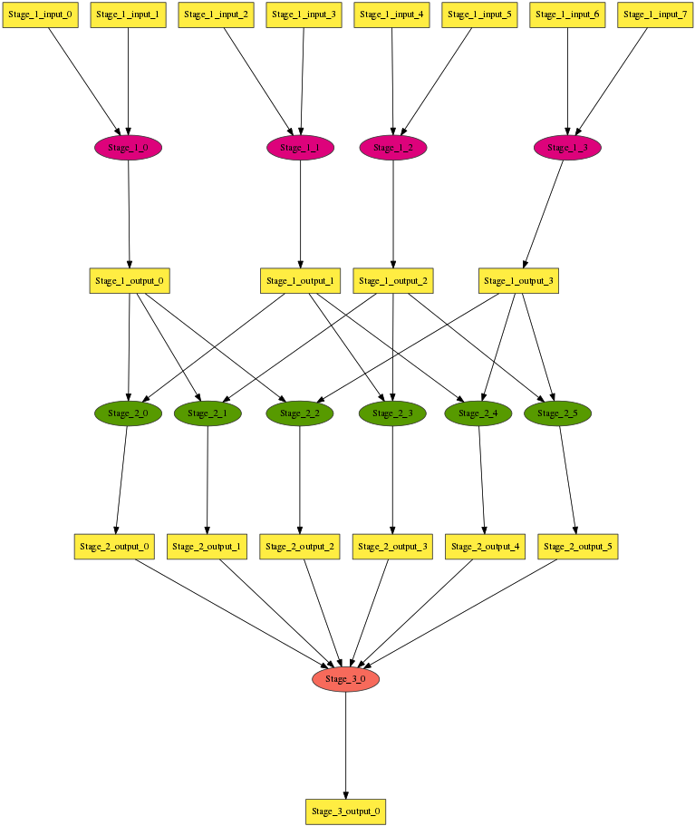
An Multi-Stage Application Example
Application have stages
Each stage has tasks
Task have lengths
Each stage has input/output files
Input/Output files have sizes
Input files map to tasks
Input files can be (pre) existing files or Output files from previous stages

Slide 7
Skeleton Abstraction
Application Skeletons abstract an application using a top-down approach: an application is composed of stages, each of which is composed of tasks.
An application can be defined by a configuration file containing:
Number of stages
For each stage
Tasks (number and length)
Input files (number, sizes, and mapping to tasks)
Output files (number, sizes)

Slide 8
Skeleton Tool Design
The Skeleton tool is implemented as a parser.
Prep Scripts
Configuration File
Skeleton
Executables
Application (Pegasus DAG, Swift Script, Shell commands)

Slide 9
Task Executable
The current implementation of task executable copies the input files from filesystem to RAM, sleeps for some amount of time (specified as the run time), and copies the output files from RAM to filesystem
Issues:
Task length described by run time does not reflect the CPU capacity
Different CPUs should give different performance
Synthetic I/O is too simple
Single block I/O operation may not reflect real I/O
Application structure is too simple
Performance of interleaved computation and I/O is missed

Slide 10
Specifying a Stage
Parameter | Format | Example
Num_Tasks | Integer | 16
Task_Length | dist [parameter][unit] | uniform 32s
Input_source | filesystem | Stage_$.Output | Stage_1.Output
Input_Files_Each_Task | Integer | 2
Tasks_Each_Input_File | Integer | 2
Input_File_Size | dist [parameter][unit] | uniform 1048576
Input_Task_Mapping | External /path/to/exec | external map.sh
Output_Files_Each_Task | Integer | 2
Output_File_Size | dist [parameter][unit] | uniform 1048576
Supported distribution includes uniform, normal, triangular, and lognorm

Slide 11
A Multi-stage Workflow
Num_Stage = 3
Stage_Name = Stage_1 Num_Tasks = 4 Task_Length = normal [10, 1]s Input_Source = filesystem Input_Files_Each_Task = 2 Tasks_Each_Input_File = 1 Input_File_Size = normal [1048576, 1]B Output_Files_Each_Task = 1 Output_File_Size = uniform 1048576B

Slide 12
A Multi-stage Workflow
Num_Stage = 3
Stage_Name = Stage_2 Num_Tasks = 6 Task_Length = uniform 32s Input_Source = Stage_1.Output Input_Files_Each_Task = 2 Tasks_Each_Input_File = 3 Input_Task_Mapping = external mapper.sh Output_Files_Each_Task = 1 Output_File_Size = uniform 1048576B

Slide 13
Mapping Inputs to Tasks
If number of input files = N * number of tasks (N = 1, 2, ...) or number of tasks = 1 mapping of inputs to tasks is trivial
Otherwise, the Input_Task_Mapping option lets users specify the mapping through a Linux executable (used for the example here)
Example: Input_Task_Mapping = external mapper.sh
Output of mapper.sh
Stage_1_output_0 Stage_1_output_1
Stage_1_output_0 Stage_1_output_2
Stage_1_output_0 Stage_1_output_3
...

Slide 14
A Multi-stage Workflow
Num_Stage = 3
Stage_Name = Stage_3 Num_Tasks = 1 Task_Length = uniform 32s Input_Source = Stage_2.Output Input_Files_Each_Task = 6 Tasks_Each_Input_File = 1 Output_Files_Each_Task = 1 Output_File_Size = uniform 1048576B

Slide 15
Skeleton Apps vs. Real Apps
Applications:
Case 1: a 6x6 degree image mosaic in Montage
Case 2: the first 256 queries of NRxNR test in BLAST
Platform configuration:
64 compute nodes on IBM Blue Gene/P
Tasks are launched with AMFS
Each task stages input file from GPFS to RAM disk, execute the task, then copies the output files from RAM disk to GPFS

Slide 16
Montage Statistics
 | # Tasks | # Inputs | # Outputs | In (MB) | Out (MB) | Time Avg | Time Stdev | Skeleton Task Length
mProject | 1319 | 1319 | 2594 | 2800 | 10400 | 11.1 | 2.5 | 12
mImgtbl | 1 | 1297 | 1 | 5200 | 0.8 | N/A | 0 | 16
mOverlaps | 1 | 1 | 1 | 0.8 | 0.4 | 9 | 0 | 9
mDiffFit | 3883 | 7766 | 7766 | 31000 | 487 | 1.7 | 0.6 | 2
mConcatFit | 1 | 3883 | 1 | 1.1 | 4.3 | 14 | 0 | 14
mBgModel | 1 | 2 | 1 | 4.5 | 0.07 | 283.1 | 0 | 284
mBackground | 1297 | 1297 | 1297 | 5200 | 5200 | 0.4 | 0.08 | 1
mAdd | 1 | 1297 | 1 | 5200 | 7400 | N/A | 0 | 519

Slide 17
Skeleton Montage Task Length
We use average time-to-solution for mProject, mOverlaps, mDifffit, mConcatFit, mBackground
mImgtbl and mAdd’s input size exceeds single RAM disk, so we can not measure the time-to-solution with data in RAM disk
However, we observe that these tasks’ time-to-solution is proportional to the number of input files when the number of input files is small, so we project the time-to-solution with the full input data set based on the measured time-to-solution.

Slide 18
Skeleton Montage vs. Real Montage
 | mProject | mImgtbl | mOverlaps | mDifffit | mConcatFit | mBgModel | mBackground | mAdd | Total
Montage | 290.4 | 139.7 | 10.2 | 359.2 | 64.6 | 283.3 | 102.6 | 793.4 | 2040.6
Skeleton | 283.4 | 124.3 | 10.5 | 313.5 | 67.0 | 283.2 | 98.2 | 807.6 | 1987.6
Error | -2.4% | -11.1% | 2.9% | -12.7% | 3.9% | -0.04% | -4.3% | 1.8% | -2.6%
Notes:
mDiffFit -12.7% error can be the result of high variance.
mImgtbl -11.1% error is the result of projection grows sublinearly.

Slide 19
BLAST Statistics
 | # Tasks | # Inputs | # Outputs | In (MB) | Out (MB) | Time Avg | Time Stdev | Skeleton Task Lenth
formatdb | 64 | 64 | 192 | 3800 | 4400 | 41.9 | 0.1 | 42
blastp | 1024 | 4096 | 1024 | 70402 | 966 | 109.2 | 14.9 | 110
merge | 16 | 1024 | 16 | 966 | 867 | 4.4 | 4.1 | real length

Slide 20
Skeleton BLAST vs. Real BLAST
 | formatdb | blastp | merge | Total
BLAST | 82.1 | 1996.3 | 35.9 | 2114.3
Skeleton | 76.2 | 1835.9 | 34.0 | 1946.1
Error | -7.2% | -8.0% | -2.9% | -8.0%
Notes:
ZhaoNote: -7.2% can be the result of ~500,000 small writes in real formatdb, while in Skeleton, dd uses larger buffer.
8.0% error in blastp can be the result of uniform task length distribution setting, while in real tasks, the length varies from 80s to 160s

Slide 21
Conclusion
The Skeleton tool can produce synthetic distributed applications that capture important distributed properties of real applications
The Skeleton tool is simpler to use than real applications
The Skeleton tool can generate applications that represent bag-of-tasks, MapReduce, and multi-stage workflows
Skeleton applications can be run with mainstream workflow frameworks and systems: Shell, Pegasus, and Swift
The execution comparison between the initial Skeleton Montage and BLAST against the real applications shows an acceptable difference of 2.6% and 8.0%
At the stage level, the difference ranges from 0.04% to 12.7%, with six out of eleven stages within 5%

Slide 22
Future Work
Near term plan:
Open source the Skeleton code with documentation
Invite users and contributors from the community
Longer term plan:
User application trace data to (help) produce synthetic applications
Determine a way to represent the computational work in a task that when combined with a particular platform can give an accurate runtime for that task
Better support tasks with interleaved computation and I/O
Support tasks that are not generic single core tasks, such as those that internally include OpenMP or MPI
Support concurrent tasks that need to run at the same time
Investigate a better task-file mapping specification

Slide 23
Acknowledgements
This work was supported in part by the U.S. Department of Energy under the ASCR award DE-SC0008617 (the AIMES project)
It has benefited from discussions with Shantenu Jha, Andre Merzky, Matteo Turilli, Jon Weissman, and Lavanya Ramakrishnan
Computing resources were provided by the Argonne Leadership Computing Facility
Work by Katz was supported by the National Science Foundation while working at the Foundation. Any opinion, nding, and conclusions or recommendations expressed in this material are those of the author(s) and do not necessarily reflect the views of the National Science Foundation.

Slide 24
Thanks!
Questions?

