Slide 1

Skeleton Tutorial
Zhao Zhang
Daniel S. Katz

Slide 2
Prerequisites
Tested on Mac or Linux
By default, uses Python3 (but can fall back to Python2, if first line in skeleton.py is changed)
Python2 is not compatible with the external or combinatorial mapper options
Swift:
Requires Swift to run output Swift scripts
Pegasus:
Requires Pegasus to run output Pegasus DAX
Generating workflow images (as described here):
Requires Pegasus dax2dot script, which requires python 2.7 or higher
Requires graphviz - http://www.graphviz.org

Slide 3
Download & Test
git clone https://github.com/applicationskeleton/Skeleton.git
cd Skeleton/src
If using python2, change first line of skeleton.py to
#!/usr/bin/env python
Test case:
./skeleton.py sample-input/bag.input Shell
Should print (the shell commands needed to execute the application):
task serial 1 5 65536 65536 1 1 0 Stage_1_Input/Stage_1_Input_0_1 Stage_1_Output/Stage_1_Output_0_1 4200000
task serial 1 5 65536 65536 1 1 0 Stage_1_Input/Stage_1_Input_0_2 Stage_1_Output/Stage_1_Output_0_2 4200000
task serial 1 5 65536 65536 1 1 0 Stage_1_Input/Stage_1_Input_0_3 Stage_1_Output/Stage_1_Output_0_3 4200000
task serial 1 5 65536 65536 1 1 0 Stage_1_Input/Stage_1_Input_0_4 Stage_1_Output/Stage_1_Output_0_4 4200000

Slide 4
Shell example (create work)
Create the tasks:
./skeleton.py sample-input/bag.input Shell > workflow
This creates
bag_Setup.sh – the script that creates the input and output directories for the tasks, and creates the initial input files
workflow – the script that can be executed to run the workflow

Slide 5
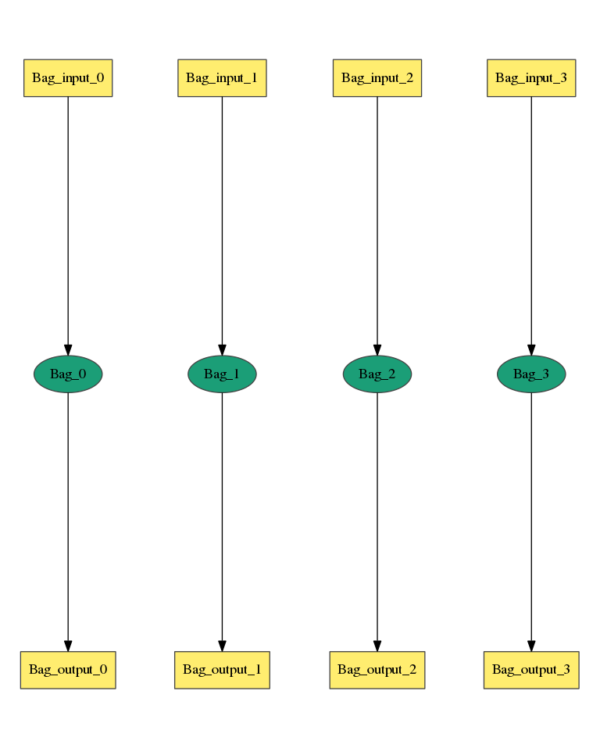
Bag of Task Input
Num_Stage = 1
Stage_Name = Stage_1
Task_Type = serial
Num_Processes = 1
Num_Tasks = 4
Task_Length = uniform 5
Read_Buffer = 65536
Write_Buffer = 65536
Input_Files_Each_Task = 1
Input_1.Source = filesystem
Input_1.Size = uniform 2100000
Output_Files_Each_Task = 1
Output_1.Size = uniform 4200000
Interleave_Option = 0
https://github.com/applicationskeleton/Skeleton/blob/master/src/sample-input/bag.input

Slide 6
Bag of Task
Output of skeleton.py (captured in workflow)
task serial 1 5 65536 65536 1 1 0 Stage_1_Input/Stage_1_Input_0_1 Stage_1_Output/Stage_1_Output_0_1 4200000
task serial 1 5 65536 65536 1 1 0 Stage_1_Input/Stage_1_Input_0_2 Stage_1_Output/Stage_1_Output_0_2 4200000
task serial 1 5 65536 65536 1 1 0 Stage_1_Input/Stage_1_Input_0_3 Stage_1_Output/Stage_1_Output_0_3 4200000
task serial 1 5 65536 65536 1 1 0 Stage_1_Input/Stage_1_Input_0_4 Stage_1_Output/Stage_1_Output_0_4 4200000
What this means:
Path_to_Task Task_Type Num_Processes Task_Length Read_Buffer Write_Buffer Num_Input Num_Output Interleave_Option [Input_File] [Output_File Output_Size]

Slide 7
Shell example (run work)
To compile
gcc -o task task.c -lm
export PATH=$PATH:$PWD
To run:
sh bag_Setup.sh
sh workflow
Output check
Look in Stage_1_Output for 4 output files, each of size 4200000

Slide 8
Swift example
Create the tasks:
./skeleton.py sample-input/bag.input Swift > workflow.swift
This creates
bag_Setup.sh – the script that creates the input and output directories for the tasks, and creates the initial input files
workflow.swift – the Swift script that can be executed to run the workflow
To setup Swift:
Install Swift: http://swift-lang.org/guides/release-0.94/quickstart/quickstart.html
../util/gent-tc-data.sh > ./tc.data
To run:
gcc –o task task.c –lm
sh bag_Setup.sh
swift –tc.file tc.data workflow.swift
Output check
Look in Stage_1_Output for 4 output files, each of size 4200000
zhaozhang@stealth:/var/tmp/ApplicationSkeleton/Skeleton/src$ ls -l Stage_1_Output/
total 16416
-rw------- 1 zhaozhang student 4200000 Sep 6 15:54 Stage_1_Output_0_1
-rw------- 1 zhaozhang student 4200000 Sep 6 15:54 Stage_1_Output_0_2
-rw------- 1 zhaozhang student 4200000 Sep 6 15:54 Stage_1_Output_0_3
-rw------- 1 zhaozhang student 4200000 Sep 6 15:53 Stage_1_Output_0_4

Slide 9
Pegasus example (incomplete)
Create the tasks:
./skeleton.py sample-input/bag.input Pegasus > workflow.dax
This creates
bag_Setup.sh – the script that creates the input and output directories for the tasks, and creates the initial input files
workflow.dax – the Pegasus DAX that describes the workflow
To run:
sh bag_Setup.sh
[run Pegasus with workflow.dax]
Output check
Look in Stage_1_Output for 4 output files, each of size 4200000

Slide 10
Bag of Task
Other options:
Num_Stage = 1
Stage_Name = Stage_1
Task_Type = parallel
Num_Processes = 6
Num_Tasks = 4
Task_Length = normal [20, 3]
Read_Buffer = 65536
Write_Buffer = 65536
Input_Files_Each_Task = 1
Input_1.Source = filesystem
Input_1.Size = uniform 2100000
Output_Files_Each_Task = 1
Output_1.Size = uniform 4200000
Interleave_Option = 0
Task_Type as parallel?

Slide 11
Bag of Task
Other options:
Num_Stage = 1
Stage_Name = Stage_1
Task_Type = serial
Num_Processes = 1
Num_Tasks = 4
Task_Length = normal [20, 3]
Read_Buffer = 65536
Write_Buffer = 65536
Input_Files_Each_Task = 1
Input_1.Source = filesystem
Input_1.Size = uniform 2100000
Output_Files_Each_Task = 1
Output_1.Size = uniform 4200000
Interleave_Option = 0
Task_Length as a statistical distribution?

Slide 12
Bag of Task
Other options:
Num_Stage = 1
Stage_Name = Stage_1
Task_Type = serial
Num_Processes = 1
Num_Tasks = 4
Task_Length = polynomial [20, 3] Input_1
Read_Buffer = 65536
Write_Buffer = 65536
Input_Files_Each_Task = 1
Input_1.Source = filesystem
Input_1.Size = uniform 2100000
Output_Files_Each_Task = 1
Output_1.Size = uniform 4200000
Interleave_Option = 0
Task_Length as a polynomial function of input file size?
20*size^3

Slide 13
Bag of Task
Other options:
Output size as a polynomial of task_length?
10*task_length^2
Num_Stage = 1
Stage_Name = Stage_1
Task_Type = serial
Num_Processes = 1
Num_Tasks = 4
Task_Length = normal [20, 3]
Read_Buffer = 65536
Write_Buffer = 65536
Input_Files_Each_Task = 1
Input_1.Source = filesystem
Input_1.Size = uniform 2100000
Output_Files_Each_Task = 1
Output_1.Size = polynomial [10, 2] Length
Interleave_Option = 0

Slide 14
Interleave_option
0
1
2
3

Slide 15
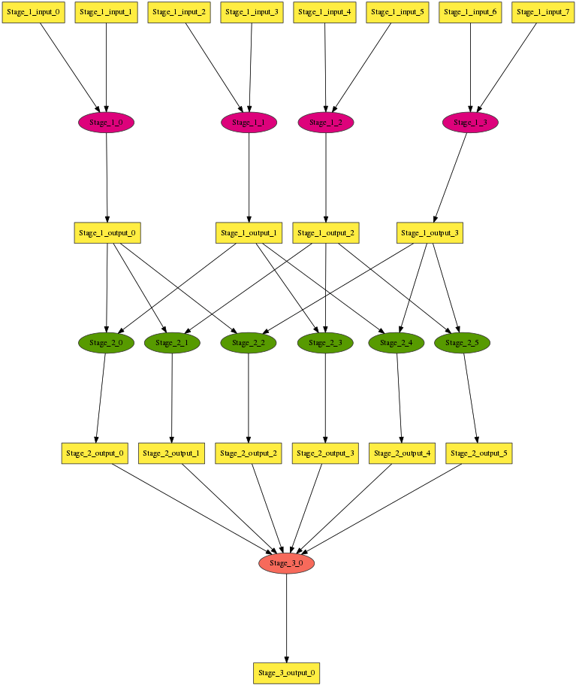
Multi-stage Workflow
Num_Stage = 3
Stage_Name = Stage_1
…
Stage_Name = Stage_2
…
Write_Buffer = 65536
Input_Files_Each_Task = 2
Input_Task_Mapping = combination Stage_1.Output_1 2
…
Stage_Name = Stage_3
…
Input_Files_Each_Task = 6
Input_Task_Mapping = combination Stage_2.Output_1 6
…
https://github.com/applicationskeleton/Skeleton/blob/master/src/sample-input/multi-stage.input

Slide 16
Mapping Files to Tasks
Do not specify Input_Task_Mapping:
Natural order
8 files, 4 tasks =>
f0, f1 : t0
f2, f3 : t1
f4, f5 : t2
f6, f7 : t3

Slide 17
Mapping Files to Tasks
Specify Input_Task_Mapping:
Input_Task_Mapping = combination Stage_1_output_1 2
4 files, 6 tasks =>
f0, f1 : t0
f0, f2 : t1
f0, f3 : t2
f1, f2 : t3
f1, f3 : t4
f2, f3 : t5
https://github.com/applicationskeleton/Skeleton/blob/master/src/sample-input/multi-stage.input
Note: combination mapper requires Python3

Slide 18
Mapping Files to Tasks
Specify Input_Task_Mapping:
Input_Task_Mapping = external sample-input/mapping.sh
cat sample-input/mapping.sh
echo Stage_1_Output_0_1 Stage_1_Output_0_2
echo Stage_1_Output_0_1 Stage_1_Output_0_3
echo Stage_1_Output_0_1 Stage_1_Output_0_4
echo Stage_1_Output_0_2 Stage_1_Output_0_3
echo Stage_1_Output_0_2 Stage_1_Output_0_4
echo Stage_1_Output_0_3 Stage_1_Output_0_4
The ith line maps to the ith task
https://github.com/applicationskeleton/Skeleton/blob/master/src/sample-input/external-mapper.input
Note: external mapper requires Python3

Slide 19
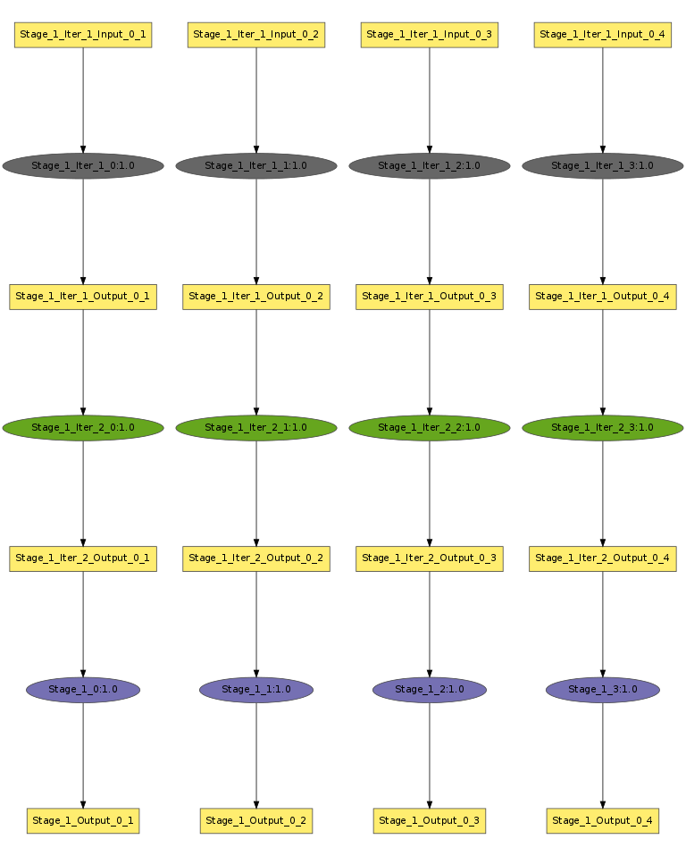
Single Stage Iterative Workflow
Num_Stage = 1
Stage_Name = Stage_1
Task_Type = serial
Num_Tasks = 4
Task_Length = uniform 10
Num_Processes = 1
Read_Buffer = 65536
Write_Buffer = 65536
Input_Files_Each_Task = 1
Input_1.Source = filesystem
Input_1.Size = uniform 1048576
Output_Files_Each_Task = 1
Output_1.Size = uniform 1048576
Interleave_Option = 0
Iteration_Num = 3
Iteration_Stages = Stage_1
Iteration_Substitute = Stage_1.Input_1, Stage_1.Output_1
Stage_1.Input_1 and Stage_1.Output_1 should have IDENTICAL number of files
https://github.com/applicationskeleton/Skeleton/blob/master/src/sample-input/single-stage-iterative.input

Slide 20
Multi Stage Iterative Workflow
Stage_Name = Stage_3
Task_Type = serial
Num_Tasks = 6
Task_Length = uniform 32
Num_Processes = 1
Read_Buffer = 65536
Write_Buffer = 65536
Input_Files_Each_Task = 1
Input_1.Source = Stage_2.Output_1
Output_Files_Each_Task = 1
Output_1.Size = uniform 1048576
Interleave_Option = 0
Iteration_Num = 3
Iteration_Stages = Stage_3, Stage_4
Iteration_Substitute = Stage_3.Input_1, Stage_4.Output_1
Stage_Name = Stage_4
Task_Type = serial
Num_Tasks = 6
Task_Length = uniform 32
Num_Processes = 1
Read_Buffer = 65536
Write_Buffer = 65536
Input_Files_Each_Task = 1
Input_1.Source = Stage_3.Output_1
Output_Files_Each_Task = 1
Output_1.Size = uniform 1048576
Interleave_Option = 0
Stage_3.Input_1 and Stage_4.Output_1 should have IDENTICAL number of files
https://github.com/applicationskeleton/Skeleton/blob/master/src/sample-input/multiple-stage-iterative.input

Slide 21
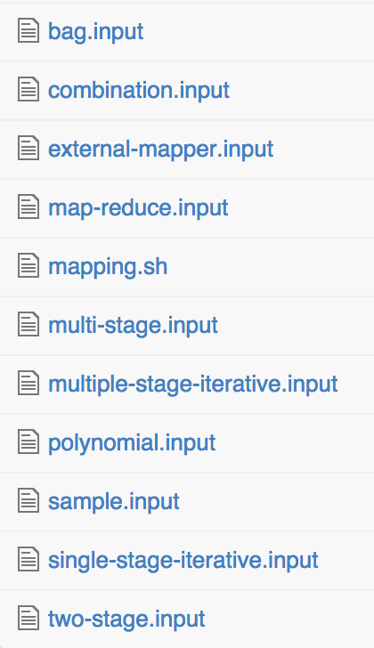
Complete List of Sample Inputs

Slide 22
Using Pegasus to create workflow images
Pegasus dax2dot script requires python 2.7 or higher
Visualizing DAX requires graphviz
Example usage:
cd Skeleton/src
./skeleton.py sample-input/bag.input DAX > bag.dax
../util/plot.sh bag.dax
open bag.png
This is how the images in this presentation have been generated

Slide 23
Conclusion
More information in ../report/report.pdf
Questions?

